Slide 1
Continuous Bulk Conveying System

Slide 2
Continuous Mechanical Handling Equipment
Course Curriculum at College
Handling of Solids
Nature and Characteristics of Bulk Solids
Conveyers-Belt conveyors, Screw conveyor
Chain and Flight conveyors
Bucket Elevators
Pneumatic Conveyors
Storage bins & silos.

Slide 3
Continuous Mechanical Handling Equipment
Continuous mechanical handling equipment refers to machinery designed for the continuous movement of materials from one location to another in a consistent and automated manner. These systems are widely used in various industries, including manufacturing, mining, agriculture, and logistics, to efficiently transport bulk materials, products, or packages.
Types of Continuous Mechanical Handling Equipment
Belt Conveyors
Chain Conveyors
Roller Conveyors
Screw Conveyors
Apron Conveyors
Bucket Elevator

Slide 4
Continuous Conveyors
Continuous conveyors are a central component in material flow technology, their main purpose is to transport materials such as bulk goods, unit loads or flowing goods continuously and efficiently from one point to another, which distinguishes them from discontinuous conveyor systems such as cranes and forklift trucks.
The choice of the right continuous conveyor depends on various factors, such as the type of material, the required conveying capacity, the conveying distance and the specific environmental conditions. The versatility of continuous conveyors makes them indispensable in many industrial and agricultural processes, as they not only increase productivity but also contribute to the safety and reliability of material handling. In an environment where time and efficiency are of the essence, continuous conveyors play a key role in optimizing and increasing the efficiency of production and transport processes.

Slide 5
Belt conveyors
Belt conveyors are among the most common and versatile conveyor systems used across various industries. They consist of a continuous belt that runs over pulleys and supports, carrying materials from one end to the other. The conveyors are troughed and flat, both horizontal and/or inclined or declined with or without curvatures in vertical plane [IS 11592:2000].
Types of Belt Conveyors
Flat Belt Conveyors.
Troughed Belt conveyors.

Slide 6
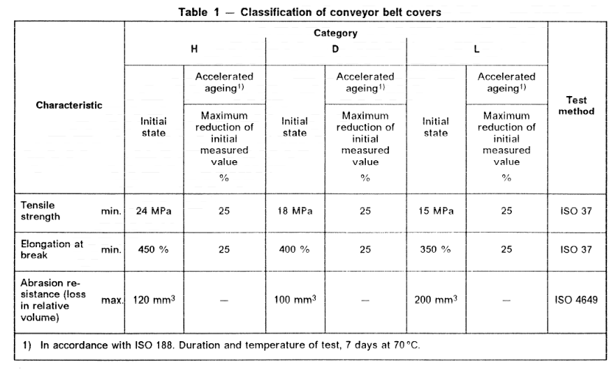
Belt Conveyors Classification [IS 16756 : 2018 ISO 10247 : 1990]

Slide 7
Conveyors Terminology [IS : 4240- 1984]
Angle of Repose
That angle to the horizontal which a material will assume naturally when in pile.
Angie of Slide
That angle at which material will slide on an inclined surface as determined y the nature of the material and the kind of surface on which it is supported.
Angle of Wrap
The angular wrap in degrees of a belt around a pulley. The term is used in calculating the power requirement of driving pulleys.
Antirunaway
A safety device to stop a declining conveyor and prevent its running away in the event of a mechanical or electrical failure.
Apron
A series of apron pans which, when attached to chain or pivotally attached one to another, forms the conveying medium for an apron conveyor.

Slide 8
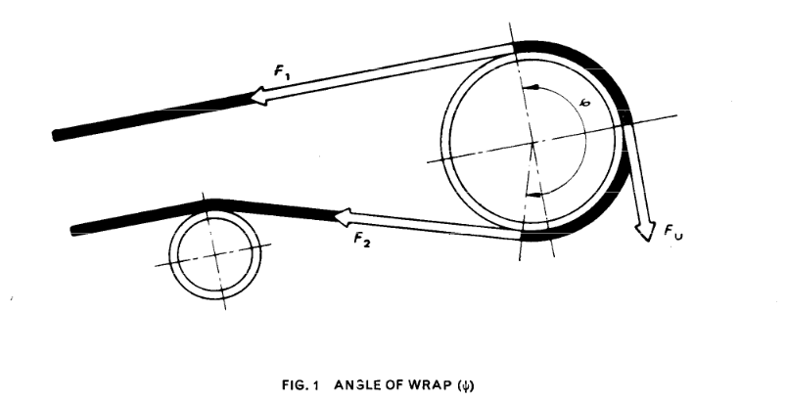

Slide 9
Conveyors Terminology [IS : 4240- 1984]
Flight attachments
The parts assembled to the flights that are used to connect them to the conveyor chain or chains.
Idler attachment
An attachment used to complete assembly of a non-load-carrying trolley.
Axle
A shaft, either rotating or nonrotating, on which are mounted the driving or supported wheels of a car or carriage.
Armoured belt
A conveyor belt which has been protected by metal strips to prevent gouging or tearing of the cover by sharp objects being handled.
Base belt
In a closed belt conveyor it is that portion of a type of closed belt which remains flat and provides the necessary tensile strength.
Bucket elevator belt
A belt fabricated for bucket elevator use to which elevator buckets are attached.

Slide 10
Flat Belt conveyors
Flat belt conveyors are suitable where the belts are meant to carry bulk materials having relatively high angle of repose, such as prepared molding sand and undented cotton seed and where it is desirable to use ploughs or deflector plates with intermediate discharge or for distributing material simultaneously at several points along the conveyor. They are also used for picking and sorting where the material should be spread in thin layers for thorough Inspection. Flat belt conveyor is that in which the belt runs flat on the carrying side, over an idler or a set of idlers [IS 11592:2000].
Types of Flat Belt Conveyors are:
Those with belts sliding on wood or steel slider beds.
Those with belts operating over straight ball or roller bearing idlers.

Slide 11
Fig: Conveyor operating over straight ball or roller bearing idlers
Fig: Conveyor belts sliding on wood or steel slider beds

Slide 12
Troughed Belt Conveyors
Troughed conveyor is that in which the belt forms a trough on the carrying side while resting/running over idler rolls which are either in set of 5-rolls/3-rolls or 2-rools. The troughing angle adopted shall conform to IS 8598 and shall be selected from the following values: 15°, 20°, 25°, 30°, 35°, 40°, 45° [IS 4776:1990].
Fig: Troughed Belt conveyors

Slide 13
Selection Features of Belt Conveyors
(Clause 5, IS 11592 : 2000)
Troughed Belt Conveyors | Flat Belt Conveyors
Higher capacity requirements | Lower capacity requirements
High speed requirements | Low speed requirements
Large lump size of material with or without intermediate discharge with trippers | Relatively higher angle of repose of conveyed material, limited lumps size of conveyed material, intermediate discharge with ploughs, distributor plates. Without vertical curvature. Maximum inclination allowed is 6°.
With or without vertical curvature Suitable for inclination or declination in accordance with IS 8730:2023 | Declination undesirable

Slide 14
Conveyors Layout Procedure
For system layout, the following data is required to proceed further:
Site plan with suitable contour drawings;
Over/under surface interferences, namely, existing and proposed roads, drains, rails, rivers, transmission lines, buildings, structures, etc;
Grade deviations;
Material flow diagram and flow rates;
Details of receiving point(s), discharge/distribution point(s);
Material characteristics including size analysis;
Climatic data and site condition; [clause 6; IS 11592:2000]

Slide 15
CONVEYOR DESIGN PROCEDURE
Once the configuration and layout of a conveyor is finalized the following design steps are taken for sizing the conveyor. Wherever multiple choices are specified, the worst condition applicable shall be considered for the design of the conveyor system. The known maximum lump size of the material can be found. [clause 7 IS 11592:2000]
Size of Material:
Unsized — 30 percent by mass of all material less than one-sixth maximum lump size. 50 percent by mass of all material less than one-third maximum lump size. 75 percent by mass of all material less than one-half maximum lump size. 90 percent by mass of all material less than two-third maximum lump size.
Sized — Material not falling within the above grading.

Slide 16
Lump Size:
Lump size indicates the longest single dimension of largest lump. This shall not be confused with crusher setting or screen openings as these limit only one dimension.
Ascertain speed factor as sum of lump size factor [IS 11592:2000 Table 4], air borne factor (IS 11592:2000 Table 4) and abrasiveness factor [IS 11592:2000 Table 5] and select belt speed (IS 11592:2000 Table 6). If the conveyor is inclined/declined, select a safe angle of inclination/declination for the particular material (IS 8730 and 8.1.2). Determine the angle of surcharge according to the nature of the material (IS 8730 ). From the selected belt speed, angle of inclination-declination and angle of surcharge for the material, determine belt width and troughing angle for the required capacity of the conveyor from (IS 11592:2000 Tables 7, 8, 9,10 and 11)

Slide 17
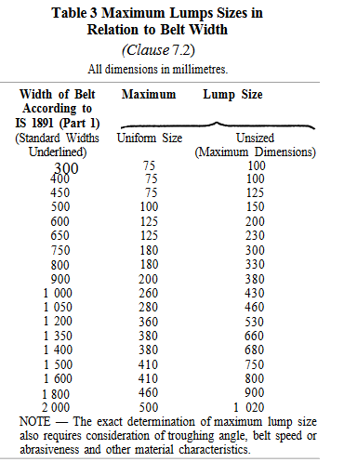

Slide 18
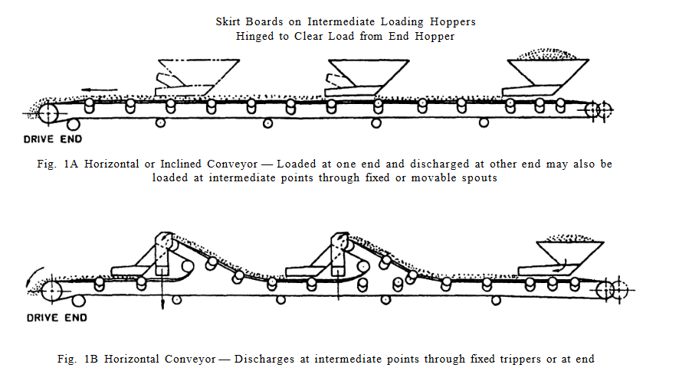

Slide 19
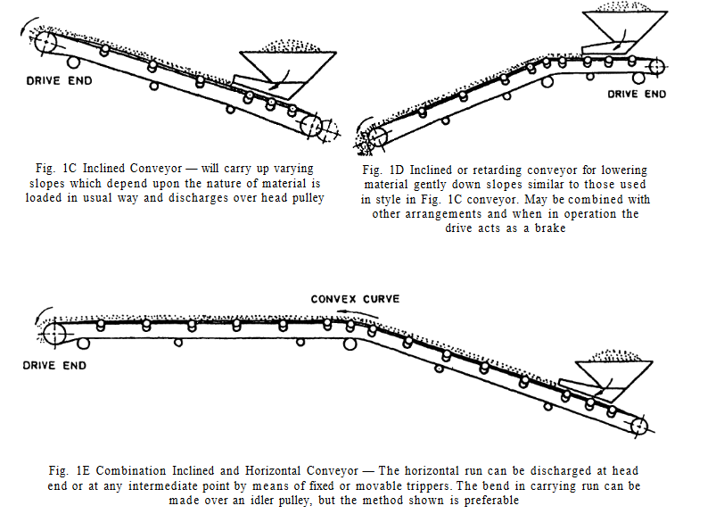

Slide 20
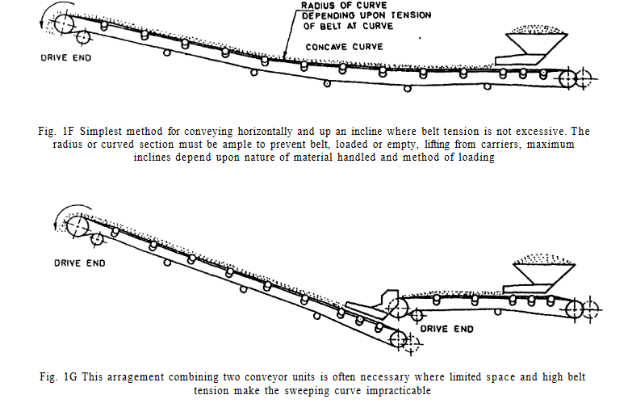

Slide 21
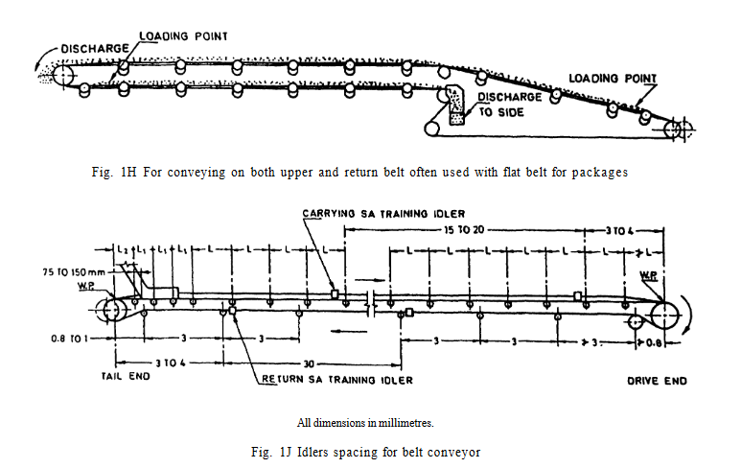

Slide 22
DESIGN ASPECTS
Characteristics of Material Affecting Conveyor Design:
The proper design of a belt conveyor/conveyor system is greatly influenced by the characteristics of the material to be handled. Generally, the material is classified as shown in IS 8730.
Care shall be taken for the inclination of an inclined/declined conveyor, carrying lumps of material, as these are likely to slide down, wherever, possible inclination of the conveyor shall not exceed the maximum allowable value (8730:2023). In case of declination, the angle of declination shall not exceed 12° in any case. (Clause 8, IS 11592:2000 ]

Slide 23
Physical Condition of Material: Care shall be taken to analyze the physical condition of the material to be conveyed which are classified as follows:
Oily or liable to react with rubber products,
High temperature,
Non-abrasive,
Mildly abrasive,
Abrasive,
Very abrasive,
Sharp abrasive,
Easily degradable,
Mildly corrosive,
Highly corrosive,
Explosive or creating harmful dust,
Very dusty,
Inflammable,
Hygroscopic, and
Sticky.

Slide 24
DESIGN ASPECTS
Belt Speed:
Belt speed depends on the following factors:
Capacity required and belt width;
Loading and unloading conditions;
Size, shapes, flowability and other characteristics of the material conveyed;
Belt construction;
Inclination of belt conveyor, and
Idler construction and diameter. [Clause 8 IS 11592:2000]
Belt speed shall be selected from the recommendation given in (IS 11592:2000 Table 6). Higher belt speeds may be considered under special design conditions. It is important also to check the adequacy of the type of belting, its joining and safety devices for the conveyors.

Slide 25
DESIGN ASPECTS (Contd.)
Widths of Belt:
The width of belt is predominantly governed by two factors, the lump size of the material conveyed and the capacity requirements of the conveyor. [IS 11592:2000 Tables 7, 8, 9, 10, 11 ] give cross-sectional area, slope factor and carrying capacity respectively of belt conveyors. The width of belt for the capacity requirement can be read off from Tables 10 and 11. This shall, however be checked for minimum belt width from (IS 11592:2000 Table 6) for given lump size factor. The greater of the two values shall be adopted.

Slide 26
DESIGN ASPECTS (Contd.)
Capacity of Belt Conveyor:
The capacity of a belt conveyor is determined primarily by the following three factors:
a) Cross-section of load on the belt — The cross- sectional load on the belt will vary with the width of belt, the type of carrying idlers used which determines the amount of troughing given to the belt, and the nature of the material being handled, which determines the quantity of material that can be safely loaded on to a given cross-section; (Clause 8 IS 11592:2000).
b) Speed of belt; and
c) Slope factor.

Slide 27
DESIGN ASPECTS (Contd.)
Belt Specification:
A conveyor belt consists of two elements, carcass and the cover. The carcass is the reinforcing member and may be of either textile reinforcements steel cords and supplies the tensile strength and the body to the belt to hold the shape. In case of textile, reinforcement, the carcass is normally build up of plies of textile fabric. The strength of fabric and the number of plies in the carcass of the belt may be varied together to suit the strength requirements. However, the strength of carcass has a practical limit. The steel cord belting is used to meet the condition of small elongation and good troughbility in conjunction with higher operating tensile forces. PVC belting is generally selected for underground mining applications where fire hazard exists.
Selection of Belt Carcass
Selection of Cover
Standardization of Belt Constructions

Slide 28
IS 8531 : 1986 ISO 1536
IS 8598 : 2019

Slide 29
Pulleys for Belt Conveyors
(IS 8531 : 1986)
Pulleys:
Based on percentage tensile force (ratio between the working tensile force and maximum allowable tensile force of the selected belt), diameters of pulleys shall be selected from the recommended values given in IS 1891 (Part 1) and shall conform to IS 8531 The drive pulleys may be lagged, wherever necessary, to increase the coefficient of friction between the belt and the drive pulley. The lagging thickness shall vary between 6 to 12 mm and the durometer hardness on head pulley shall be 55 to 65 Shore A scale, whilst on the snub and bend pulley shall be 35 to 45 Shore A scale. The softer rubber tends to resist the build up and allowing of solid objects to get embedded in the rubber rather than damage the belt. In case of steel cord belting and PVC belting,
special consideration shall be made in selection of pulley diameters and lagging, its type, thickness, material and application

Slide 30
Idlers & Idler Set for Belt Conveyors
(IS 8598 : 2019)
Idlers:
Idlers are an essential component of conveyor systems, particularly belt conveyors. They are used to support the conveyor belt and the materials being transported, ensuring smooth and efficient operation. Idlers help in reducing friction and wear, thus extending the lifespan of the conveyor belt and improving overall system performance IS 8598 :2019
There are two basic type of belt conveyor idlers:
Carrying idlers which support the loaded run of the conveyor belt; and
Return idlers which support empty return run of the conveyor belt

Slide 31
Idlers & Idler Set for Belt Conveyors (contd.)
Carrying Idlers:
Carrying idlers can have three types of general configurations:
1) Five/three roll throughing idlers for troughed belts consisting of four/two outer rolls, which are inclined upward and a horizontal central roll.
2) Two roll throughing idlers for troughed belts consisting of two identical idler rolls, inclined upward to facilitate the belt to from a trough.
3) Horizontal carrying idler for supporting flat loaded belts consisting of a single horizontal idler roll positioned between brackets which attach directly to the conveyor frame.

Slide 32
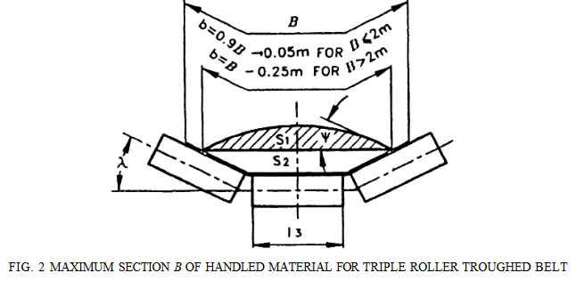
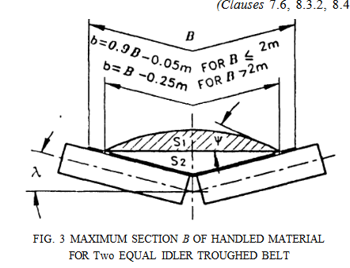
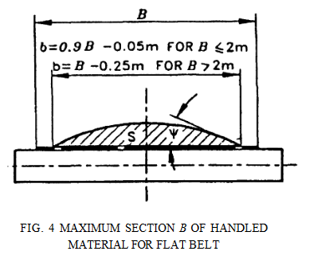

Slide 33
Idlers & Idler Set for Belt Conveyors (contd.)
Type of carrying idlers
1) The most commonly used type to carrying idlers consists of three in line idler rolls of equal length. For a given width of belt, roll inclination and surcharge angle of the material, the three equal length roll troughing idler forms the belt into the best troughed shape to carry a maximum load cross-section.
2) Troughing idler arrangement having a relatively long horizontal roll and two short upward inclined rolls does not form a given belt into a trough for maximum load cross- section but is useful under certain conditions, for instance where conveyor’s load must be spread for manual inspection, picking up or sorting. The inclined end rolls turn up the belt edges to prevent or greatly
minimize spillage.
3) In an offset troughing idler, the inclined rolls (two numbers on both the sides) and the horizontal roll are located in two different vertical planes.

Slide 34
Idlers & Idler Set for Belt Conveyors (contd.)
Catenary type:
Troughing idler consists of a flexible catenary member on which integral small diameter rolls or multiple roll assembly is mounted. The rolls can be moulded either in the flexible member, which rotates as an assembly in fixed bearings at the ends of the catenary member or in the individual rolls which may rotate on bearings supported by the flexible catenary member.
Garland type:
This type of idlers are suspended from stringers by suitable suspension methods. This type of idlers consist of rolls connected in between with flexible links and can be used for both on carrying and return side.

Slide 35
Idlers & Idler Set for Belt Conveyors (contd.)
Impact type Idlers:
Impact type idlers having rolls made of resilient material, are used at loading points where the lump size and the weight of the handled.
Tilting of Idlers
Angle of tilt shall be provided on the side rollers if specified by the purchaser.
The angle of tilt on side rollers of idlers shall be in the direction of belt run for the unidirectional
conveyors and it shall be 'zero' degree for reversible belt conveyor.
Angle of tilt on side rollers of idlers shall be as small as possible (generally 2°) and in any case, it
shall not be more than 3°.

Slide 36
Idlers & Idler Set for Belt Conveyors (contd.)
Idler Spacing:
Carrying idler spacing
The following points shall be considered carefully while determining the idler spacing for carrying idlers of a belt conveyor:
a) Increased idler spacing increases the belt sag and hence the power loss due to friction is
greater.
b) Very low belt sag means higher belt tensions and therefore, cost of the belt is high.
c) The practical upper limit of belt sag is 2 percent of the idler spacing after which the force required to pull the load increases steeply. However, for all practical cases, the belt sag shall be limited to 0.5 to 2.0 percent of the idler spacing.

Slide 37
Applications of Flat Belt Conveyors
Manufacturing: Moving parts and products along assembly lines.
Warehousing and Distribution: Transporting packages, boxes, and pallets.
Food Processing: Handling raw ingredients and packaged foods.
Pharmaceutical: Conveying bottles, containers, and other products.
Retail: Moving goods in and out of storage areas.
Advantages of Flat Belt Conveyors
Versatility: Suitable for a wide range of materials and applications.
Ease of Installation: Simple design allows for quick setup and integration.
Cost-Effective: Generally less expensive than more complex conveyor systems.
Smooth Operation: Provides a stable and smooth surface for items, reducing the risk of damage.
Low Maintenance: Fewer components result in lower maintenance requirements.

Slide 38
Applications of Troughed Belt Conveyors
Mining: Transporting ores, coal, and other bulk minerals.
Agriculture: Moving grains, seeds, and other agricultural products.
Cement and Construction: Handling raw materials like sand, gravel, and cement.
Power Plants: Conveying coal to and ash from boilers.
Quarrying: Moving crushed stone, sand, and gravel.
Advantages of Troughed Belt Conveyors
Efficient Bulk Handling: The trough shape helps contain materials, reducing spillage and increasing load capacity.
Versatility: Suitable for a wide range of materials, including fine powders, granules, and large lumps.
Continuous Operation: Provides a constant flow of materials, enhancing productivity.
Adaptability: Can be designed for horizontal, inclined, or declined movement, and can navigate curves and changes in direction.

Slide 39
Safety and Statutory Requirement
The conveyor shall conform to all the statutory requirements. In addition, the conveyor shall also take into account all the statutory requirements as mentioned in IS 7155 (in eight parts). Any additional safety requirements to the extent specified by the purchaser shall also be taken into account.
Maintenance and Safety
Regular Inspections:
Check for wear and tear on the belt, pulleys, and rollers.
Belt Alignment:
Ensure the belt is properly aligned to prevent slippage and uneven wear.
Lubrication:
Keep moving parts well-lubricated to reduce friction and wear.
Cleaning:
Regularly clean the belt and other components to prevent buildup and contamination.
Safety Features:
Install emergency stop buttons, safety guards, and sensors to detect malfunctions.

Slide 40
CODE OF RECOMMENDED PRACTICE FOR CONVEYOR SAFETY
BELT CONVEYORS AND FEEDERS
IS 7155 (Part 3) : 2023
Specific Safety Requirements — Besides statutory and other requirements relating to safety in
general, specific safety requirements shall be observed at the following stages.
a) During the construction stage (design and manufacture);
b) During the installation stage (design, commissioning and entry into service); and
c) During the utilization stage (operation and
maintenance) (IS 7155: 2023).

Slide 41
During the Utilization Stage (Operation and Maintenance)
In addition to the requirement in 4.4.2 of IS 7155 (Part 2) the adjustment and maintenance in
good running order of the belt and pulley cleaning devices shall be carried out regularly.
In addition to the requirement in 4.4.4 of IS 7155 (Part 2) the manual cleaning of pulleys, idlers and other parts, necessitated by the build-up of material or any other cause, shall only be undertaken when the equipment is at rest, and after rendering the starting devices inoperative.
In compliance with the requirement in 4.4.5 of IS 7155 (Part 2) the user shall be particularly careful to ensure a regular feed, avoiding, even momentarily, the overloading of the appliance.
In particular, the user shall not change the feeding points without previously consulting he manufacturer/constructor.

Slide 42
Screw conveyors
IS 5563:1985 Specification for screw conveyors for industrial use
Screw conveyors, also known as auger conveyors, are widely used in various industries for moving bulk materials horizontally, vertically, or at an incline. They consist of a helical screw blade, called a flighting, that rotates inside a tube or trough to move the material along the conveyor IS 5563:1985
Types of Screw Conveyors
Horizontal Screw Conveyors.
Inclined Screw Conveyors.
Vertical Screw Conveyors.
Shaftless Screw Conveyors.
Flexible Screw Conveyors.

Slide 43
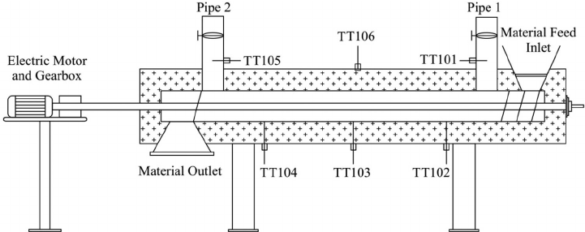
Fig: Screw Conveyors

Slide 44
Horizontal Screw conveyors
Horizontal screw conveyors are a type of screw conveyor designed to move bulk materials horizontally. They are widely used in various industries for their simplicity, efficiency, and versatility. Here’s a detailed overview:
Components of Horizontal Screw Conveyors
Screw
Trough or tube
Drive Mechanism
End Bearing
Shaft

Slide 45
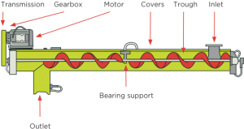
Screw
Helical Blade: The rotating component that moves the material.
Material: Typically made up steel or stainless steel, depending on the application
Fig: Horizontal Screw Conveyors

Slide 46
Trough or Tube
Enclosure: Houses the screw and contains the material being moved.
Shapes: Typically U-Shaped (Trough)
Drive Mechanism:
Motor: Power the screw.
Gearbox: Adjust the speed and torque.
End Bearings:
Support: Provide support to the screw at both end.
Type: can be flange-mounted or pillow-block bearings.
Shaft:
Support Shaft: The Central shaft to which the helical blades are attached the shaft ends. Shall conform to IS : 3688-1977 ‘Dimensions for shaft ends and shaft heights shall conform to IS : 2031-1962.

Slide 47
Inclined Screw conveyors
Inclined screw conveyors are designed to move bulk materials at an angle. They are similar to horizontal screw conveyors but are used when materials need to be conveyed between different elevations or over obstacles. The design and operational considerations differ due to the effects of gravity and the additional force required to lift materials.
Components of Inclined Screw Conveyors
Screw
Trough or tube
Drive Mechanism
End Bearing
Shaft

Slide 48
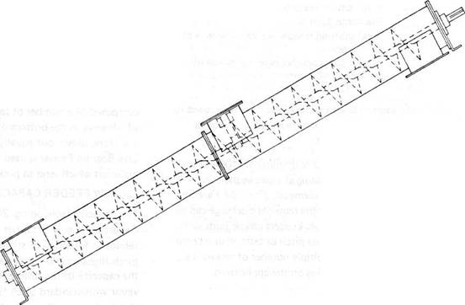
Fig: Inclined Screw Conveyors

Slide 49
Vertical Screw conveyors
Vertical screw conveyors are specialized screw conveyors designed to move bulk materials vertically. They are efficient and effective for elevating materials in various industries, offering a compact solution for moving materials to higher levels.
Components of Vertical Screw Conveyors
Screw
Trough or tube
Drive Mechanism
End Bearing
Shaft

Slide 50
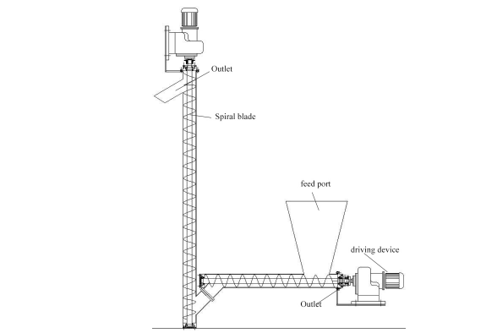
Fig: Vertical Screw Conveyors

Slide 51
Applications of Screw Conveyors
Agriculture: Moving grains, seeds, and feed.
Food Processing: Handling ingredients, powders, and bulk food products.
Mining: Transporting minerals, ores, and coal.
Wastewater Treatment: Moving sludge and biosolids.
Manufacturing: Conveying bulk materials like plastic granules, metal chips, and chemicals.
Advantages of Screw Conveyors
Versatility: Suitable for a wide range of materials and applications.
Compact Design: Requires less space compared to other conveyor types.
Enclosed System: Reduces dust and contamination.
Continuous Operation: Can run continuously, providing a steady flow of materials.
Easy to Control: Simple to regulate the flow rate by adjusting the screw speed.

Slide 52
Maintenance and Safety
Regular Inspections:
Check for wear, alignment, and damage to the screw, trough, and bearings.
Lubrication:
Keep bearings and other moving parts well-lubricated to reduce friction and wear.
Cleaning:
Regularly clean the screw and trough to prevent buildup and contamination.
Safety Features:
Install guards, emergency stop buttons, and sensors to detect malfunctions.

Slide 53
Vertical Screw conveyors
Vertical screw conveyors are specialized screw conveyors designed to move bulk materials vertically. They are efficient and effective for elevating materials in various industries, offering a compact solution for moving materials to higher levels.
Components of Vertical Screw Conveyors
Screw
Trough or tube
Drive Mechanism
End Bearing
Shaft

Slide 54
Chain conveyors
Chain conveyors are a type of material handling equipment that uses chains to move materials along a predetermined path. They are highly effective for transporting heavy loads and can be used in various industrial applications, including manufacturing, warehousing, and distribution IS 5626:1990.
Types of Chain Conveyors
Drag chain conveyors.
Apron chain Conveyors.
Slat Chain Conveyors
Roller chain Conveyors

Slide 55
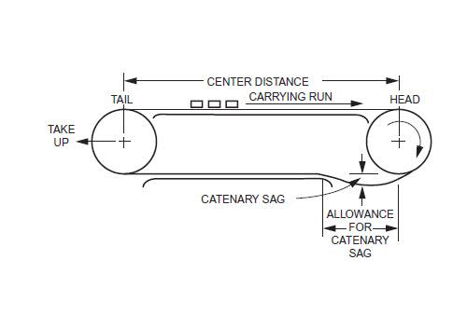
Fig: Chain Conveyors

Slide 56
Drag chain conveyors
Drag chain conveyors are a type of material handling equipment that uses heavy-duty chains to drag bulk materials through a trough. They are highly effective for moving bulk materials, especially when handling large volumes or heavy loads. Here’s a detailed overview:
Components of Drag chain conveyors
Drag Chain
Trough or tube
Drive Mechanism
Sprockets
Bearing
Inlet and Outlet

Slide 57
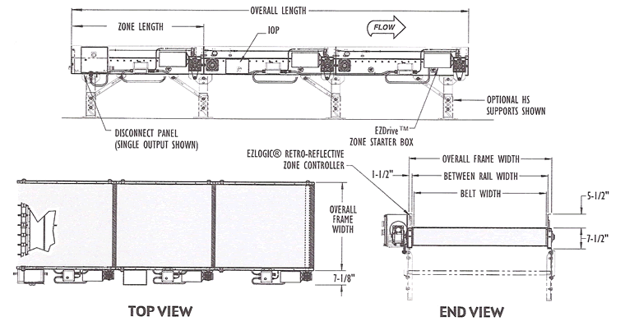
Fig: Drag Chain Conveyors

Slide 58
Drag Chain:
Link Chain: The primary chain used for dragging materials.
Flight Attachments: Plates or bars attached to the chain to move materials along the trough.
Trough:
Enclosure: The channel through which materials are moved.
Materials: Typically made of steel for durability.
Drive Mechanism:
Motor: Powers the conveyor.
Gearbox: Adjusts the speed and torque.
Sprockets:
Drive Sprockets: Connected to the motor to drive the chain.
Idler Sprockets: Guide and support the chain.

Slide 59
Applications of Chain Conveyors
Automotive Industry: Transporting car parts and assemblies.
Mining: Moving ores, coal, and other mined materials.
Agriculture: Handling grains, seeds, and other bulk agricultural products.
Manufacturing: Moving heavy machinery parts, metal scraps, and large assemblies.
Waste Management: Conveying waste materials to sorting or processing areas.
Advantages of Chain Conveyors
Durability: Robust construction makes them suitable for heavy-duty applications.
Versatility: Can handle a wide range of materials and load sizes.
Customizability: Can be tailored to specific applications with different chain types and attachments.
Continuous Operation: Provides a steady flow of materials.
Low Maintenance: Fewer moving parts result in lower maintenance requirements.

Slide 60
Maintenance and Safety
Regular Inspections:
Check for wear and tear on the chains, sprockets, and rollers.
Lubrication:
Keep chains and other moving parts well-lubricated to reduce friction and wear.
Cleaning:
Regularly clean the conveyor to prevent buildup and contamination.
Safety Features:
Install emergency stop buttons, safety guards, and sensors to detect malfunctions.

Slide 61
Armoured face conveyors
An armoured face conveyor (AFC) is a type of chain conveyor that is used in longwall mining operations to transport coal from the face of the mine to the conveyor belt or other haulage system. The AFC is a critical component in longwall mining systems, designed to handle the extreme conditions and heavy loads encountered in underground mining [IS 11619:1986].
Component of armoured face conveyor Conveyors
Conveyor Pan
Chains
Flights
Drive Mechanism
Return End
Tensioning System
Skid Bars and Wear Strips

Slide 62
Conveyor Pan:
Structure: Heavy-duty steel sections that form the base of the conveyor.
Function: Supports the chain and flights, and serves as the surface over which the coal is transported.
Chains:
Drive Chain: Heavy-duty chain that moves the flights.
Attachment Chain: Chains with attachments (flights) that drag the coal along the conveyor pan.
Flights:
Description: Bars or paddles attached to the chain that push the coal along the conveyor pan.
Drive Mechanism:
Motor: Powers the conveyor.
Gearbox: Adjusts the speed and torque.
Drive Sprockets: Connected to the motor to drive the chain.

Slide 63
IS 11619 : 1986 (Clause 2)
Twin Outboard Chain Assembly –
Pairs of chain to which scraper bars are coupled by means of shackle type connectors.
Nominal Chain Centres –
The distance between the centres of the chains in the assembly.
Force-deflection Test –
A test to determine the ability of a scraper bar to sustain a minimum deflection and the strength rating.
Minimum Deflection –
The deflection that a scraper bar is required to sustain without fracture.
Strength Rating –
The force required to produce a central deflection in the scraper bar, equal to ten percent of the nominal chain centres of the assembly.

Slide 64
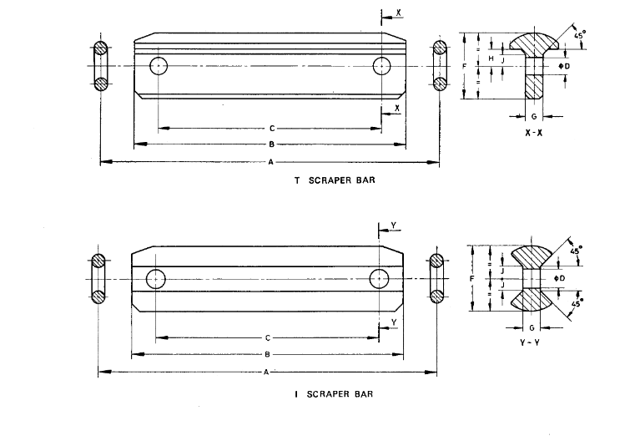
Fig: armoured face conveyors

Slide 65
Applications of Armoured Face Conveyors
Longwall Mining: Primarily used in longwall mining to transport coal from the mining face to the main haulage system.
Underground Mining: Suitable for other underground mining operations that require efficient material handling under harsh conditions.
Advantages of Armoured Face Conveyors
Durability: Built to withstand the harsh conditions and heavy loads of underground mining.
High Capacity: Capable of transporting large volumes of coal efficiently.
Continuous Operation: Provides a steady flow of materials, enhancing productivity.
Robust Construction: Designed to handle the abrasiveness and impact of mining operations.
Versatility: Can be adapted to various mining conditions and layouts.

Slide 66
Apron conveyors : Design Rules
IS 7423: 2022/ ISO 7189: 1983
An apron conveyor is a type of conveyor system that uses steel or rubber aprons (flights) attached to chains to move heavy, bulky materials. They are highly durable and suitable for handling coarse, abrasive materials in various industries such as mining, foundries, and steel mills [IS 7423: 2022 ISO 7189: 1983].
Component of Apron Conveyors
Apron
Chains
Conveyor Bed
Drive Mechanism.
Sprockets
Bearings
Inlet and Outlet.

Slide 67
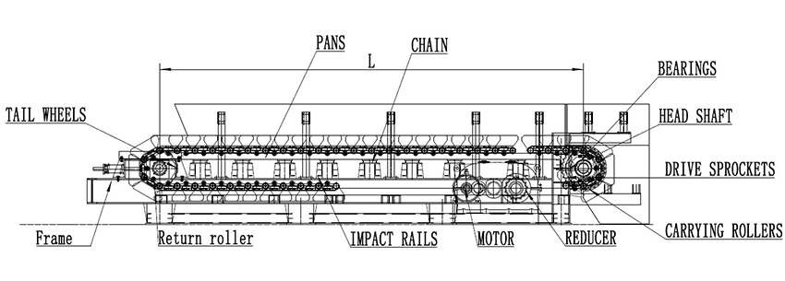
Fig: Apron conveyors

Slide 68
IS 8599 : 1977
Lays down the recommendations for the selection of apron conveyors commonly used for handling heavy lumpy or abrasive materials such as coal, stone, gravel, mine ore etc.
Apron conveyors are used extensively in modern mining, manufacturing and processing industries. Heavy duty apron feeders are used directly under dump hoppers to feed run of the mine ores to crusher and have reinforced pans to take the shock of falling lumps, Apron conveyors may be either horizontal or inclined. Apron conveyors usually operate at slow speeds without any appreciable vibration and as such minimum lump breakage.
Capacities - Apron conveyors are in operation handling up to 3000 t/h and there is no practical difficulty in the way of even larger capacities. However, this standard is applicable to apron conveyors up to a capacity of 250 t/h. Maximum capacities are obtained by using skirt boards, 300 mm to 1,200 mm in height to increase the depth of the material in the pan (IS 8599:2000).
Speed of Conveyor - The speed of the conveyor varies with the class of service and the type of pans. For feeders drawing material from bins or hoppers the speed is usually kept under 10m/min. Longer conveyors receiving fed loads may be operated at higher speeds of 18 to 30 m/min or more
depending on the chain, pitch and number of teeth on the sprocket.

Slide 69
Applications of Apron Conveyors
Mining: Transporting ores, coal, and other mined materials.
Steel Mills: Handling slag, scrap metal, and other heavy materials.
Foundries: Moving sand, castings, and other materials.
Waste Management: Conveying waste materials to sorting or processing areas.
Cement Industry: Transporting clinker, raw materials, and finished products.
Advantages of Apron Conveyors
Durability: Robust construction makes them suitable for heavy-duty applications.
High Capacity: Capable of transporting large volumes of materials efficiently.
Versatility: Can handle a wide range of materials and load sizes.
Continuous Operation: Provides a steady flow of materials, enhancing productivity.
Low Maintenance: Fewer moving parts result in lower maintenance requirements.

Slide 70
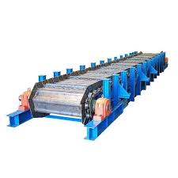
Conveyors Safety: Apron Conveyors/Apron Feeders
IS 7155 (Part 5) : 2023
Besides statutory and other requirements relating to safety in general, specific safety requirements shall be observed at the following stages:
a) During the construction stage (design, and manufacture);
b) During the installation stage (design, commissioning and entry into service);
c) During the utilization stage (operation and maintenance) [IS 7155 (Part 5) : 2023]

Slide 71
Conveyors Safety: Apron Conveyors/Apron Feeders
IS 7155 (Part 5) : 2023
Construction Stage: Selection of materials, hardware and components shall depend upon the duty conditions of the conveyor and characteristics of the material to be transported. Chains and chain sprockets shall be suitably selected for the conveyor arrangement.
Installation Stage: Proper leveling of foundation and alignment of head and tails sections; Alignment of drive unit; Adequate guarding and protection shall be provided to prevent injury to the personnel [IS 7155 (Part 5) : 2023 ]
Utilization Stage: Periodical adjustments of take ups to keep the chains under the required tension Maintenance to apron conveyor/feeder only on taking total shut down of the system.

Slide 72
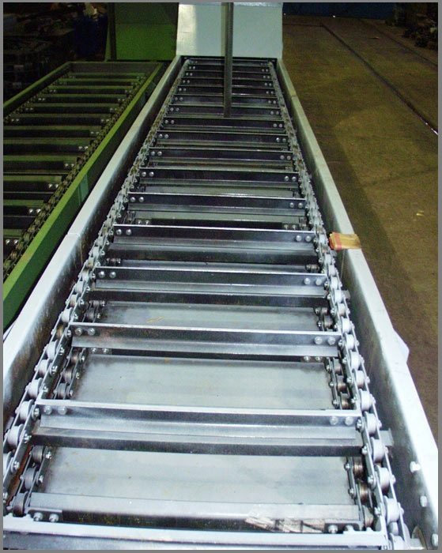
Conveyor Safety: Flight (Scrapper) Conveyor
IS 7155 (Part 8) : 2023
Flight conveyors, also known as flight chain conveyors or flight conveyors, use a series of flights or paddles attached to chains to transport materials. They are particularly effective for handling bulk materials and can be used in various industries, including agriculture, mining, and manufacturing .
[IS 7155 (Part 8) : 2023]
Component of Apron Conveyors
Flight
Chains
Conveyor Bed
Drive Mechanism.
Sprockets
Bearings
Inlet and Outlet.

Slide 73
FLIGHT CONVEYOR (SCRAPER CONVEYOR)
SPECIFIC SAFETY REQUIREMENTS
Besides statutory and other requirements relating to safety in general, specific safety requirements shall be observed at the following stages:
During the construction stage (design, and manufacture);
During the installation stage (design, commissioning and entry into service); and
During the utilization stage (operation and maintenance)
Construction Stage: Capacity, speed of the flight, the pull on the chains and the power requirements for propulsion shall be given due consideration.
Installation Stage: As the chain (namely the pulling members) shall constantly be rubbing on the casing, renewable liners shall be provided for replacement in case of excessive wear.
Utilization Stage: The material fed into the conveying system shall be regulated as per the predetermined quantities.

Slide 74
Conveyors Safety: General Information
IS 7155 (Part 1) : 2023
Stages
Construction stage: The safety requirements during construction stage shall be those to be taken care of during the design and manufacture of the conveyor system, equipment and machinery.
Installation stage: The safety requirements during installation stage shall be those to be taken care of during layout, erection and entry into service of the conveyor system, equipment and machinery [IS 7155 (Part 1) : 2023].
Utilization stage: The safety requirements during utilization stage shall be those to be taken care of during operation and maintenance of the conveyor systems, equipment and machinery.

Slide 75
Conveyors Safety: General Information
IS 7155 (Part 1) : 2023
Lighting: Suitable lighting of conveyor systems, equipment and machinery shall be provided [IS 3646 (Part 1)].
Electrical Equipment: Installed and maintained to meet the statutory requirements as per
IS 732, IS 4051, IS 16724, IS 5572 and IS/IEC 60079 (Part 0).
Fire Protection: Adequate fire protection facilities shall be provided and approval of the statutory authority. Guidance Standards: IS 1641, IS 1642, IS 1643, IS 1644 and IS 3034.
Dust and Fumes: The design of the system shall be such as to prevent or control the emission of dust and fumes.
Static Charge/Electricity: For normal runoff mine the accumulated static charge may not pose much of a problem. However, for special application which carry explosive dusts and compounds, limiting the accumulated static charge/electricity in a conveying system is extremely important.

Slide 76
Conveyors Safety Vibrating conveyor/feeder
IS 7155 (Part 4) : 2023
Besides statutory and other requirements relating to safety in general, specific safety requirements
shall be observed at the following stages:
a) During the construction stage (design, and manufacture);
b) During the installation stage (design, commissioning and entry into service); and
c) During the utilization stage (operation and maintenance) [IS 7155 (Part 4) : 2023].

Slide 77
Conveyors Safety Vibrating conveyor/feeder
IS 7155 (Part 4) : 2023
During the Construction Stage (Design and Manufacture)
Design of the vibrating conveyor/feeder shall be done keeping in view the various parameters, to obtain the selected capacity, speed of transportation of material under the influence of vibrator and minimum material depth on the pan.
It shall be ensured that after installation the material fed into the vibrating conveyor/feeder shall be regulated and compatible with the selected/designed capacity of the conveyor/feeder.
The various parameters during design and construction shall be selected in such a way that vibrating conveyor/feeder shall be suitable to operate above, at or below its resonance point so that distinct advantages are availed off and drawbacks avoided.
Dynamic loads, in addition to static loads, shall be carefully analyzed and care shall be taken for such loads while deciding/designing the vibration damping arrangement(s) and the foundation of the conveyor/feeder.

Slide 78
Conveyors Safety Vibrating conveyor/feeder
IS 7155 (Part 4) : 2023
During the Installation Stage
Clearance between the trough and any external stationary structure shall not be less than 75 mm.
A clear space of not less than 600 mm shall be provided between the moving end of vibrating conveyor/feeder and any fixed structure in cases of installations without walkways.
The conveyor/feeder shall be installed in such a way that accumulation of materials shall not dampen the normal oscillation of the conveyor/feeder.
Adequate and suitable guards shall be provided for all moving parts.
During utilization stage
The material fed into the vibrating conveyor/feeder shall be so regulated as not to exceed the capacity requirements of the conveyor/feeder

Slide 79
Selection, Training and Supervision of Operators
IS 7155 (Part 6) : 2023
SAFE OPERATING PROCEDURES:
Besides statutory and other requirements relating to safety in general specific attention of the operators shall be drawn to observe the following relating to conveyor installations and where the operator observe any deficiency in these, he shall report to the appropriate authority for immediate remedial action:
All starting and stopping controls shall be clearly marked. The area around these devices shall be kept free of obstruction to permit ready access to them and a clear view of them at all times;
The area around all loading and unloading points on the conveyors shall be kept clear of obstructions at all times;
No ‘riding’ shall be permitted on a conveyor at any time; [IS 7155 (Part 6) : 2023]

Slide 80
Selection, Training and Supervision of Operators
No maintenance or repair work shall be carried out while a conveyor is in operation. In every case the power shall be disconnected and the starting control shall be positively locked in the open or stop position before such work is commenced. A ‘shut down’ permission shall be taken prior to commencing any maintenance/ repair work;
Before restarting a conveyor that has stopped due to an overload, the reason shall be ascertained and the stoppage cleared before restarting. The starting control shall be locked out before any attempt is made to remove the cause of an overload;
At no time a conveyor be used for a purpose other than one for which it was designed, and neither shall it be loaded in excess of its safe working load;
Good housekeeping shall be maintained at all times;
Operators shall not wear loose clothing which may cause a trapping hazard.

Slide 81
Conveyor Safety: Inspection and Maintenance
IS 7155 (Part 7) : 2023
SPECIFIC SAFETY REQUlREMENT
Besides statutory and other requirements relating to inspection and maintenance of conveyor system, specific safety requirements relating to these aspects shall be observed particularly at the utilization stage.
Inspection and Maintenance :An inspection and maintenance program shall be planned, organized and implemented to keep the entire conveyor system in a safe operating condition.
It shall include the various checks to be made, time schedule and the responsibility of personnel at various levels to implement the programmed.
Regular Checks: Those responsible for inspection and maintenance shall be thoroughly familiar with the recommendations made by the conveyor manufacturer and the inspection and maintenance programme. Among other checks all take up devices provided for the purpose of adjusting for stretch in the belt, chain or cable shall be checked for proper [IS 7155 (Part 7) : 2023].

Slide 82
Inspection and Maintenance
IS 7155 (Part 7) : 2023
Lubrication
Inadequate or improper lubrication may lead to increased breakdown of the system/subsystem/component thus causing safety hazard. Particular attention shall be paid to lubrication schedules recommended by the manufacturer of conveyor and to the replacement of worn parts before they fail. The lubricant shall be of the type, grade, as recommended by the machine manufacturer.
Safety of Personnel
Where inspection and maintenance personnel are required to work in situations where there is a risk of falling, consideration shall be given to the use of safety belts and harness assemblies.

Slide 83
Feeders
Feeders:
Feeders are devices or mechanisms used to regulate and direct the flow of materials into the conveyor system. They play a crucial role in ensuring a smooth and consistent supply of materials, helping to prevent bottlenecks and maintain efficient operation.
The different types of feeders are:
Rotary vane feeders
Rotary table feeders
Belt feeders
Mechanical vibrating feeders
Screw feeders

Slide 84
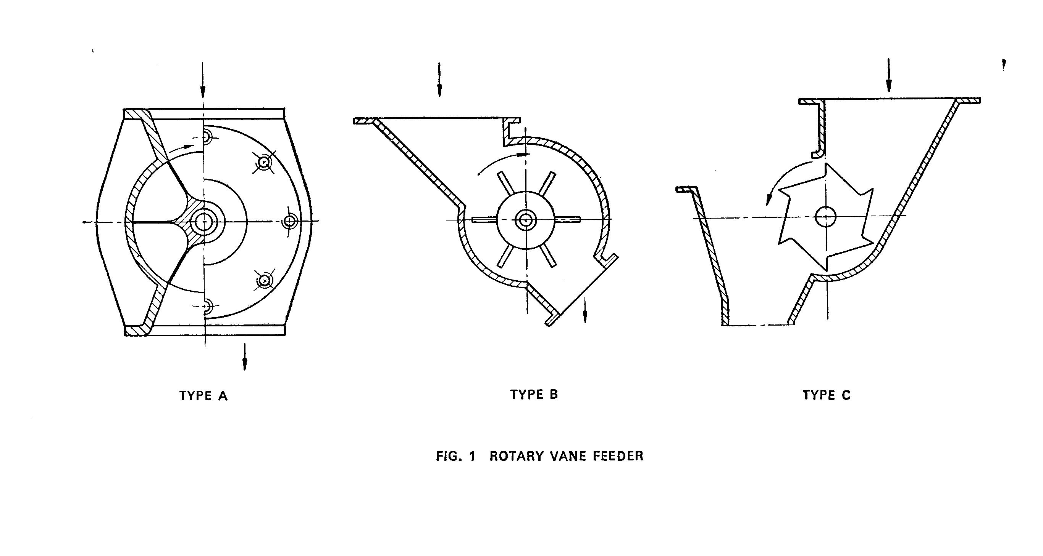
Rotary Vane Feeders [IS 12060:1987]

Slide 85
Rotary Table Feeders [IS 12108:1987]

Slide 86
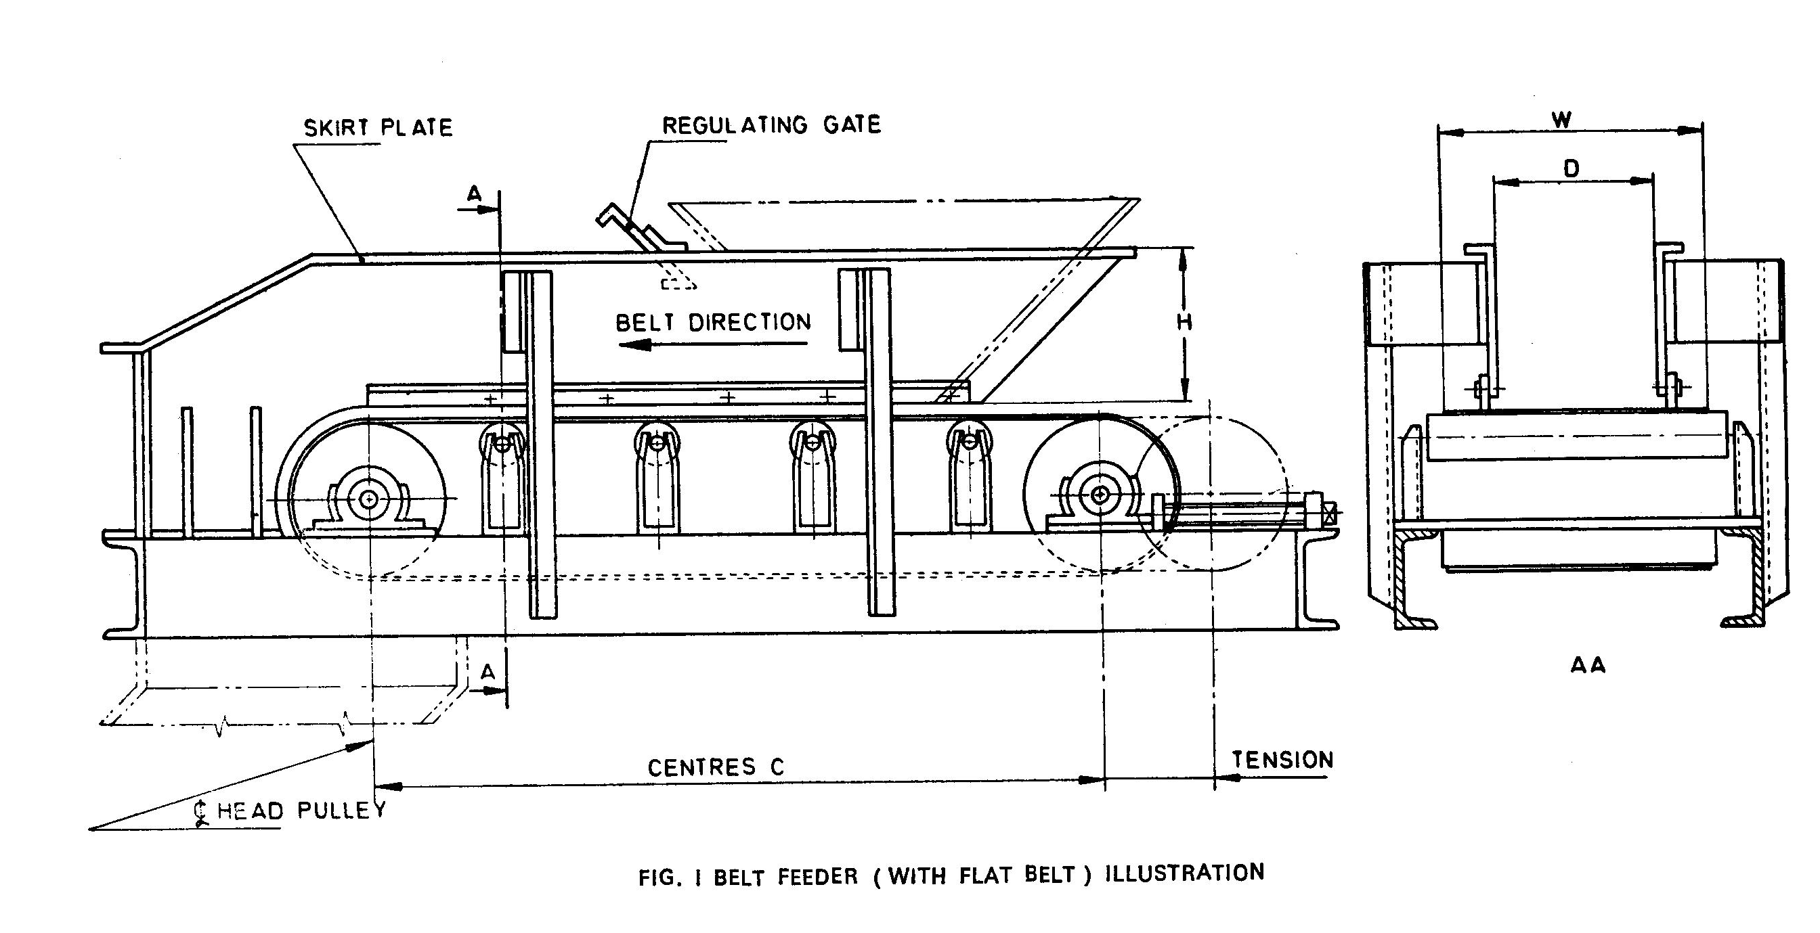
Belt Feeders [IS 12215:1987]

Slide 87
Mechanical Vibrating Feeders [IS 12401: 1988]

Slide 88
Screw Feeders [IS 13324: 1992]

Slide 89
Application of Indian Standard in Amusement parks
Amusement parks in India are becoming quite common and people visit these parks quite often. In order to ensure their safety in amusement parks or while enjoying the rides, an attempt has been made to stipulate safety in the form of a National Code. It is hoped that organizers of amusement parks, manufacturers of rides would make use of these codes to ensure the overall safety of human beings and equipment at such places.
[IS 15475(Part 1): 2022] covers general information, safety information, design criteria, maintenance and performance tests that are to be adopted in the safe use of amusement rides and devices.

Slide 90
Classification of IS 15475
IS 15475 deals with the recommended practice for amusement rides safety. It is basically divided into 6 Parts:
Part 1: General information
Part 2: Safety requirements
Part 3: Design, manufacture, and erection
Part 4: Selection, training, and supervision of operators
Part 5: Operation and maintenance procedures
Part 6: Performance tests

Slide 91
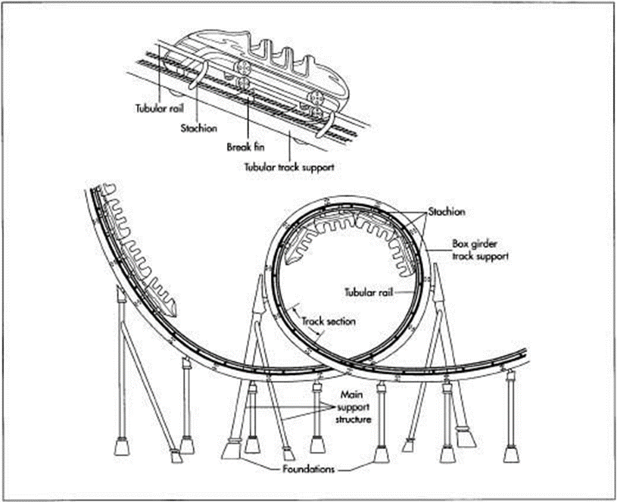
Design and Construction
The standard provides guidelines for the design and construction of conveyors, ensuring they are robust and capable of withstanding the operational stresses typically encountered in amusement park environments.

Slide 92
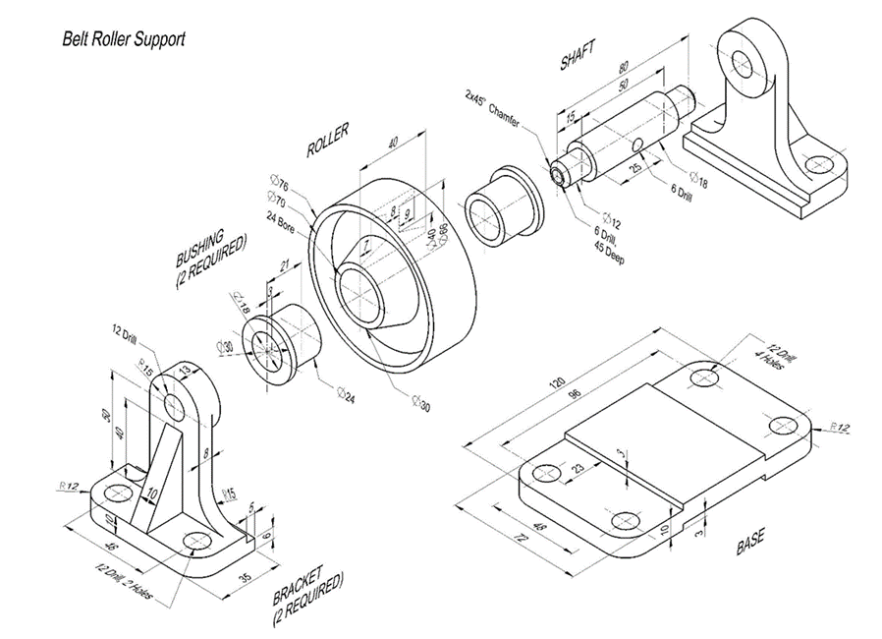
Materials and Components
[IS 15475(Part 3): 2022 ]specifies the materials and components that should be used in the construction of conveyors. This ensures that the conveyors are durable, corrosion-resistant, and able to operate reliably over their lifespan.

Slide 93
Materials used in conveyors used in amusement rides:
Plastics:
Modular Plastic Belts: Made of materials such as polypropylene (PP) or polyethylene (PE), these belts offer durability, low friction, and are easy to clean. They are suitable for conveying riders or objects safely.
Acetal (POM): Used for components like sprockets or guides due to its excellent wear resistance and strength.
Nylon: Offers high tensile strength and abrasion resistance, used in various components to enhance durability and reduce friction.
Rubber:
Rubber compounds are chosen for their grip, flexibility, and ability to withstand wear and tear. They are essential for safely conveying riders or objects throughout the ride.

Slide 94
Materials used in conveyors used in amusement rides:
Steel:
Mild Steel: Commonly used for structural components of the conveyor frame due to its strength and cost-effectiveness.
Stainless Steel: Provides corrosion resistance, making it suitable for outdoor rides or environments where exposure to moisture is a concern.
Galvanized Steel: Offers corrosion protection through a zinc coating, extending the conveyor's lifespan.
Aluminum:
Lightweight and corrosion-resistant, aluminum is used for components where weight reduction is critical, such as support structures or certain frame elements.

Slide 95
Components of conveyors used in amusement rides:
Rollers and Pulleys:
Steel or Aluminum Rollers: Support the conveyor belt and ensure smooth movement without causing discomfort to riders.
Drive Pulleys: Transmit power to the conveyor belt, typically using motorized mechanisms designed for precise control.
Idler Pulleys: Guide the belt and maintain proper tension, critical for smooth operation and safety.
Belt Types:
Flat Belts or Modular Plastic Belts: Depending on the ride's requirements, these belts provide stability and safety while accommodating different speeds and inclines.
Fabric Belts: Used in heavy-duty applications where strength and flexibility are paramount, ensuring safe and reliable conveyance of heavy loads or riders.

Slide 96
Components of conveyors used in amusement rides:
Frames and Supports:
Robust Steel Frames: Provide structural integrity and support for the entire conveyor system, designed to withstand dynamic loads and stress during ride operations.
Adjustable Legs and Mounting Brackets: Ensure the conveyor system can be installed and adjusted to fit the specific layout and operational needs of the amusement ride.
Bearings and Bushings:
Precision Ball Bearings: Enable smooth and quiet operation of rollers and pulleys, enhancing rider comfort and overall performance.
Bronze or Plastic Bushings: Reduce friction and wear in moving parts, contributing to the longevity and reliability of the conveyor system.
Motors and Drive Components:
Electric Motors: Specifically chosen for their power and efficiency, these motors drive the conveyor belts with precision and control, ensuring safe and reliable operation.
Gearboxes and Couplings: Transmit torque from the motor to the conveyor pulleys or rollers, maintaining consistent speed and performance during ride operation.

Slide 97
Safety Requirements in amusement rides:
[IS 15475(Part 2): 2022] sets out specific safety requirements that conveyors in amusement parks must adhere to. This includes provisions for emergency stops, automatic safety devices, guardrails, and other measures to prevent accidents and ensure rider safety.
The in-running nips and pinch points of the conveying device (belts, chains belt pulleys, etc.) and the movable parts (chains sprockets, spur gears couplings, etc.) shall be protected.
All lubrication points used frequently shall be accessible without it being necessary to remove the guards.
Wheels and rollers of travelling ride and of additional travelling equipment shall be guarded at points accessible to personnel under normal working conditions

Slide 98
Safety and control devices used in conveyors:
Emergency Stop Buttons:
Strategically placed to halt conveyor operation immediately in case of emergencies, ensuring rider safety.
Safety Sensors:
Detect anomalies such as obstructions on the belt or irregular movements, triggering safety protocols to prevent accidents.
Guardrails and Covers:
Essential for preventing access to moving parts and ensuring riders remain safely within designated areas throughout the ride.

Slide 99
Safety and control devices used in Amusement Rides:
Control Panels:
House electrical components and control systems, providing centralized management and monitoring of conveyor operations.
Wiring and Cable Management:
Designed for reliability and safety, ensuring all electrical connections are secure and protected from environmental elements.

Slide 100
Safety requirements in Water Rides:
According to [IS 15492(Part 2): 2022 ]water slides installed in the park should be treated as structures and attention is drawn to the statutory requirements with regard to means of access and means of support.
The user should remain in contact with the slide proper throughout its length unless made aware prior to use of the possibility of becoming involuntarily airborne.
The top edges of both outer sides of a slide shall be made in such a way that in normal use the user cannot touch or reach the outer parts of the slide.
The individual components of the slide proper shall be arranged or designed in such a way that slider is contained at all times within slide and that his natural progression is safe.
The height of the entrance to the cover or tube shall be at least 1200 mm and the surface of the slide proper shall form a smooth, continuous surface, free from irregularities.

Slide 101
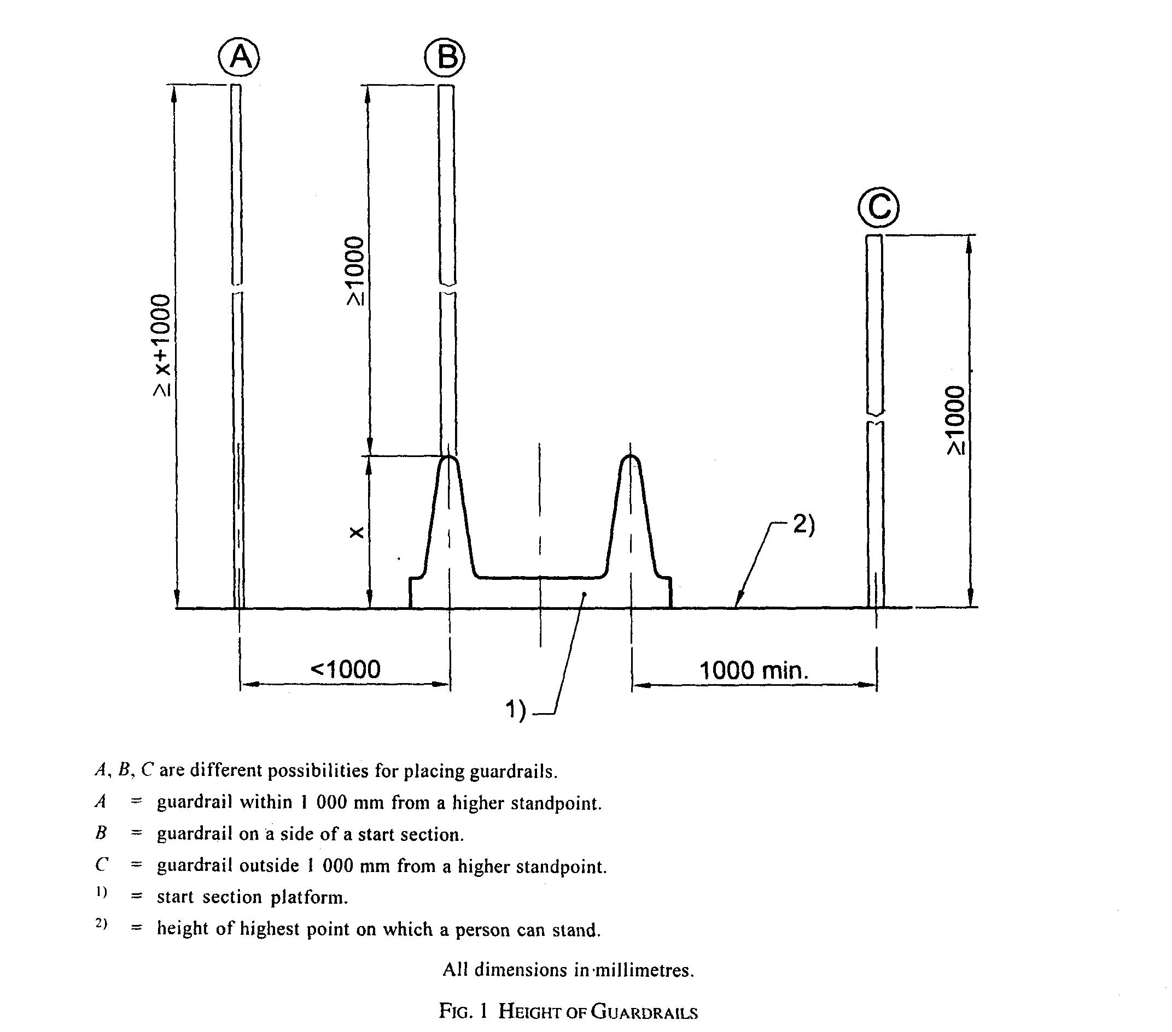

Slide 102
Types of conveyor used in amusement rides
Friction Wheel Conveyors:
Friction wheel conveyors are commonly used in roller coasters for their ability to smoothly and gently move coaster cars into position for loading and unloading. They consist of wheels that make contact with the underside of the coaster car and propel it along the track or into the station.
Chain Lift Conveyors:
Chain lift conveyors are used specifically for transporting coaster cars up steep inclines, such as the initial ascent of a roller coaster. They consist of a chain looped around sprockets, which engages with the coaster car to lift it to the top of the ride's highest point.

Slide 103
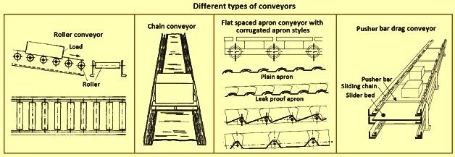
Chain conveyors are common in roller costars and water rides

Slide 104
Types of conveyor used in amusement rides
Belt Conveyors:
Belt conveyors may be used in roller coasters for tasks such as moving items or equipment within the maintenance areas or for loading/unloading platforms where a more controlled and gentle movement of objects is required.
Spiral/Screw Conveyors:
In some roller coasters, especially those with tight space constraints or where the loading area is compact, spiral conveyors can be used to efficiently move coaster cars from ground level to the loading platform or vice versa.

Slide 105
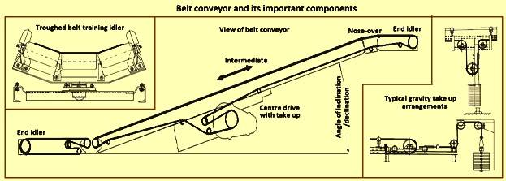
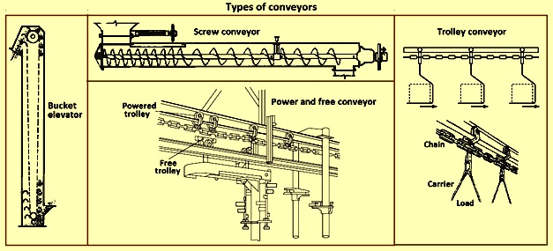
Belt Conveyors are commonly seen in roller costars
Trolley and screw conveyors are common in Ropeways

Slide 106
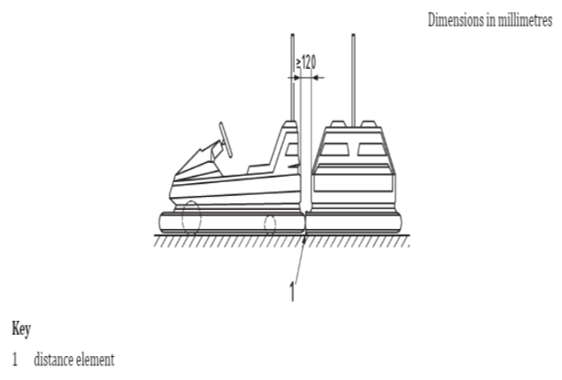
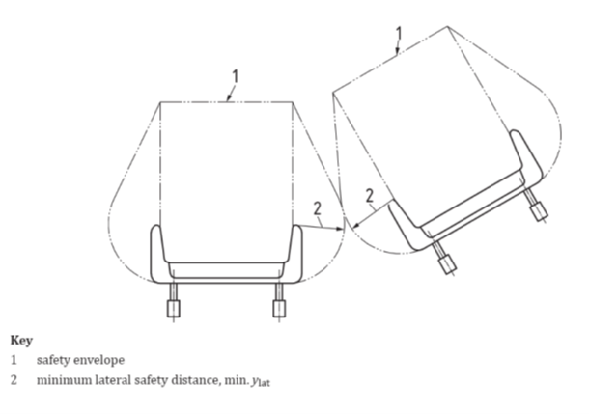
Inspectional Parameters
Design loads, including unbalanced load, taking into account the possible operating conditions or alternative installations
In the case of moving parts, the velocity or the rotational speed and acceleration shall be stated.
Details of elastic deformations (flexure, torsion), when such details affect the stability or operating safety of the device.
Details of structural components that require special examination and inspection in accordance with verification of strength.
Maintaining safety envelope and minimum lateral safety distance in rides.

Slide 107
Design, Construction, and Safety of Ropeways
IS 17237:2019
Scope:
[IS 17237:2019 ] covers the general requirements for ropeways, including their design, construction, operation, and safety aspects. It applies to aerial tramways, gondolas, chairlifts, and other types of ropeway systems.
Safety Requirements:
The standard includes provisions for safety measures to ensure the safe operation of ropeway systems. This includes guidelines for load capacities, emergency systems, and safety devices.
Design Criteria:
It provides detailed criteria for the design and construction of ropeways to ensure structural integrity and operational efficiency.
Maintenance:
The standard outlines maintenance practices and safety checks to ensure ongoing safety and reliability of the ropeway systems.

Slide 108
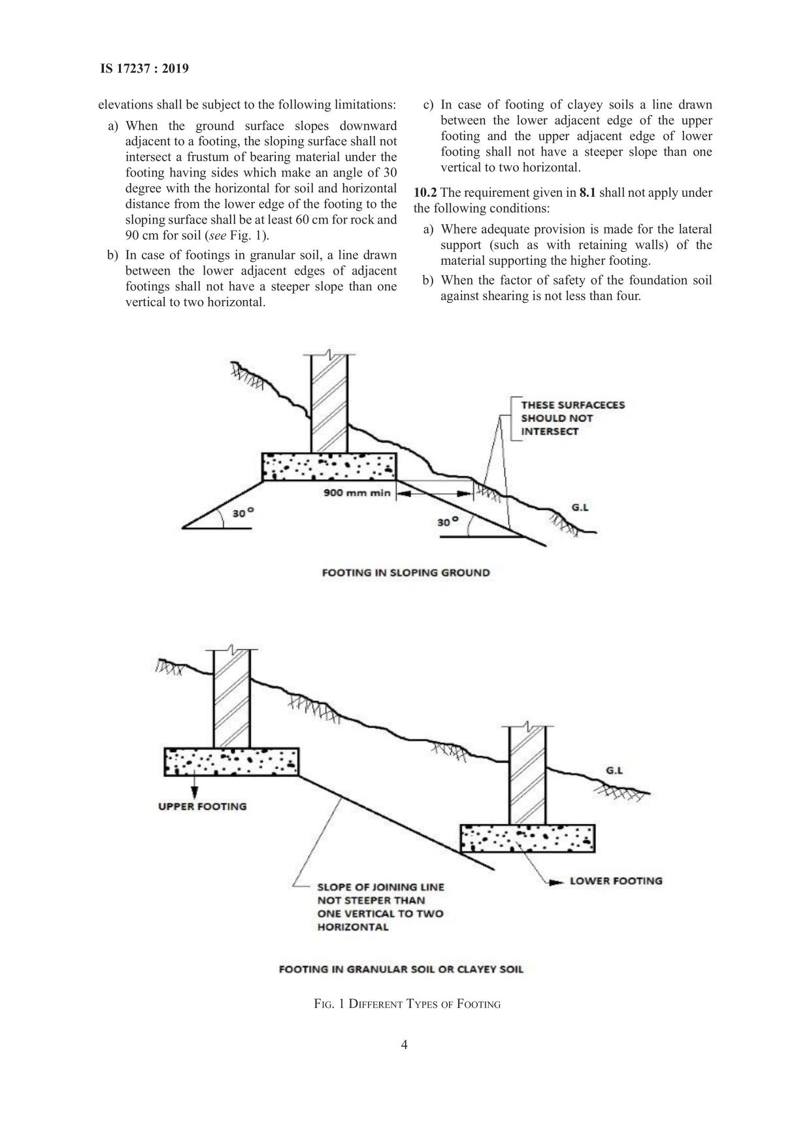

Slide 109
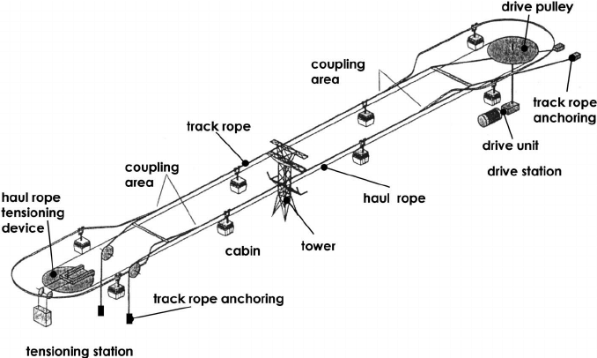
Design of Conveyors used in ropeways

Slide 110
Maintenance and Service of Conveyors used in ropeways
The maintenance practices for conveyors in ropeways must follow [IS 8565: 1977] for maintenance of mechanical equipment and [IS 15259: 2002] for safety requirements in maintenance procedures.
All conveyors used in ropeways must comply with general safety guidelines provided by the BIS and the Indian Ministry of Labor & Employment. This includes adherence to safety practices, installation procedures, and regular inspection protocols.

Slide 111
Safety requirements in Ropeways:
Regular inspections and testing of mechanical, electrical, and structural components are mandatory. This includes the cables, towers, stations, and other critical systems
Systems to monitor and react to adverse weather conditions that could impact safety, such as high winds or heavy snowfall.
Inspection of foundations for any crack, damage, tilting including the state of anchor bolts.
Implementation of real-time monitoring systems for cable tension, speed, and other critical parameters.

Slide 112
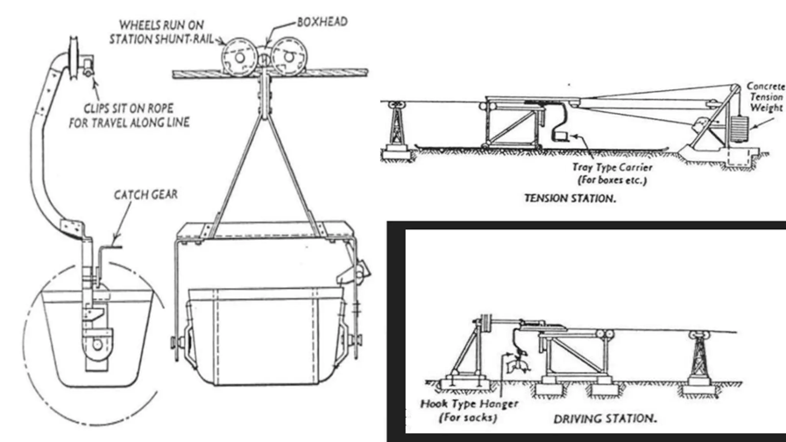
Application of conveyors in ropeways
Conveyor Belts:
In some modern ropeway systems, particularly in ski resorts, conveyor belts (often called "magic carpets") are used to transport skiers from the base to the loading area. This allows skiers to remain on their skis while moving smoothly to the starting point of the ropeway.

Slide 113
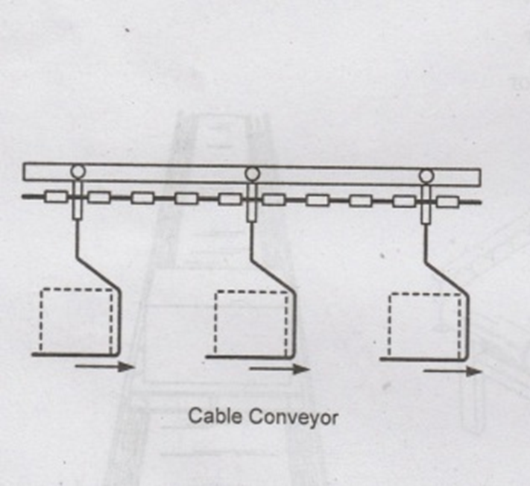
Application of conveyors in ropeways
Cable conveyors:
These conveyors form a distinct group of materials handling equipment to transport people and bulk materials in load carrying buckets, using overhead moving cables and/or wire ropes and are com- posed of one or more spans from the loading point to the discharge point/points covering long distances up to several kilometers. These conveyors are also known as ropeways or aerial tramways.

Slide 114
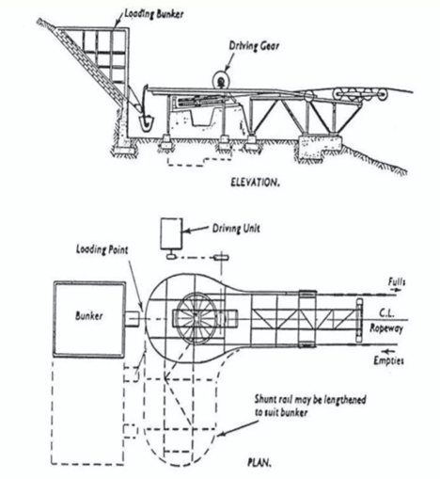
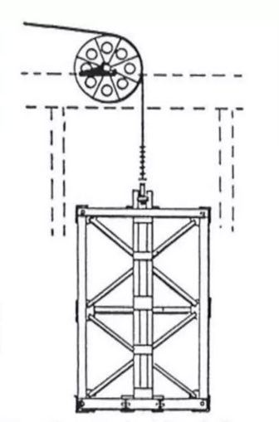
Application of conveyors in ropeways
Bulk Material Conveyors in Mining and Industrial Ropeways:
Bulk material conveyors used in mining and industrial applications must adhere to [IS 11592: 2000] for belt conveyors and [IS 6533(Part 1): 1989] for the design and construction of mining conveyors. These standards ensure that the conveyors are designed to handle specific types of bulk materials safely and efficiently.

Slide 115
THANK YOU

