Slide 1
Rolling Bearings- Wear & Tear Pattern on Bearings and Associated Failures – Understanding with the help of Standards

Slide 2
Rolling Bearings: Course Content
Introduction to Rolling Bearings
Application of Rolling Bearings
Different components of Rolling Bearings and Indian Standards on them
Advantages of Rolling Bearings
Understanding Failure Analysis of Rolling Bearings with the help of IS 17276 : 2019/ISO 15243 : 2017

Slide 3
Rolling Bearings: The Backbone of Modern Engineering (Let’s Recapitulate)
Fundamental indispensable component in many machines and devices
Reduce friction between moving parts
Ensure smooth and efficient operation by reducing friction between moving parts.
Types of Rolling Bearings
Ball Bearings: These bearings use spherical balls as rolling elements. They are versatile and can handle both radial and axial loads. Common types include deep groove ball bearings, angular contact ball bearings, and thrust ball bearings.
Roller Bearings: Instead of balls, these bearings use cylindrical, tapered, spherical, or needle-like rollers. They are designed to handle heavier loads than ball bearings. Types include cylindrical roller bearings, tapered roller bearings, spherical roller bearings, and needle roller bearings.

Slide 4
Applications of Rolling Bearings
Automotive Industry: Bearings are crucial in engines, transmissions, wheels, and steering systems, ensuring smooth and efficient operation of vehicles.
Aerospace: Precision bearings are used in aircraft engines, landing gear, and other critical components, where reliability and performance are paramount.
Industrial Machinery: Bearings are integral to the functioning of machines in manufacturing, construction, and mining, where they support heavy loads and high speeds.
Household Appliances: From washing machines to fans, bearings ensure the longevity and quiet operation of various household devices.
Medical Equipment: Precision bearings are used in medical devices such as MRI machines and surgical instruments, where accuracy and reliability are essential.

Slide 5
Different Components of Rolling Bearings
Inner Ring: Fits onto the rotating shaft and rotates with it.
Outer Ring: Usually stationary and fits into the housing.
Rolling Elements: Balls or rollers that reduce friction and support the load.
Cage: Maintains the spacing and alignment of the rolling elements.

Slide 6
Advantages of Rolling Bearings
Low Friction and Wear: The rolling motion significantly reduces friction compared to sliding bearings, leading to less wear and longer service life.
High Load Capacity: Especially in roller bearings, the design allows for handling heavy radial and axial loads efficiently.
High-Speed Performance: Bearings can operate at high speeds with minimal frictional heat generation.
Precision and Reliability: Bearings are designed to precise tolerances, ensuring consistent performance and reliability in critical applications.
Versatility: With a wide range of types and sizes, bearings can be adapted to almost any application, providing solutions for diverse engineering challenges.

Slide 7
Important Indian Standards on Rolling Bearings

Slide 8
IS 2399 : 2024 / ISO 5593 : 2023 Rolling Bearings - Vocabulary
Some important definitions given in the Standard are –
Rolling bearing - Bearing operating with rolling (rather than sliding) motion between the parts supporting load and moving in relation to each other.
Ball bearing - Rolling bearing with balls as rolling elements.
Roller bearing - Rolling bearing with rollers as rolling elements
Rolling bearing cage - Bearing part which partly surrounds all or several of the rolling elements and moves with them
Bearing inner ring - Bearing ring incorporating the raceway(s) on its outside surface
Bearing outer ring - Bearing ring incorporating the raceway(s) on its inside surface

Slide 9
IS 2898(Part 1) : 2019/ISO 3290 – 1 : 2014 Rolling Bearings Balls : Part 1 Steel Balls
This standards specifies following for steel balls used in ball bearings :
Terms and definitions
Symbols
Requirements
Ball Size
Quality of geometry and surface
Sorting accuracy and ball gauges
Hardness
Dimensions and tolerances
Method for assessment of deviation from spherical form
Illustration of ball gauges and sorting principles

Slide 10
IS 2898(Part 2) : 2019/ISO 3290 – 2 : 2014 Rolling Bearings Balls : Part 2 Ceramic Balls
This standards specifies following for ceramic balls used in ball bearings :
Terms and definitions
Symbols
Requirements
Ball Size
Quality of geometry and surface
Sorting accuracy and ball gauges
Hardness
Material
Dimensions and tolerances
Method for assessment of deviation from spherical form
Illustration of ball gauges and sorting principles

Slide 11
IS 4216 : 1983 Specification for needle cages
This standards specifies following for the needle cages used in needle bearings :
Material
Dimensions
Designation
General Requirements

Slide 12
IS 4217 : 2020 Rolling bearings – Needle rollers - Specification
This standards specifies following for the needle rollers used in needle bearings :
Dimensions
Tolerances
Material
Hardness
Designation
Manufacture
Finish
Sampling and Testing
Preservation, Packing and Marking

Slide 13
IS 9202 : 2020 Rolling bearings – Cylindrical rollers - Specification
This standards specifies following for the Cylindrical rollers used in roller bearings :
Basic design, dimensions, weights
Material
Hardness
Designation
Manufacture
Finish
Sampling and Testing
Preservation, Packing and Marking

Slide 14
IS 6455 : 2020 Single row deep grove ball bearings - Specification
This standards specifies following for the single row deep grove ball bearings :
Dimensions and designations
Tolerances and geometrical characteristics
Rolling Elements
Material of races and balls
Cage
Radial internal clearance
Surface finish
Hardness
Load rating
Workmanship and delivery requirements
Packing & Marking

Slide 15
The Failure of Rolling Bearings: Causes, Effects, and Remedies

Slide 16
Some Common Causes of Failure
Fatigue Failure
Improper Installation
Contamination
Overloading
Corrosion

Slide 17
IS 17276 : 2019/ISO 15243 : 2017 Rolling Bearings — Damage and Failures — Terms, Characteristics and Causes
The Standard covers
How bearing damage progresses
Terms and definitions used in analysing bearing damage and failure
Failure modes
Failure analysis
Illustrations of damage
Other investigations
Explanation of terms used

Slide 18
IS 17276 : 2019/ISO 15243 : 2017 Rolling Bearings — Damage and Failures — Terms, Characteristics and Causes
Failure Modes of Rolling Bearings
Rolling Contact Fatigue
Subsurface initiated fatigue
Surface initiated fatigue
Wear
Abrasive wear
Adhesive wear
Corrosion
Moisture corrosion
Frictional corrosion
Fretting corrosion
False brinelling
Electrical Erosion
Excessive current erosion
Current leakage erosion

Slide 19
Failure Modes of Rolling Bearings (Contd..)
Plastic deformation
Overload deformation
Indentation from particles
Cracking and fracture
Forced fracture
Fatigue fracture
Thermal cracking

Slide 20
IS 17276 : 2019/ISO 15243 : 2017 Rolling Bearings — Damage and Failures — Terms, Characteristics and Causes
Failure analysis — Illustrations of damage and other investigations
Failure analysis
Securing evidence before and after removal
Important points
Conserving evidence
Gathering evidence
Interpreting the evidence
Contact traces
Radial bearings
Various kinds of loadings
Thrust bearings
Various kinds of loadings
Illustrated failures compendium — Cause of failure and countermeasures

Slide 21
Failure analysis — Illustrations of damage and other investigations

Slide 22
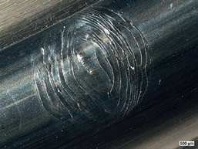
IS 17276 : 2019/ISO 15243 : 2017 Rolling Bearings — Damage and Failures — Terms, Characteristics and Causes
A.2.2.1.1 Cracks resulting from subsurface initiated fatigue in the early stage, before spalling on the outer ring raceway of an angular contact ball bearing
Cause of failure
— Fatigue cracks due to heavy load in combination with accumulation of load cycles.
Countermeasure
Use a bearing with higher load-carrying capacity.

Slide 23
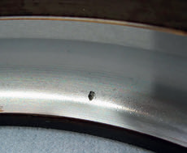
IS 17276 : 2019/ISO 15243 : 2017 Rolling Bearings — Damage and Failures — Terms, Characteristics and Causes
A.2.2.1.2 Spalling in an early stage on the outer ring raceway of an angular contact ball bearing
Cause of failure
Fatigue cracks and initial spalling due to:
heavy load in combination with accumulation of load cycles;
further operation after fatigue cracks started.
Countermeasure
Use a bearing with higher load-carrying capacity.

Slide 24
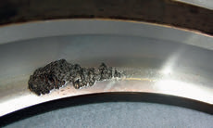
IS 17276 : 2019/ISO 15243 : 2017 Rolling Bearings — Damage and Failures — Terms, Characteristics and Causes
A.2.2.1.3 Spalling in a more advanced stage on an outer ring raceway of an angular contact ball bearing
Cause of failure
Fatigue cracks and propagated spalling due to:
heavy load in combination with accumulation of load cycles; further operation after fatigue, cracks at the raceway surface.
Countermeasure
Use a bearing with higher load-carrying capacity.

Slide 25
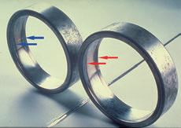
IS 17276 : 2019/ISO 15243 : 2017 Rolling Bearings — Damage and Failures — Terms, Characteristics and Causes
A.2.2.1.4 Spalling resulting from subsurface initiated fatigue at two diametrically opposite locations — On the outer ring raceways of a self-aligning ball bearing
Cause of failure
Ovality of the housing, resulting in localized higher stresses.
Similar damage can occur if split housings are wrongly assembled or if particles are embedded in the housing seating.
Countermeasure
Check form accuracy of adjacent parts and improve them, if necessary.
Assemble split housings properly.
Ensure utmost cleanliness during mounting.

Slide 26
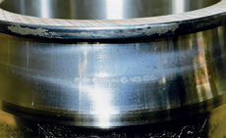
IS 17276 : 2019/ISO 15243 : 2017 Rolling Bearings — Damage and Failures — Terms, Characteristics and Causes
A.2.2.2.1 Microspalling on the inner ring raceway of a spherical roller bearing
Cause of failure
Increased surface roughness of therolling contacts due to:
inadequate lubrication;
particles entering the bearing.
Countermeasure
Protect the surface finish by:
correct lubrication;
improved sealing;
ensure system cleanliness.

Slide 27
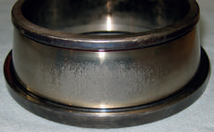
IS 17276 : 2019/ISO 15243 : 2017 Rolling Bearings — Damage and Failures — Terms, Characteristics and Causes
A.2.2.2.2 Surface initiated fatigue on the inner ring raceway of a tapered roller bearingCause of failure
Grey stains and microspalls at the raceway due to:
insufficient lubrication;
sliding motion;
insufficient preload;
misalignment.
Countermeasure
Improve lubrication.
Apply correct preload.
Ensure alignment.

Slide 28
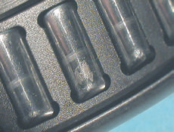
IS 17276 : 2019/ISO 15243 : 2017 Rolling Bearings — Damage and Failures — Terms, Characteristics and Causes
A.2.2.2.3 Surface initiated fatigue on roller raceways of a needle roller bearing
Cause of failure
—Grey stains and microspalls on rollersdue to:
insufficient lubrication;
sliding motion;
misalignment of the shaft.
Countermeasure
Improve lubrication.
Realign the shaft and/or housings.

Slide 29
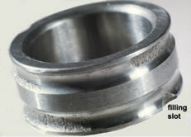
IS 17276 : 2019/ISO 15243 : 2017 Rolling Bearings — Damage and Failures — Terms, Characteristics and Causes
A.2.2.2.4 Surface initiated fatigue on the inner ring raceways of a double row angular contact ball bearing — Oblique running path pattern
Cause of failure
Misalignment during operation due to:
shaft deflection;
abutment faces on mating part(s) out-of-square.
Countermeasure
Eliminate misalignment.
Select a bearing type suitable to accommodate the misalignment.
Reduce shaft deflection.
Check the squareness of the abutment faces on mating part(s).

Slide 30
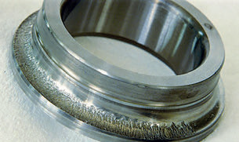
IS 17276 : 2019/ISO 15243 : 2017 Rolling Bearings — Damage and Failures — Terms, Characteristics and Causes
A.2.2.2.5 Spalling on the inner ring raceway of an angular contact ball bearing
Cause of failure
Entry of foreign particles.
Water ingress.
Inadequate lubrication.
Countermeasure
Improve the sealing.
Review the lubrication for the operating conditions.

Slide 31
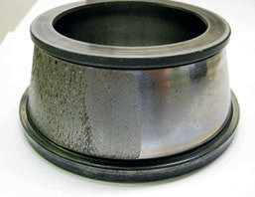
IS 17276 : 2019/ISO 15243 : 2017 Rolling Bearings — Damage and Failures — Terms, Characteristics and Causes
A.2.2.2.6 Spalling (peeling) on the inner ring raceways of a tapered roller bearing
Cause of failure
Thin lubricant film resulting from:
heavy loads;
low speed;
elevated temperatures.
Countermeasure
Select proper lubricant to increase lubricant film thickness under operating conditions.
Improve maintenance on lubrication system.

Slide 32
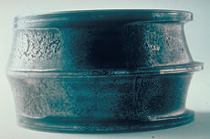
IS 17276 : 2019/ISO 15243 : 2017 Rolling Bearings — Damage and Failures — Terms, Characteristics and Causes
A.2.3.1.1 Abrasive wear on the inner ring raceways of a spherical roller bearing non-rotating inner ring
Cause of failure
Ingress of contamination, causing very heavy abrasive wear on raceways.
Countermeasure
Improve the sealing arrangement.
— Improve the lubrication intervals and/or grease.
Use a sealed bearing if operating conditions permit.

Slide 33
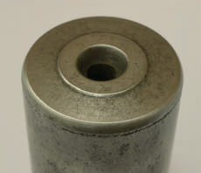
IS 17276 : 2019/ISO 15243 : 2017 Rolling Bearings — Damage and Failures — Terms, Characteristics and Causes
A.2.3.1.2 Abrasive wear on the end face of a cylindrical roller
Cause of failure
Contaminated or insufficient lubricant causing abrasive wear of the roller end face contact.
Countermeasure
Ensure system cleanliness.
Improve lubrication.

Slide 34
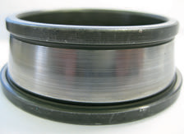
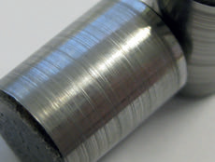
IS 17276 : 2019/ISO 15243 : 2017 Rolling Bearings — Damage and Failures — Terms, Characteristics and Causes
A.2.3.1.3 Abrasive wear on the inner ring raceway and roller of a tapered roller bearing
Cause of failure
Particle contamination from external sources.
Worn out or ineffective seals.
Particles embedded into soft cage material.
Countermeasure
Eliminate or minimize source of contamination.
Replace seals or upgrade sealing arrangement.
Replace lubricant more often.
Make sure the bearing is properly cleaned before assembly.

Slide 35
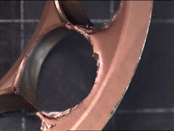
IS 17276 : 2019/ISO 15243 : 2017 Rolling Bearings — Damage and Failures — Terms, Characteristics and Causes
A.2.3.1.4 Abrasive wear on the cage pockets of a solid metal cage of an angular contact ball bearing
Cause of failure
Inadequate lubrication.
Entrance of contaminants.
Countermeasure
Improve lubrication.
Review the sealing arrangement.

Slide 36
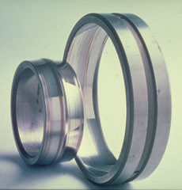
IS 17276 : 2019/ISO 15243 : 2017 Rolling Bearings — Damage and Failures — Terms, Characteristics and Causes
A.2.3.1.5 Abrasive wear, polishing of the inner and outer ring raceways of a spherical roller bearing
Cause of failure
Ingress of very fine contaminants, resulting in shiny (heavily) worn raceways of rings and rolling elements.
Inadequate sealing arrangement and/or lubrication.
Countermeasure
Improve sealing arrangement.
Improve lubrication: select proper lubricant and/or relubrication interval.
Consider to use a sealed bearing.

Slide 37
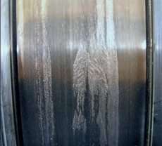
IS 17276 : 2019/ISO 15243 : 2017 Rolling Bearings — Damage and Failures — Terms, Characteristics and Causes
A.2.3.2.1 Adhesive wear - Smearing on the inner ring raceway of a cylindrical roller bearing
Cause of failure
— Smearing (skidding) between rollers and inner ring raceway due to:
too light load;
high acceleration;
insufficient lubrication.
Countermeasure
Reduce acceleration.
Increase load.
Use coating on surfaces.
Improve lubrication.

Slide 38
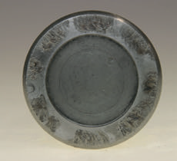
IS 17276 : 2019/ISO 15243 : 2017 Rolling Bearings — Damage and Failures — Terms, Characteristics and Causes
A.2.3.2.2 Adhesive Wear - Smearing on the large end face of a tapered roller
Cause of failure
Inadequate lubrication resulting inmetal-to-metal contact, plastic deformation, and heat damage.
Countermeasure
Use and maintain proper lubricant to provide adequate quantity, quality, and film thickness.
Ensure lubrication and delivery system can support the specific application’s speed and loads together with environmental requirements.

Slide 39
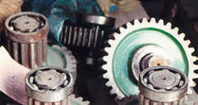
IS 17276 : 2019/ISO 15243 : 2017 Rolling Bearings — Damage and Failures — Terms, Characteristics and Causes
A.2.3.2.1 Moisture corrosion - Corrosion on sub-assemblies from improper storage
Cause of failure
Rust on unused sub-assemblies, caused by:
improper storage;
insufficient preservation.
Countermeasure
Store sub-assemblies and bearings in dry places with constant temperature and low humidity.
If possible, avoid mounting bearings on sub-assemblies, which are then left unprotected.

Slide 40
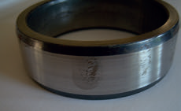
IS 17276 : 2019/ISO 15243 : 2017 Rolling Bearings — Damage and Failures — Terms, Characteristics and Causes
A.2.3.2.2 Corrosion, hand perspiration (fingerprint)
Cause of failure
Faulty handling, bearing in the unpreserved condition touched with perspiring hands.
Countermeasure
Avoid touching bearings with moist/perspiring hands.
Use gloves or a barrier cream.
Clean surfaces, apply thixotropic agent and repack properly.

Slide 41
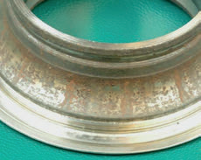
IS 17276 : 2019/ISO 15243 : 2017 Rolling Bearings — Damage and Failures — Terms, Characteristics and Causes
A.2.3.2.3 Contact corrosion on the inner ring raceway of an angular contact ball bearing
Cause of failure
Bearing operated with lubricant contaminated by water.
Countermeasure
Change the bearing and contaminated lubricant.
Check that sealing is not damaged during assembling operations.
Replace seals, or optimize sealing arrangement, or optimize relubrication interval.

Slide 42
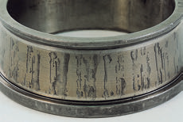
IS 17276 : 2019/ISO 15243 : 2017 Rolling Bearings — Damage and Failures — Terms, Characteristics and Causes
A.2.3.2.4 Contact corrosion on the inner ring raceway of a tapered roller bearing, spacing equivalent to roller pitch
Cause of failure
Ingress of water or corrosive material (such as acid).
Condensation of moisture contained inthe air.
Poor packaging and storing conditions.
Countermeasure
Improve the sealing effect.
Take measures to prevent rust when not operating for a long period of time.

Slide 43
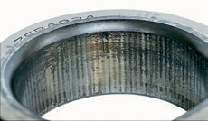
IS 17276 : 2019/ISO 15243 : 2017 Rolling Bearings — Damage and Failures — Terms, Characteristics and Causes
A.2.4.2.1 Fretting corrosion on the entire surface of the inner ring bore of a cylindrical roller bearing
Cause of failure
Insufficient interference fit between the inner ring and the shaft.
Countermeasure
Specify adequate fit with attention to the load.
Consider the influence of surface roughness of the shaft seating.

Slide 44
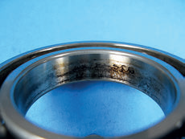
IS 17276 : 2019/ISO 15243 : 2017 Rolling Bearings — Damage and Failures — Terms, Characteristics and Causes
A.2.4.2.2 Fretting corrosion on the inner ring bore of a ball bearing
Cause of failure
Fretting corrosion due to:
insufficient interference fit;
repeated sliding between the inner ring and shaft.
Countermeasure
Increase the shaft fit.
Apply coating to the surfaces.

Slide 45
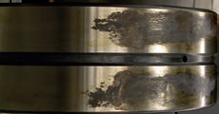
IS 17276 : 2019/ISO 15243 : 2017 Rolling Bearings — Damage and Failures — Terms, Characteristics and Causes
A.2.4.2.3 Fretting corrosion on the outside diameter of a spherical roller bearing
Cause of failure
Heavily loaded, micro movements under load led to fretting corrosion.
Countermeasure
Use special anti fretting paste on the seats.
Use a special coating.

Slide 46
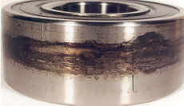
IS 17276 : 2019/ISO 15243 : 2017 Rolling Bearings — Damage and Failures — Terms, Characteristics and Causes
A.2.4.2.4 Fretting corrosion on the outside diameter of a deep groove ball bearingCause of failure
Heavy loads and deflections.
Worn out housing bore.
Countermeasure
Reduce loads or stiffen housing or system.
Perform regular maintenance on housings.
Repair or replace housing – follow bearing manufacturer’s advice.
Improve fitting practice.

Slide 47
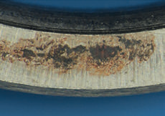
IS 17276 : 2019/ISO 15243 : 2017 Rolling Bearings — Damage and Failures — Terms, Characteristics and Causes
A.2.4.2.5 Fretting corrosion on the face of a deep groove ball bearing
Cause of failure
Micromovements between the inner ring and its counterpart (fixed on the shaft) during operation, due to vibrations.
Countermeasure
Tighten axial clamping.
Use anti-fretting paste.

Slide 48
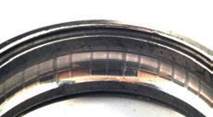
IS 17276 : 2019/ISO 15243 : 2017 Rolling Bearings — Damage and Failures — Terms, Characteristics and Causes
A.2.4.3.1 False brinelling on the inner ring raceway of an angular contact ball bearing
Cause of failure
Vibrations during bearing transportation causing relative movement of inner ring and outer ring.
Countermeasure
During transportation, prevent any relative movement between inner and outer ring.
Preload bearings (if possible).

Slide 49
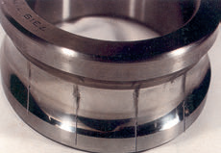
IS 17276 : 2019/ISO 15243 : 2017 Rolling Bearings — Damage and Failures — Terms, Characteristics and Causes
A.2.4.3.2 False brinelling on the inner ring raceway of a deep groove ball bearing
Cause of failure
Vibrations during standstill.
Countermeasure
Reduce vibration.
Apply preload.
Apply coating.

Slide 50
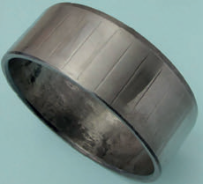
IS 17276 : 2019/ISO 15243 : 2017 Rolling Bearings — Damage and Failures — Terms, Characteristics and Causes
A.2.4.3.3 False brinelling on the inner ring raceway of a needle roller bearing — Standby equipment
Cause of failure
False brinelling at the raceway at rolling element pitch due to vibrations during standstill.
Countermeasure
Rotate sometimes.
Reduce vibration.
Apply preload.
Use a coating.

Slide 51
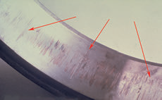
IS 17276 : 2019/ISO 15243 : 2017 Rolling Bearings — Damage and Failures — Terms, Characteristics and Causes
A.2.4.3.4 False brinelling on the outer ring raceway of a cylindrical roller bearing
Cause of failure
Frequent vibrations on stand-by equipment, marks at roller pitch, several sets because of stop/go.
Countermeasure
Counter vibrations by taking adequate design.
Adapt lubrication.
Consider another bearing type.

Slide 52
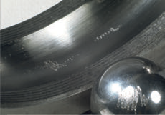
IS 17276 : 2019/ISO 15243 : 2017 Rolling Bearings — Damage and Failures — Terms, Characteristics and Causes
A.2.5.1.1 Excessive current erosion - Craters in the outer ring raceway of a deep groove ball bearing
Cause of failure
Passage of an electric current causing craters on raceways and balls.
Countermeasure
Verify and apply correct electrical insulation of the machine or the bearing.
Provide proper earthing of the machine for example during electric welding operations.

Slide 53
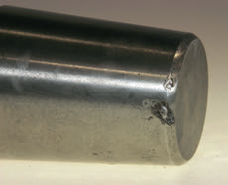
IS 17276 : 2019/ISO 15243 : 2017 Rolling Bearings — Damage and Failures — Terms, Characteristics and Causes
A.2.5.1.2 Electrical erosion, cratering on a tapered roller
Cause of failure
Improper electric earthing while the bearing is stationary.
Countermeasure
Provide proper earthing during welding or electric source.
Insulate the bearing from the welding or electric source.

Slide 54
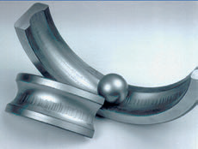
IS 17276 : 2019/ISO 15243 : 2017 Rolling Bearings — Damage and Failures — Terms, Characteristics and Causes
A.2.5.2.1 Current leakage erosion- Fluting (washboarding) on the inner and outer ring raceways of a deep groove ball bearing
Cause of failure
Fluting on raceway running path caused by passage of electric current of comparatively low intensity through rotating bearing, dark discolouration of the bottoms of the fluting depressions, balls are coloured dull grey.
Countermeasure
Check insulation.
Provide proper earthing.
Use electrically insulated bearings or hybrid bearings.

Slide 55
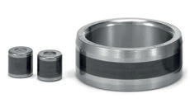
IS 17276 : 2019/ISO 15243 : 2017 Rolling Bearings — Damage and Failures — Terms, Characteristics and Causes
A.2.5.2.2 Fluting due to current leakage erosion on the inner ring raceway and rollers of a cylindrical roller bearing
Cause of failure
Arcing and burning occur through the thin oil film at points of contact between an inner ring raceway and rollers due to electrical potential difference between inner and outer rings.
Countermeasure
Check insulation.
Provide proper earthing.
Use electrically insulated bearings.

Slide 56
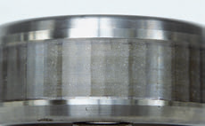
IS 17276 : 2019/ISO 15243 : 2017 Rolling Bearings — Damage and Failures — Terms, Characteristics and Causes
A.2.5.2.3 Advanced stage of fluting due to current leakage erosion on the inner ring raceway of a cylindrical roller bearing
Cause of failure
Progression from current leakage erosion.
Countermeasure
Check insulation.
Provide proper earthing.
Use electrically insulated bearings.

Slide 57
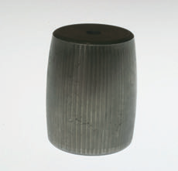
IS 17276 : 2019/ISO 15243 : 2017 Rolling Bearings — Damage and Failures — Terms, Characteristics and Causes
A.2.5.2.4 Fluting on a spherical roller raceway, resulting from electric erosion
Cause of failure
Flow of electric current through bearing while bearing is rotating.
Countermeasure
Provide proper earthing.
Insulate the bearing from the electric source.

Slide 58
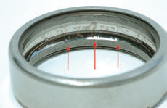
IS 17276 : 2019/ISO 15243 : 2017 Rolling Bearings — Damage and Failures — Terms, Characteristics and Causes
A.2.6.1.1 Plastic deformation - Deformation by overloading - Overload deformation in the outer ring raceway of a deep groove ball bearing
Cause of failure
(Axial) Overload on the outer ring of a deep groove ball bearing, due to faulty mounting procedure.
Plastic deformation at ball distance.
Countermeasure
Use correct mounting tools and procedures.
Check that assembled parts are not axially preloaded.
Confirm design does not cause axial preload.

Slide 59
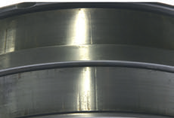
IS 17276 : 2019/ISO 15243 : 2017 Rolling Bearings — Damage and Failures — Terms, Characteristics and Causes
A.2.6.1.2 Overload deformation on the inner ring raceways of a spherical roller bearing
Cause of failure
Heavy impact load under static or rotational conditions and/or improper mounting practice.
Countermeasure
Improve bearing installation so that rollers are not pressed into the raceways.
Select bearing that can handle known shock loads.
Eliminate or minimize source of shock loading.

Slide 60
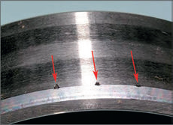
IS 17276 : 2019/ISO 15243 : 2017 Rolling Bearings — Damage and Failures — Terms, Characteristics and Causes
A.2.6.1.3 Overload deformation on the inner ring raceway of a cylindrical roller bearing - deformations corresponding to rolling element pitch
Cause of failure
Plastic deformations at the edge of the inner ring raceway by the rollers due to misalignment during mounting operation.
Countermeasure
Follow installation instructions to avoid misalignment.
Use a guiding ring.

Slide 61
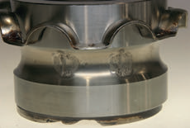
IS 17276 : 2019/ISO 15243 : 2017 Rolling Bearings — Damage and Failures — Terms, Characteristics and Causes
A.2.6.1.4 Spalling resulting from overload deformation on the inner ring raceway of a deep
groove ball bearing, corresponding to ball pitch
Cause of failure
Application overload.
Shock load.
Countermeasure
Select bearing that can handle application loads.
Eliminate or minimize shock loading through the bearings.

Slide 62
IS 17276 : 2019/ISO 15243 : 2017 Rolling Bearings — Damage and Failures — Terms, Characteristics and Causes
A.2.6.2.1 Indentations from particles - Indentation from particles on raceways and rolling elements of a spherical roller bearing
Cause of failure
Heavy contamination and overrolling of the particles in a large bearing, resulting in a large number of indentations.
Countermeasure
Improve oil filtration.
Improve sealing devices.

Slide 63
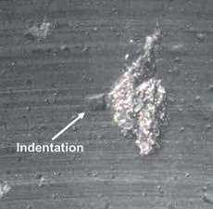
IS 17276 : 2019/ISO 15243 : 2017 Rolling Bearings — Damage and Failures — Terms, Characteristics and Causes
A.2.6.2.2 Spalling starting on an indentation on an inner ring raceway
Cause of failure
Surface spalling initiated on dents, caused by overrolling of pollution hard particles that entered into the bearing cavity.
Countermeasure
Work in a clean environment.
Improve sealing system.
Check pollution of lubricant and/or lubrication system.

Slide 64
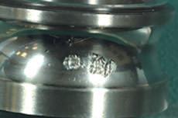
IS 17276 : 2019/ISO 15243 : 2017 Rolling Bearings — Damage and Failures — Terms, Characteristics and Causes
A.2.6.2.3 Indentations and subsequent spalling in the inner ring of a deep groove ball bearing
Cause of failure
Contamination and overrolling of the particles, resulting in indentations and finally spalling.
Countermeasure
More frequent lubrication.
Improve sealing arrangement.
Use a sealed bearing if possible.

Slide 65
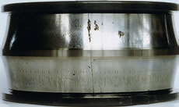
IS 17276 : 2019/ISO 15243 : 2017 Rolling Bearings — Damage and Failures — Terms, Characteristics and Causes
A.2.7.1.1 Fracture - Forced fracture - Forced fracture on the inner ring of a spherical roller bearing
Cause of failure
Large fitting stress due to temperature difference between a shaft and an inner ring.
Countermeasure
Correct the interference.
Check the operating conditions.

Slide 66
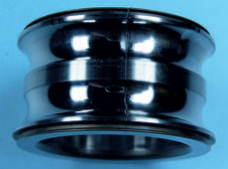
IS 17276 : 2019/ISO 15243 : 2017 Rolling Bearings — Damage and Failures — Terms, Characteristics and Causes
A.2.7.1.2 Forced fracture of the inner ring of a deep groove ball bearing
Cause of failure
Static overload during standstill.
Countermeasure
Prevent overload.
Use of bearing with higher static load capacity.

Slide 67
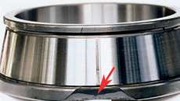
IS 17276 : 2019/ISO 15243 : 2017 Rolling Bearings — Damage and Failures — Terms, Characteristics and Causes
A.2.7.1.3 Forced fracture of the back face rib of the inner ring of a tapered roller bearing
Cause of failure
Large impact during mounting.
Countermeasure
Use appropriate mounting tools and procedures

Slide 68
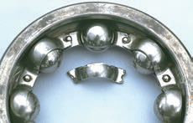
IS 17276 : 2019/ISO 15243 : 2017 Rolling Bearings — Damage and Failures — Terms, Characteristics and Causes
A.2.7.2.1 Fatigue fracture - Fatigue fracture of the cage of a deep groove ball bearing
Cause of failure
Misalignment.
Abnormal load action on cage in bearing operation due to misaligned mounting between an inner ring and an outer ring.
Countermeasure
Correct alignment.
Improve the mounting method.
Select a suitable cage type/material.

Slide 69
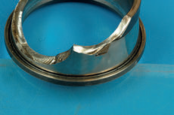
IS 17276 : 2019/ISO 15243 : 2017 Rolling Bearings — Damage and Failures — Terms, Characteristics and Causes
A.2.7.2.2 Fatigue fracture of the inner ring of a tapered roller bearing
Cause of failure
Initiation of crack on surface defect, because of shock during mounting, and fatigue propagation by bending stresses associated to axial load variation in service.
Countermeasure
Careful mounting.

Slide 70
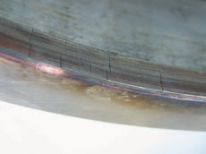
IS 17276 : 2019/ISO 15243 : 2017 Rolling Bearings — Damage and Failures — Terms, Characteristics and Causes
A.2.7.3.1 Thermal cracking - Thermal cracks on the outside rib of the outer ring of a cylindrical roller bearing
Cause of failure
Lubrication problem – cage pocketsof the cage were worn out, the outer ring guided cage rubbed heavily onto the outer ring raceway, the sliding resulted in excessive heat and thermal cracks appeared.
Countermeasure
Make sure that the proper lubrication is used (type, viscosity, quantity).
If possible, use a cage that is roller guided.

Slide 71
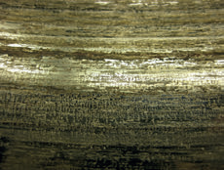
IS 17276 : 2019/ISO 15243 : 2017 Rolling Bearings — Damage and Failures — Terms, Characteristics and Causes
A.2.7.3.2 Thermal cracks on the inner ring bore of a tapered roller bearing
Cause of failure
Fit loss of the inner ring on the shaft and high heat generated from friction.
On loose fitted inner ring poor lubrication between the bore and the shaft seat.
Countermeasure
Follow bearing manufacturer’s shaft fit recommendations.
Ensure proper lubrication is maintained between loose-fitted bearings on shaft seats.

Slide 72
IS 17276 : 2019/ISO 15243 : 2017 Rolling Bearings — Damage and Failures — Terms, Characteristics and Causes
A.2.7.3.3 Thermal cracks on the large end face of a roller of a tapered roller bearing
Cause of failure
Heat generation due to sliding with the inner ring rib under poor lubrication.
Countermeasure
Improve lubrication.
Shorter lubrication intervals.

Slide 73
Benefits of Studying Indian Standards on Bearings
Standards help immensely in
Designing the bearing
Understanding correct fitment
Preventive Maintenance
Failure Analysis
Product Improvement
For other standards on Plain and Rolling Bearings you may visit
https://www.bis.gov.in
https://www.manakonline.in

Slide 74
Get involved, Make a difference
Thank you!
For any queries contact: sppd@bis.gov.in

