Slide 1
Presentation material for mechanical under graduates ON REFRIGERATION & AIR CONDITIONING
Presented by
Kumar Animesh (Sc-E/Director & Head GZBO)

Slide 2
Working Principles of RAC
First Law of Thermodynamics / Law of conservation of energy / Quantitative Law
Second Law of Thermodynamics / Law of degradation of energy / Qualitative Law
Enthalpy (H): Total energy of heat in a system which is equivalent to the sum of total internal energy and resulting energy due to its pressure and volume.
Entropy (S): Measure of degree of randomness of a molecule; entropy of universe always increases.

Slide 3
Relevant Indian Standards
IS/ISO 80000-5 : 2019 – Quantities and Units (Part 5 Thermodynamics)
Scope: This standard gives names, symbols, definitions and units for quantities of thermodynamics. Where appropriate, conversion factors are also given.
{Table 1 : Quantities and Units used in Thermodynamics}

Slide 5
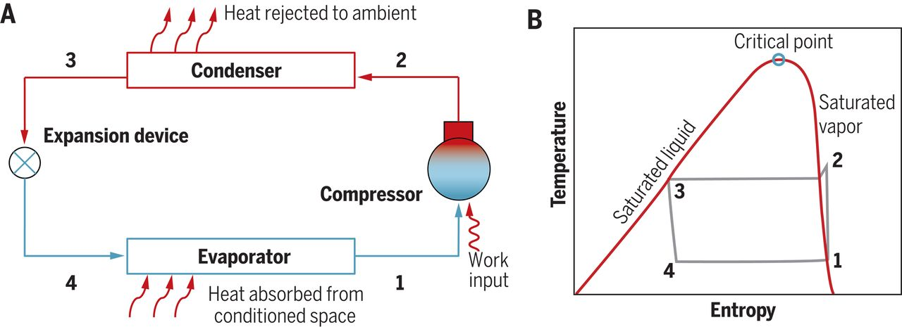
Key Components in RAC System

Slide 6
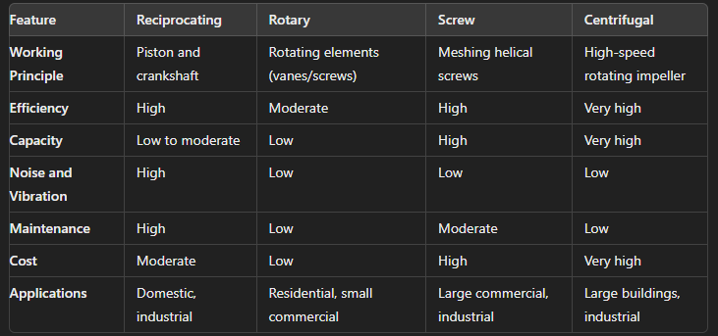
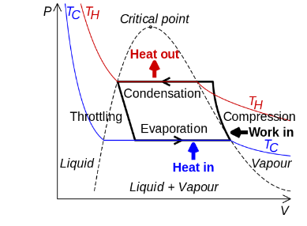
Key Components in RAC System
COMPRESSOR
Working:
Compresses the low-temperature, low-pressure refrigerant gas it receives from the evaporator to high temperature, high pressure gas at condenser.

Slide 7
Relevant Indian Standards
IS 10617: 2018 – Hermetic Compressors (UNDER MANDATORY CERTIFICATION)
Scope: This standard deals with the safety and performance requirements of hermetic sealed type standalone motor-compressors operating on vapour compressor cycle, suitable for low, medium and high temperature applications based on reciprocating (including linear), rotary and scroll pump mechanisms, their protection system, if any, which are intended for use in equipment for house hold, industrial and commercial purposes. However, it does not cover semi-hermetic compressors.
IS 5111 : 1993– Testing of Refrigerant Compressors
Scope: The provisions of this Standard apply only to single stage refrigerant compressors of the positive displacement type. Selected test methods are described for the determination of the refrigerating capacity, power, isentropic efficiency and coefficient of performance.
IS/IEC 60335-2-34 : 2021– Household and similar electrical appliances safety (Motor Compressors)
Scope: This part of IEC 60335 deals with the safety of sealed (hermetic and semi-hermetic type) motor-compressors, their protection and control systems, if any, which are intended for use in equipment for household and similar purposes and which conform with the standards applicable to such equipment.
IS/IEC 60335-2-89 : 2010 – Household and similar electrical appliances safety (Commercial refrigerating appliances with an incorporated or remote refrigerant unit or compressor)
Scope: This standard specifies safety requirements for electrically operated commercial refrigerating appliances that have incorporated compressor or that are supplied in two units for assembly as a single appliance (split system)

Slide 8
HERMETIC COMPRESSOR TEST PARAMETERS AS PER IS 10617
CLASSIFICATION OF COMPRESSORS

Slide 9
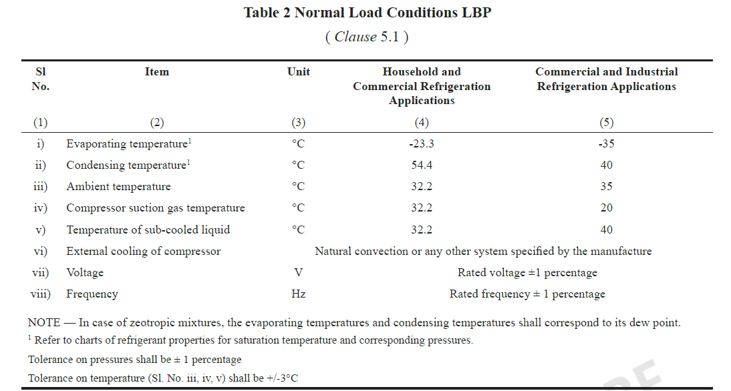
HERMETIC COMPRESSOR TEST PARAMETERS AS PER IS 10617
COMPRESSOR CAPACITY RATING TESTS

Slide 10
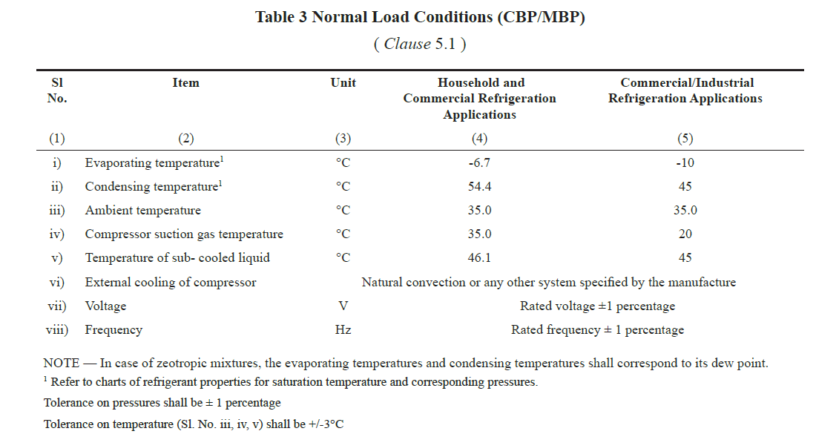
HERMETIC COMPRESSOR TEST PARAMETERS AS PER IS 10617
COMPRESSOR CAPACITY RATING TESTS

Slide 11
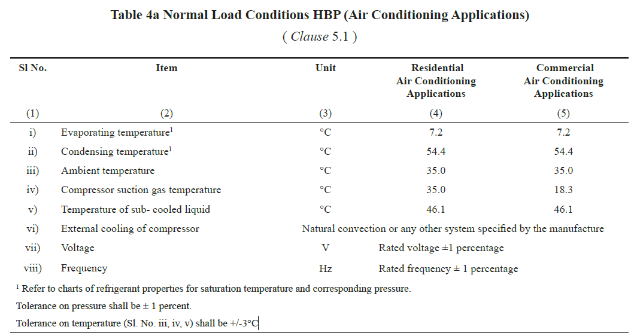
HERMETIC COMPRESSOR TEST PARAMETERS AS PER IS 10617
COMPRESSOR CAPACITY RATING TESTS

Slide 12
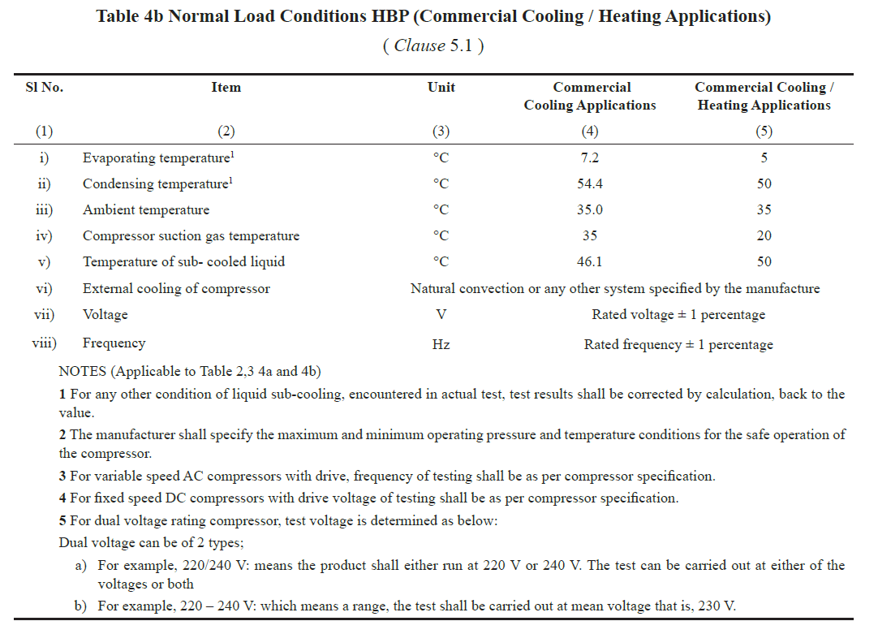
HERMETIC COMPRESSOR TEST PARAMETERS AS PER IS 10617
COMPRESSOR CAPACITY RATING TESTS

Slide 13
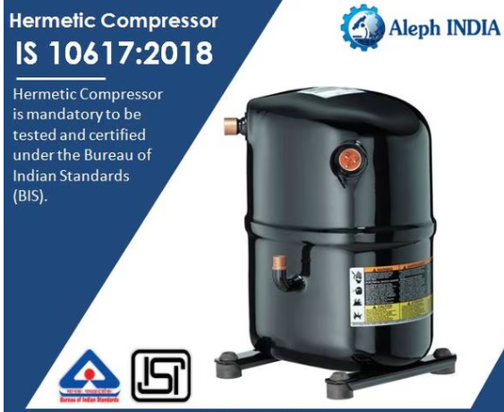
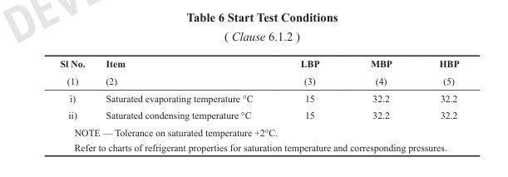
HERMETIC COMPRESSOR TEST PARAMETERS AS PER IS 10617
COMPRESSOR PERFORMANCE TEST (as per Clause 6.1.1)
STARTABILITY TEST (as per Clause 6.1.2)

Slide 14
HERMETIC COMPRESSOR TEST PARAMETERS AS PER IS 10617
LOCKED ROTOR TEST (as per Clause 6.1.3)
As per clause 6.1.3 of IS 10617, the compressor with overload protection system shall undergo short duration locked rotor testing.
It is obtained by blocking the movement of rotor and/or piston on specimen compressor which shall be charged with oil, if necessary and vapour refrigerant.
HIGH VOLTAGE TEST (as per Clause 6.1.4)
The compressor shall be able to withstand 1.5 kV AC voltage for 1 min/s without breakdown.
Also, the leakage current measured shall not exceed 5mA.

Slide 15
HERMETIC COMPRESSOR TEST PARAMETERS AS PER IS 10617
PNEUMATIC TEST OF SHELL (as per Clause 6.1.6)
The shells shall be tested pneumatically (dry air/nitrogen) at a test pressure of 1MPa (gauge) and shall not show any leakage.
BURSTING TEST (as per Clause 6.1.7)
The housing shall withstand the pressure expected in normal use. This is achieved/checked by following tests:
For non-sub critical refrigeration systems, a minimum of 3.5 times the saturated vapour pressure of the refrigerant at 70 deg. Celsius rounded up to the next 0.5 MPa (5 bar).
For sub critical refrigeration systems, three times the design pressure but not less than the minimum test pressure as required.

Slide 16
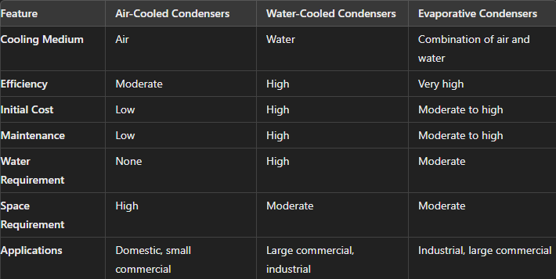
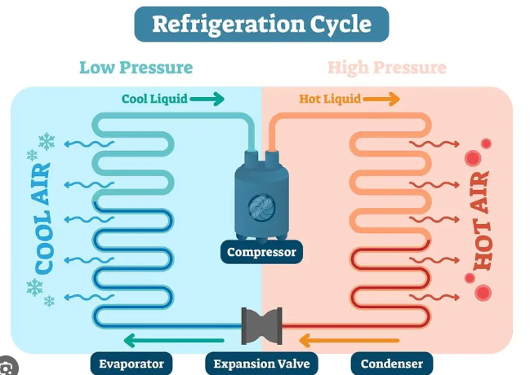
Key Components in RAC System
CONDENSER
Working:
The primary function of a condenser is to reject the heat absorbed by the refrigerant during the refrigeration cycle to the surroundings.

Slide 17
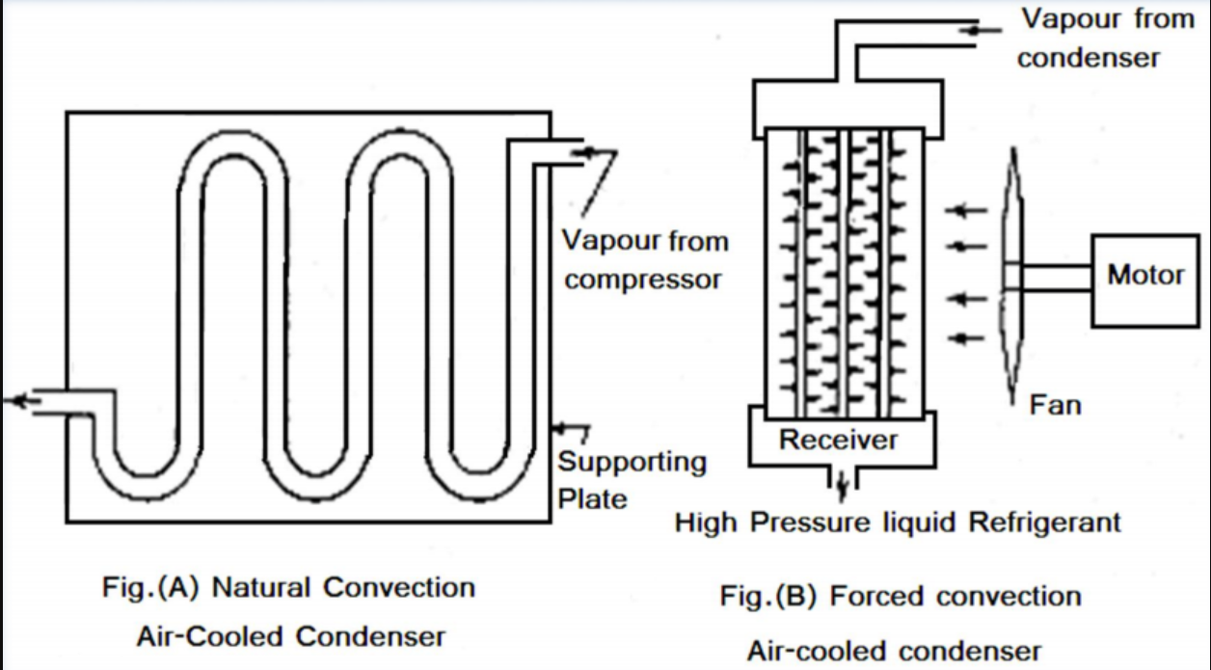
Air Cooled Condenser
Working Principle:
Heat Absorption: The hot, high-pressure refrigerant vapor from the compressor enters the condenser coils.
Heat Transfer: As the refrigerant flows through the condenser coils, the heat is transferred from the
refrigerant to the surrounding air. Fans or blowers are used to increase the airflow over the condenser coils,
enhancing the heat transfer process.
Condensation: The refrigerant loses heat and
starts to cool down. As it cools, it condenses from
a vapor to liquid.
Heat Rejection: The heat is rejected to the
atmosphere. The cooled, high pressure liquid
refrigerant then flows to the expansion device,
where it will be prepared for next cycle.

Slide 18
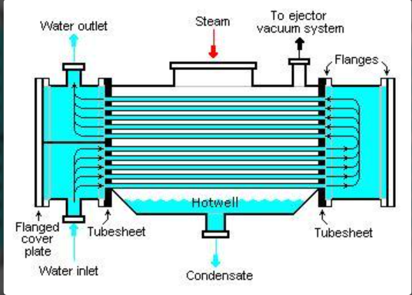
Water Cooled Condenser
Working Principle:
Heat Absorption: The hot, high-pressure refrigerant vapor from the compressor enters the condenser coils.
Heat Transfer: The refrigerant flows through the condenser tubes, and water flows over or around these
tubes. Heat from the refrigerant is transferred to the water, cooling the refrigerant.
Condensation: The refrigerant loses heat to
water, it condenses from vapor to liquid.
Heat Rejection: The heated water is then
either recirculated through a cooling tower or
discharged and replaced with cooler water.

Slide 19
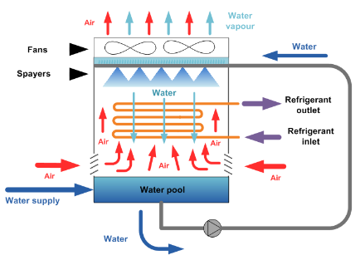
Evaporative Condenser
Working Principle:
Heat Absorption: The hot, high-pressure refrigerant vapor from the compressor enters the condenser coils.
Heat Transfer: Water is sprayed over the condenser coils. A fan forces air over the coils and the sprayed
water, enhancing the heat transfer process.
Evaporation: As the water absorbs heat from the
refrigerant, it evaporates. The evaporation of
water removes a significant amount of heat from
the refrigerant.
Condensation: The refrigerant loses heat and
condenses from a vapor to liquid within coils.
5. Heat Rejection: The remaining water that does
not evaporate falls to basin and recirculated.
Further heat gets rejected vide air and evaporation

Slide 20
Relevant Indian Standards
IS 11329 : 2018 – Finned type heat exchanger for other room air conditioner (Under Mandatory Certification)
Scope: This standard specifies the general requirement and method of tests for finned type heat exchangers used for manufacturing of air conditioners of all types and sizes.
IS 11327 : 2022 – Requirements for Refrigerant Condensing Units
Scope: This standard covers requirement of condensing unit built with electric motor driven by fixed speed and variable speed positive displacement compressors for commercial and industrial applications. The condensing units could be air cooled or water cooled, having single stage and two stage compressor of open type, hermetic and semi hermetic construction.

Slide 21
TERMINOLOGIES RELATED TO CONDENSER AS PER IS 11329
Heat Exchangers: A device specifically designed to transfer heat between two physically separated fluids or mixtures of fluids. (clause 3.1)
Evaporator: A device used to turn the liquid from a chemical into its gaseous form. The liquid is evaporated, or vaporized into a gas. (clause 3.2)
Condenser: where the heat exchanging fluids rejects heat and changes from gaseous phase to liquid phase. (clause 3.3)
Design Pressure: The pressure used in design calculations for the purpose of determining the minimum thickness of various components like suction, discharge and liquid refrigerant piping. (clause 3.4)
Maximum Working Pressure: It is the maximum pressure that any part of the heat exchanger attains in its operating range for the intended use of evaporator and condenser. (clause 3.5)
Design Stress: The maximum stress from all sources permitted for the materials of construction at the design temperature. (clause 3.6)

Slide 22
CLASSIFICATION OF HEAT EXCHANGERS AS PER IS 11329
Fin pack with Collar and tube type: These types of heat exchangers are made of plate fin packs with collars and tubes. These heat exchangers are manufactured by expansion of collar fin packs and tubes assembly. (clause 4.1.1)
Copper Tube Aluminium Fin (CTAF): Made of copper tube & aluminium plate fins packs with collars
Copper inner groove/micro groove tube and aluminium fin: Made of inner grooved copper tube (IGT) (Outer Dia > 5mm) or micro groove copper tube (Outer Dia < 5mm) and aluminium plate fins with collar packs.
Aluminium Tube and Aluminium Fin (ATAF): Made of aluminium tube and aluminium plate fins packs with collar.
Enhanced Fin Surfaces: Surface/edge enhanced fin, louvered fin/slit fin, raised lanced/super fin.
Micro Channel Aluminium Tube and Aluminium Fin Heat Exchanger (MCHE): MCHE shall be made with flat micro channel tube, fins and two refrigerant manifolds/headers. (clause 4.1.2)

Slide 23
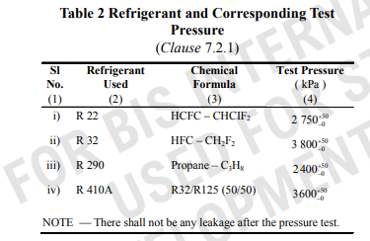
HEAT EXHANGERS TEST PARAMETERS AS PER IS 11329
INTERNAL CONTAMINATION (as per Clause 7.1.1)
Total residue contamination is maximum 100 mg/m2 of total internal surface area of which, 40 mg/m2 may be soluble and 60 mg/m2 max may be insoluble.
MOISTURE CONTENT (as per Clause 7.1.2)
Allowable moisture content shall be 50 mg/m2 of total internal surface area.
WATER LEAK TEST (as per Clause 7.2.1)
All coils shall be subjected to dry nitrogen or dry air with the given test pressure
for water leak test purpose.
HELIUM LEAK TEST (as per Clause 7.2.2)
Helium being used as tracer gas, sensitive to detect minute leaks in heat exchanger
assemblies

Slide 24
HEAT EXHANGERS TEST PARAMETERS AS PER IS 11329
MECHANICAL STRENGTH (as per Clause 7.3)
The pressure resistance is done to check the mechanical strength (resistance against bursting) of the coil.
BURST TEST(as per Clause 7.3.1)
Heat exchanger shall withstand 3 times the design pressure of the heat exchanger on the low pressure side.
Heat exchanger shall withstand 5 times the design pressure of the heat exchanger on the high pressure side.
FATIGUE STRENGTH TEST (as per Clause 7.3.2)
This is a cyclic test consisting of 250000 cycles. After completion of test, the heat exchanger shall withstand 1.5 times design pressure and there should not be any visible leak and burst.
In addition, heat exchanger shall withstand 3 times design pressure prior to cycle test and there should not be any visible leak or burst.
CORROSION RESITANCE TEST (as per Clause 7.4)
Heat exchanger material shall be corrosion resistant and shall be treated appropriately with anti corrosive protection material to prevent damage or leakage due to oxidation effect due to presence of any pollutant in the surroundings.

Slide 25
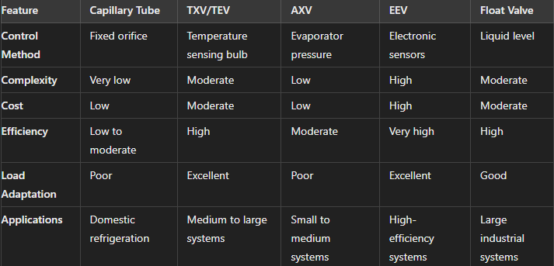
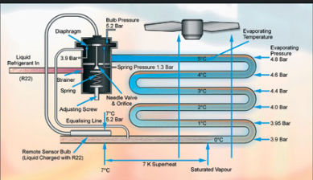
Key Components in RAC System
EXPANSION DEVICE
Working:
Its primary function is to reduce the pressure of the refrigerant coming from condenser, thereby allowing it to expand and cool before entering the evaporator.

Slide 26
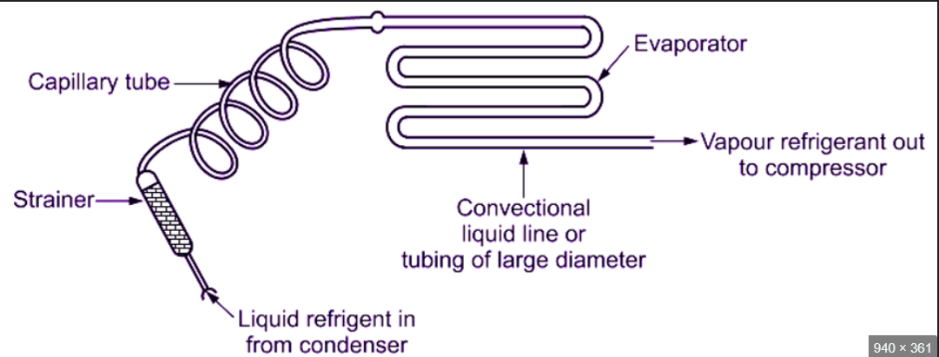
Capillary Tube
Working Principle:
Pressure Drop: The capillary tube is a long, narrow tube with a small internal diameter. As the high pressure liquid
refrigerant flows through the capillary tube, the
resistance created by the narrow diameter causes
a pressure drop.
Throttling Process: The refrigerant undergoes a
throttling process, where it expands and its
pressure decreases significantly.
Expansion: The refrigerant exits the capillary tube
as low pressure, low temperature mixture of liquid
and vapour. This low pressure refrigerant then
enters the evaporator, where it absorbs heat and
evaporates, providing the cooling effect.

Slide 27
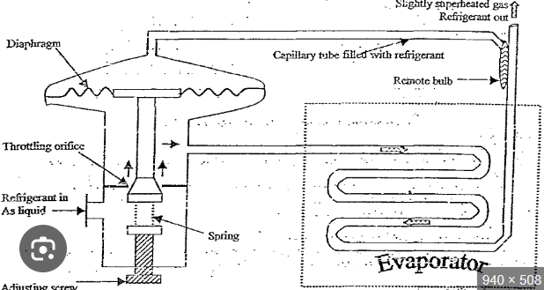
Thermostatic Expansion Valve (TXV)
Working Principle:
Sensing Bulb: The TXV has a sensing bulb filled with a temperature sensitive fluid attached to the evaporator outlet.
The bulb senses the temperature of the refrigerant
leaving the evaporator.
Pressure Balance: The temperature sensed by
the bulb affects the pressure inside it. This pressure
is transmitted to the diaphragm inside the TXV.
Diaphragm Action: The diaphragm moves in
response to the pressure changes from the sensing
bulb. This movement adjusts the position of a
needle or pin that controls valve opening.
4. Regulation of Refrigerant flow:
When superheat is too high, indicating that the evaporator is not getting enough refrigerant, the valve opens more
to allow more refrigerant flow and vice versa.

Slide 28
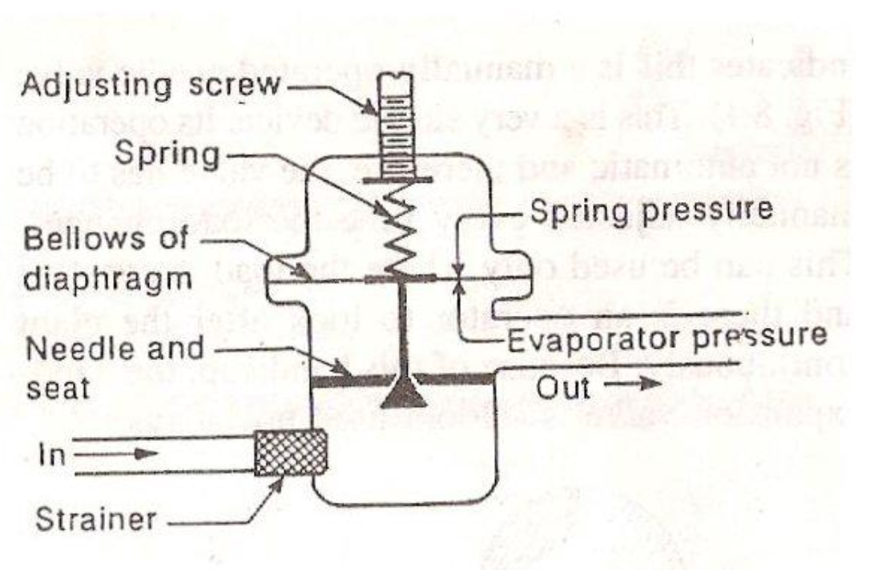
Automatic Expansion Valve (AXV)
Working Principle:
Pressure Sensing: The AXV is designed to maintain a constant pressure in the evaporator. The pressure inside the
The bulb senses the temperature of the refrigerant
evaporator is sensed by the valve.
Diaphragm Action: A diaphragm inside the valve
moves in response to the evaporator pressure.
The diaphragm is balanced by a spring that can be
adjusted to set the desired evaporator pressure.
Needle Valve Adjustment: The diaphragm’s
movement adjusts the position of needle,
controlling the opening and closing of valve. When
the evaporator pressure drops below the set point,
the valve opens to allow more refrigerant in.
Similarly, when the evaporator pressure rises above the set point, the valve closes to reduce the refrigerant flow.

Slide 29
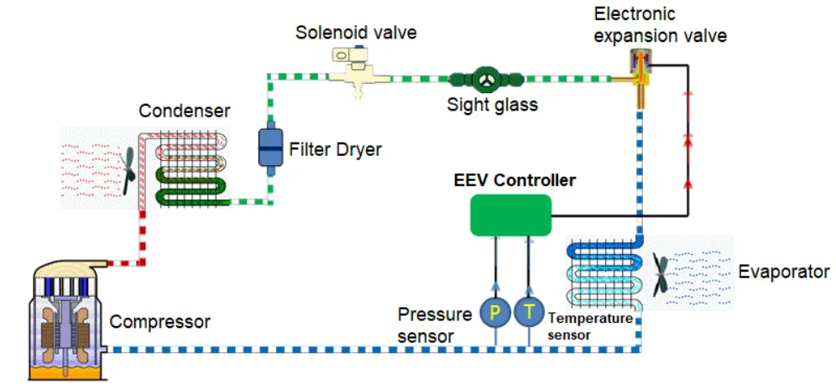
Electronic Expansion Valve (AXV)
Working Principle:
Sensing and Control: An EEV is equipped with sensors that monitor various parameters such as superheat,
evaporator temperature, and pressure. The data
from these sensors is sent to electronic controller
Electronic Controller: The controller processes
the sensor data and calculates the optimal position
for valve to maintain desired operating conditions.
It sends signals to the valve actuator to adjust the
valve opening precisely.
Modulating Valve: The valve modulates the
refrigerant flow based on the controllers instructions.
This modulation ensures that the correct amount of
refrigerant is delivered to the evaporator, optimizing
system performance.

Slide 30
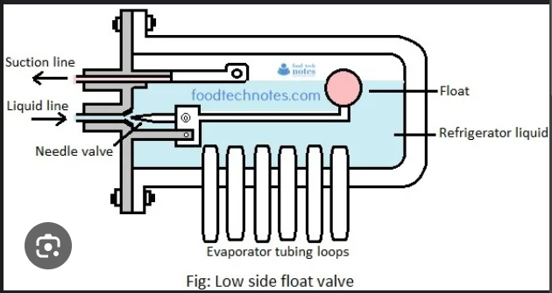
Float Valve
Working Principle:
Evaporator Control with Low Side Float Valve:
Float maintains a constant level of liquid refrigerant
in evaporator. As refrigerant evaporates and the
liquid level drops, the float descends, closing the
valve and reducing the refrigerant flow and vice versa.
Receiver Control with High Side Float Valve:
Float maintains a constant level of liquid refrigerant
in the receiver. As the liquid level rises, the float
opens the valve, allowing the refrigerant to flow to
the expansion device and vice versa.

Slide 31
TERMINOLOGIES RELATED TO TXV AS PER IS 10594
Internal Equalization: An equalization method to transmit the outlet pressure of expansion valve (inlet pressure of evaporator) to the executing element of the valve (diaphragm or corrugated pipe) through the internal channel of the valve. (clause 3.2)
External Equalization: An equalization method to transmit the outlet pressure of evaporator to the executing element of the valve through the external equalization pipe, which is used to compensate for the pressure reduction when the refrigerant flows through the distributor and evaporator. (clause 3.3)
Superheat: The superheat is difference between the temperature of sensing bulb and the refrigerant saturated temperature corresponding to the pressure at the outlet of expansion valve (in case of internal equalization) and outlet pressure of evaporator (in case of external equalization). (clause 3.4)
Static Superheat: A superheat value set to control the heat generated in the process from closing to opening of expansion valve or vice versa. (clause 3.5)
Opening Superheat: The superheat required for opening the expansion valve to the degree corresponding to the nominal cooling capacity. (clause 3.6)

Slide 32
TERMINOLOGIES RELATED TO TXV AS PER IS 10594
Working Superheat: The sum of static superheat & opening superheat of the expansion valve (clause 3.7)
Sub cooled (flash gas free) liquid: The liquid refrigerant cooled to below the saturated temperature under a certain pressure (clause 3.8)
Pressure Drop: The difference between inlet pressure and outlet pressure of expansion valve. (clause 3.9)
Hysteresis: The difference between the opening superheat and closing superheat of the expansion valve at the same refrigerant flow. (clause 3.10)
Nominal Cooling Capacity: The refrigerant flow through the expansion valve multiplied by the difference between the enthalpy value at the inlet of the expansion valve and the saturated steam enthalpy value at the evaporation temperature under the specified test condition of cooling capacity. (clause 3.11)
Max Working Pressure (MWP): Maximum pressure for which system or component is designed, alternatively it is also known as maximum allowable pressure or PS. It is the limit which should not be exceeded whether the system is working or not. (clause 3.12)

Slide 33
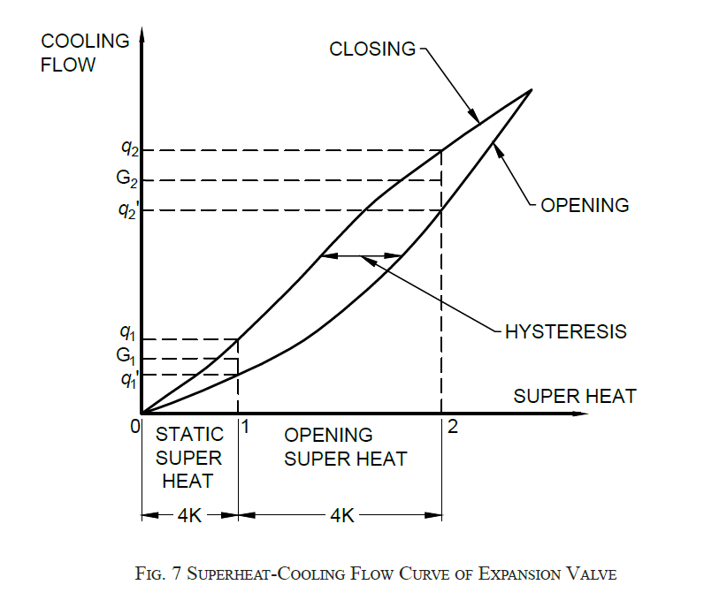
TXV Test Parameters as per IS 10594
Hydraulic Strength Test
Pressure Test
Burst Test
Tightness Test
Corrosion Test
Leakage Rate of External Equalizer
Ex-factory Static Superheat
Nominal Cooling Capacity
Extended Cooling Capacity
Hysteresis
Vibration Resistance
Lifetime of Capillary
Internal Leakage of Throttle Opening

Slide 34
TXV TEST PARAMETERS AS PER IS 10594
PRESSURE TEST (as per Clause 5.2.1)
Expansion valve shall be pressure tested without leakage. There shall be no visual deformation and cracks.
BURST TEST (as per Clause 5.2.2)
Expansion valve shall be pressure tested and free of leakage or cracking.
TIGHTNESS TEST (as per Clause 5.3)
The tightness can be tested by helium. The leakage rate of expansion valves shall be less than 6.4x10^-6 mbar.L/s and the leakage rate of the power head shall be less than 1x10^-6 mbar.L/s.
CORROSION RESISTANCE TEST (as per Clause 5.4)
Thermostatic expansion valve shall be constructed of any corrosion resistant materials and shall conform to salt spray test for duration not less than 72h.
ENVIRONMENTAL HEAT RESISTANCE (as per Clause 5.5)
The temperature-sensing element of expansion valves shall be free from leakage.

Slide 35
TXV TEST PARAMETERS AS PER IS 10594
INTERNAL LEAKAGE OF THROTTLE OPENING (as per Clause 5.8)
The actual leakage rate of the throttle opening of the expansion valves shall not be more than 1 percent of the nominal flow rate.
NOMINAL COOLING CAPACITY (as per Clause 5.9)
The measured cooling capacity of expansion valves shall not be less than 95 percent of the nominal cooling capacity.
HYSTERESIS (as per Clause 5.11)
The measured hysteresis of the expansion valves shall not be more than 2K.
VIBRATION RESISTANCE (as per Clause 5.12)
After vibration resistance test, the expansion valves shall function properly and the retested static superheat shall reach the original default value within the specified tolerance.
LIFETIME OF CAPILLARY (as per Clause 5.14)
The capillary should withstand minimum seven bending cycles without any rupture or crack.

Slide 36
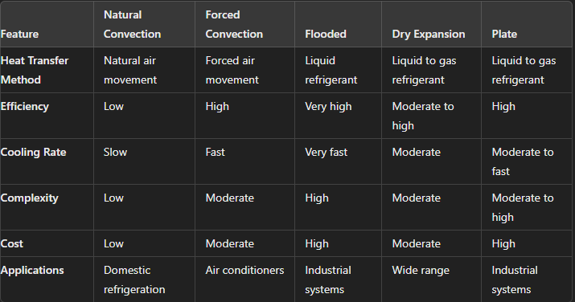
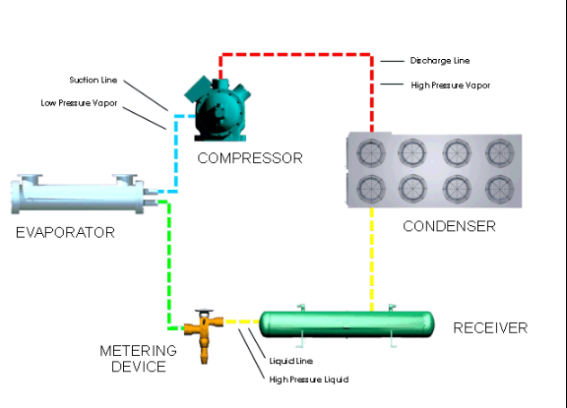
Key Components in RAC System
EVAPORATOR
Working:
The evaporator absorbs heat from the environment to cool the space or substance. The refrigerant in the evaporator absorbs this heat and evaporates, changing from liquid to a gas.

Slide 37
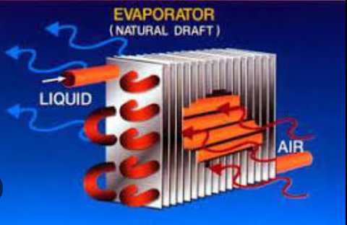
Natural Convection Evaporators
Working Principle:
Heat Absorption: The evaporator contains refrigerant that absorbs heat from the surrounding air. As the air near the
evaporator surface warms, it becomes less dense
and rises.
Natural Air Movement: Cooler, denser air from
the surroundings moves in to replace the warmer
air, creating a natural circulation of air over the
evaporator surface. This continuous movement
of air transfers heat to the refrigerant, causing it to
evaporate and absorb the latent heat.
Refrigerant Evaporation: The low pressure
liquid refrigerant enters the evaporator and absorbs
heat from the air, evaporating into low pressure gas.
The gaseous refrigerant is then carried away to the
compressor to continue the refrigeration cycle.

Slide 38
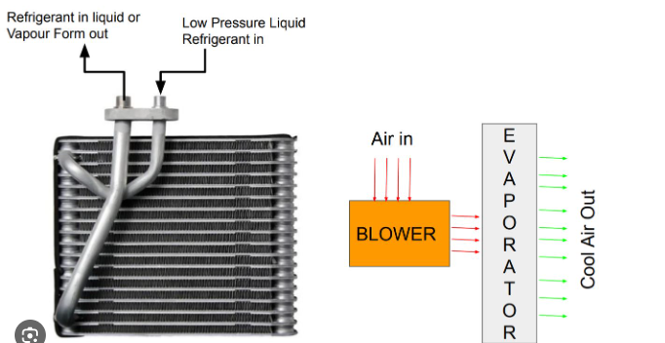
Forced Convection Evaporators
Working Principle:
Heat Absorption: The evaporator contains refrigerant that absorbs heat from the surrounding air. Fans or blowers force air over the surface of the evaporator coils, increasing the rate of heat transfer.
Refrigerant Evaporation: The refrigerant
usually in a low pressure liquid state, enters the
evaporator coils. As the refrigerant absorbs heat
from the air, it evaporates into a low pressure gas.
Air Circulation: The forced air movement created
by the fans ensures a continuous supply of warmer
air to the evaporator coils. Cooled air is then
circulated back into the space being cooled, while
the warmed refrigerant gas is sent to the compressor
to continue the refrigeration cycle.

Slide 39
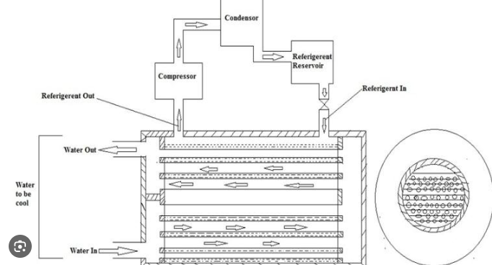
Flooded Evaporators
Working Principle:
Heat Absorption: The evaporator is flooded with liquid refrigerant, maintaining a constant level. As the air or fluid
to be cooled passes over the evaporator, heat is absorbed by the refrigerant.
Refrigerant Evaporation: The liquid refrigerant
absorbs heat and begin to evaporate. The mixture
of liquid and vapour refrigerant ensures that the
entire surface area of coils is used to heat transfer.
Recirculation: The mixture of liquid and vapour
refrigerant leaves the evaporator and enters a
separator, which separates the vapour from the
liquid. The vapour is sent to the compressor, while
the liquid is recirculated back to the evaporator.

Slide 40
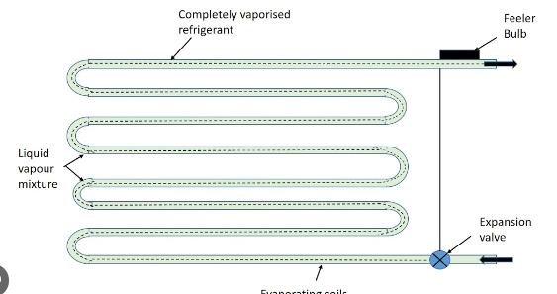
Dry Expansion Evaporators
Working Principle:
Refrigerant Flow Control: The refrigerant enters the evaporator coils in a partially liquid state. A metering device, such as thermostatic expansion valve (TXV) or an electronic expansion valve (EEV), controls the flow rate of the
refrigerant into the evaporator.
Heat absorption and evaporation:
As the refrigerant flows through the evaporator
coils, it absorbs heat from the air or fluid passing
over the coils. The refrigerant evaporates completely
before reaching the outlet of evaporator coils.
Superheat: The refrigerant leaves the evaporator
as a low pressure, superheated vapour. Superheating
causes that no liquid refrigerant returns to the
compressor, which could cause damage

Slide 41
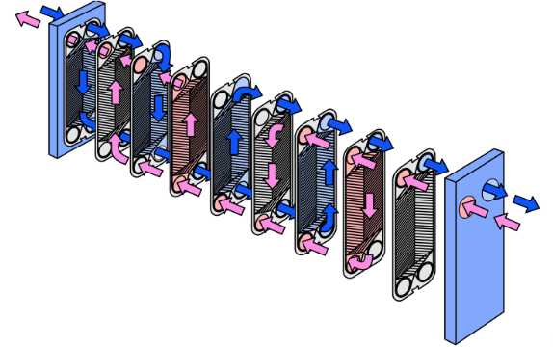
Plate Evaporators
Working Principle:
Heat Transfer: Plate evaporators consist of thin metal plates stacked together with narrow gaps between them. The
refrigerant flows through one set of channels, while the fluid to be cooled (air, water or other fluids) flows through
adjacent channels.
Counter Flow Design: Typically, plate evaporators use
counter flow arrangement where the refrigerant and the
fluid flow in opposite directions. This maximizes the
temperature gradient between the two fluids, enhancing
heat transfer efficiency.
Evaporation Process: As the refrigerant absorbs heat
from the liquid, it evaporates within the channels. The
evaporated refrigerant (now in gaseous state) is then
carried away to the compressor.

Slide 42
REFRIGERANTS
Refrigerants are essential substances used in refrigeration and air conditioning systems to transfer heat from one location to another, allowing for cooling and heating of spaces. They are the key to the efficiency and effectiveness of these systems.
TYPES OF REFRIGERANTS (GWP – Global Warming Potential, ODP – Ozone Depletion Potential)
Type | Examples | Properties | Applications | Environmental Impact | Notes
Chlorofluoro-carbons(CFCs | R-12 (Dichlorodifluoromethane | Stable, non-flammable, low toxicity | Early refrigeration & air conditioning systems | ODP high; phased out under Montreal Protocol | Historically used but replaced due to environmental concerns
Hydrochloro-fluorocarbons (HCFCs) | R-22 (Chlorodifluoromethane) | Less ozone-depleting than CFCs, still contributes | Residential and commercial air conditioning | ODP moderate; phase-out under Montreal Protocol | Transitioning to alternatives due to ozone concerns
Hydrofluoro-carbons (HFCs) | R-134a (1,1,1,2-Tetrafluoroethane), R-410A (a blend of R-32 and R-125) | Does not deplete ozone layer, high GWP | Widely used in refrigeration and air conditioning | GWP high; phase-down under Kigali Amendment | Commonly used but facing regulations due to GWP
Hydrofluoro-olefins (HFOs) | R-1234yf (2,3,3,3-Tetrafluoropropene) | Low GWP, does not deplete ozone layer | Automotive air conditioning, commercial refrigeration | Low GWP, environmentally friendly | Emerging alternative to HFCs with lower environmental impact
Natural Refrigerants | Ammonia (R-717), Carbon Dioxide (R-744), Propane (R-290), Isobutane (R-600a) | Low GWP, low ODP, varies in flammability and toxicity | Industrial refrigeration, commercial, residential systems | Generally environmentally friendly but requires careful handling | Energy-efficient and sustainable options; safety considerations for flammable refrigerants

Slide 43
PROPERTIES OF REFRIGERANTS
Boiling Point: The temperature at which refrigerant changes from liquid to gas. Determines the operating temperature range of the refrigeration system.
Pressure: The pressure at which the refrigerant operates in its liquid and gas phases. Affects the systems efficiency and design.
Heat Transfer Capability: The ability of the refrigerant to absorb and release heat, impacting the efficiency of the refrigeration cycle.
Ozone Depletion Potential (ODP): A measure of how much a refrigerant contributes to ozone layer depletion. Lower ODP is preferable.
Global Warming Potential (GWP): A measure of how much a refrigerant contributes to global warming relative to carbon dioxide. Lower GWP is preferable.
Flammability: The tendency of a refrigerant to ignite. Refrigerants with high flammability require special handling and safety measures.
Toxicity: The degree to which a refrigerant can cause harm to human health. Low toxicity is preferred for safety.

Slide 44
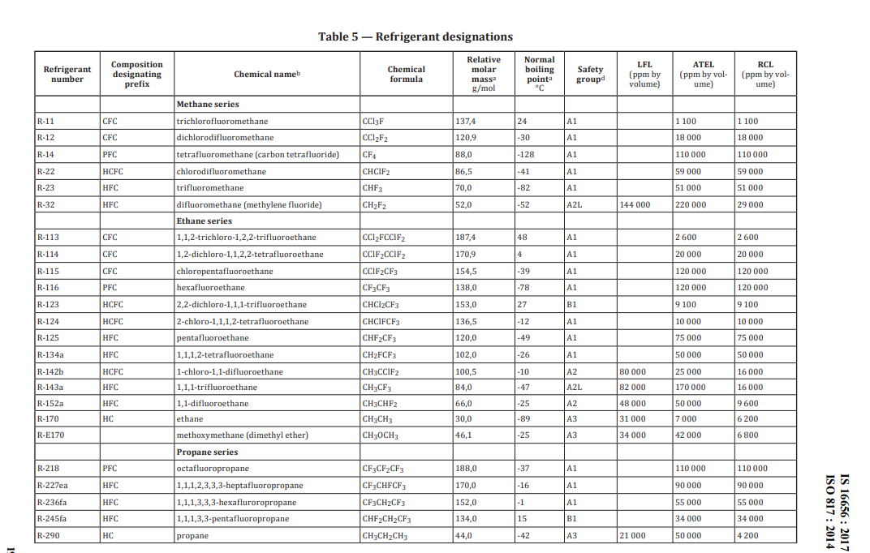
Relevant Indian Standard (IS 16656)

Slide 45
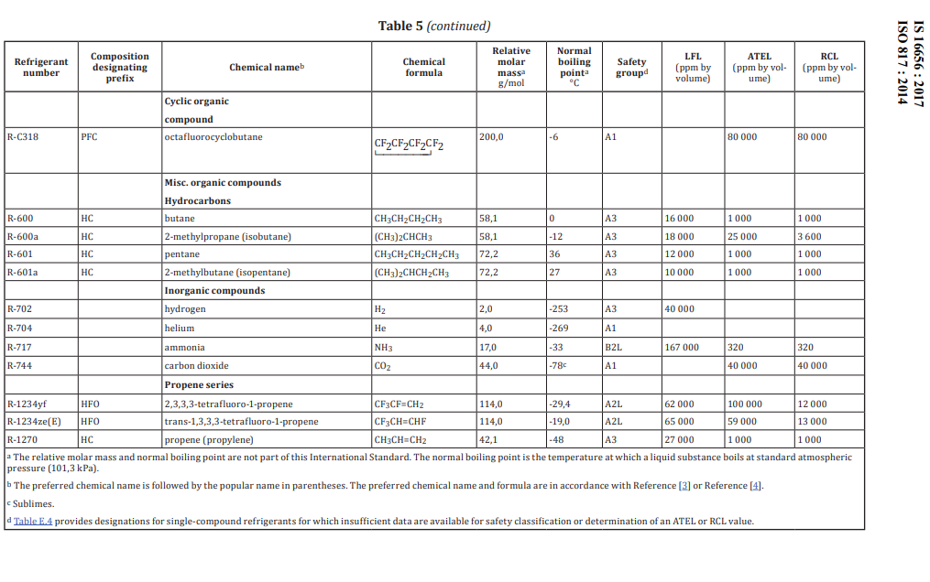
Relevant Indian Standard (IS 16656)

Slide 46
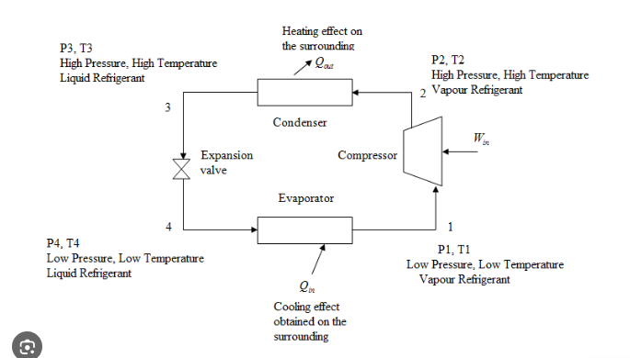
Refrigeration Cycles
VAPOUR COMPRESSION REFRIGERATION CYCLE
The most widely used refrigeration cycle, found in domestic refrigerators, air conditioners, and large commercial refrigeration systems.

Slide 47
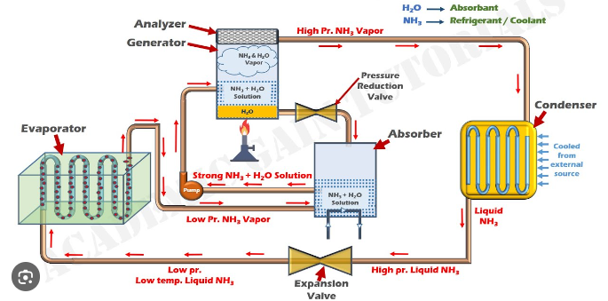
Refrigeration Cycles
VAPOUR ABSORBTION REFRIGERATION CYCLE
Used in applications where waste heat or other low grade heat sources are available.

Slide 48
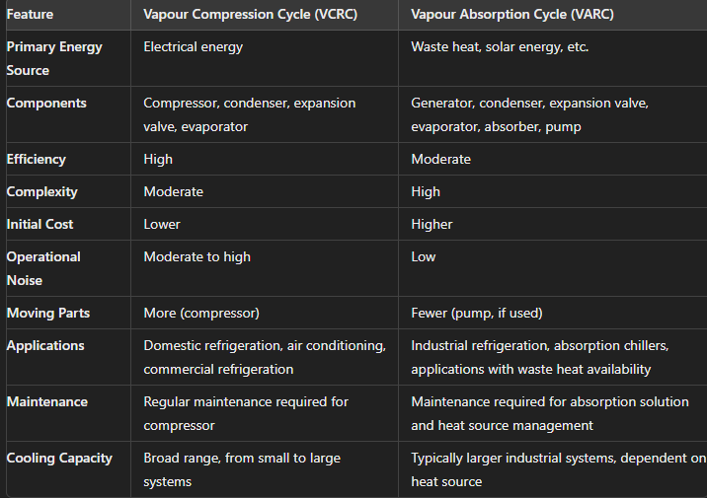
Refrigeration Cycles

Slide 49
Refrigeration Load Calculation
Refrigeration load calculation is a critical process in designing and selecting the appropriate refrigeration system for a given application.
It involves determining the total amount of heat that must be removed from a space or product to achieve and maintain the desired temperature.
This calculation ensures that the refrigeration system is neither undersized nor oversized, leading to optimal performance and efficiency.

Slide 50
Key Components of Refrigeration Load
External Heat Gains:
Transmission Load: Heat transferred through walls, floors, ceilings, windows, and doors due to temperature differences between the outside and inside.
Infiltration Load: Heat gained through air leakage into the refrigerated space from outside.
Internal Heat Gains:
Product Load: Heat introduced by the products being stored, including the initial temperature of the products and the heat they release during storage.
Occupant Load: Heat generated by people working in the refrigerated space.
Lighting Load: Heat produced by lighting fixtures within the space.
Equipment Load: Heat generated by equipment operating inside the refrigerated area (e.g., motors, fans, and defrost heaters).
Operational Heat Gains:
Defrost Load: Heat introduced during defrost cycles.
Door Openings: Heat gained when doors are opened, allowing warm air to enter.
Miscellaneous Heat Gains:
Miscellaneous Loads: Other heat sources that may be specific to the application, such as heat from fans, forklifts, or other equipment not previously accounted for.

Slide 51
Steps in Refrigeration Load Calculation
Determine the Desired Conditions:
Define the target temperature and humidity levels for the refrigerated space.
Calculate External Heat Gains:
Transmission Load: Use the formula Q=U×A×ΔTQ, where Q is the heat transfer rate (BTU/hr or W), U is the overall heat transfer coefficient (BTU/hr·ft²·°F or W/m²·K), A is the surface area (ft² or m²), and ΔT is the temperature difference between inside and outside (°F or K). Calculate for each surface (walls, ceiling, floor, windows, doors) and sum the results.
Infiltration load: Estimate the volume of air entering through leaks and openings. Use empirical methods or detailed calculations involving air exchange rates.
Calculate Internal Heat Gains:
Product Load: Determine the heat required to cool down the product from its initial temperature to the storage temperature. Use specific heat capacity (Cp​) and mass (m) of the product. Include latent heat if the product releases moisture.

Slide 52
Steps in Refrigeration Load Calculation
Product Load: Determine the heat required to cool down the product from its initial temperature to the storage temperature. Use specific heat capacity (Cp​) and mass (m) of the product: Q=m×Cp×ΔT. Include latent heat if the product releases moisture.
Occupant Load: Estimate the number of occupants and use the standard heat gain values per person.
Lighting Load: Calculate the total wattage of lighting fixtures and convert to heat load.
Equipment Load: Sum the heat output of all operating equipment within the space.
Calculate Operational Heat Gains:
Defrost Load: Estimate the frequency and duration of defrost cycles and the heat introduced during each cycle.
Door Openings: Estimate the frequency and duration of door openings and the associated heat gain.
Sum of all heat Gains:
Add the external, internal, operational, and miscellaneous heat gains to determine the total refrigeration load.

Slide 53
Power Consumption (Refrigeration)
Power consumption in refrigeration systems is a critical factor in determining their efficiency and operational cost. Understanding how power is consumed and the factors that affect it can help in designing more efficient systems and reducing energy expenses.
Key Components of Power Consumption:
Compressor
Condenser fans
Evaporator fans
Pumps
Control systems including thermostats, sensors, microprocessors etc.
Factors affecting Power Consumption:
Load conditions
Ambient temperature
Refrigerant type
System design
Maintenance
Operating Conditions

Slide 54
Calculating Power Consumption
Determining the cooling load (Q)
The cooling load is the total amount of heat that needs to be removed from the refrigerated space. It can be calculated as: Q=U×A×ΔTQ, where U is the overall heat transfer coefficient, A is the surface area, and ΔT is the temperature difference.
Calculate required refrigeration capacity:
The refrigeration capacity needed to meet the cooling load can be found using: Capacity=Q/COP, where, COP (Coefficient of performance) is the ratio of cooling effect produced to the work input.
Estimate Compressor power consumption:
Pcompressor​ = Capacity/EER, where EER (Energy Efficiency Ratio) is the ratio of cooling capacity (in BTU/hr) to power input (in watts).
Include power consumption of fans and pumps:
Add the power consumption of condenser fans, evaporator fans and pumps. These can be estimated based on their rated power and operating hours.
Total Power Consumption:
Sum the power consumption of all components to get the total power consumption of the refrigeration

Slide 55
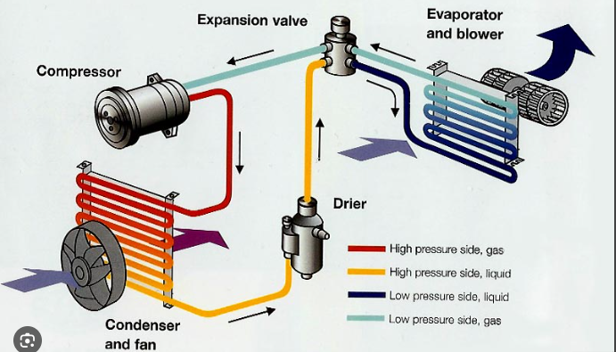
Air Conditioning Systems
Air conditioning (AC) systems are designed to control the temperature, humidity, and air quality in indoor environments. They are commonly used in residential, commercial, and industrial settings to provide comfort and improve air quality.
Basic Principles of Air Conditioning:
Refrigeration Cycle: This involves the absorption
and expulsion of heat to cool the air.
Ventilation: This process ensures the circulation
of fresh air and removal of stale air.
Dehumidification: This reduces the humidity
level in the air to improve comfort.

Slide 56
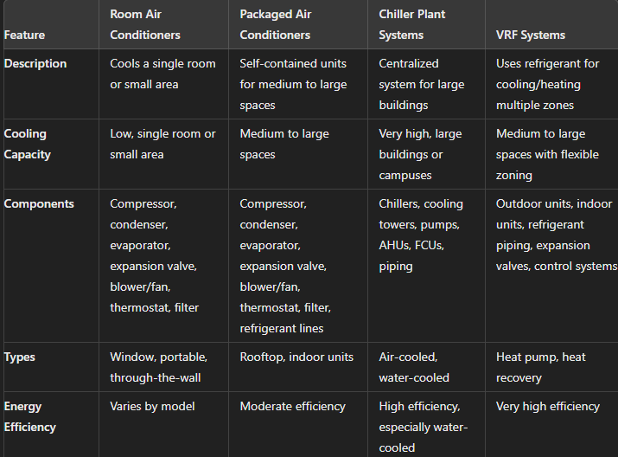
Types of Air Conditioning Systems

Slide 57
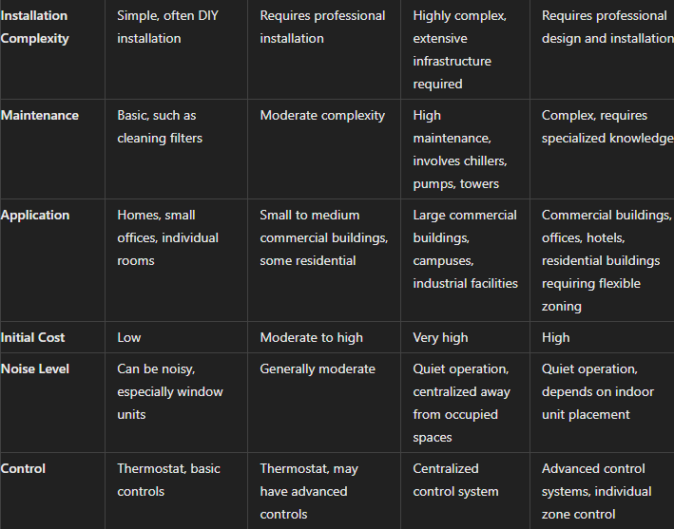
Types of Air Conditioning Systems

Slide 58
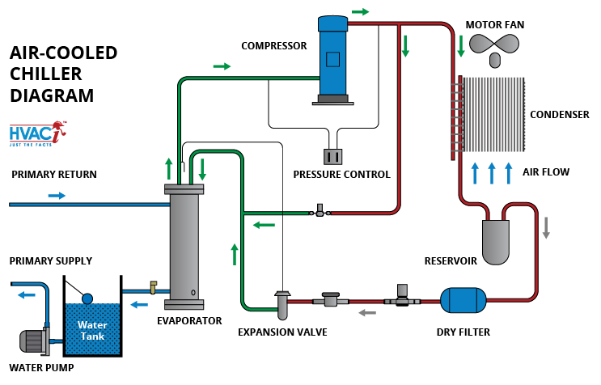
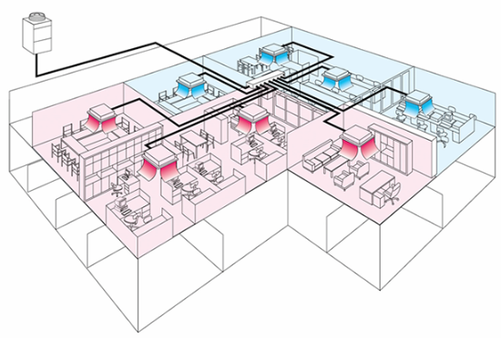
Types of Air Conditioning Systems

Slide 59
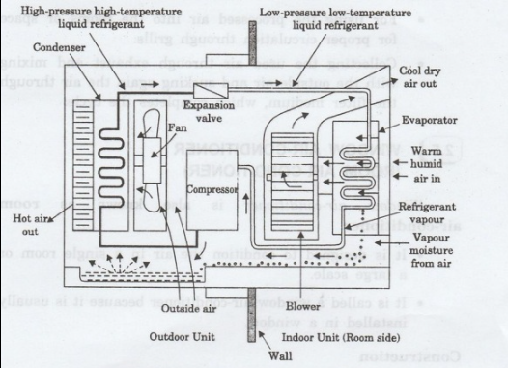
Room Air Conditioners
Room air conditioners are a common and convenient way to cool individual rooms or small spaces. They are self contained units designed to be installed in a window, through a wall or as portable units.
Working Principle:
Cooling Cycle:
The compressor compresses refrigerant, raising its temperature
and pressure. The high pressure refrigerant flows to condenser
coil; condensing into liquid and releasing heat to outside air.
The liquid refrigerant then passes through the expansion valve,
where its pressure drops & it partially evaporates, cooling down.
The cold refrigerant enters the evaporator coil, absorbing heat
from the room air as it evaporates completely. The cooled air is
blown back into the room by the indoor fan, while the
refrigerant returns to the compressor to repeat the cycle.
Dehumidification:
As the air passes over the cold evaporator coil, moisture
condenses on the coil and drips into a pan, which is then drained outside.

Slide 60
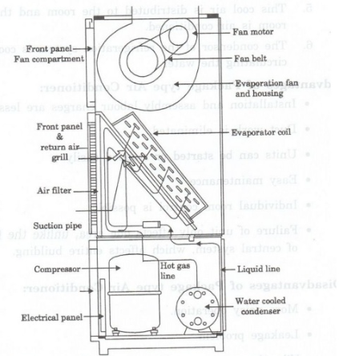
Packaged Air Conditioners
Self contained HVAC systems designed to provide both cooling and heating from a single unit.
Working Principle:
Cooling Mode:
The compressor compresses refrigerant, raising its temperature
and pressure. The high pressure refrigerant flows to condenser
coil; condensing into liquid and releasing heat to outside air.
The liquid refrigerant then passes through the expansion valve,
where its pressure drops & it partially evaporates, cooling down.
The cold refrigerant enters the evaporator coil, absorbing heat
from the room air as it evaporates completely. The cooled air is
blown back into the room by the indoor fan, while the
refrigerant returns to the compressor to repeat the cycle.
Heating Mode (for Heat Pump Systems):
The refrigeration cycle is reversed. The evaporator coil acts as a
condenser, releasing heat to the indoor air.
The condenser coil acts as an evaporator, absorbing heat from the outside air (or water). This process continues until the indoor spaces reaches the desired temperature.

Slide 61
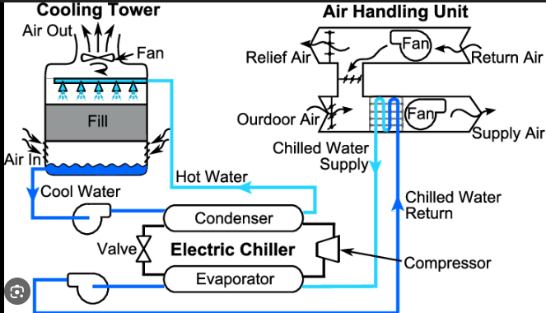
Chiller Plant Systems
Working Principle:
Chilling Cycle:
The chillers evaporator absorbs heat from the return chilled water, cooling it down. The refrigerant in the evaporator
absorbs this heat and evaporates. The compressor raises
refrigerant pressure and temperature. The refrigerant releases heat
in the condenser, either to ambient air (air cooled) or to condenser
water (water cooled). The high pressure refrigerant flows through
the expansion device, where its pressure drops and cools down
before evaporator.
Water Circulation
Chilled water is pumped from the chiller to the air handling unit or
fan coil units in the building. These units use the chilled water to
cool air, which is then distributed throughout the building. The
warmed water returns to the chiller to be cooled again.
Heat Rejection (for water cooled systems):
The condenser water absorbs heat from the refrigerant and is pump
to the cooling tower. The cooling tower releases this heat to the atmosphere through evaporation and sensible heat transfer. The cooled water returns to the chiller to absorb more heat.

Slide 62
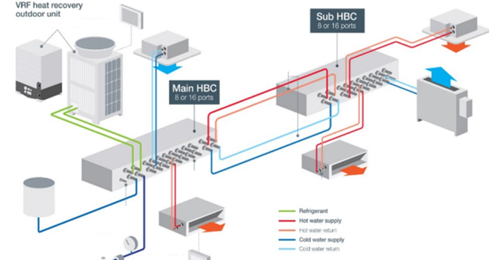
Variable Refrigerant Systems
Working Principle:
Cooling Mode:
The compressor in the outdoor unit compresses the refrigerant, raising temperature and pressure. The high pressure refrigerant flows through the condenser coil and condenses into
liquid. The liquid refrigerant then passes through the expansion
valve; pressure drops and partially evaporates. The cold refrigerant
enters the indoor units, absorbs heat from indoor air and cooling
the space. The warmed refrigerant returns to the outdoor unit to
repeat the cycle.
Heating Mode:
The refrigeration cycle is reversed. The indoor units acts as
Condensers, releasing heat to the indoor air. The outdoor unit acts
As an evaporator, absorbing heat from the outside air. This process
Continues until the desired temperature is reached.
Heat Recovery Mode:
The system simultaneously provides cooling to some indoor units while heating others. Excess heat from one area can be transferred to another area that requires heating, optimizing energy use.

Slide 63
Relevant Indian Standards
IS 1391 (Part 1) : 2017–Room Air Conditioners - Part 1 Unitary Air Conditioners) (Under Mandatory Certification)
Scope: This standard prescribes the constructional and performance requirements of non-ducted unitary air conditioners up to and including rated voltage of 240V and rated frequency of 50Hz. It also prescribes the test conditions and corresponding test procedures for determining various performance characteristics of unitary air conditioners which operate non frosting when cooling and dehumidifying at standard rating conditions. It also specifies unitary air conditioners which may also serve as heaters by heat pump/electric heater application.
IS 1391 (Part 2) : 2017–Room Air Conditioners - Part 2 Split Air Conditioners) (Under Mandatory Certification)
Scope: This standard prescribes the constructional and performance requirements of non-ducted split air conditioners up to and including capacity of 10500W, up to and including rated voltage of 240V for single phase and 415V for three phase and rated frequency of 50Hz. It also prescribes the test conditions and corresponding test procedures for determining various performance characteristics of split air conditioners which operate non frosting when cooling and dehumidifying at standard rating conditions. It also specifies split air conditioners which may also serve as heaters by heat pump/electric heater application.
IS/ISO 13043 : 2011 – Road Vehicles – Refrigerant systems used in mobile air conditioning systems (MAC) Safety Requirements conditioner
Scope: This standard is restricted to refrigerant systems providing cooling or heating of passenger compartment, battery, etc., in passenger motor vehicles. It provides minimum design requirements for refrigerant containment and safety requirements of these systems.

Slide 64
Relevant Indian Standards
IS/ISO 13261-1 : 1998 – Sound Power rating of air conditioning and air source heat pump equipment (Part 1 : Non ducted outdoor equipment)
Scope: It is applicable to the sound power rating of the outdoor sections of factory-made residential, commercial and
industrial air-conditioning and air-source heat pump equipment which are electrically driven with mechanical compression and which are intended to be installed outdoors.
IS/ISO 13261-2 : 1998 – Sound Power rating of air conditioning and air source heat pump equipment (Part 2 : Non ducted indoor equipment)
Scope: It is applicable to the sound power rating of the indoor sections of non-ducted, factory-made, residential, commercial
and industrial air-conditioning and air-source heat pump equipment, which are electrically driven with mechanical
compression including free-delivery heat pumps, packaged-terminal air-conditioners and water-source heat pumps.
IS 14618 : 2022– Automotive Vehicles – Air conditioning and heating systems thermal performance – Method of measurement
Scope: This standard covers the procedure for evaluating cabin cooling and heating performance of an automotive air conditioning and heating system and its compatibility with the engine. This standard does not apply to such automotive vehicles which are provided with a completely independent prime mover for the air conditioning system.

Slide 65
TERMINOLOGIES RELATED TO AIR CONDITIONERS AS PER IS 1391 (PART 1 & 2)
Standard Barometric Pressure: 1.01325 bar (760 mm of Hg) (clause 3.1.2)
Room Discharge Airflow: Rate of flow of air from the outlet of unit into the conditioned space (clause 3.1.3)
Room Intake Airflow: Rate of flow of air into the unit from the conditioned space. (clause 3.1.4)
Outdoor Discharge Airflow: Discharge rate of flow of air from the unit. (clause 3.1.5)
Outdoor Intake Airflow: Rate of flow of air into the unit from the outdoor-side (clause 3.1.6)
Exhaust Airflow: Rate of flow of air from the room side through the unit to the outdoor side (clause 3.1.7)
Total Cooling Capacity: The amount of sensible and latent heat that the unit can remove from the conditioned space in the definite interval of time. (clause 3.1.12)
Total Heating Capacity: The amount of heat that the unit can add to the conditioned space (but not including supplementary heater) in the definite interval of time. (clause 3.1.14)

Slide 66
Air Conditioner Test Parameters as per IS 1391 (1 & 2)
Production Routine Tests (Cl 12.2)
General running test (cl 12.2.1)
Leakage test (cl 12.2.1)
High voltage test (cl 12.2.3)
Leakage current test (cl 12.2.4)
Provisions for Earthing (Earth resistance test) (cl 12.2.5)
Type Tests (Cl 12.3)
Power factor test (Cl 9.3)
Maximum operating condition test (cl 9.4)
Freeze up test (cl 9.5)
Enclosure sweat test (cl 9.6)
Condensate disposal test (cl 9.7)
Power consumption test for cooling and heating (cl 9.8 and cl 9.9 respectively)
Cooling capacity test (9.10)
Heating capacity test (cl 9.11)
Maximum heating performance test (cl 9.13)
Sound pressure test (cl 9.14)

Slide 67
Air Conditioner Test Parameters as per IS 1391 (1 & 2)
Safety Tests (Cl 12.3.3)
Protection against access to live parts (cl 8 of IS 302 Part 1).
Electric strength (cl 13.3 of IS 302 Part 1)
Provision for earthing (cl 27 of IS 302 Part 1)
Electrical leakage current at operating temperature (cl 13.2 of IS 302 Part 1)
Acceptance Tests (Cl 12.4)
Performance test (cl 12.4.1)
Dry bulb temperature of return air
Dry bulb temperature of supply air
ISEER
Current consumption
Total power consumption
Voltage and power factor
Pressure test or leakage test (cl 12.4.2)
Leakage current test (cl 12.4.3)

Slide 68
AIR CONDITIONER TEST PARAMETERS AS PER IS 1391
GENERAL RUNNING TEST (as per Clause 12.2.1)
The air conditioner/heat pump shall be run by supplying the rated voltage and measure the power; which shall meet the limits as prescribed by the manufacturers when tested at prevailing ambient conditions.
LEAKAGE TEST (as per Clause 12.2.2)
There shall be no leakage in the refrigerator circuit when refrigerant charging.
HIGH VOLTAGE TEST (as per Clause 12.2.3)
The electrical insulation of all circuits shall be such as to withstand a test voltage of 1000V rms applied for not less than 1s when tested as per Annex A of IS 302 (Part 1).
LEAKAGE CURRENT TEST (as per Clause 12.2.4)
The leakage current shall not exceed 3.5 mA at rated voltage as per IS 302 (Part 1).
EARTH RESISTANCE TEST (as per Clause 12.2.5)
The Earth resistance of the unit shall not exceed 0.1 ohm when tested as per IS 302 (Part 1).

Slide 69
AIR CONDITIONER TEST PARAMETERS AS PER IS 1391
POWER FACTOR TEST (as per Clause 9.3)
When operating under full load capacity, the air conditioner shall have an overall power factor, measured at rated voltage and frequency of not less than 0.90.
MAXIMUM OPERATING CONDITIONS TEST (as per Clause 9.4)
During one entire test, the air conditioner shall operate without visible or audible indication of damage and without tripping.
The motor of air conditioner shall operate continuously for the first 1h of the test without tripping any protective devices.
FREEZE UP TEST (as per Clause 9.5)
During the test no ice shall drop from the unit, and no water shall drip or blow off from the unit on the room side.
ENCLOSURE SWEAT TEST (as per Clause 9.6)
During the test, no condensed water shall drip, run or blow off from the unit.

Slide 70
AIR CONDITIONER TEST PARAMETERS AS PER IS 1391
CONDENSATE DISPOSAL TEST (as per Clause 9.7)
During the test, the air conditioner shall have the ability to dispose off all condensate and there shall be no dripping or blowing off of water from the unit such that the building or surroundings may become wet.
POWER CONSUMPTION TEST FOR COOLING (as per Clause 9.8)
The power consumption under rated conditions shall not exceed by 10 percent of the declared value.
POWER CONSUMPTION TEST FOR HEATING BY HEAT PUMP (as per Clause 9.9)
The rate of power consumption for heat pump shall not exceed 110 percent of the rated energy for heating by heat pump.
COOLING CAPACITY TEST (as per Clause 9.10)
The capacity of the production unit as determined on the room side shall not be less than 95 percent of the nameplate rating.
HEATING CAPACITY TEST (as per Clause 9.11)
The measured standard heating capacity at full capacity shall not be less than 90 percent of rated value.

Slide 71
Procedure Flow Chart (IS 1391 Part 1)

Slide 72
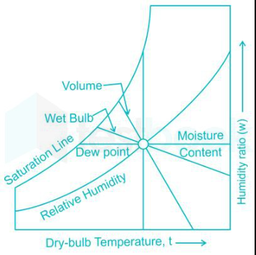
Psychrometry
Psychrometry is the study of the properties of air-water vapour mixtures. It is fundamental to the field of HVAC (Heating, Ventilation, and Air Conditioning) and many other applications where control of air properties is important.
Key Properties of Air and Moisture:
Dry Bulb Temperature (DBT): Temperature of air measured by
regular thermometer.
Wet Bulb Temperature (WBT): Temperature of air measured
by a thermometer with its bulb wrapped in a wet cloth.
Dew Point Temperature (DPT): Temperature at which air
becomes saturated and water vapour begins to condense.
Specific Humidity: Mass of water vapour per unit mass of dry
air (unit: g/kg)
Relative Humidity (RH): Ratio of current amount of water vapour
in the air to the maximum amount the air can hold at that
temperature, generally expressed in percentage.

Slide 73
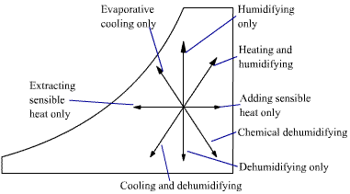
Psychrometric Processes
Sensible Heating & Sensible Cooling:
Involves changing the Dry bulb temperature of the air without changing its moisture content.
Humidification & Dehumidification:
Humidification adds moisture to the air (increasing specific humidity and often increasing DBT)
Dehumidification removes moisture from the air (decreasing specific humidity and often decreasing WBT)
Adiabatic Mixing:
Process of mixing two air streams at different conditions
without adding or removing the heat.
Evaporative Cooling:
Air is cooled by the evaporation of water, which increases
specific humidity but decreases the DBT.

Slide 74
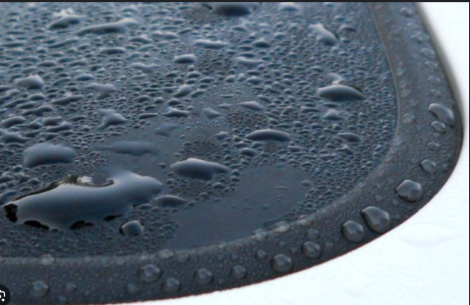
Application of Psychrometrics
HVAC Design:
Designing air conditioning systems to maintain desired indoor conditions.
Sizing and selecting equipment such as air handlers, fans and humidifiers.
Industrial Processes:
Controlling humidity and temperature for manufacturing processes (e.g. pharmaceuticals, electronics etc.)
Ensuring product quality and process efficiency.
Agriculture:
Maintaining greenhouse environments for optimal plant growth.
Controlling storage conditions for crops and produce.
Meteorology:
Understanding and predicting weather conditions and patterns.
Analyzing atmospheric moisture content and heat transfer.

Slide 75
Innovations in RAC Technology
Following are some key areas where significant advancements have been made in RAC Technology:
Energy Efficiency
Variable speed technology
Nano fluids as refrigerants
Environment Impact
Low global warming potential refrigerants
Natural refrigerants
Smart Technology
IoT and smart thermostats
Adaptive control systems
Health & Comfort
Improved air quality
Humidity control
Renewable Energy Integration
Solar powered air conditioning
Geothermal heat pumps
Advanced Materials Design
Enhanced insulation materials
Compact and light weight designs
Noise Reduction
Quiet operation technology
Inverter technology
Refrigeration Cycle Enhancing
Magneto-caloric Refrigeration
Thermo-electric Cooling

Slide 76
REFERENCES
SI. No. | IS No. & Year | TITLE
1. | IS 10594 : 2021 | Specification for Thermostatic Expansion Valves
2. | IS 10617 : 2018 | Hermetic compressors - Specification Second Revision
3. | IS 11327 : 2022 | Requirements for Refrigerants Condensing Units Second Revision
4. | IS 1391 (Part 1) : 2023 | Room Air Conditioners Specification Part 1 Unitary Air Conditioners Fourth Revision
5. | IS 1391 (Part 2) : 2023 | Room Air Conditioners Specification Part 2 Split Air Conditioners Fourth Revision
6. | IS 11329 : 2018 | Finned type heat exchanger for room air conditioner First Revision
7. | IS 11951 : 2024 | PUMPSET FOR DIRECT EVAPORATIVE AIR COOLER SPECIFICATION Second Revision
8. | IS 16590 : 2023 | Liquid Chilling Package Units - Specification First Revision
9. | IS 3315 : 2019 | Evaporative air coolers Desert Coolers - Specification Third Revision
10. | IS 4831 : 2019 | Recommendation on units and symbols for refrigeration First Revision
11. | IS 8148 : 2018 | Ducted and package air - Conditioners - Specification Second Revision

Slide 77
THANK YOU !!

