Slide 1
CHEMICAL ANALYSIS
OF METALS
Notes:
Why do we do chemical anaylsis of metals

Slide 2
Course content in B.E. Metallurgy
The subject is normally taught in the fourth semester of four year UG course on Metallurgy
A typical course content of Analytical techniques in metallurgy is given below
Course Outcome (CO)
CO1 Introduction to techniques in qualitative analysis.
CO2 Basic principle and method of colorimetric.
CO3 Knowledge of Absorptiometry electro gravimetric analysis.
CO4 Analysis of titration.
CO5 Principle of nuclear magnetic resource and its applications.
CO6 Study of thermal analysis, Thermodialatometry, scanning calorimetric.
CO7 Analysis of metals by physico and chemical method.
Reference Books
1 A Text Book of Metallurgical Analysis, B.C. Agrawal, S.P. Jain, Khanna.
2 Instrumental Methods of Analysis – G.W. Ewing, Mc-Hill.
3 A Text of Qualitative/Anatilative Analysis – A.1 YogelLonsgman.
4 Metallurgical Analysis – V.G. Iyer, Kohinoor.
5 An Introduction to Metallurgical Analysis – S.K. Jain Vikas.
6 Introduction to Thermal Analysis – M.E. Brown.
7 Undergraduate Instrumental Analysis – James W. Robinson.

Slide 3
CHEMICAL ANALYSIS
QUALITATIVE
METHOD
QUANTITATIVE METHOD
Notes:
What is the difference between qualitative and quantitative method.
Can you give example of these two type of methods

Slide 4
Qualitative Analysis
In qualitative analysis, the identity, not the amount of metal ions present in a mixture is determined. The technique consists of selectively precipitating only a few kinds of metal ions at a time under given sets of conditions.
Quantitative Analysis
Quantitative analysis is determining how much of each component there is in a given sample. The value can be written in a variety of units, including mass, volume, concentration, and relative abundance.
There are two methods in quantitative analysis which are:
Chemical methods – volumetric methods, titration methods, gravimetric methods, combustion analysis techniques etc
Instrumental methods methods – AES (Atomic emission spectroscopy), x-ray fluorescence spectroscopy, mass spectroscopy, and other techniques are examples.
Notes:
Have you studied any of these methods in your syllabus
Metallurgical Analysis book by B.C Agarwal and S.P. Jain

Slide 5
Standardization
For the various techniques mentioned in earlier slides Indian standards are available for chemical analysis of metals which include volumetric methods, gravimetric methods, instrumental methods like Spark OES, ICP etc.
A total number of 215 standards have been formulated by BIS on chemical analysis of metals .
As an example, In the forthcoming slides we shall discuss the various Indian standards formulated for determination of carbon content in steel.
We shall also study the format and various clauses of Indian standards and why it is important to follow the Indian standards in testing .

Slide 6
Some important terms used in a test method standard - IS/ISO/IEC GUIDE 99 : 2007
MEASURAND - quantity intended to be measured.
ACCURACY - closeness of agreement between a measured quantity value and a true quantity value of a measurand.
TRUE QUANTITY VALUE - true value of a quantity true value quantity value consistent with the definition of a quantity.
PRECISION - closeness of agreement between indications or measured quantity values obtained by replicate measurements on the same or similar objects under specified conditions .
CERTIFIED REFERENCE MATERIAL CRM - reference material, accompanied by documentation issued by an authoritative body and providing one or more specified property values with associated uncertainties and traceabilities, using valid procedures
REPEATABILITY - condition of measurement, out of a set of conditions that includes the same measurement procedure, same operators, same measuring system, same operating conditions and same location, and replicate measurements on the same or similar objects over a short period of time.
REPRODUCIBILITY - condition of measurement, out of a set of conditions that includes different locations, operators, measuring systems, and replicate measurements on the same or similar objects.
MEASUREMENT UNCERTAINTY - non-negative parameter characterizing the dispersion of the quantity values being attributed to a measurand, based on the information used
Notes:
What is difference between accuracy and precision
Can a measurement system be accurate but not precise, precise but not accurate, neither, or both
What is the difference betwenn LOD and LOQ
Whether LOD or LOQ will be higher.
Why is it important to know measurement uncertainty
What is measurand

Slide 7
Formulation of a test method standard
For the formulation of a test method standard first of all validation of the test method is done.
A sample of known purity is sent to different laboratories and they are advised to undertake the tests as per the test method proposed.
Based on the test results received the repeatability , reproducibility , degree of uncertainty of the test method standard is determined .
Any national/international standard on the test method standard can be formulated only after undertaking this validation studies.
The advantage of using any national/international standard is that the user need not again undertake validation studies and he can proceed with testing by undertaking the verification of the test method which is done using CRM, blank anaylsis, calibration etc and the requirements of IS/ISO/IEC 17025 are fulfilled
Notes:
Questions to be asked to students
How do you think test method standard is formulated .
Can we simply pick up any test method and put it in standard.
What is IS/ISO/IEC 17025
Why do you think validation and verification is required
What do you mean by CRM
What is difference between CRM and RM

Slide 8
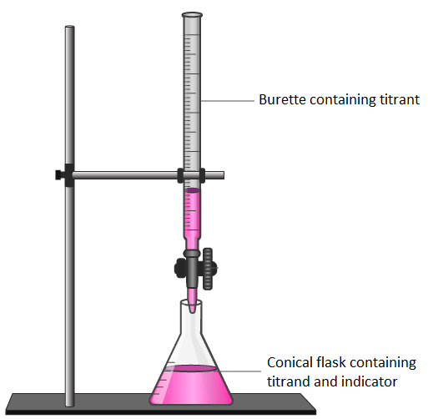
Volumetric Analysis
Volumetric analysis, which involves determining the concentration of a chemical in a solution by reacting a known volume of the solution with a solution of the material at a known concentration.
According to the law of chemical equivalence, substances react in the same ratio as their equivalent weight. This is the foundation of volumetric analysis. ‘Titration’ refers to the method used to do this kind of analysis.

Slide 9
Determination of percent carbon in steel – Volumetric method – IS 228 (Pt 1)
1 SCOPE
This standard (Part 1) covers volumetric method for determination of carbon in the range 0.05 to 2.50 percent in plain carbon, low alloy and high alloys steels.
2 REFERENCES
The following standards contain provisions, which through reference in this text, constitute provisions of this standard. At the time of publication the editions indicated were valid. All standards are subject to revision and parties to agreements based on this standard are encouraged to investigate the possibility of applying the most recent editions of the standards indicated below:
IS No. Title
IS 264 : 2005 Nitric acid — Specification (third revision)
IS 265 : 2021 Hydrochloric acid — Specification (fifth revision)
IS 6226 (Part 1) : 1994 Recommendations for apparatus for chemicals analysis of metals: Part 1 apparatus for determination of carbon by direct combustion (first revision)
Notes:
Have you undertaken this analysis
Can someone tell me the test method
Let us see what is the test method mentioned in standard
What additional things do you see mentioned in the standard

Slide 10
Determination of percent carbon in steel – Volumetric method – IS 228 (Pt 1)
3 SAMPLING
The sample shall be drawn as prescribed in the relevant Indian Standard. (The sample is cleaned with organic solvent like ether or acetone, dried in an air oven at 100 ºC ± 5 ºC before use).
4 APPARATUS
The apparatus recommended in IS 6226 (Part 1) may be used.
5 DETERMINATION OF CARBON BY VOLUMETRIC METHOD
5.1 Outline of the Method
The sample is burnt in a current of pure oxygen in presence of a suitable flux. Combustion of the sample in a stream of oxygen, thus converts all the carbon present to carbon dioxide. After removal of sulphurous gases by suitable absorbents, the carbon dioxide gas is collected in a specially jacketed burette along with excess of oxygen. The carbon dioxide is then absorbed in alkali. On passing the excess oxygen back to the burette, the contraction in volume is read against a scale, calibrated directly to the percentage of carbon.
Notes:
Have you undertaken this analysis
Can someone tell me the test method
Let us see what is the test method mentioned in standard
What additional things do you see mentioned in the standard

Slide 11
Determination of percent carbon in steel – Volumetric method – IS 228 (Pt 1)
5.2 Procedure
5.2.1 Before use the apparatus should be tested for satisfactory working against standard steel of appropriate values of carbon.
5.2.2 For Plain Carbon Steel
Take one gram of an accurately weighed and clean sample free from extraneous carbon in the form of small drillings or shavings in a porcelain boat which can withstand a temperature of 1 150 °C without breaking or cracking.
5.2.2.1 Introduce the boat into the hot combustion tube in the furnace kept at 1 000 ºC to 1 100 ºC.
5.2.3 For Low Alloy and High Alloy Steels
Take one gram of an accurately weighed and clean sample free from extraneous carbon in the form of small drillings or shavings in a porcelain boat, which can stand a temperature of 1 250 ºC without breaking and cracking. Spread 0.5 g of pure tin granules over the sample. In case of high alloy steel mix the sample with 0.5 g of pure iron (99.99 percent) filings also. Introduce the boat into the hot combustion tube in the furnace, kept between 1 150 ºC to 1 250 °C.
5.2.4 Close the furnace inlet with a rubber stopper, allow the sample to heat for one to one and a half minute. Regulate the flow of oxygen to 300 ml to 400 ml per minute into the furnace and establish connection with the burette, which has been previously filled with acidulated water/brine water coloured with methyl red, so that the liquid level in the bulbed portion of the gas burette does not fall rapidly. After a minute or so the level of water in the burette begins to fall more rapidly, though the same rate of oxygen is maintained, indicating completion of combustion.
5.2.5 Take readings, when the level reaches near the zero graduation mark after closing the bend way stopcock and equalizing the levels of the burette and the connected levelling bottle. Pass the collected and measured gas twice into the absorbing bulb, till constant reading is obtained, Record the burette reading. On the basis of one gram of sample taken for analysis, the burette is graduated to measure directly the percentage of carbon.
5.2.5.1 Examine the combustion boat for complete fusion of the sample, if not thoroughly fused, repeat the determination with a fresh sample.
Notes:
Have you undertaken this analysis
Can someone tell me the test method
Let us see what is the test method mentioned in standard
What additional things do you see mentioned in the standard

Slide 12
Determination of percent carbon in steel – Volumetric method – IS 228 (Pt 1)
5.3 Blank
Run a blank experiment on the same quantity of accelerators used, without any sample and make the appropriate corrections.
5.4 Calculation
Carbon, percent = (A − B) × F
where
A = burette reading after absorption of carbon dioxide in caustic potash with one gram of sample,
B = burette reading for the blank experiment, and
F = Correction teeter for temperature and pressure (see Table 1).
5.5 Reproducibility
± 0·01 percent up to 1.50 percent carbon, and
± 0·02 percent above 1.50 percent carbon.
Notes:
Have you undertaken this analysis
Can someone tell me the test method
Let us see what is the test method mentioned in standard
What additional things do you see mentioned in the standard

Slide 13
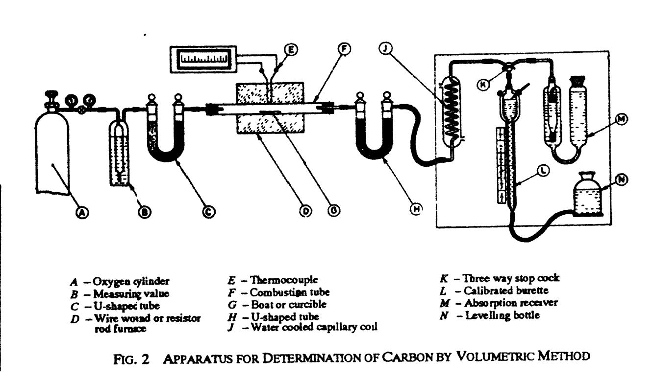
Apparatus as per IS 6226 (Pt 1) for Volumetric method
Notes:
Have you seen this apparatus

Slide 14
Apparatus for Volumetric method
Notes:
This is how it looks in your laboratory

Slide 15
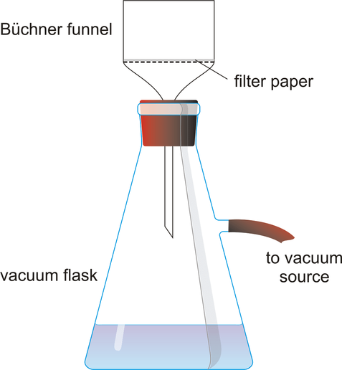
Gravimetric Analysis
Gravimetric analysis, a method of quantitative chemical analysis in which the constituent sought is converted into a substance (of known composition) that can be separated from the sample and weighed. The steps commonly followed in gravimetric analysis are:
preparation of a solution containing a known weight of the sample,
separation of the desired constituent,
weighing the isolated constituent, and
computation of the amount of the particular constituent in the sample from the observed weight of the isolated substance.

Slide 16
Determination of carbon in steel
(Gravimetric method) - IS 228 (Part 4)
Outline of the method — The sample is burnt in a stream of purified oxygen and the carbon dioxide formed is absorbed, after purification, in suitable absorbent.
The increase in weight of the absorbent represents carbon dioxide.
The standard contains clauses on scope, the outline of the method, Reagents, apparatus, sampling, procedure, calculation, and accuracy.
Notes:
Can somebody explain the gravimetric method of carbon anaylsis

Slide 17
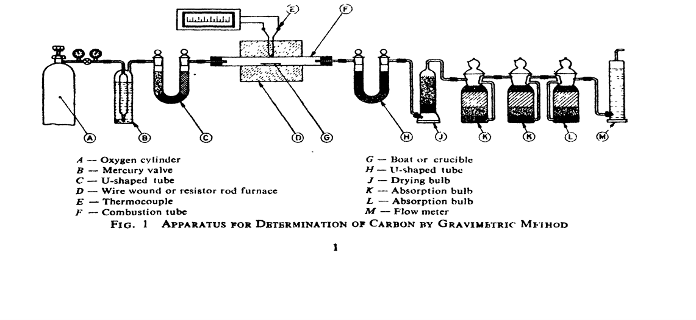
Apparatus as per IS 6226 (Pt 1) for Gravimetric method

Slide 18
Advantages of using standard
The method of test is similar to what is taught to you in syllabus However the standard has few more important points that makes it more useful.
The standard is in line with international standard and the test report giving reference to this standard shall be accepted world wide.
The standard not only standardize the test method but also standardize the test equipment
The standard also specifies the reproducibility value to ensure that the test done is accurate and precise.
The standard specifies the purity requirement of the reagents used, the flow rates to be maintained, and the consumable specification.
With all the above specified and the step wise procedure defined, the standard ensures that the results are accurate, reproducible and repeatable .
Notes:
Do you think that the test report giving reference to the text book shall be accepted world wide.

Slide 19
Instrumental Analysis
Instrumental analysis is a discipline within analytical chemistry, focusing on the development and application of sophisticated instruments to quantitatively and qualitatively measure the chemical composition of substances.
Instrumental analysis method comprises of techniques such as ICP-OES, Atomic Absorption Spectroscopy, Gas Spectroscopy, Spark Emission Spectroscopy and electrochemical techniques to achieve precise and sensitive detection of analytes etc.
Instrumental analysis techniques are quick, efficient and accurate.
Instruments can analyse multiple samples in a short period, making them suitable for high-throughput analyses.
Hence, instrumental analysis techniques are widely adopted by industries for chemical analysis of their products.
Notes:
What are the advantages and disadvantages of Instrumental analysis

Slide 20
COMPARISION AMONG DIFFERENT
INSTRUMENTAL ANALYSIS METHODS
Aspect | Spark OES | AAS | XRF | ICP-OES
Sample Type | Solid | Liquid (sample dissolution required) | Solid | Liquid (sample dissolution required)
Sample Preparation | Minimal | Extensive | Minimal to moderate | Extensive
Speed and Throughput | High | Low to Moderate | Moderate to high | Moderate
Quantitative Analysis | Highly accurate | Accurate but requires extensive calibration | Quantitative, lower precision for light elements | Highly accurate
Notes:
Which test equipment is available in your institute
How do you decide which equipment to use

Slide 21
Determination of carbon by thermal conductivity method – IS 228 (Pt 14)
Outline of the method — The sample is burnt in a stream of oxygen in presence of a metal accelerator.
The carbon dioxide formed is selectively adsorbed on the molecular sieve at a temperature and released by heating at 300ºC.
The detector is a thermistor cell which senses the difference between thermal conductivity of the carrier gas (with helium specially extra-low carbon and oxygen in other cases) and that of the carrier gas containing carbon dioxide.
The difference is proportional to carbon content of the sample.

Slide 22
Determination of carbon and sulphur by infrared absorption method - IS 228 (Pt 20)
Outline of the method — The sample is burnt with accelerator at high temperature in a flow of oxygen in a high frequency induction furnace.
The oxygen flow serves both as oxidizing agent and as system carrier gas. Carbon in the ample is converted to carbon dioxide and sulphur to sulphur dioxide.
These are carried by oxygen stream into the nondispersive infrared absorption analyzer where these gases are measured quantitatively.

Slide 23
Emission spectrometric analysis of plain carbon and low alloy steels (IS 8811)
The sample is excited by controlled spark/discharge using a point(counter electrode) to plane (polished flat surface of sample). The radiation from spark/discharge is dispersed by a quartz prism/grating.
The radiant energy (intensity) of the selected analytical lines are converted to electrical impulses by photomultiplier tube, which is amplified and stored in capacitor.
The charge from each capacitor is measured and converted into intensity ratios. The concentration of elements are calculated from analytical working curves prepared by exposing standard sample of similar type.
Notes:
What are the advantages of using spectrometric anaylsis as compared to gravimetric/volumetric method

Slide 24
Clauses in standard
The standard specifies
the requirements of the spectrometer such as wavelength, working conditions, electrical power tolerance to prevent radio frequency interference
the materials used for electrodes
provision of spart stand and argon system
purity of argon to be used
use of a triggered controlled high voltage capacitor discharge for precision and accuracy
measuring system
sample preparation method
standard samples to be used
calibration of the equipment and
procedure for testing

Slide 25
Importance of standardization
With standardization of the equipment's parts, calibration standards and method of tests, it is ensured that the sources of error are minimized and results are accurate .
It is also useful for the manufacturer to design the equipment.
It is useful to the purchaser that instead of mentioning all the detailed requirement, only the relevant standard number can be specified in the purchase order.
User can be ensured that following the test method specified the result will be repeatable and reproducible and the standard number quoted in the test result gives confidence to the recipient of test report that the testing has been done as per the standardized test method used .
Notes:
Can you explain how standardization of test method shall be useful to you

Slide 26
Compendium of method of chemical
analysis of steels – SP 71
As mentioned in earlier slides there are different methods available to users to determine a particular element.
Since these test methods are mentioned in separate standards, a special publication has been prepared which gives brief of all test methods available for a particular element, alongwith the relevant IS number.
This will facilitate the user as he can have idea of all the test methods available for a determination of particular element and depending upon the availability of reagents, apparatus and accuracy requirement he can choose the test method and then for details of test procedure, refer to the relevant Indian standard.

Slide 27
Test method standard for testing elements present in steel
As mentioned in earlier slides BIS has formulated standard for testing various elements in ferrous, non ferrous metals, refractories, foundry sand etc . As an example we will see here the list of standards formulated by BIS for testing various elements present in steel
Sr No | Element to be tested | Title of standard | Scope of the standard
1 | Carbon | IS 228 (Part 1) : 1987 Methods for chemical analysis of steels: Part 1 determination of carbon by volumetric method | This standard (Part 1) covers volumetric method for determination of carbon in the ~ It) range 0.05 to 2.50percent in plain carbon, low alloy and high alloys steels.
 |  | IS 228 (Part 4) : 1987 Method for chemical analysis of steels: Part 4 determination of total carbon by gravimetric method | This standard covers the method of determination of total carbon content of plain carbon, low alloy and high alloy steels of 0.1 percent and above by the gravimetric method.
 |  | IS 228 (Part 14) : 1988 Methods for chemical analysis of steels: Part 14 determination of carbon by thermal conductivity method (For Carbon 0.005 To 2.000 Percent | This standard covers a method for determination of carbon in all types of steels and alloys steels in the range of 0.005 to 2.000 percent
 |  | IS 228 (Part 20) : 2021 ISO 15350 : 2000 Methods for Chemical Analysis of Steels - Part 20 : Determination of Carbon and Sulphur by Infra Red Absorption Method (for Carbon 0.005 to 2 Percent and Sulphur 0.001 to 0.35 Percent) | This standard covers method for determination of carbon contents of mass fraction 0.005 % to 4.3 % and sulphur contents of mass fraction between 0.0005 % and 0.33 % by Infra Red Absorption Method

Slide 28
Test method standard for testing various elements present in steel
Sr No | Element to be tested | Title of standard | Scope of the standard
2 | Manganese | IS 228 (Part 12) : 2001 Methods for chemical of steels analysis: Part 12 determination of manganese by periodate spectrophotometric method in plain carbon, low alloy and high alloy steels (For Manganese 0.01 To 5.0 Percent) (Fourth Revision) | This standard (Part 12) describes the method for the determination of manganese in plain carbon, low alloy and high alloy steels in the range of 0.01 to 5.0 percent by periodate spectrophotometric method.
 |  | IS 228 (Part 2) : 1987 Methods for chemical analysis of steels part 2 determination of manganese in plain - Carbon and low alloy steels by arsenite method (Third Revision) | This standard ( Part 2 ) covers method for the determination manganese in plain carbon and low alloy steels by arsenite method.

Slide 29
Test method standard for testing various elements present in steel
Sr No | Element to be tested | Title of standard | Scope of the standard
3 | Silicon | IS 228 (Part 8) : 1989 Methods for chemical analysis of steels: Part 8 determination of silicon by the gravimetric method (For Silicon 0.05 To 5.00 Percent) | This standard (Part 8 ) covers the gravi- metric method for determination of silicon (0.05 to 5.00 percent ) in plain carbon and alloy steels including high speed steels containing tungsten.
 |  | IS 228 (Part 11) : 1990 Methods for chemical analysis of steels : Part 11 determination of total silicon by reduced molybdosilicate spectrophotometric method in carbon steels and low alloy steels (For Silicon 0.01 To 0.05 Percent) | This standard (Part 11) covers the spectrophotometric method for determination of total silicon in the range of 0.01 to 0.05 percent in carbon steels and low alloy steels.
4 | Sulphur | IS 228 (Part 9) : 1989 Methods for chemical analysis of steels : Part 9 determination of sulphur by evolution method (For Sulphur 0.01 To 0.25 Percent) | This standard (Part 9) covers method for determination of sulphur in plain carbon and low alloy steel by evolution method.
 |  | IS 228 (Part 20) : 2021/ ISO 15350 : 2000 Methods for Chemical Analysis of Steels - Part 20 : Determination of Carbon and Sulphur by Infra Red Absorption Method (for Carbon 0.005 to 2 Percent and Sulphur 0.001 to 0.35 Percent) | This standard covers method for determination of carbon contents of mass fraction 0.005 % to 4.3 % and sulphur contents of mass fraction between 0.0005 % and 0.33 % by Infra Red Absorption Method

Slide 30
Test method standard for testing various elements present in steel
Sr No | Element to be tested | Title of standard | Scope of the standard
5 | Phosphorus | IS 228 (Part 3) : 1987 Reviewed In : 2023 Methods for chemical analysis 6f steels: Part 3 determination of phosphorus by alkali metric method (Third Revision | This standard ( Part 3 ) covers method for determination phosphorus of content of plain carbon steel and alloy steels by alkali- metric method.
6 | C, Mn, Si, S, P and 13 more elements | IS 8811 : 1998 Method for emission spectrometric analysis of plain carbon and low alloy steels point to plane technique (First Revision) | This standard gives a generalised spectrometric analysis procedure for determination of Al, As, B, C, Cr, Co, Cu, Mn, Mo, Ni, Nb, P, Si, S, Sn, Ti, V and Zr when present as alloying element or as impurity in plain carbon and low alloy steels with a minimum iron content of 94 percent .

Slide 31
Need for standard on chemical analysis
Quality Control and Assurance
Uniformity
Reproducibility
Validated methods
Regulatory Compliance
Regulatory Standards
Traceability
Industrial and Commercial Application
Product Specification
Material Properties
Failure Prevention
International Trade and Marketability
International trade
Market acceptance

Slide 32
General Format of a test method standard
Scope
References
Terminology
Reagents
Apparatus
Sampling
Procedure
Calculation
Accuracy
Notes:
How this knowledge of the availability of different standard, importance of following standard shall be useful for you in future when you work in some organization

Slide 33
MTD 34 : Methods of Chemical Analysis of Metals Sectional Committee
Scope of the committee : Standardization in the field of chemical/instrumental analysis of ferrous, non-ferrous metals, ores and other raw materials
Total Number of test method standards formulated by this committee : 215

Slide 34
Some Important standards for chemical analysis of Metals
IS 228 (Part 1 to Part 24): Methods of Chemical analysis of Steel
IS 1493 (Part 1 to Part 13): Methods of chemical analysis of iron ores
IS 1559 (Part 1 to Part 7): Methods of chemical analysis of ferro silicon
IS 1760 (Part1 to 6) : Methods of chemical analysis of limestone, dolomite and allied materials
IS 1917 (Part1 to 7) : Methods of chemical analysis of Quartarzite and high silica sand.
IS 2000 (Part 1 to 9) : Method of chemical analysis of bauxite
IS 8811 Method for emission spectrometric analysis of plain carbon and low alloy steels point to plane technique
IS 12308 (Part 1 to Part 14): Methods of chemical analysis of cast iron and pig iron
IS 12614 (Part 1 to Part 7): Methods of chemical analysis of Ferro Molybodenum
SP 71 : 2012 : Compendium of method of chemical analysis of steels

Slide 35
Standard under development
Instrumental test methods for chemical analysis of Steel, Stainless steel, Aluminium, Copper, Ferro alloys etc
Programme of work of MTD 34 committee
Notes:
Show the student the standards under development and how they can comment on them .

Slide 36
Workshop
Steps involved in development of test method standard for determination of Manganese in steel
Identify the need of the standard .
For the literature survey, identify the test method to be standardized .
Identify the laboratories and inform them of the preparation of test method standard .
Involve various laboratories to test the standard samples by the proposed test method and obtain the repeatability , reproducibility and measurement uncertainty.
The test results are put forward to the Standard body technical committee where the experts, based on the above test results, finalize the test method and the degree of uncertainty of the method .
The certified reference material is also finalized for verification of the test method by the user , prior to test .
Notes:
Ask the student to write down the steps and give them 10-15 minutes time. Then discuss.

Slide 37
Why this session is being conducted
In future when you start working in a metallurgical firm , you should be aware that it is important to follow the standardized test method for chemical analysis.
You should be aware that BIS has formulated more than 200 test method standard and how you can login and find the test method standard relevant to the element to be tested . In case the same is not available, what are the steps required for formulation of new test method standard .
In the test report being issued to the customer , you should be able to give reference to the standard as per which the product has been tested .
In case you are purchasing a raw material, you can ask the vendor to give the test report as per the specified Indian standard so that you are sure of the results reported.
In case of new firm, the standard will provide you help in purchasing of test equipment and consumables.
Using the CRM specified in the standard you can verify the proper functioning of the test equipment and competence of the testing person.
Notes:
How this knowledge of the availability of different standard, importance of following standard shall be useful for you in future when you work in some organization

Slide 38
THANK YOU
3

