Slide 1
Thin pressure vessel —
Gas Cylinders

Slide 2
INTRODUCTION TO PRESSURE VESSELS
Pressure vessels are containers designed to hold gases or liquids at a pressure substantially different from the ambient pressure.
These vessels must withstand internal or external pressures, considering factors such as material strength, temperature, and corrosion resistance, and are often constructed using steel, stainless steel, or composite materials.
The construction involves welding, riveting, or forging, with a focus on ensuring the integrity of joints and seals, and includes safety features like pressure relief valves.

Slide 3
INTRODUCTION TO PRESSURE VESSELS
They are used in many industries, including the chemical, energy, and food and beverage sectors, for applications such as reactors, storage tanks, and boilers.
Regular inspections and maintenance, employing non-destructive testing methods, are crucial for safe operation, making pressure vessels reliable and essential components of modern industrial processes.
Pressure vessels are further categorized into two main categories:
Thin Pressure Vessels: If wall thickness is less than 1/20th of the diameter (t < D/20)
Thick Pressure Vessels: If wall thickness is comparable to or greater than 1/20th of the diameter (t ≥D/20)

Slide 4
THIN PRESSURE VESSELS
Thin pressure vessels are essential components in many industrial applications where moderate pressures are required. Their design involves understanding the stresses involved, careful material selection, and adherence to safety standards. Despite their limitations in handling extremely high pressures, they offer numerous advantages in terms of cost, weight, and ease of fabrication, making them a practical choice for many uses.
Key Characteristics
Simplified Stress Analysis — Due to the small wall thickness, the stress across the wall is nearly uniform, allowing the use of simplified formulas for stress calculations.
Efficiency in Material Use — Thin-walled vessels are designed to maximize the use of material strength, resulting in efficient designs that use less material compared to thick-walled vessels.
Economic Advantage — The reduced material requirements and simpler manufacturing processes make thin-walled pressure vessels more cost-effective for many applications.

Slide 5
STRESS ANALYSIS OF THIN – WALLED PRESSURE VESSELS

Slide 6
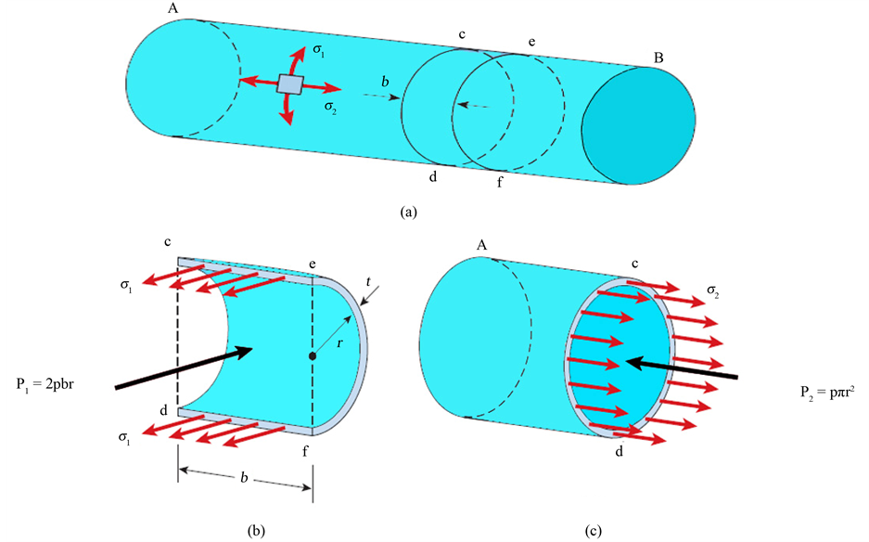
Radial Stress
Radial stress is the stress exerted perpendicular to the wall. In thin-walled vessels, radial stress is negligible compared to hoop and axial stresses.
Stress in Thin Cylinders

Slide 7
Hooke’s Law
Hooke’s Law is relevant in understanding the behaviour of materials under stress, particularly in defining material properties and elasticity.
YIELD STRENGTH
Yield strength is the stress at which a material begins to deform plastically.
Material Specifications: Yield strength for materials used for manufacturing cylinders must be minimum 240 N/mm2 as per clause 4 of IS 3196 (1).
Design and construction: As per clause 6 of IS 3196 (1), yield strength is used to calculate the wall thickness of cylinders in order to ensure safety and durability.
Testing and Quality Control: As per clause 18 of IS 3196 (1), the observed yield strength during the acceptance test of the material shall not be less than that specified.

Slide 8
Hooke’s Law
Percentage Elongation / Strain
Percentage elongation is a measure of a material's ductility, indicating how much a material can stretch before breaking. It is expressed as a percentage and is calculated using the formula:
where:
Lf is the final length of the specimen after fracture.
Lo​ is the original gauge length of the specimen.
Material Specifications: As per clause 4 of IS 3196 (1), minimum percentage elongation required for materials for cylinder manufacturing should be 25 %.
Testing and Quality Control: As per clause 18 of IS 3196 (1), the observed percentage elongation during the acceptance test of the material shall not be less than that specified.

Slide 9
Hooke’s Law
TENSILE STRENGTH
Tensile strength is a measure of the force required to pull something to the point where it breaks. It is an important property of materials used in various engineering applications, including the manufacture of high-pressure cylinders.
Material Specifications: As per clause 4 of IS 3196 (1), minimum tensile strength required for materials for cylinder manufacturing should be 350 N/mm2.
Design and construction: As per clause 6 of IS 3196 (1), tensile strength is used to calculate the necessary wall thickness and overall design to prevent failure under pressure.
Testing and Quality Control: As per clause 18 of IS 3196 (1), the observed tensile strength during the acceptance test of the material shall not be less than that specified.

Slide 10
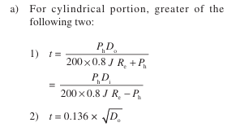
Design Calculations – Wall Thickness
Designing thin pressure vessels, such as gas cylinders, involves applying principles of mechanical engineering and materials science to ensure safety, functionality, and durability.
As per Clause 6 of IS 3196(1), wall thickness is calculated on the basis of maximum allowable stress and internal subjected pressure. Given below:
As per clause 6.2.2, minimum wall thickness shall not be less than 2 mm for cylinders upto and including 13 L water capacity and not less than 2.4 mm for cylinders above 13 L water capacity.
where, t is calculated min. wall thickness of cylindrical wall
tc is calculated min. wall thickness of semi-ellipsoidal ends
Ph is test pressure in kgf/cm2
Di is inner diameter
Do is outer diameter
J is weld joint factor
Rc is yield strength
ho is external height of domed ends
hi is internal height of domed ends

Slide 11
MANUFACTURING PROCESS OF LPG CYLINDERS

Slide 12
Manufacturing
FORGING
Forging is a manufacturing process used to shape metal by applying compressive forces, which can be crucial in producing components like thin cylinder vessels or gas cylinders.
As per clause 4.2 of IS 3196 (1), the bung/valve pad shall be hot forged from rolled steel bars.
Hot forging is a metalworking process where metal is deformed at elevated temperatures, typically above 60% of its melting temperature. This process is particularly useful for shaping materials that are difficult to work with at room temperature, such as certain alloys and high-strength steels.
Also, as per clause 4.2 of IS 3196 (1), the bung machined from hot forging process shall be free from surface defects such as fissures, surface cracks, porosity, laminations, pinholes etc.

Slide 13
Manufacturing
ROLLING
The rolling process is a metalworking technique used to reduce the thickness of a material or to shape it into a desired form by passing it through rolls. For thin cylinder vessels or gas cylinders, rolling is a key process in producing cylindrical shells.
As per clause 4.2 of IS 3196 (1), the bung shall be made from the rolled steel bars (as per IS 2062 : Hot rolled medium and high tensile structural steel).
Also, as per clause 8.2, the edges of the plate forming the longitudinal joint of the shell shall be made by rolling and not by blows, to form the required curvature.

Slide 14
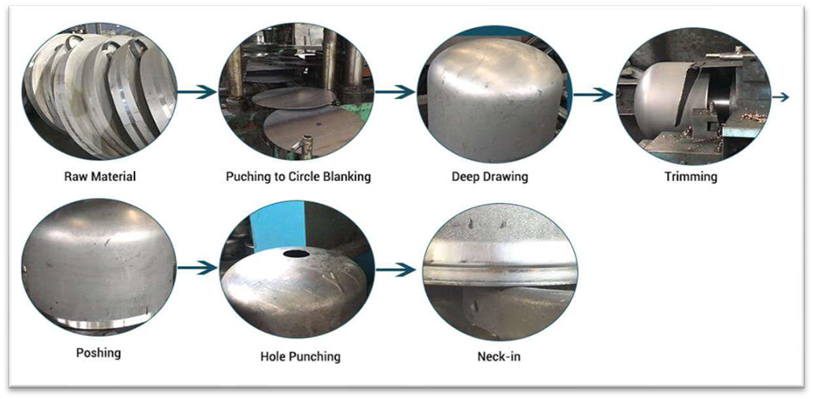
Manufacturing
DRAWING
The drawing process is a metalworking technique used to form thin cylinder vessels or gas cylinders by stretching a sheet or plate into the desired shape. This process is crucial for producing components with precise dimensions and smooth surfaces.
As per clause 6.1 of IS 3196 (1), the cylindrical portion shall be cold or hot drawn or pressure formed cylindrical portion with hemi-spherical, ellipsoidal or tori-spherical ends welded to it.

Slide 15
Manufacturing
THREADING
The threading process is essential for creating threaded openings or connections in thin cylinder vessels, such as gas cylinders. Threading is used to provide secure, detachable connections for fittings, valves, and other components.
As per clause 9.1.1 of IS 3196 (1), the bung threads shall be cleaned using a machine tap of the same thread profile as bung threads.
As per clause 10.3 (Annex B) of IS 3196 (1), the bung threads shall be of smooth finished and shall not be broken at any point.
As per clause 7.1 of IS 8737 (valve fittings for use with LPG), all the valves shall have taper threads at inlet.
As per clause 7.6 of IS 8737, all valve with threaded outlet connections shall be provided with suitable security nuts to prevent damage to threads and leakage of gas. All valves without threaded outlet connections shall be provided with suitable security taps.

Slide 16
Manufacturing
WELDING
Welding is a process of joining materials, typically metals or thermoplastics, by causing coalescence. It is a crucial technique used in the manufacturing of high-pressure cylinders, ensuring structural integrity and durability.
Welding Procedures: Clause 7 of IS 3196 (1) specifies the welding procedures to be followed for cylinder construction, ensuring consistency and quality.
As per clause 7.3 of IS 3196 (1), manual arc welding shall not be employed for circumferential seam which shall consist of a joggle joint so that the external surface of the container is smooth.
Thin pressure vessels (generally gas cylinders) are generally manufactured either by Metal Inert Gas (MIG) welding or Submerged arc welding

Slide 17
Manufacturing
METAL INERT GAS (MIG) WELDING
MIG welding, also known as Gas Metal Arc Welding (GMAW), is a welding process in which an electric arc forms between a consumable wire electrode and the work piece, heating the metals and causing them to melt and join. A shielding gas (typically argon or a mixture of gases) is used to protect the weld pool from contamination.
As per clause 7.8.2 of IS 3196 (1), the fusion of the welded metal with the parent metal shall be smooth and free from overlapping, under cutting or abrupt irregularity.
SUBMERGED ARC WELDING
Submerged Arc Welding (SAW) is a common welding process that involves the formation of an arc between a continuously fed electrode and the work piece. The arc is submerged under a blanket of granular flux, which protects the weld pool from atmospheric contamination, improves weld quality, and increases deposition rates.
As per clause 7.8.2 of IS 3196 (1), there shall be no cracks, notching or porous patches in the welded surfaces and the surface adjacent to the weld. The welded bead shall not be concave.

Slide 18
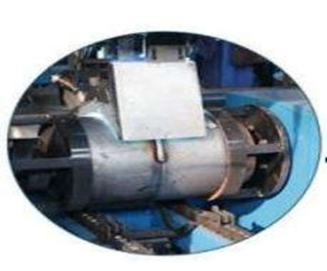
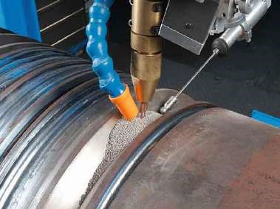
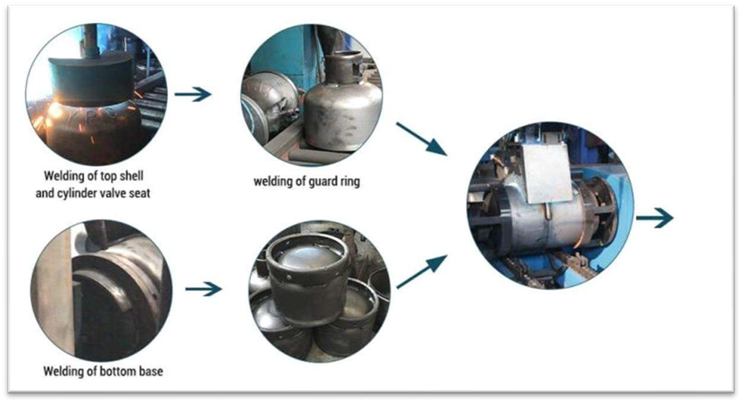
Submerged Arc Welding
MIG Welding

Slide 19
Heat Treatment
NORMALIZING
Normalizing of cylinders is compulsory if manufactured from the steel as per IS 15914 (High tensile strength flat rolled steel plate (up to 6 mm) sheet and strip for the manufacturer of welded gas cylinder.
Heat treatment in which, a cylinder is heated to uniform a temperature above the upper critical point of the steel to regenerate or to homogenize the metallurgical structure of the steel and then cooling in a controlled or still air atmosphere as per clause 3.1 of IS 3196 (1).
As per 11.1 of IS 3196 (1), all cylinders shall be efficiently and uniformly normalized or stress relieved.
As per clause 20.2, letter N next to IS number if the cylinder is normalized

Slide 20
Heat Treatment
STRESS RELIEVING
Stress relieving is a heat treatment process used to reduce residual stresses in materials that have been introduced during manufacturing processes such as welding, machining, or casting. This process involves heating the material to a specific temperature below its critical point, holding it at that temperature, and then cooling it slowly. Stress relieving helps to minimize the risk of distortion, cracking, and premature failure in high-pressure applications as per clause 3.2 of IS 3196 (1)
As per 11.1 of IS 3196 (1), all cylinders shall be efficiently and uniformly normalized or stress relieved.
As per clause 20.2, letter N next to IS number if the cylinder is normalized

Slide 21
Heat Treatment
STABILIZING
Heat treatment given to a cylinder, in order to stabilize the structure of the steel by heating to a uniform temperature below the upper critical point of the steel and subsequently cooled to obtain the desired mechanical properties as per clause 3.2 of IS 3196 (1).
CRITICAL TEMPERATURE
The temperature at which phase or magnetic changes takes place as per clause 3.3 of IS 3196 (1).
Clause 6 of IS 3196 (1), includes thermal considerations during welding, including preheating and post-weld heat treatment, to ensure the material does not exceed its critical temperature, preventing undesirable phase transformations.

Slide 22
FINISHING
Circularity: As per clause 8.5.1 of IS 3196 (1), The out-of-roundness of the cylindrical shell shall be limited so that the difference between the maximum and the minimum outside diameter in the same cross-section is not more than 1 percent of the mean of these diameters, for two-piece cylinders, and 1.5 percent for three-piece cylinders. The measurement shall not be taken over any of the welds but shall be taken adjacent to the welds.
Surface Defects: As per clause 8.5.2 of IS 3196 (1), the internal and external surfaces of the cylinder shall be free from defects which will adversely affect the safe working of the cylinder.
Straightness: as per clause 8.5.4 of IS 3196 (1), the maximum deviation of the shell from a straight line shall not exceed 0.3 percent of the cylindrical length.

Slide 23
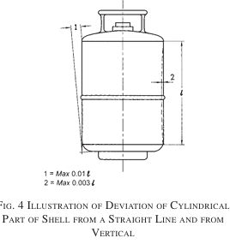
FINISHING
Profile Regularity: As per clause 8.5.3 of IS 3196 (1), the contour of dished end shall not deviate from the approved dimensions by more than 1.25 percent of the nominal diameter in respect of radial dimensions and by more than 1 percent in respect of axial dimensions. Such deviations shall not be abrupt changes and shall be outside the specified shape.
Verticality: As per clause 8.5.5 of IS 3196 (1), Deviation from vertical shall not exceed 10 mm/m length.

Slide 24
ZINC COATING
Zinc coating, also known as galvanizing, involves applying a layer of zinc to steel or iron to protect it from corrosion.
This is commonly achieved through methods such as hot-dip galvanizing, electro-galvanizing, and zinc spraying
Zinc acts as a sacrificial anode, meaning it will corrode in place of the underlying metal, thereby providing long-term protection.
Requirements for zinc coating thickness: As per clause 23.2 of IS 3196 (1), the outside surface of cylinder shall be coated by spraying zinc to a minimum thickness of 37 microns.
Requirements for zinc coating quality: Zinc wire used for spraying shall be as per IS 12447 (Zinc and zinc alloy wire for thermal spraying - Metallizing)
Method of zinc coating: zinc spraying to be done as per IS 6586 (Recommend practice for metal spraying for protection of iron steel).

Slide 25
POWDER COATING
Powder coating is a finishing process in which a dry powder, typically made of polymer resin, is applied to a metal surface and then cured under heat to form a protective layer.
This process provides a durable, high-quality finish that is resistant to corrosion, chipping, and scratching.
Powder coating is environmentally friendly since it does not involve solvents.
Requirements for powder coating: As per clause 23.2 of IS 3196 (1), the cylinder shall be powder coated conforming to IS 13871 of signal red colour.
Requirements for powder coating thickness: As per clause 23.2 of IS 3196 (1), the powder coating shall have a thickness of minimum 30 microns.

Slide 26
TESTS
RADIOGRAPHIC TEST
Radiographic testing (RT) is a non-destructive testing (NDT) method used to examine the internal structure of materials and components.
This technique utilizes X-rays or gamma rays to create images of the internal features, revealing any defects such as cracks, voids, or inclusions that may not be visible on the surface.
For Designing Cylinder (thickness): as per clause 6.2.1 of IS 3196 (1), weld joint factor for calculation of cylinder thickness is 1.0 (if each weld is to be fully radiographed); 0.9 (for cylinders with circumferential seam or seam only (not radiographed); 0.9 (for cylinders with seams other than circumferential which are spot radiographed).
As per clause 13.1 of IS 3196 (1), radiographic technique used shall be sufficiently sensitive to reveal a defect having a thickness equal to 2 percent of the combined thickness of the weld and the strip.

Slide 27
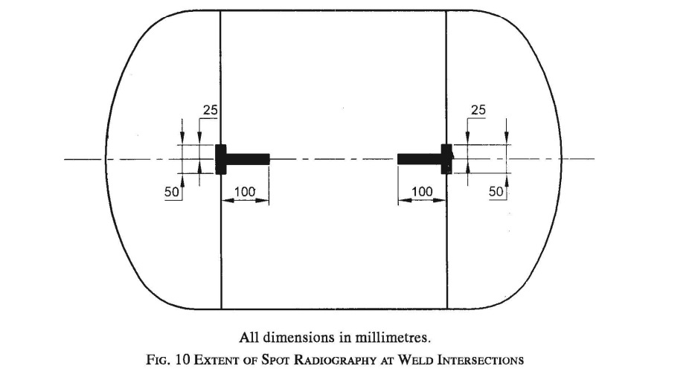
TESTS
RADIOGRAPHIC TEST
Spot Radiography: It is a specific type of radiographic testing focused on inspecting critical areas or sections of a component rather than performing a full radiographic examination. This method is often used to evaluate weld quality, particularly in high-stress areas, ensuring that no significant defects are present that could compromise the integrity of the component. (as per clause 13.2 of IS 3196 (1) and clause 10 of IS 3196 (3).

Slide 28
TESTS
HYDROSTATIC TEST
A hydrostatic test is a type of pressure test conducted to verify the integrity and strength of pressure vessels, such as high-pressure cylinders.
Test Principle: The test involves filling the cylinder with water (or another incompressible fluid) and pressurizing it to a level higher than its normal operating pressure. (clause 15.1 of IS 3196 (1)).
Test Pressure: The internal pressure required for the hydrostatic test and the hydrostatic stretch test of the cylinders (clause 3.5 of IS 3196 (1).
As per clause 6.2.1 of IS 3196 (1), for calculating thickness of cylinder (designing parameter), hydrostatic test pressure for LPG with vapour pressure not exceeding 16.87kg/cm2 (gauge) at 15 deg. Celsius shall be taken as 25 kg/cm2.

Slide 29
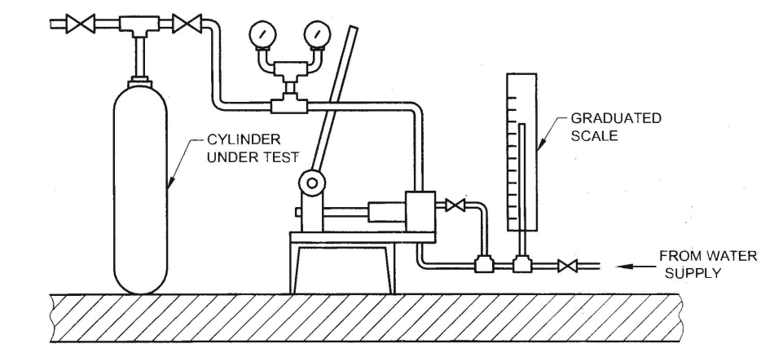
TESTS
HYDROSTATIC TEST
This helps identify leaks, structural weaknesses, and ensure the cylinder can safely withstand its intended operating conditions.
Marking: Each cylinder shall be permanently stamped with test pressure value (in MPa) along with the date at which test was conducted.

Slide 30
TESTS
PNEUMATIC LEAKAGE TEST
A pneumatic leakage test is a method used to detect leaks in pressure vessels and piping systems by pressurizing them with air or another gas and checking for pressure drops or escaping gas.
This test is often used as an alternative or complement to hydrostatic testing, particularly in situations where using water is impractical or could cause contamination or damage to the system.
Test Method and Requirements: Cylinder shall be subjected to an air pressure of 1.180 MPa (12 kgf/cm2) for a period of 1 min while being immersed in a water and shall not show any leakage from the body of cylinder and valve pad joint (clause 16.1 of IS 3196 (1) and clause 8.1 of IS 3196 (3).

Slide 31
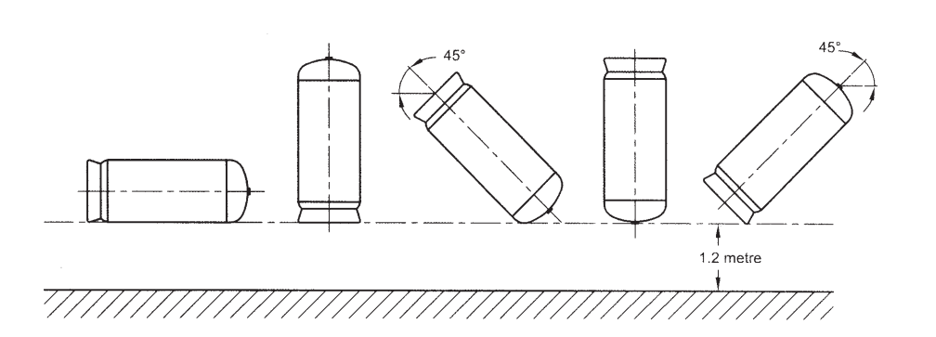
TESTS
DROP TEST
Drop tests are a type of mechanical testing used to evaluate the impact resistance and durability of pressure vessels, such as high-pressure cylinders.
During a drop test, the cylinder is dropped from a specified height which is 1.2 meter onto a hard surface to simulate the conditions it might experience during handling, transportation, or accidental drops. (clause 9.3.4 and 19 of IS 3196 (1)
The test assesses the cylinder's ability to withstand impact without sustaining significant damage or losing its structural integrity.

Slide 32
TESTS
IMPACT TEST
Impact testing is a method used to determine the toughness and ability of a material to absorb energy during plastic deformation.
It evaluates how a material behaves under sudden and forceful impacts, which is critical for assessing its performance in real-world applications where unexpected impacts can occur.
The strikers (flat surface and edge) shall be of metallic materials having a hardness higher than that of the cylinder and sufficiently robust to prevent the impact energy being absorbed by deflection of the striker. (clause 19 of IS 3196(1)).
Two types of Impact test: Flat surface Impact test and Edge Impact Test

Slide 33
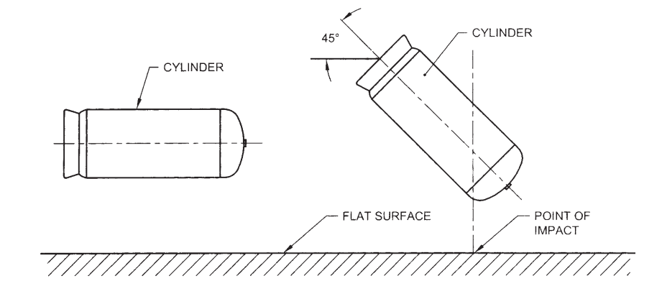
TESTS
FLAT SURFACE IMPACT TEST (Annex C, Cl 19 of IS 3196 (1))
The striker shall be a flat surface with a length equal to the overall cylinder length and width equal to the cylinder diameter.
The impact energy, F, is determined by: F = 30 M
where, F is energy (joules) and M is max operating mass of cylinder (kg)
The striking velocity shall be between 7 m/s and 8 m/s.

Slide 34
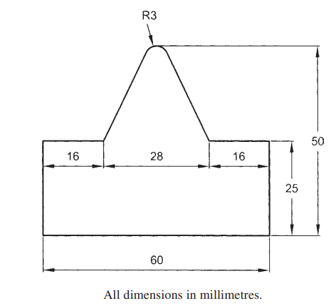
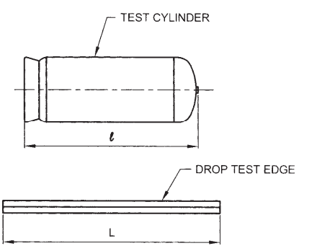
TESTS
EDGE IMPACT TEST (Annex C, Cl 19 of IS 3196 (1))
The impact energy, F, is determined by: F = 12 M
where, F is energy (joules) and M is max operating mass of cylinder (kg)
The striking velocity shall be between 4 m/s and 5 m/s.
Striker Profile Edge Impact Test

Slide 35
TESTS
FATIGUE TEST / CYCLE TEST
Fatigue testing is a method used to determine the durability of a material under cyclic loading.
This type of testing is essential for understanding how materials behave under repeated stress over time, which is crucial for predicting the lifespan and performance of components in real-world applications.
Fatigue failure can occur even at stress levels lower than the material's ultimate tensile strength, making this testing critical for ensuring long-term reliability and safety.
As per clause 17.1.2 of IS 3196 (1) and clause 9.3 of IS 3196 (3), Fatigue test shall be carried out as type test an upper cyclic pressure either:
Equal to two thirds of the test pressure; 80000 cycles without failure.
Equal to test pressure; 12000 cycles without failure.

Slide 36
TESTS
BURST TEST
A burst test is a type of pressure test used to determine the maximum pressure that a pressure vessel, such as a high-pressure cylinder, can withstand before failure.
This test involves increasing the internal pressure of the cylinder until it bursts, thereby identifying the ultimate strength and failure point of the material and construction. The rate of pumping shall not exceed five times the water capacity of the cylinder per hour (166.5 ltr/hr) (clause 17.2.1 of IS 3196 (1)).
The results of the burst test help ensure that the cylinders have adequate safety margins for their intended applications.
Burst Pressure: Highest pressure reached in a cylinder during the burst test (clause 3.6 of IS 3196 (1)).

Slide 37
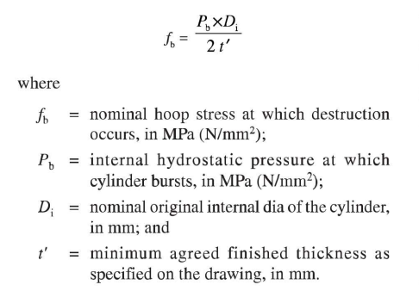
TESTS
BURST TEST
Minimum Test Requirement: As per clause 17.2.3 of IS 3196 (1), the measured bursting pressure shall not under any circumstances be less than 225 percent of the test pressure (56.25 kgf/cm2)
Design Parameter: As per clause 9.1.2 of IS 3196 (3), the nominal hoop stress corresponding to the pressure at which destruction occurs shall be calculated from the formula given below:

Slide 38
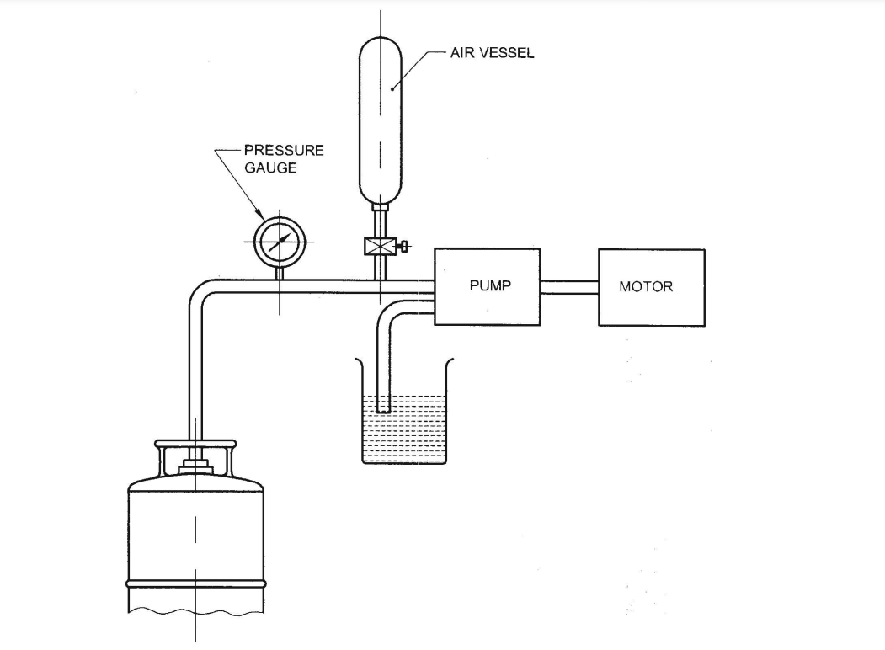
TESTS
BURSTS TEST APPARATUS

Slide 39
TESTS
ACCEPTANCE TEST
Acceptance tests for gas cylinders are crucial to ensure their safety, reliability, and performance before they are put into service. (as per clause 18 of IS 3196(1) and clause 5 of IS 3196(3)).
These tests verify that the cylinders meet all regulatory, safety, and quality standards.
Parent Metal Testing: for 2 piece cylinders, one tensile test in longitudinal direction and one tensile test in transverse direction.
Weld Metal Testing: for 2 piece cylinders, one tensile test, one root bend test and one face bend test to be taken across circumferential weld.

Slide 40
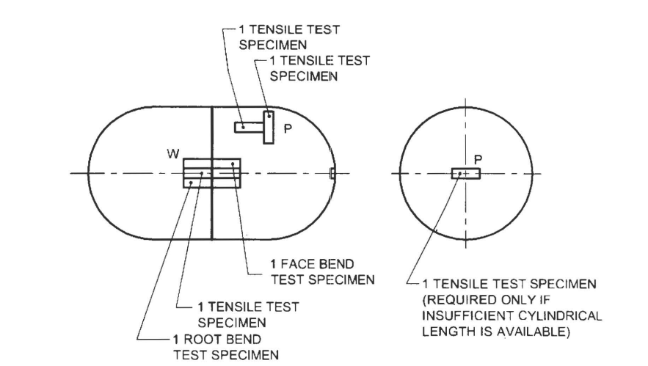
TESTS
PARENT METAL TENSILE TESTS
Tensile strength : 350 – 450 N/mm2
Yield Strength : 240 N/mm2 (min)
Percentage Elongation : 25 % (min)

Slide 41
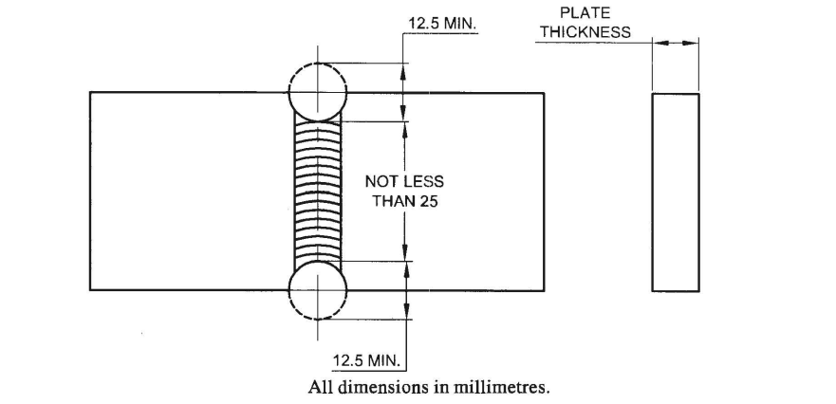
TESTS
TENSILE TEST ON WELD JOINT
Tensile strength : 350 N/mm2 (min)

Slide 42
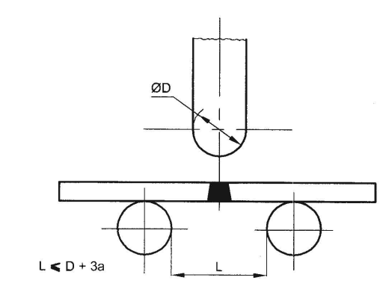
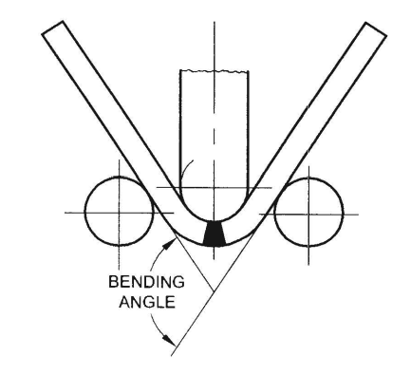
TESTS
BEND TESTS ACROSS WELD

Slide 43
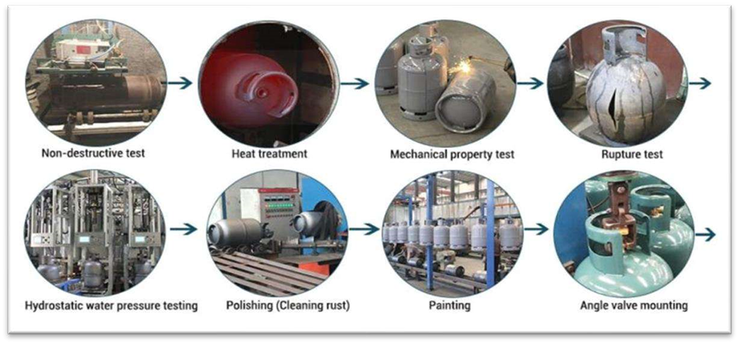

Slide 44
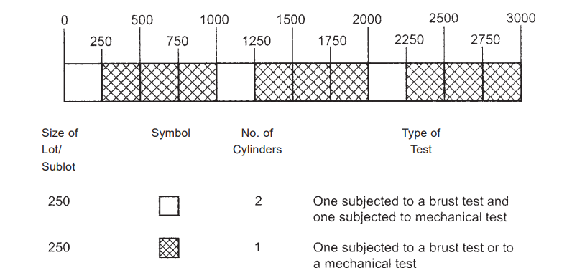
SAMPLING STATISTICS
As per clause 3.7 of IS 3196 (1), a batch shall consist of finished cylinders not exceeding 3000 cylinders made consecutively by the same manufacturer using the same manufacturing technique. A batch shall contain material of one cast only.
Samples (sub-lot of 250 cylinders) taken for mechanical or burst test shall be alternated between mechanical and bursts tests.

Slide 45
DIFFERENT TYPES OF GASES AND THEIR STORAGE METHODS

Slide 46
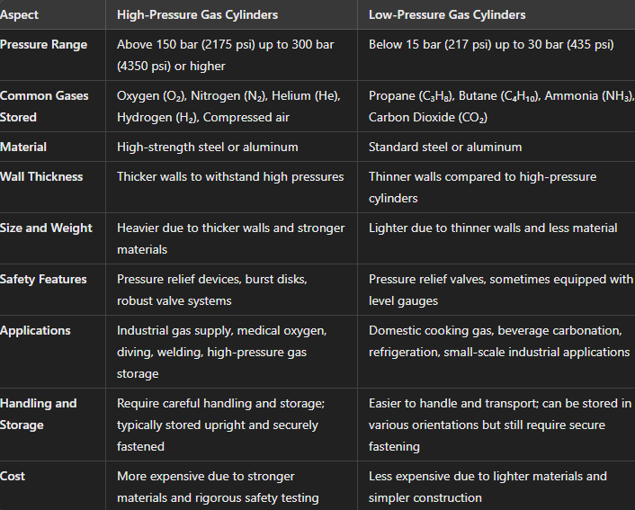
HIGH PRESSURE VS LOW PRESSURE GAS CYLINDERS

Slide 47
Thank You!

