Slide 1
Pumps and Indian standards
BUREAU OF INDIAN standards

Slide 2
What you know

Slide 3
Academic syllabus
Appreciate the classification of Pumps
Classify pumps: Positive displacement, Roto-Dynamic (constant head) pumps
Comprehend the working of centrifugal and reciprocating pumps
Explain the different types of casing of centrifugal pumps
State the equations for work done, power and efficiencies of centrifugal pump
Explain the specific speed of centrifugal pumps
Explain the selection of centrifugal pumps based on specific speed and head
Describe the Concept of NPSH – (Net Positive Suction Head)
Explain the cavitation and priming in centrifugal pumps.
Illustrate the Performance curves of centrifugal pumps - w.r.t to the effect of speed on discharge, head & power
Distinguish static head & dynamic head required for a system of pumping system.
Explain the System characteristic curve of a pumping system
State the equations for finding discharge
Explain the slip and significance of negative slip
State the equations for power required to drive a reciprocating pump

Slide 4
What is a Pump?
A pump is a device that moves fluids (liquids or gases) by mechanical action. Pumps operate by creating a pressure difference across the fluid, which causes the fluid to flow from regions of higher pressure to lower pressure.

Slide 5
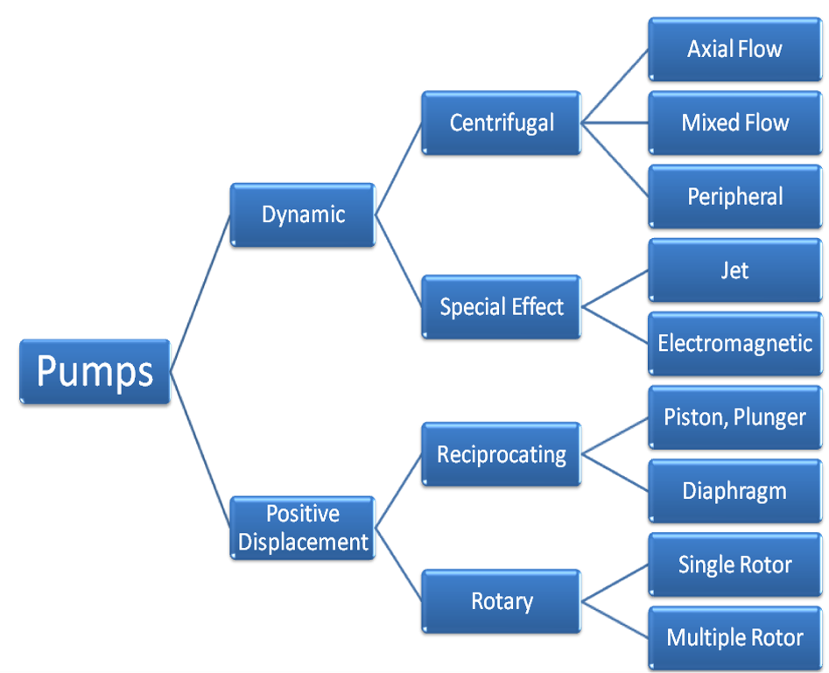
Classification of Pumps

Slide 6
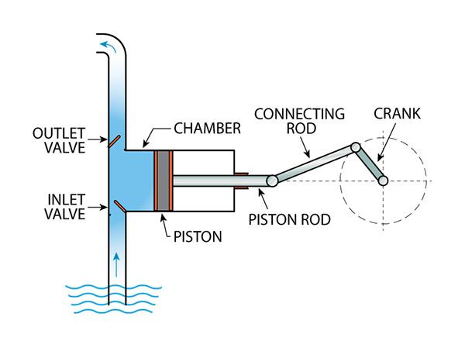
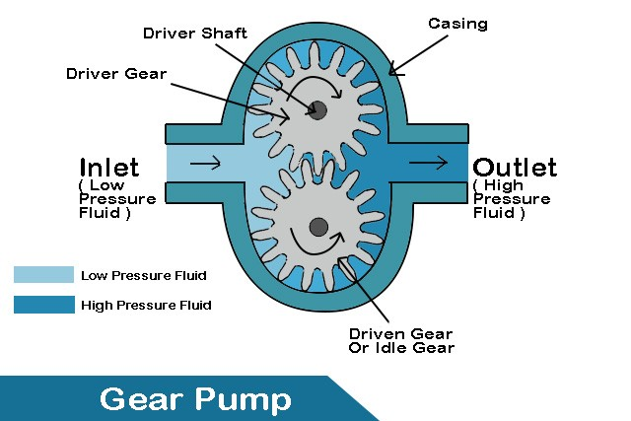
Positive Displacement Pumps
Working Principle: Traps a fixed amount of fluid and displaces it to create flow.
Types:
Reciprocating Pumps: Use a piston or diaphragm (e.g., Piston pumps, plunger pumps, diaphragm pumps)
APPLICATIONS: HIGH-PRESSURE APPLICATIONS, HYDRAULIC SYSTEMS.
Rotary Pumps: Use gears, screws, or vanes (e.g., Gear pumps, screw pumps, vane pumps)
APPLICATIONS: LUBRICATION SYSTEMS, FUEL TRANSFER, CHEMICAL PROCESSING.

Slide 7
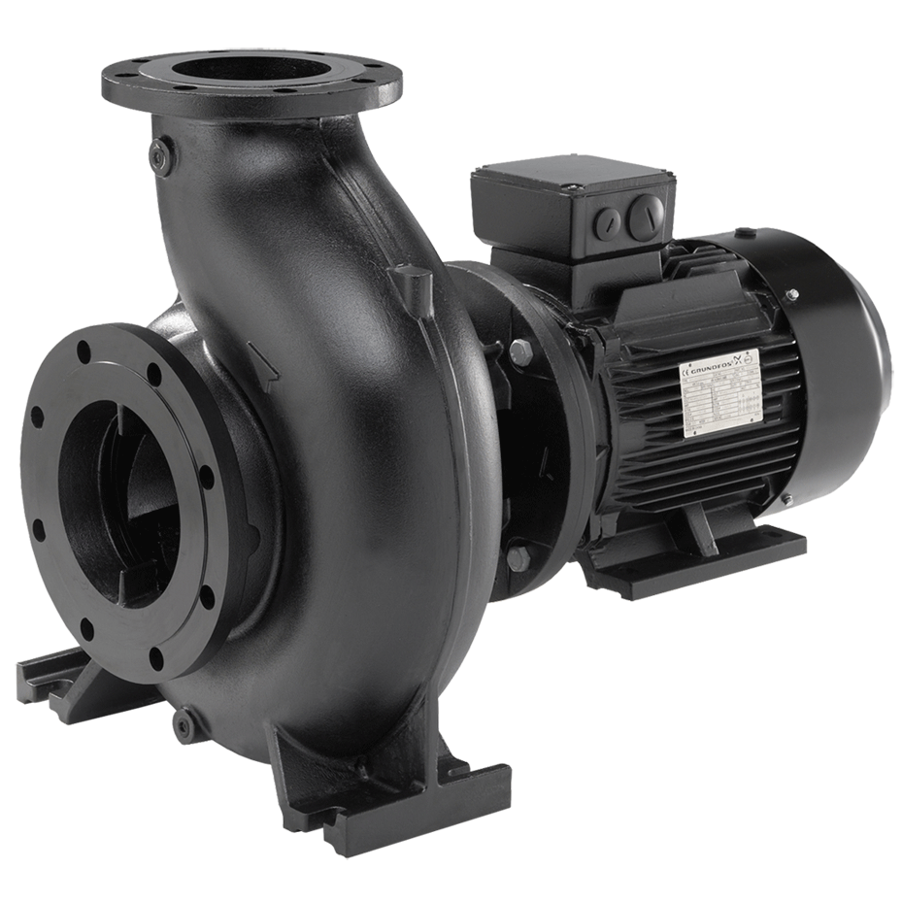
Dynamic Pumps
Working Principle: Adds energy to the fluid primarily through the dynamic action of the rotating impeller.
Centrifugal Pumps
Working Principle: Converts rotational kinetic energy to hydrodynamic energy, uses a rotating impeller to increase the velocity of a fluid.
APPLICATIONS: WATER SUPPLY, SEWAGE TREATMENT, CHEMICAL
INDUSTRIES.
Axial Flow Pumps
Working Principle: Fluid flows parallel to the pump shaft.
APPLICATIONS: HIGH FLOW, LOW HEAD APPLICATIONS, IRRIGATION, FLOOD CONTROL.

Slide 8
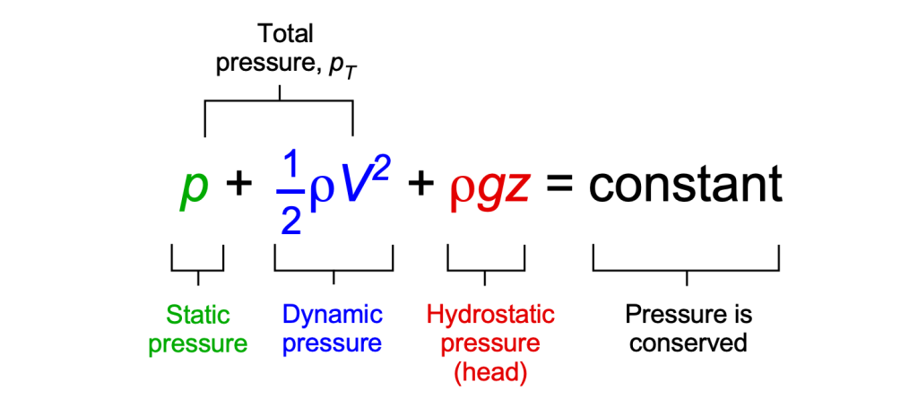
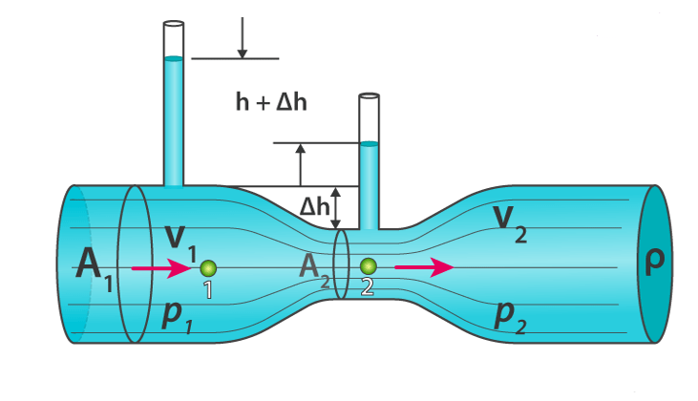
Bernoulli’s Theorem
STATEMENT: FOR AN INCOMPRESSIBLE, NON-VISCOUS FLUID, THE TOTAL MECHANICAL ENERGY ALONG A STREAMLINE IS CONSTANT.
Equation:
Assumptions of Bernoulli’s Theorem:
Incompressible Fluid: Density remains constant.
Non-viscous Fluid: Neglects internal friction.
Steady Flow: Flow parameters do not change with time.
Along a Streamline: Applies to flow along a specific path

Slide 9
Applications of Bernoulli’s Theorem
Venturi Meter : Used to measure fluid flow rate
Aerofoil Lift : Explains lift force on airplane wings
Pitot Tube : Measures fluid flow velocity
Siphon : Demonstrates fluid transfer over a barrier
Centrifugal Pump : Converts imparted kinetic energy to pressure

Slide 10
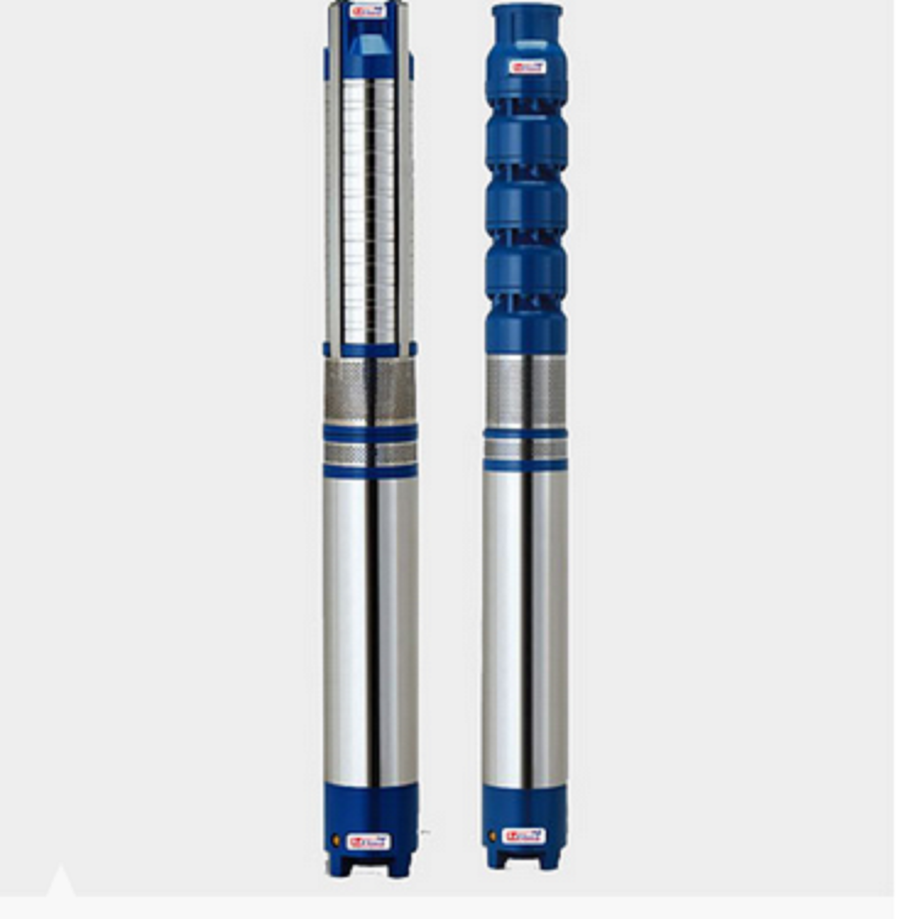
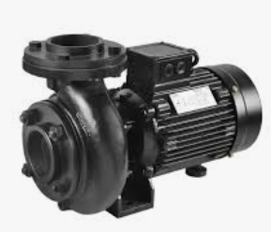
Centrifugal Pumps
Monoblock Pumps
(IS 9079)
Submersible Pumps
(IS 8034)

Slide 11
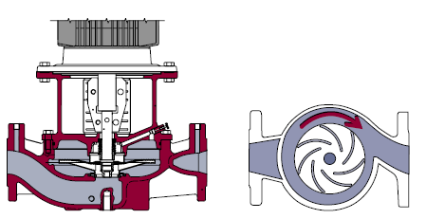
WORKING of centrifugal Pump
Centrifugal pump is the most used pump around the world.
The centrifugal pump is built on a simple principle: Liquid is led to the impeller hub and by means of the centrifugal force it is flung towards the periphery of the impeller
Centrifugal Pump mainly consists of Impellers & Volutes / Diffusers

Slide 12
Terminology (3 of IS 5120)
Total suction head: This is equal to the static suction head minus the friction and entrance losses in suction pipe line
Total delivery head: This is the sum total of the static delivery head and the friction and exit losses in the delivery pipe line
Total head: This is the measure of the energy increase per unit mass of liquid imparted to it by the pump and is, therefore, the algebraic difference of the total delivery head and the total suction head
Net positive suction head (NPSH): This is the total suction head of liquid in metres, absolute, determined at the pump suction nozzle and corrected to pump datum less the vapour pressure head of the liquid at pumping temperature, at the suction nozzle in metres absolute
Specific Speed: it is a term used for classifying pumps on the basis of their performance and dimensional proportions regardless of their actual size or t h e speed at which they operate

Slide 13
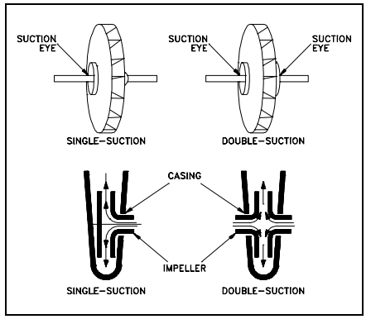
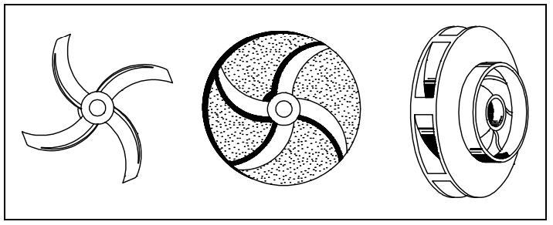
Impeller Classification
A rotating element producing head (table 1 of IS 5120)
Impellers can be either single suction or double-suction
Impellers can be open, semi-open, or enclosed
Single Suction & Double Suction Impellers
Open, Semi-Open and Closed Impellers

Slide 14
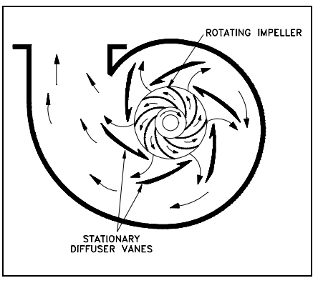
Diffuser
Some centrifugal pumps contain diffusers to increase the efficiency of the centrifugal pump by allowing a more gradual expansion and less turbulent area for the liquid to reduce in velocity. (table 1 of IS 5120)
The diffuser vanes are designed in a manner that the liquid exiting the impeller will encounter an ever increasing flow area as it passes through the diffuser.
This increase in flow area causes a reduction in flow velocity, converting kinetic energy into flow pressure
Diffuser

Slide 15
Why standards?
STRUCTURED TECHNICAL INFORMATION
raw material specification
BENCHMARKING PARAMETERS
safety requirements
REPEATABLE AND RE-PRODUCABLE TEST METHODS
technical data
ENABLES conformity assessment
information for consumers

Slide 16
Important Indian Standards on Pumps
Sl No. | IS No. | IS Title
1. | IS 8034 : 2018 | Submersible Pump Sets - Specification (Third Revision)
2. | IS 6595-1 : 2018 | Horizontal Centrifugal Pumps for Clear, Cold Water - Specification: Part 1 Agricultural and Rural Water Supply Purposes (Fourth Revision)
3. | IS 9079 : 2018 | Mono-set Pumps for Clear, Cold Water for Agricultural and Water Supply Purposes - Specification (Third Revision)
4. | IS 11346 : 2002 | Tests for Agricultural and Water Supply Pumps - Code of Acceptance (First Revision)
5. | IS 14220 : 2018 | Openwell Submersible Pumpsets - Specification (First Revision)
6. | IS 17018 (Part 1) : 2022 | Solar Photovoltaic Water Pumping Systems Part 1 Centrifugal Pumps Specification
7. | IS 17429 : 2020 | Solar Photovoltaic Water Pumping Systems - Testing Procedure - Guidelines

Slide 17
Do you know? What is covered in product standard?

Slide 18
Contents of a product standard
SCOPE OF STANDARD
REFERENCES
TERMINOLOGY
CLASSIFICATION
DESIGN FEATURES
GENERAL REQUIREMENTS
SAFETY REQUIREMENTS
TOLERANCES ON SPECIFIED VALUES
TEST METHODS
INFORMATION FOR CONSUMERS

Slide 19
Components of Centrifugal Pump (table 1 of IS 5120)
Impeller : Rotating part that imparts kinetic energy to the fluid
Casing : Encloses the impeller and directs fluid flow
Pump shaft : Transmit power from the motor to the impeller
Suction nozzle : Inlet pipe that brings fluid into the pump
Discharge nozzle : Outlet pipe that discharges fluid from the pump
WHAT MATERIALS SHOULD BE USED FOR MANUFACTURING THEM?
STANDARD PROVIDES THE SOLUTION

Slide 20
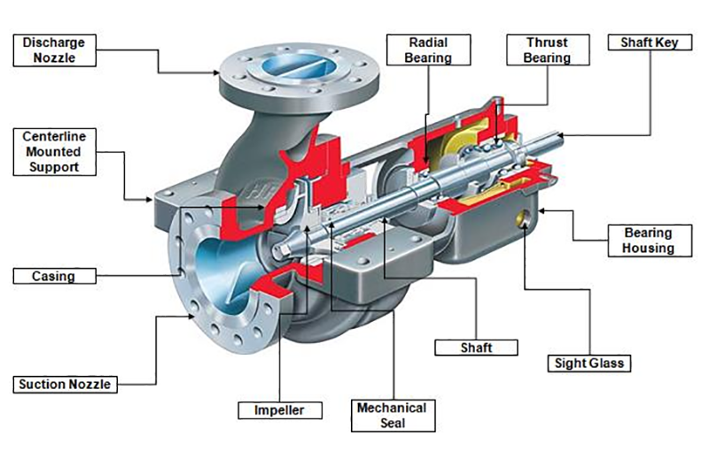
Components of Centrifugal Pump (table 1 of IS 5120)

Slide 21
Components of Centrifugal Pump (6.2 of IS 8034)
Sl No. | Component | Material of Construction (Parts Made of Casted/Moulded/ Sheet Metal Fabricated Process)
1. | Shaft Sleeve | Bronze grade LTB 2, 3, 4 or 5 of IS 318 or 12 percent chromium steel grade X 04 Cr 12, X 12 Cr 12 and X 20 Cr 13, X04Cr19Ni-9/10 conforming to IS 6911 or IS 6603
2. | Casing Wear Ring (if provided) | Bronze grade LTB 2, 3, 4 or 5 of IS 318 or nitrile rubber or NBR or plastic/technopolymer or X04Cr19Ni-9/10 of IS 6911
3. | Bush | Bronze grade LTB 2, 3 or 4 of IS 318 or nitrile/cutless rubber or NBR
4. | Discharge Casing/ Non Return Valve Housing | Cast iron grade FG 200 of IS 210 or plastic/technopolymer or X04Cr19Ni-9/10 of IS 6911
5. | Impeller | Bronze grade LTB 2 of IS 318 or stainless steel grade X 12 Cr 12 or X04Cr19Ni-9/10 of IS 6911 or IS 6603 or plastic/technopolymer
6. | Pump Bowl/Diffuser | Cast iron grade FG 200 of IS 210 or plastic/technopolymer or X04Cr19Ni-9/10 of IS 6911
7. | Pump Shaft | Stainless steel grade X 04 Cr 12, X 12 Cr 12 or X 20 Cr 13 or X15Cr16Ni2 of IS 6603
8. | Suction Casing | Cast iron grade FG 200/FG 260 of IS 210 or X04Cr19Ni-9/10

Slide 22
Do you know? What are parameters used for benchmarking of submersible pumps (IS 8034)?

Slide 23
Requirements of Pumps
General Requirements:
Material of construction (6.2 of IS 8034)
Design features & sizes ( 7 of IS 8034)
Balancing (8.5 of IS 8034)
Direction of rotation (8.7 of IS 8034)
Locked rotor test (9.9 of IS 8034)
Marking (14 of is 8034)
Performance requirements:
Pump efficiency (11.4 of IS 8034)
Overall efficiency (11.5 of IS 8034)

Slide 24
Electrical Performance & safety requirements
Insulation Resistance Test (9.2 of IS 8034)
High Voltage Test (9.3 of IS 8034)
Leakage Current Test (9.4 of IS 8034)
Temperature Rise Test (9.5 & 9.6 of IS 8034)
Breakaway (Starting) Torque Test (9.7 of IS 8034)
Speed (9.8 of IS 8034)
No load running of motor (9.9 of IS 8034)

Slide 25
Performance Characteristics of Centrifugal Pumps
Head : The height to which the pump can raise the fluid
Flow Rate : Volume of fluid pumped per unit time
Efficiency : Ratio of the useful power delivered by the pump to the power supplied
Power : Input power required to operate the pump

Slide 26
Determining Performance Characteristics
Head vs. Flow Rate Curve: Shows the relationship between head and flow rate, typical downward-sloping curve
Efficiency Curve: Indicates pump efficiency at different flow rates, generally bell-shaped curve, showing peak efficiency
Power Curve: Displays power consumption at various flow rates, generally increases with flow rate
NPSH Curve: Net Positive Suction Head required to prevent cavitation

Slide 27
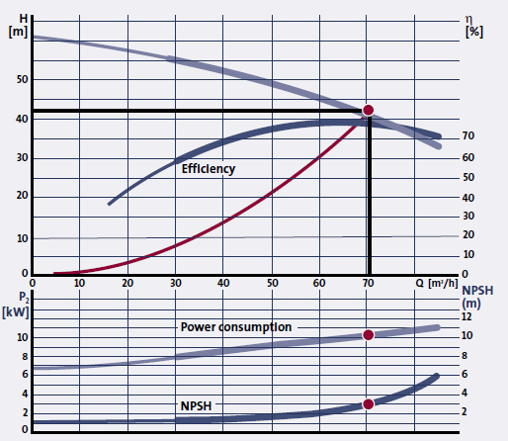
Pump Curves
The Performance Curves For A Centrifugal Pump are Shown In Figure Head, Power Consumption, Efficiency And NPSH are shown as a Function Of The Flow
Pump Curves

Slide 28
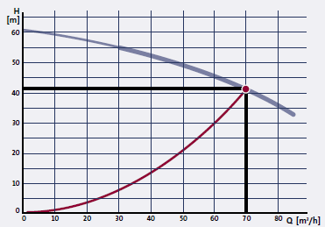
QH Curve
The QH-Curve shows the Head, Which the Pump is able to Perform at a Given Flow. Head is Measured in meter Liquid column [mLc]; Normally the Unit Meter [M] is Applied

Slide 29
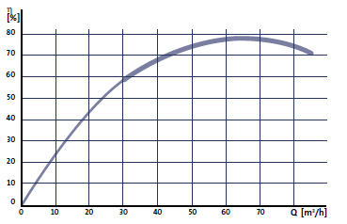
Efficiency Curve
The Efficiency Η_{p} is the Relation Between the Power, Which the Pump Delivers to The Water (Utilised Amount Of Power, P_{H}) and the Power Input to the Shaft (Supplied Power, P₂):

Slide 30
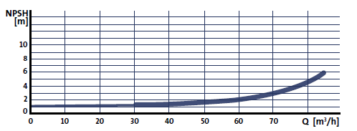
npsh Curves
The NPSH-Value of a Pump is the Minimum Absolute Pressure that has to be Present at the Suction Side of the Pump to Avoid Cavitation. The NPSH-Value is Measured in [M] and Depends on the Flow; When the Flow Increases, the NPSH-Value Increases as Well

Slide 31
Factors Affecting Performance
Impeller Design : Shape, size, and number of blades
Pump Speed : Rotational speed of the impeller
Fluid Properties : Viscosity, density, and temperature
System Configuration: Pipe length, diameter, and fittings

Slide 32
Do you know? What are the test methods?

Slide 33
√ Minimize human error √ Standard Testing Environment √ Standard Test Equipment √ Repeatable √ Reproducible √ Reliable Test Results
BENEFITS OF
STANARD TEST METHODS

Slide 34
Test methods for Pumps
IS NO. | IS TITLE
IS 11346: 2002 | TESTS FOR AGRICULTURAL AND WATER SUPPLY PUMPS - CODE OF ACCEPTANCE (FIRST REVISION)
IS 17429: 2020 | SOLAR PHOTOVOLTAIC WATER PUMPING SYSTEMS - TESTING PROCEDURE - GUIDELINES
IS 9137: 2019 | CODE FOR HYDRAULIC PERFORMANCE ACCEPTANCE TESTS FOR CENTRIFUGAL, MIXED AND AXIAL FLOW PUMPS - CLASS C (FIRST REVISION)
IS 10981: 1983 | CODE OF ACCEPTANCE TEST FOR CENTRIFUGAL, MIXED FLOW AND AXIAL PUMPS - CLASS B
IS NO. | IS TITLE
IS 14536: 2018 | SELECTION, INSTALLATION, OPERATION AND MAINTENANCE OF SUBMERSIBLE PUMPSET - CODE OF PRACTICE (FIRST REVISION)

Slide 35
Test for Hydraulic Performance of Pump
Flow Measurement: (see 3.1.1 of IS 11346)
Volumetric Tank Method
Vee-Notch Method
Orifice Plate Method
Flow Meters
Measurement of Total Head (see 3.1.2 of IS 11346)
Delivery Head Measurement by Mercury Manometer or Pressure Gauge
Suction Head Measurement by Vacuum Gauge or Mercury Manometer
Head measurement by pressure transducers
Power Measurement (see 3.1.3 of IS 11346)
Speed (see 3.2.4 of IS 11346)

Slide 36
Do you know? How to carryout testing OF PUMPS?

Slide 37
Routine and type tests
Routine tests are to be carried out on every unit of pump sets manufactured (repeatable tests)
Type tests required not to be carried out on every unit of pump sets (sampling basis). Testing carried out only when there is change in design

Slide 38
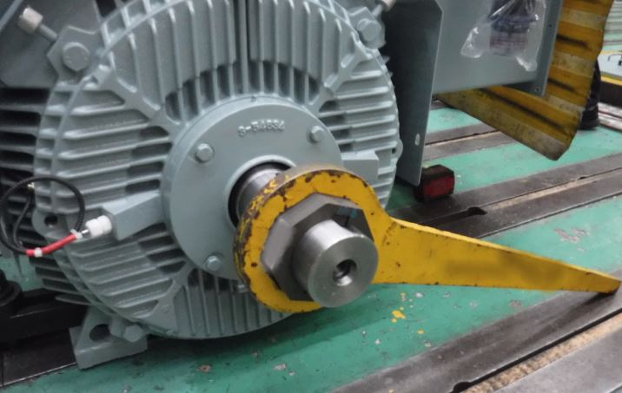
Routine tests (9.9 0f is 8034)
Insulation resistance test (Before high voltage test only)
High voltage test
No load running of motor and reading of current, voltage, power and speed
Locked rotor reading of voltage, current and power

Slide 39
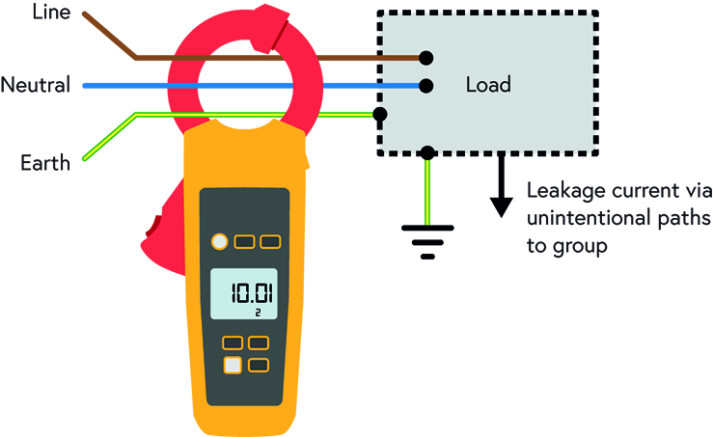
Type tests (9.10 of is 8034)
Hydraulic Performance
Insulation resistance Test (Both before and after the high voltage test)
Measurement of stator resistance
Leakage Current Test at rated voltage at no load
Breakaway (starting) torque
Temperature rise test at rated voltage

Slide 40
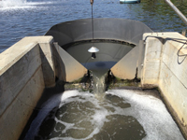
Test for Hydraulic Performance of Pump
Flow Measurement:
Volumetric Tank Method ― The Volumetric Tank Method is a classical technique for measuring fluid flow rates, particularly useful in calibration and field-testing scenarios. (see 3.2.1.1 of IS 11346)
Vee-Notch Method ― It involves using a triangular weir, where the liquid flows through a V-shaped notch. The height of the liquid above the notch (head) is measured, and this measurement is used to calculate the flow rate based on the known geometry of the notch. (see 3.2.1.2 of IS 11346)

Slide 41
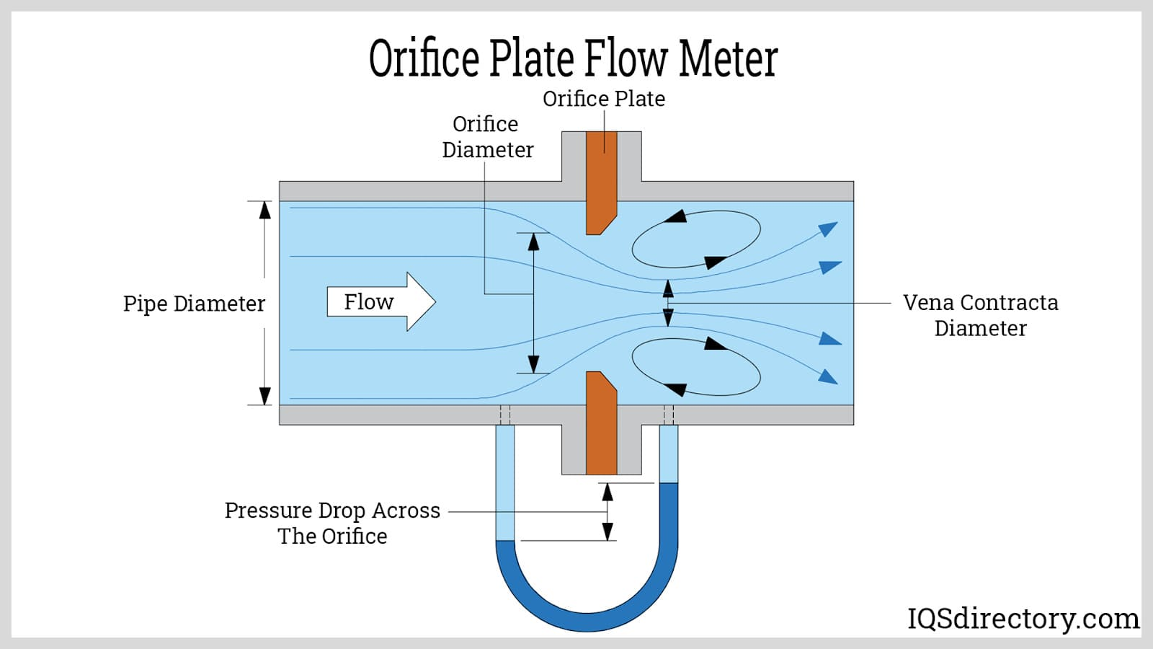
Test for Hydraulic Performance of Pump
Flow Measurement:
Orifice Plate Method ― The method is based on Bernoulli's principle, which relates the pressure difference in a flowing fluid to its velocity. An orifice plate is a thin plate with a hole (orifice) in the middle, placed perpendicular to the flow of fluid in a pipe. (see 3.2.1.3 of IS 11346)
Flow Meters ― Flow meters are instruments used to measure the flow rate of liquids or gases in a system. They play a crucial role in various industries such as water management, oil and gas, chemical processing, and food and beverage production. (see 3.2.1.4 of IS 11346)

Slide 42
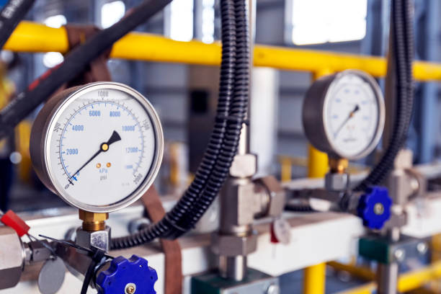
Test for Hydraulic Performance of Pump
Measurement of Total Head (see 10.2.1 of IS 11346)
Delivery Head Measurement by Mercury Manometer or Pressure Gauge
When the pump is running, observe the difference in mercury levels in the two arms of the manometer. The difference in height (Δh) of the mercury columns, usually measured in millimetres or inches, represents the pressure exerted by the pump.
2. Suction Head Measurement by Vacuum Gauge or Mercury Manometer
Suction head measurement is crucial in understanding the performance of pumps. It can be measured using different instruments such as vacuum gauges or mercury manometers.

Slide 43
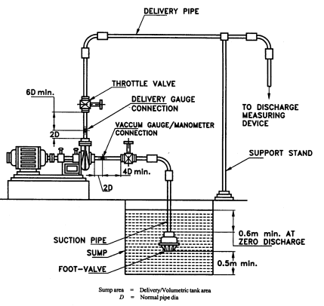
TYPICAL TEST SETUP FOR
NON-SELF-PRIMING PUMPS

Slide 44
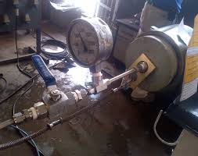
Test for Hydraulic Performance of Pump
Hydrostatic Pressure Test (see 10.3 of IS 8034)
A type of test that fills a pressure vessel or pipe system with fluid to a specified PSI to ensure it can safely hold the amount of pressure it is rated for and maintain structural integrity

Slide 45
balancing
process used to correct the unequal distribution of geometric mass (see Unbalance) In the case of centrifugal pumps.
this is performed in such a manner as to render the rotation axis of the pump's rotor a free axis.
balancing procedure and tolerances rotors with rigid behaviours (see IS/ISO 21940-11)

Slide 46
Do you know? What information is required for various stakeholders?

Slide 47
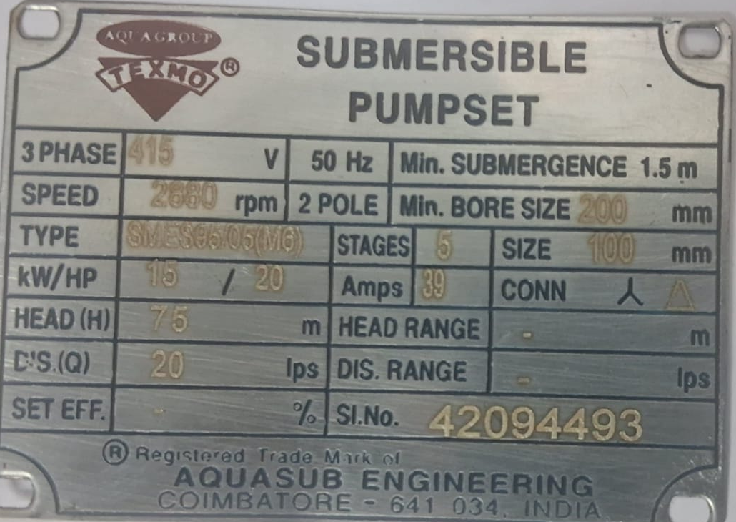
Markings on Pump (14 of is 8034)
A name plate of corrosion-resistant material is affixed on the pumpset with the following details:
a) Manufacturer’s name or trade-mark, if any;
b) Model;
c) Serial No.;
d) Number of stages;
e) Bore size, Min;
f) Head, at nominal duty point;
g) Discharge, at nominal duty point;
h) Overall efficiency;
j) Motor rating (kW);
k) Rated speed (rpm);

Slide 48
Basis for selection of Submersible Pump (6 of IS 14536)
A) Installation Site,
B) Pump Operating Conditions:
1) Capacity........L/Min, L/S Or M3/H
2) Number of Poles of Motor
3) Total Head
4) Total Depth of Casing Pipe
5) Static Water Depth
6) Tube Well Capacity at Predicted Draw-Down

Slide 49
C) Description of the Well:
Installation of Pump in: Openwell, Tubewell, Openwell with w Boring, and Others.
Minimum Inside Diameter of the Tubewell or Casing Pipe.
Total Depth of Open Well/Deep Well.
Static Water Depth.
D) Site Conditions:
1) Height above Mean Sea Level in Metres, and
2) Details of Quality of Water.
E) Power Supply:
1) Type of Supply (Single-Phase/Three Phase)
2) Frequency (Hz)
3) Voltage (V), and
4)Variation in Voltage/Frequency.

Slide 50
INFORMATION FURNISHED BY THE MANUFACTURER (16 of IS 8034)
A) Type Designation of Pump and Submersible Motor,
B) Details of Pump;
1) Method of Lubrication;
2) Minimum Bore Well Diameter, in mm; Number of Stages; Outside Diameter;
3) Discharge (l/s), Total Head (m), Speed (rpm);
4) Overall Efficiency at Duty Point (Percent); and
5) Minimum Submergence at Duty Point (M).
C) Details of Motor:
Rating (kW), Type, Power Supply,
Number of Poles of Motor, and
Maximum Current at Rated Voltage and Frequency.

Slide 51
D) Accessories:
1) Suitable Starter,
2) Main Switches,
3) Ammeter and Voltmeter,
4) Pressure Gauge,
5) Water Level Indicating Relays,
6) Reflux Valve and Sluice Valve, and
7) Erection Clamps and Special Spanners, If any.

Slide 52
E) Additional Information to be Furnished with the Supply, if Required.
Performance Curves:
Discharge v/s Head Curve,
Discharge v/s Overall Efficiency,
Discharge v/s Current,
Instructions for Installation and Maintenance,
Weight of the Pump Motor together in Kg and that of Cables in Kg/m,
Maximum Current (Amp), Rated Voltage (V); Rated Frequency (Hz);
Connection Star, Delta, Star/Delta (For Three Phase);
Type of Duty (Whether Continuous or Not);
Delivery Size;
Head Range for Non-Overloading Requirements; and
Type of Motor CSR/CSCR (For Single Phase).

Slide 53
Do you know that Standards are dynamic documents?
Issue of amendments
periodic review
revision of standard
adoption of new technologies

Slide 54
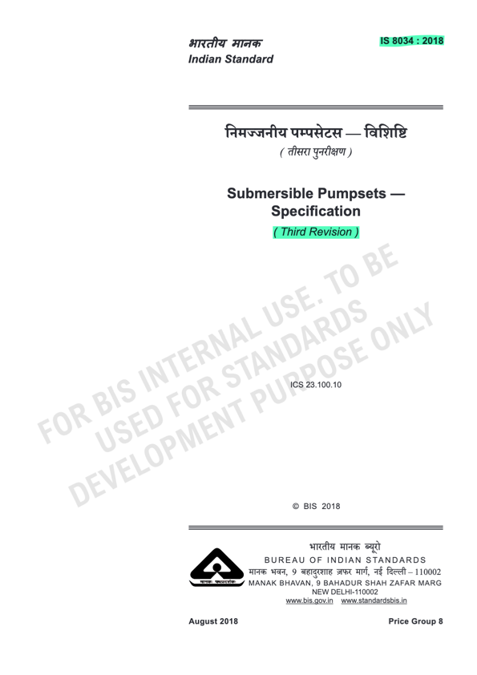
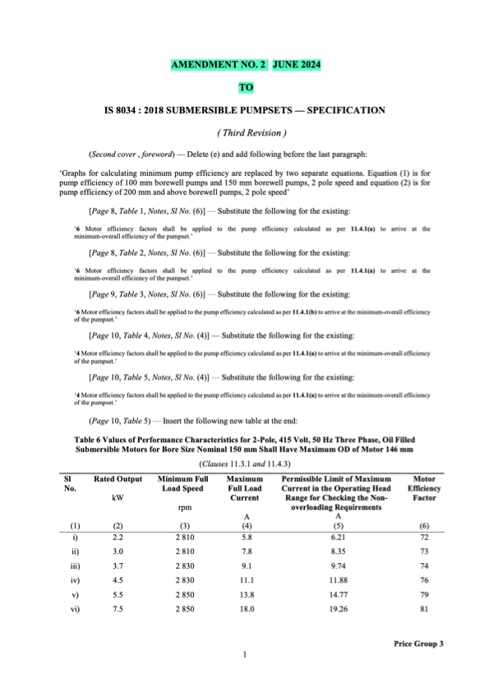
REVISION OF A STANDARD
AMENDMENT TO A STANDARD

Slide 55
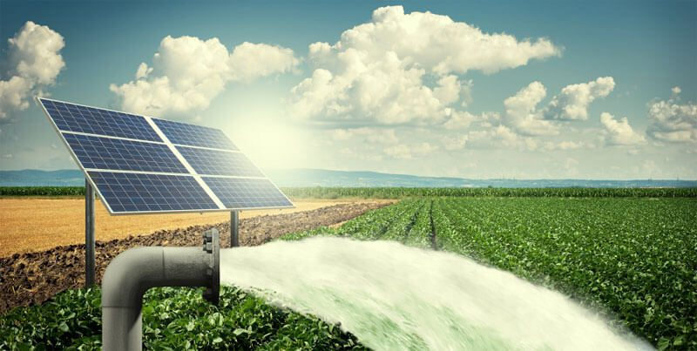
Solar Photovoltaic (SPV) Water Pumping System
Constructional Features [4 of is 17018 (part 1)]
Motor Pumpset
SPV Pump Controller
Module Mounting Structures (MMS) and Tracking System
Testing of SPV Pumps using PV array simulator
Hot and Cold day solar irradiance profiles

Slide 56
Typical Solar Radiation Hot and Cold Profile (5.2 of is 17429)

Slide 57
Conformity assessment
Standards enables third party certification (bis product certification)
The submersible pump sets may also be marked with BIS Standard Mark, if obtained from the Bureau of Indian Standards.

Slide 58
www.BIS.GOV.IN

Slide 59
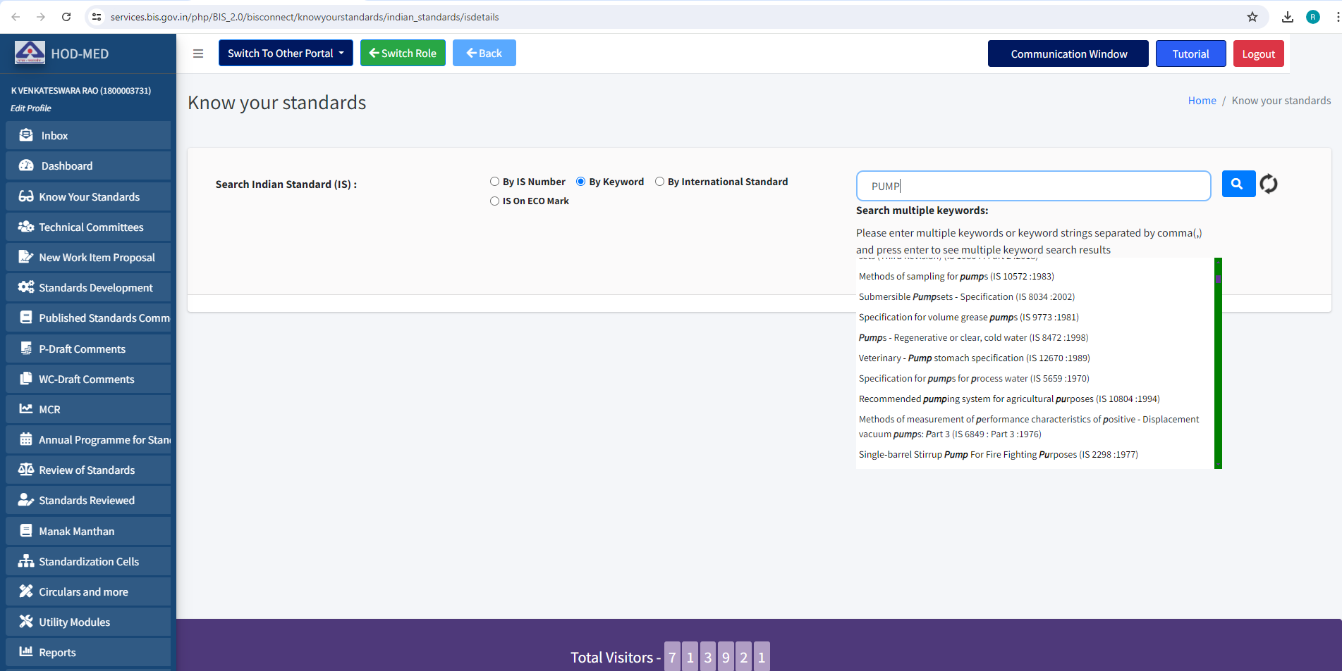
KNOW YOUR STANDARD

Slide 60
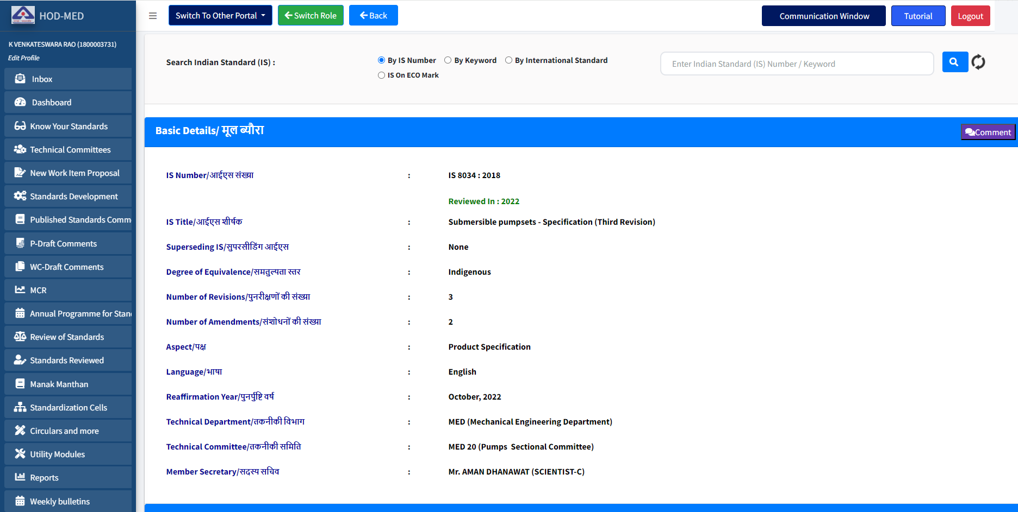
KNOW YOUR STANDARD

Slide 61
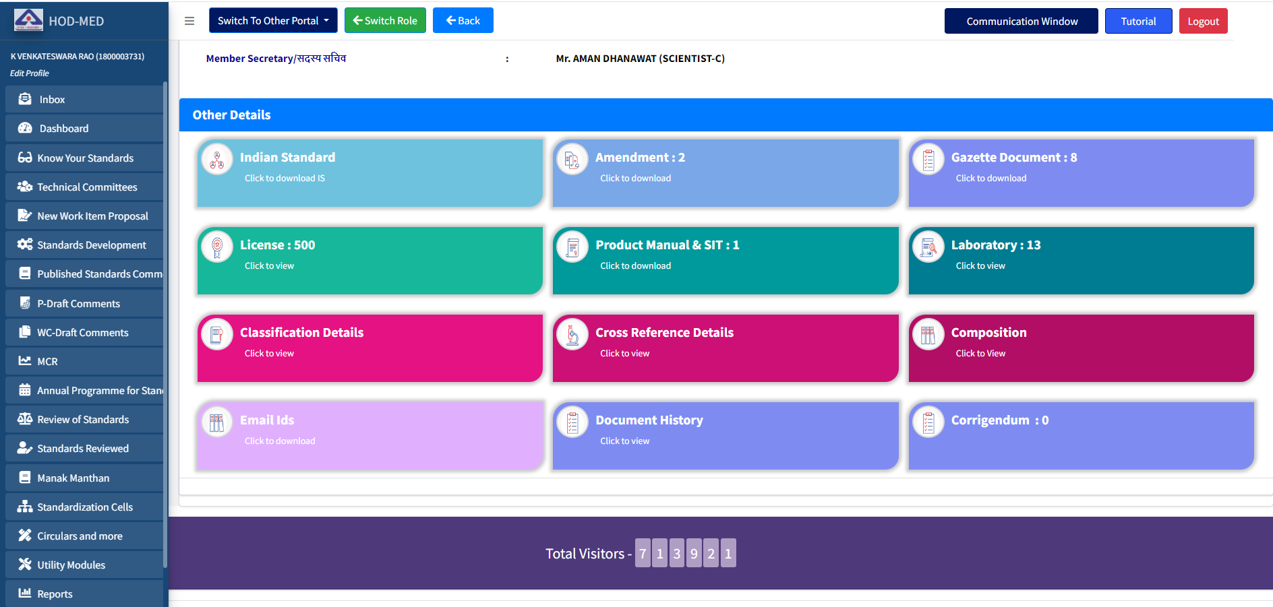
KNOW YOUR STANDARD

Slide 62
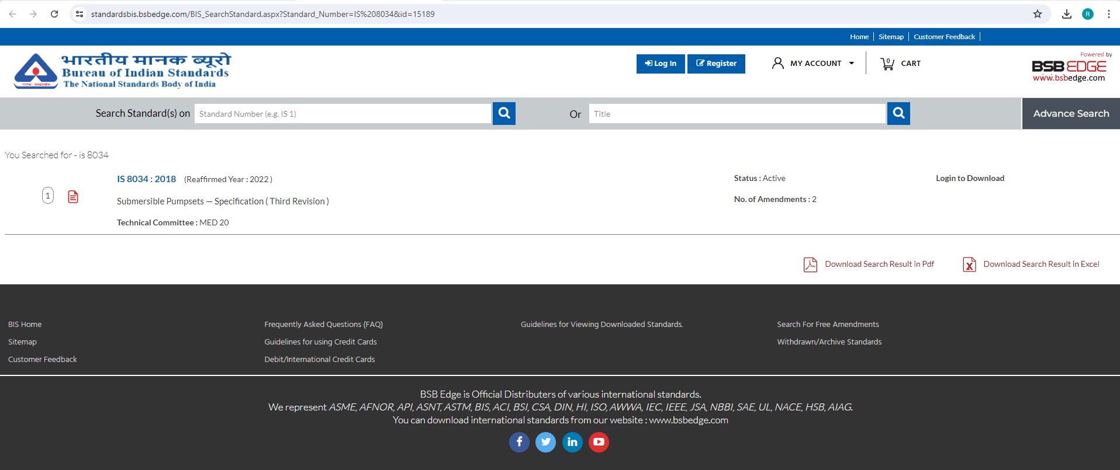
Generic slide
KNOW YOUR STANDARD

Slide 63
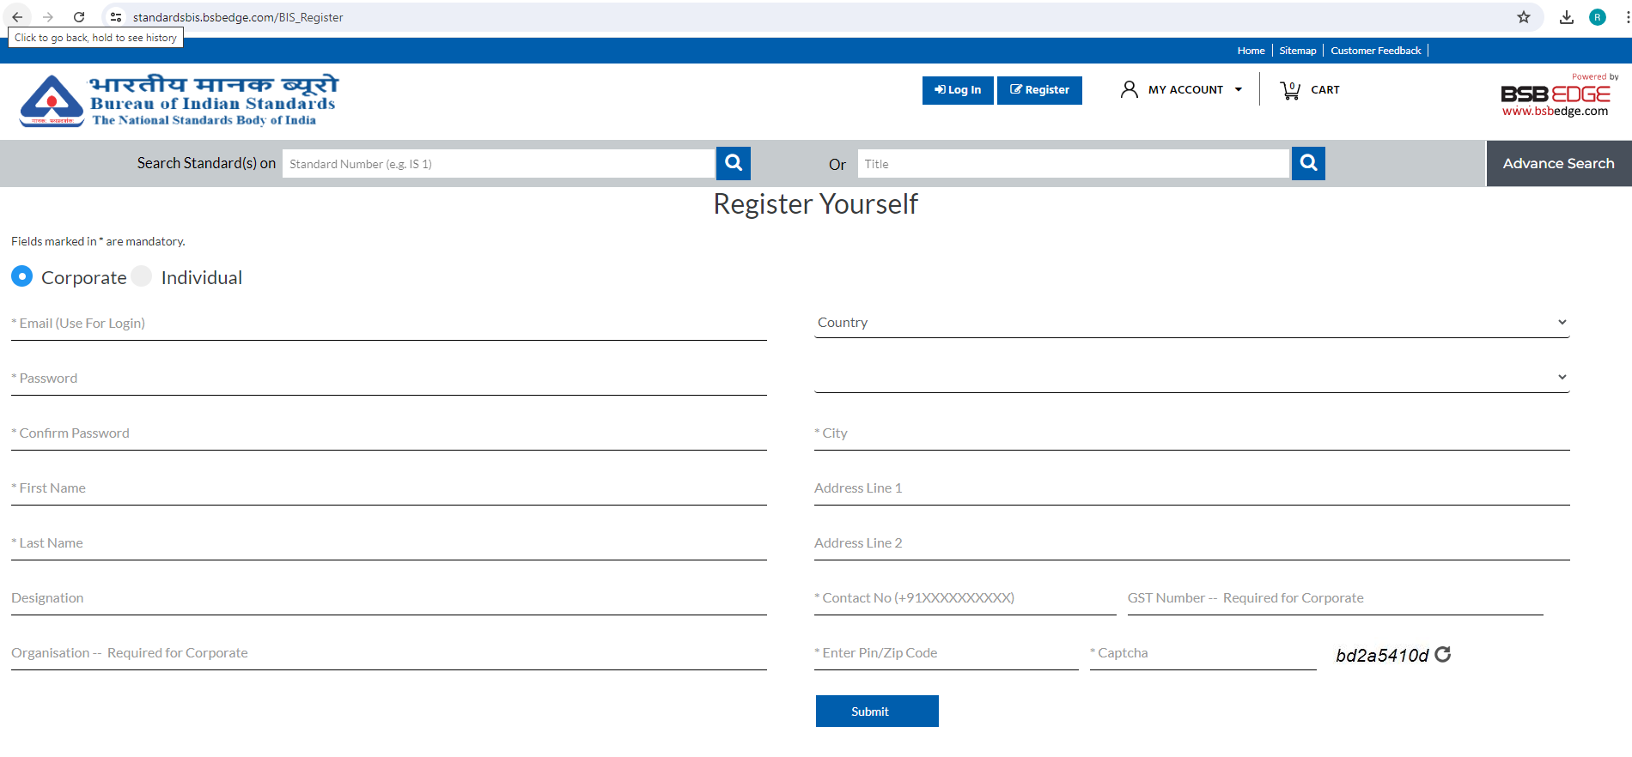
REGISTER AND DOWNLOAD Indian STANDARD

Slide 64
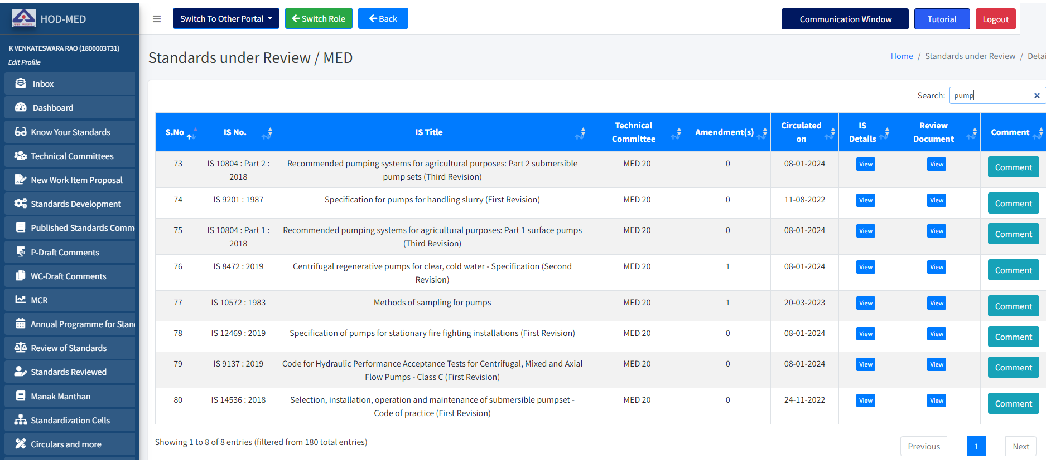
Comment on Indian standards

Slide 65
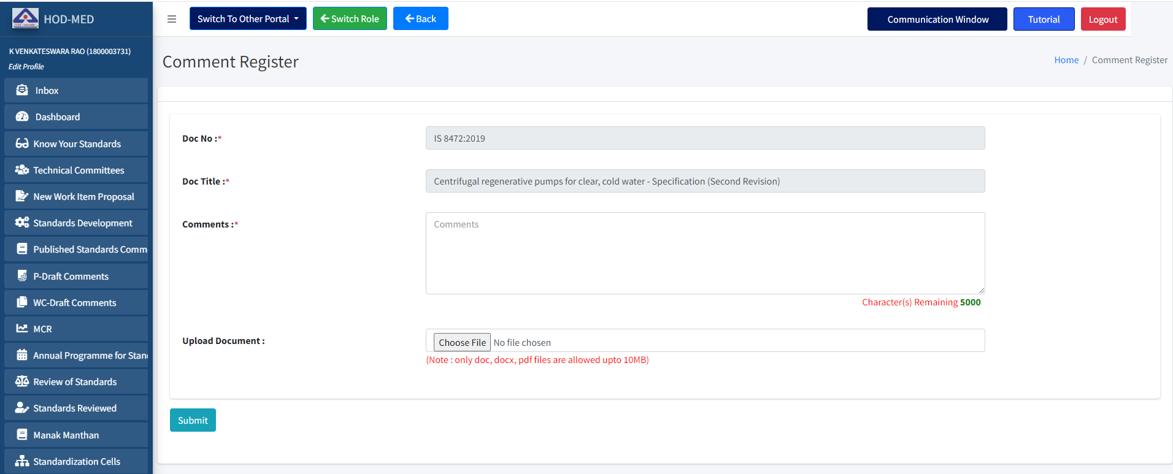
Comment on Indian standards

Slide 66
CONCLUSION
Solutions by standards:
consumer : information required for purchasing a pump
Manufacturer : quality assurance and competitive advantage
Govt. Depts. : no need to have separate technical specifications
entrepreneur : no reinventing of wheel, use existing standards as building blocks
professionals : availability of standard testing procedures
Environment : improved power efficiency and safety
Society : quality culture

Slide 67
Thank You !

