Slide 1
Soil Mechanics & Foundation Engineering
An insight into Indian Standards
Amit Roy
Bureau Of Indian Standards

Slide 2
Introduction
Soil mechanics and foundation engineering are vital disciplines in civil engineering that deal with the behavior of soil and its interaction with structures.
Key Concepts:
Soil Composition: Soil is composed of mineral particles, organic matter, water, and air. Understanding its composition is crucial for assessing its properties.
Soil Classification: Soils are classified based on grain size, mineral composition, plasticity, and other factors. Common classification systems include the Unified Soil Classification System (USCS) and the AASHTO Soil Classification System.
Soil Properties: Properties like density, porosity, permeability, compressibility, and shear strength determine soil behavior under different conditions.
Soil Testing: Various laboratory and in-situ tests are conducted to determine soil properties. Tests include the triaxial test, direct shear test, consolidation test, and Standard Penetration Test (SPT).
Understanding the Key Concepts
(Soil Mechanics)

Slide 3
Introduction…..
Foundation engineering focuses on designing safe and stable foundations for structures based on soil conditions. Key aspects include:
Types of Foundations: Foundations can be shallow (such as spread footings and mat foundations) or deep (such as piles and drilled piers), depending on soil conditions and structural requirements.
Soil-Structure Interaction: Understanding how soil interacts with the foundation and transferring loads from the structure to the soil is crucial for designing effective foundations.
Foundation Design: Designing foundations involves considering factors like soil bearing capacity, settlement, lateral stability, and potential hazards like earthquakes and expansive soils.
Foundation Construction: Construction methods must ensure that foundations are installed properly, considering soil conditions and design specifications.
Understanding the Key Concepts
(Foundation Engineering)

Slide 4
Why adherence to Standards?
Standards
Local Soil Conditions
Environmental & Climatic Factors
Structural Requirements
Regulatory compliance
Historical Experience
Promotion of Best Practices
Capacity Building

Slide 5
Why Standards?
Local Soil Conditions: India has diverse soil types ranging from sandy to clayey soils, which vary significantly across regions. Indian Standards are tailored to address the specific challenges posed by these diverse soil conditions, providing guidelines for soil testing, analysis, and foundation design that are relevant and effective in the Indian context.
Climate and Environmental Factors: Indian Standards take into account the climatic variations and environmental factors that influence soil behaviour and foundation performance. Guidelines for factors such as groundwater levels, seismic activity, and monsoon conditions are incorporated to ensure that foundations are designed to withstand local environmental stresses.
Structural Requirements: Indian Standards are aligned with the structural requirements and building codes prevalent in the country. They provide guidance on foundation design parameters, load considerations, and safety factors that are essential for ensuring the structural integrity and stability of buildings and infrastructure projects.
Regulatory Compliance: Adherence to Indian Standards is often mandated by regulatory authorities for construction projects in India. Engineers and developers are required to follow these standards to obtain necessary approvals, permits, and certifications, ensuring compliance with legal and regulatory requirements.
Historical Experience: Indian Standards draw upon the extensive experience and knowledge accumulated through decades of construction and infrastructure development in the country. They reflect the lessons learned from past successes and failures, incorporating best practices and recommendations based on practical experience and research.
Promotion of Best Practices: Indian Standards promote the adoption of best practices in soil mechanics and foundation engineering, encompassing aspects such as site investigation, soil testing, foundation types, construction techniques, and quality control measures. By following these standards, engineers can minimize risks, enhance project efficiency, and optimize resource utilization.
Capacity Building: Indian Standards contribute to capacity building efforts by providing guidance and training resources for engineers, geotechnical professionals, and construction stakeholders involved in soil mechanics and foundation engineering. They serve as educational tools that empower practitioners with the knowledge and skills necessary to tackle complex soil-structure interaction problems effectively.
Understanding the Indispensability & Impact Factor

Slide 6
Soil Composition & Application of Indian Standards for Safety, Stability & Performance of Structures
Critical Factors affecting Soil composition
Load Bearing Capacity: Soil composition determines the load-bearing capacity of the ground. Different types of soil (e.g., sand, clay, silt) have varying strengths and compressibility. Engineers assess soil composition to ensure that foundations can support the intended loads without excessive settlement or failure.
Shear Strength: Soil composition affects shear strength, which is crucial in determining the stability of slopes and foundations. Cohesive soils like clay have higher shear strength compared to cohesionless soils like sand. Understanding this helps engineers design stable slopes and foundations that can withstand applied forces.
Permeability: Permeability, or the ability of soil to transmit water, is influenced by soil composition. This is important for assessing drainage conditions around foundations and ensuring that water doesn’t accumulate excessively, which could lead to instability or erosion.
Application of Indian Standards for Safety & Performance
Foundation Design: IS 456:2000 (Code of Practice for Plain and Reinforced Concrete) and IS 800:2007 (General Construction in Steel – Code of Practice) incorporate guidelines for designing foundations based on soil conditions. The standards specify factors such as allowable bearing capacity, settlement criteria, and methods for calculating safe bearing pressures, ensuring that foundations are designed to withstand expected loads and soil conditions.
Classification of Soils: Indian standards such as IS 1498:1970 provide guidelines for classifying soils based on their particle size distribution and plasticity characteristics. Proper classification helps engineers understand the engineering properties of soils, which is essential for selecting appropriate construction techniques and foundation types.
Geotechnical Investigations: IS 1892:2021 outlines the procedures for subsurface investigations for foundations to determine soil properties such as moisture content, density, permeability, shear strength, and consolidation characteristics. These investigations provide critical data for designing safe foundations and earthworks.

Slide 7
Soil Composition & Application of Indian Standards for Safety, Stability & Performance of Structures
Critical Factors affecting Soil composition……..
Application of Indian Standards for Safety & Performance……..
Consolidation and Settlement: Soil composition impacts consolidation behaviour, which refers to the gradual settlement of soil under load. Clayey soils, for example, may experience significant consolidation over time due to their low permeability and high compressibility. Engineers analyse soil composition to predict settlement and design foundations accordingly to minimize long-term settlement.
Expansive Soils: Some soils, particularly expansive clays, can swell or shrink significantly with changes in moisture content. This can exert pressure on foundations and cause structural damage. Understanding the composition and behaviour of these soils helps engineers implement measures to mitigate potential problems, such as using proper moisture control techniques or foundation designs.
Foundation Design: Ultimately, soil composition guides foundation design choices. Engineers select foundation types (e.g., shallow foundations, deep foundations) and design parameters (e.g., size, depth) based on soil composition data obtained through geotechnical investigations. This ensures that foundations are safe, stable, and durable over the structure’s lifespan.
IS 6403:1981, titled "Code of Practice for Determination of Settlement of Foundations of Structures." This standard provides guidelines and procedures for evaluating settlement characteristics of soils, which are crucial for designing safe and stable foundations
IS 1498:1970 - This standard provides guidelines for the classification and identification of soils for general engineering purposes. It includes provisions for identifying expansive soils based on their mineralogical composition and their potential for volume change due to variations in moisture content.
Slope Stability: IS 14458: Part 1: 1998 provides guidelines for retaining walls for hill area based on soil properties. Soil composition influences factors such as shear strength and permeability, which are critical in assessing slope stability and mitigating risks associated with soil erosion and landslides.
IS 1904:2021 - Code of Practice for Design and Construction of Foundations in Soils (Other than Raft, Ring and Shell): This standard provides detailed guidelines for designing foundations in various soil conditions, excluding raft, ring, and shell foundations. It covers aspects such as allowable bearing pressure, settlement criteria, and reinforcement detailing

Slide 8
Indian Standards on Soil Composition for Safety, Stability & longevity of Structures
Application of Indian standards on soil composition is integral to ensuring the safety, performance, and stability of structures across various engineering disciplines
Indian standards on soil composition provide guidelines for assessing soil properties, designing foundations, evaluating slope stability, and implementing quality control measures during construction.
Adhering to these standards, engineers can effectively mitigate risks associated with soil variability and ensure the long-term durability and safety of infrastructure projects in India across various sectors.
Standard provides guidelines for predicting and measuring settlements of foundations. It covers methods for settlement analysis, allowable settlement criteria, and monitoring procedures
Indian standard includes provisions for considering soil-structure interaction effects during seismic events. It provides guidelines for seismic design parameters and recommends practices to enhance the seismic performance of foundation
Standards play a crucial role in ensuring that foundations in India are designed and constructed to withstand anticipated loads, soil conditions, and environmental factors.
Understanding its Implications ( Sum up & Key Takeaways)

Slide 9
Soil Classification
Engineering Properties: Soil classification provides a systematic framework for categorizing soils based on their physical and engineering properties. These properties include grain size distribution, consistency (e.g., cohesion and plasticity), density, permeability, compressibility, and shear strength. Understanding these properties helps engineers assess how soils will behave under different loading conditions and environmental factors.
Foundation Design: Different types of foundations are suitable for different soil types. For example, cohesive soils like clays may require deeper foundations or special soil improvement techniques due to their low permeability and potential for swelling and shrinking. In contrast, cohesionless soils like sands are more suitable for shallow foundations but may require consideration of factors like bearing capacity and settlement.
Construction Techniques: Soil classification guides the selection of appropriate construction techniques and methods. For instance, cohesive soils may require special excavation and dewatering methods to maintain stability during construction. Knowledge of soil classification also helps in choosing suitable materials for backfilling and compaction.
Risk Assessment and Mitigation: Soil classification allows engineers to identify potential geotechnical hazards such as landslides, subsidence, and soil liquefaction. By understanding the properties of different soil types, engineers can assess risks associated with site development and implement appropriate mitigation measures in the design phase.
Key Concepts

Slide 10
Soil Classification…..
Earthworks and Embankments: Soil classification is essential for designing and constructing earthworks such as embankments, dams, and levees. It ensures that the selected soils have the required strength, stability, and permeability properties to withstand the imposed loads and hydraulic conditions.
Environmental Considerations: Soil classification is also important for evaluating environmental impacts. For example, understanding the permeability of soils helps in assessing groundwater flow patterns and potential contamination risks. Certain soil types may also influence vegetation growth and habitat suitability in ecological assessments.
Standardization and Communication: Standard soil classification systems, such as the Unified Soil Classification System (USCS) or the AASHTO classification system, provide a common language for geotechnical engineers, researchers, and stakeholders to communicate soil properties effectively. This standardization enhances collaboration and ensures consistent interpretation of soil data across different projects and regions.
Key Concepts……

Slide 11
Impact of application of Indian Standards on Soil Classification
IS 1498:1970 - Classification and Identification of Soils for General Engineering Purposes
Impact: This standard outlines the classification system for soils based on grain size distribution and plasticity. It categorizes soils into different groups, such as coarse-grained soils (sands and gravels) and fine-grained soils (silts and clays). This classification helps engineers and builders understand soil behaviour, which is crucial for determining appropriate foundation designs, predicting settlement, and ensuring stability.
IS 2720 (Part 2):1973 - Methods of Test for Soils: Part 2, Determination of Water Content
Impact: This standard specifies the method for determining the moisture content of soil. Accurate measurement of water content is crucial for understanding soil compaction, stability, and strength. It affects decisions related to soil stabilization and the selection of suitable construction materials.
IS 2720 (Part 28):1974 - Methods of Test for Soils: Part 28, Determination of Density (By Sand Replacement Method)
Impact: This method determines the in-situ density of soil, which is essential for assessing soil compaction and understanding its bearing capacity. It helps ensure that soil achieves the required density for supporting structures, reducing the risk of differential settlement.

Slide 12
Impact of application of Indian Standards on Soil Classification……….
IS 2720 (Part 4):1985 - Methods of Test for Soils: Part 4, Determination of Grain Size Distribution
Impact: This standard provides the procedure for analysing soil grain size distribution. Knowing the grain size distribution helps in determining the soil's permeability, shear strength, and compaction characteristics. This information is critical for designing foundations and drainage systems.
IS 2720 (Part 5):1985 - Methods of Test for Soils: Part 5, Determination of Liquid and Plastic Limits
Impact: This standard describes how to determine the plasticity characteristics of soil, such as the liquid limit and plastic limit. These properties are crucial for understanding soil behaviour under varying moisture conditions and for predicting potential problems like soil shrinkage or swelling.
IS 2720 (Part 10):1991 - Methods of Test for Soils: Part 10, Determination of Unconfined Compressive Strength
Impact: This standard provides a method to measure the unconfined compressive strength of soil, which is important for assessing the soil's load-bearing capacity. It helps in evaluating the suitability of soil for supporting structures and can influence decisions on soil improvement or stabilization.

Slide 13
Impact of application of Indian Standards on Soil Classification……….
IS 2720 (Part 39: Sec 2):1979 - Methods of Test for Soils: Part 39, Determination of Shear Strength by Direct Shear Test
Impact: This test measures the shear strength of soil, which is vital for understanding the soil’s stability and its ability to resist sliding or failure under load. This information is crucial for designing stable slopes and foundations.
IS 2720 (Part 15):1965 - Methods of Test for Soils: Part 15, Determination of Consolidation Properties
Impact: This standard outlines the method for determining soil consolidation characteristics, which are essential for predicting settlement over time. Accurate consolidation testing helps in designing foundations that can accommodate expected settlements.
IS 2720 (Part 16):1987 - Methods of Test for Soils: Part 16, Determination of CBR (California Bearing Ratio)
Impact: The CBR test evaluates the strength of soil for use in pavement and road construction. Understanding the CBR value helps in designing appropriate pavement thickness and ensuring the durability of road surfaces.

Slide 14
Soil Properties
Key Indian Standards
IS 2720 (Part 1): Methods of test for soils - Part 1: Preparation of dry soil samples for various tests.
IS 2720 (Part 2): Methods of test for soils - Part 2: Determination of water content.
IS 2720 (Part 3): Methods of test for soils - Part 3: Determination of specific gravity.
IS 2720 (Part 4): Methods of test for soils - Part 4: Grain size analysis.
IS 2720 (Part 5): Methods of test for soils - Part 5: Determination of liquid and plastic limit.
IS 2720 (Part 6): Methods of test for soils - Part 6: Determination of shrinkage factors.
IS 2720 (Part 7): Methods of test for soils - Part 7: Determination of water content-Dry density relation using light compaction.

Slide 15
Soil Properties……
IS 2720 (Part 8): Methods of test for soils - Part 8: Determination of water content-dry density relation using heavy compaction.
IS 2720 (Part 9): Methods of test for soils - Part 9: Determination of dry density-moisture content relation by constant mass of soil method.
IS 2720 (Part 10): Methods of test for soils - Part 10: Determination of unconfined compressive strength.
IS 2720 (Part 11): Methods of test for soils - Part 11: Determination of shear strength parameters of a specimen tested in unconsolidated undrained triaxial compression without the measurement of pore water pressure.
IS 2720 (Part 12): Methods of test for soils - Part 12: Determination of shear strength parameters of soil from consolidated undrained triaxial compression test with the measurement of pore water pressure.
IS 1892: Subsurface investigation for foundations- Code of Practice.
IS 1904: Criteria for Design of Foundations in Soils: General Requirements.
IS 8009: Part 1: 1976- Shallow foundations subjected to symmetrical static vertical loads-code of practice
Key Standards………

Slide 16
Implications on Application of IS on Soil Properties
Implications of Standards
Standardized Testing Procedures
Optimum Design
Quality Assurance
Environmental Considerations
Regulatory Compliance
Safety in Construction
Education and Training

Slide 17
Indian Standards on Soil Properties
Standardized Testing Procedures: Adherence to IS Codes ensures standardized testing procedures for soil properties. This promotes consistency and reliability in the interpretation of soil characteristics such as strength, permeability, and settlement behaviour.
Quality Assurance: Application of IS Codes facilitates quality assurance in soil testing and engineering practices. Engineers can rely on standardized methodologies to obtain accurate data crucial for design calculations and construction decisions.
Safety in Construction: Designing foundations and structures based on standardized soil properties reduces the risk of failures due to inadequate load-bearing capacity or soil instability. This enhances safety and durability of buildings and infrastructure.
Regulatory Compliance: Many regulatory bodies and government agencies in India require compliance with BIS standards for construction projects. Adhering to these standards ensures projects meet legal requirements and obtain necessary approvals.
Optimized Design: Knowledge of soil properties as per IS Codes allows engineers to optimize foundation designs and construction techniques tailored to local soil conditions. This helps in achieving cost-effective and efficient solutions.
Environmental Considerations: Understanding soil properties as per IS Codes aids in environmental management practices such as erosion control, groundwater management, and sustainable land development. It ensures responsible use of natural resources and minimizes environmental impact.
Education and Training: IS Codes serve as educational tools for teaching soil mechanics principles and testing techniques in engineering curricula. They contribute to the professional development of engineers and technicians involved in geotechnical engineering.
Understanding the Implications on its Application

Slide 18
Deep Insights into Indian Standards for Soil Testing and Identification
Importance of Soil testing
Foundation Design and Stability: Soil testing provides essential data on parameters such as bearing capacity, shear strength, compressibility, and settlement characteristics of soil. This information is fundamental for designing foundations that can safely support the loads of structures without excessive settlement or failure.
Selection of Construction Techniques: Different soil types and conditions require varying construction techniques. Soil testing helps engineers determine the appropriate methods for excavation, compaction, and soil stabilization to ensure the stability and durability of foundations and structures.
Risk Assessment and Mitigation: Soil testing helps identify potential risks such as soil liquefaction during earthquakes, slope instability, or soil erosion. By understanding these risks, engineers can implement appropriate mitigation measures in the design and construction phases.
Optimization of Foundation Types: Based on soil test results, engineers can optimize the type of foundation (e.g., shallow foundations, deep foundations) and their dimensions (e.g., footing size, pile depth) to suit the specific soil conditions and structural requirements. This ensures cost-effective and efficient designs.
Verification of Design Assumptions: Soil testing provides empirical data to verify design assumptions made during preliminary studies. It helps refine engineering analyses and ensures that design parameters are based on actual soil properties rather than assumptions or estimates.
Understanding the Importance and Application

Slide 19
Deep Insights into Indian Standards for Soil Testing and Identification......
Construction Quality Control: During construction, soil testing is essential for quality control purposes. It ensures that soil compaction meets specified standards, verifies the suitability of backfill materials, and monitors changes in soil properties due to construction activities.
Environmental Considerations: Soil testing can assess soil contamination, permeability, and groundwater conditions, which are crucial for environmental impact assessments and sustainable construction practices. It helps mitigate environmental risks associated with construction projects.
Legal and Regulatory Compliance: Many regulatory bodies require soil testing as part of the approval process for construction projects. Adhering to these requirements ensures compliance with safety and environmental regulations, reducing legal risks and liabilities.
Long-Term Performance Prediction: By understanding soil behaviour through testing, engineers can predict the long-term performance of foundations and structures under various conditions (e.g., seasonal changes, seismic events). This supports durability assessments and maintenance planning.
Research and Development: Soil testing data contributes to ongoing research and development in soil mechanics and foundation engineering. It helps advance understanding of soil-structure interaction and leads to innovations in construction materials and techniques.
Understanding the Importance and Application………

Slide 20
Deep Insights into Indian Standards for Soil Testing and Identification......
IS 2720 (Part 1): Methods of test for soils - Part 1: Preparation of dry soil samples for various tests.
IS 2720 (Part 2): Methods of test for soils - Part 2: Determination of water content.
IS 2720 (Part 3): Methods of test for soils - Part 3: Determination of specific gravity.
IS 2720 (Part 4): Methods of test for soils - Part 4: Grain size analysis.
IS 2720 (Part 5): Methods of test for soils - Part 5: Determination of liquid and plastic limit.
IS 2720 (Part 6): Methods of test for soils - Part 6: Determination of shrinkage factors.
IS 2720 (Part 7): Methods of test for soils - Part 7: Determination of water content-Dry density relation using light compaction.
IS 2720 (Part 8): Methods of test for soils - Part 8: Determination of water content-Dry density relation using heavy compaction.
Overview of Indian Standards (IS) related to Soil Testing

Slide 21
Deep Insights into Indian Standards for Soil Testing and Identification......
9. IS 2720 (Part 9): Methods of test for soils - Part 9: Determination of dry density-moisture content relation by constant mass of soil method.
10. IS 2720 (Part 10): Methods of test for soils - Part 10: Determination of unconfined compressive strength.
11. IS 2720 (Part 11): Methods of test for soils - Part 11: Determination of shear strength parameters of a specimen tested in unconsolidated undrained triaxial compression without the measurement of pore water pressure.
12. IS 2720 (Part 12): Methods of test for soils - Part 12: Determination of shear strength parameters of soil from consolidated undrained triaxial compression test with the measurement of pore water pressure.
13. IS 1892: Subsurface investigation for foundations- Code of Practice.
14. IS 1904: Criteria for Design of Foundations in Soils: General Requirements.
Overview of Indian Standards (IS) related to Soil Testing…….

Slide 22
Application of Indian Standards on Soil Testing & its Implications
Soil testing is indispensable in soil mechanics and foundation engineering for ensuring safe, cost-effective, and sustainable construction practices
It provides the empirical basis for informed decision-making throughout the project lifecycle, from initial design stages to construction and long-term maintenance.
Indian standards provide guidelines and procedures for various aspects of soil testing, aimed at ensuring quality, consistency, and reliability in the assessment of soil properties
Indian Standards provide standardized protocols for conducting tests in laboratories and in the field, ensuring consistency in data interpretation and application across different projects and regions in India
Adherence to these Indian Standards in soil testing is crucial for ensuring accurate assessment of soil properties, which in turn supports safe and efficient design and construction practices in civil engineering, geotechnical engineering, agriculture, environmental science, and related fields.
Key Takeaways

Slide 23
Sub Surface Investigation
Site Reconnaissance and Preliminary Studies:
Site History and Geology: Understanding the geological history and composition of the site through literature review and geological maps.
Topographic and Environmental Considerations: Assessing surface conditions, drainage patterns, and environmental factors that may impact subsurface conditions.
Exploratory Methods:
Boreholes: Drilling holes into the ground to collect soil samples at various depths for laboratory testing. Boreholes also provide data on soil stratigraphy, groundwater levels, and presence of contaminants.
Test Pits: Excavating pits manually to examine soil profiles, observe soil conditions, and collect disturbed and undisturbed samples for testing.
Geophysical Surveys: Using methods like seismic refraction, electrical resistivity, and ground-penetrating radar (GPR) to map subsurface layers, identify anomalies, and estimate soil properties without excavation.
Key Concepts

Slide 24
Sub Surface Investigation…….
Laboratory Testing:
Physical Properties: Determining soil texture, particle size distribution, specific gravity, and water content to understand soil behaviour under different conditions.
Mechanical Properties: Conducting tests such as triaxial shear tests, direct shear tests, and unconfined compression tests to assess soil strength, shear strength parameters, and compressibility.
Chemical and Contaminant Analysis: Testing for pH, organic content, and contaminants to evaluate soil suitability for construction and environmental impact.
Groundwater Assessment:
Permeability Tests: Measuring soil permeability to understand groundwater flow rates and potential impacts on foundation design and construction dewatering.
Piezometer Installation: Installing piezometers to monitor groundwater levels and pressures over time, essential for assessing potential water table fluctuations and their effects on stability.
Geotechnical Interpretation and Reporting:
Soil Classification: Classifying soils based on their engineering properties (e.g., Unified Soil Classification System, AASHTO classification) to facilitate design decisions.
Engineering Parameters: Estimating soil parameters such as bearing capacity, settlement characteristics, slope stability, and lateral earth pressure coefficients.
Report Preparation: Documenting findings, test results, interpretations, and recommendations for foundation design, construction methods, and potential mitigation measures.
Risk Assessment and Mitigation:
Geotechnical Hazards: Identifying risks such as liquefaction potential, landslides, and expansive soils that could affect site stability and infrastructure safety.
Mitigation Strategies: Recommending appropriate foundation types, soil improvement techniques, and construction practices to mitigate identified risks and ensure long-term performance.
Key Concepts…….

Slide 25
Introduction to Indian Standards on Sub Surface Investigation
1. IS 1892 : 2021 - Code of Practice for Subsurface investigations of foundations:
This standard provides guidelines for conducting subsurface exploration specifically for hydroelectric projects, including methods for geological mapping, drilling, and sampling.
2. IS 5510:1969 – Guide for soil surveys for river valley projects:
Focuses on subsurface exploration methods tailored for river valley projects, addressing geological and geotechnical considerations specific to such environments.
3. IS 2131: 1981 - Methods of Standard Penetration Test for Soils:
Specifies the procedure for conducting the Standard Penetration Test (SPT), a widely used method for assessing the consistency of soils and providing data for geotechnical analyses.
Key Indian Standards related to Sub Surface Investigation

Slide 26
Introduction to Indian Standards on Sub Surface Investigation….
IS 2720 (Part 1 to 41): - Methods of Test for Soils:
A comprehensive set of standards covering various laboratory and field tests for determining physical properties of soils, essential for subsurface investigations.
IS 4968: Part 1: 1976 - Method for subsurface sounding for soils:-
Describes the procedure for conducting subsurface tests to evaluate the settlement characteristics of soils under applied loads, crucial for foundation design.
IS 6403: 1981 - Method of Test for Determination of Bearing Capacity of Shallow Foundations:
Specifies methods for determining the bearing capacity : of soils, which is important for assessing groundwater flow and drainage characteristics.
IS 875 (Part 1 to 5): - Code of Practice for Design Loads (Other than Earthquake) for Buildings and Structures:
Key Indian Standards related to Sub Surface Investigation……..

Slide 27
Indian Standards (Sub Surface Investigation)
Application of Indian Standards on Sub Surface Investigation
Safety Guidelines
Quality Assurance & Control
Standardized Methods & Procedures
Training & Education
Integration with Engineering Design
Research & Development
International Collaboration
Impact Factor

Slide 28
Indian Standards (Sub surface Investigation)
Standardized Methods and Procedures: Indian standards provide standardized methods and procedures for conducting various aspects of subsurface investigation, such as drilling, sampling, and testing. This consistency ensures that engineers and geologists across different projects and regions follow uniform practices, leading to reliable and comparable data.
Quality Assurance and Control: By adhering to Indian standards, practitioners can ensure quality assurance and control throughout the investigation process. Standards specify the criteria for equipment calibration, sampling techniques, testing procedures, and data interpretation, thereby minimizing errors and enhancing the reliability of results.
Safety Guidelines: Standards include safety guidelines and protocols that are crucial for ensuring the safety of personnel involved in subsurface investigation activities. This includes guidelines for handling drilling equipment, conducting tests in hazardous conditions, and maintaining environmental safety.
Training and Education: Indian standards serve as a foundational framework for training and education in subsurface investigation. They provide a structured curriculum for teaching fundamental principles, methods, and best practices to students, engineers, and geologists. This ensures that future professionals are well-prepared to conduct investigations effectively and responsibly.
Advancing Understanding & Impact Factor on application of IS

Slide 29
Indian Standards (Sub surface Investigation)…….
Integration with Engineering Design: Standards bridge the gap between subsurface investigation and engineering design by providing guidelines on how investigation results should inform design parameters. This integration ensures that engineering structures are designed based on accurate and relevant subsurface data, minimizing risks and optimizing performance.
Research and Development: Standards also stimulate research and development in subsurface investigation techniques and technologies. They encourage innovation by setting benchmarks and encouraging the exploration of new methods that could improve efficiency, accuracy, and cost-effectiveness in investigations.
International Collaboration: Many Indian standards are aligned with international standards, facilitating collaboration and knowledge exchange with global experts in subsurface investigation. This alignment ensures that practitioners can leverage global best practices while adapting them to local conditions and requirements.
Advancing Understanding & Impact Factor on application of IS……..

Slide 30
Sub Surface Investigation (Application of Indian Standards)
Overall Impact & Significance
Indian standards enhance learning in subsurface investigation by providing a structured framework of best practices.
Promotes quality and safety
Supporting education and training,
Integrating with engineering design
Stimulating innovation
Facilitating international collaboration.
Adhering to these standards not only ensures compliance but also fosters continuous improvement and advancement in the field of subsurface investigation in India.
Sum Up

Slide 31
Extracts of Indian Standards
Key Learnings/Guidance & Analysis

Slide 32
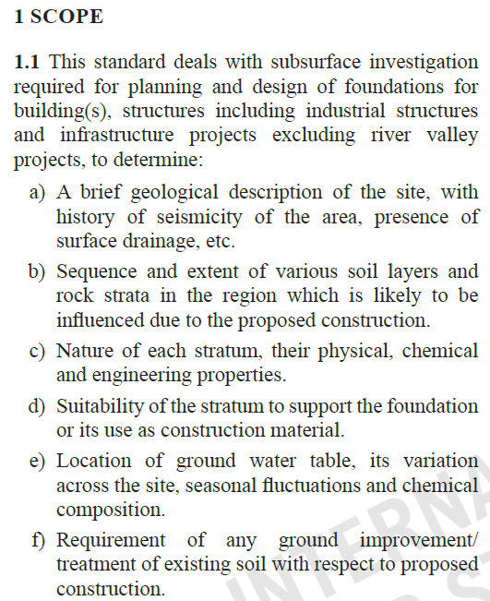
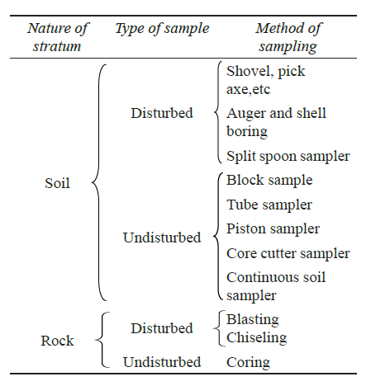
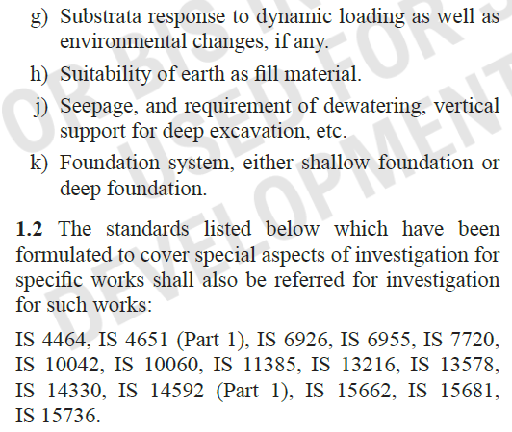
IS 1892: 2021

Slide 33
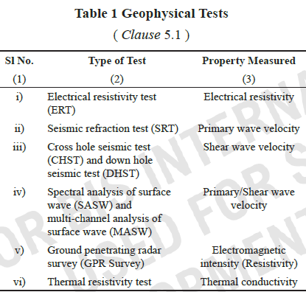
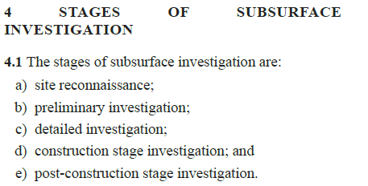
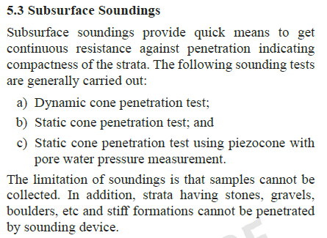
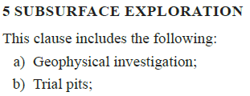
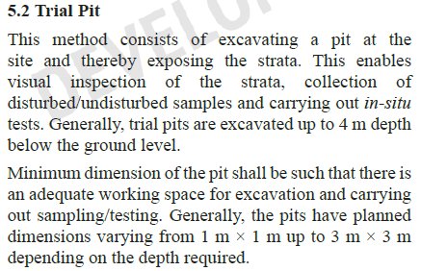
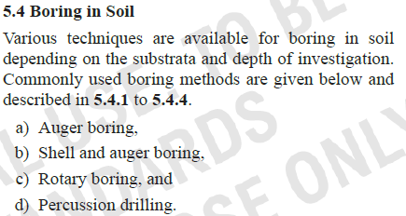
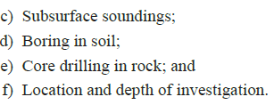
IS 1892: 2021

Slide 34
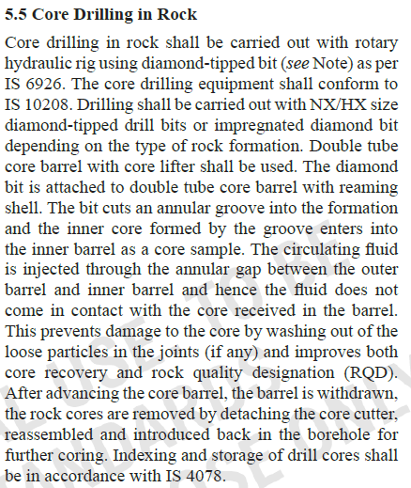
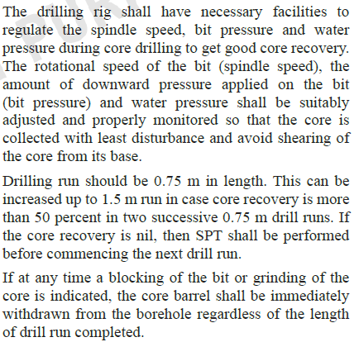
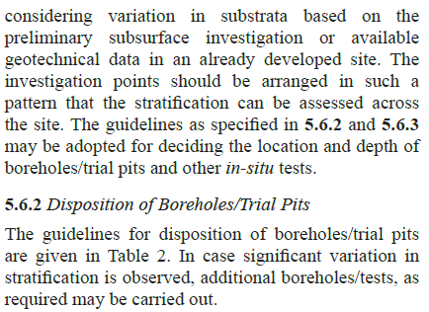
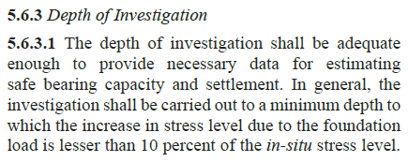
IS 1892: 2021

Slide 35
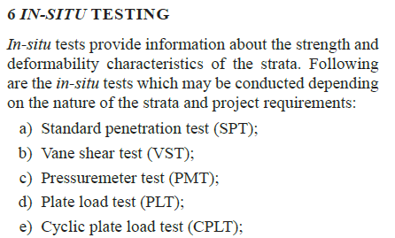
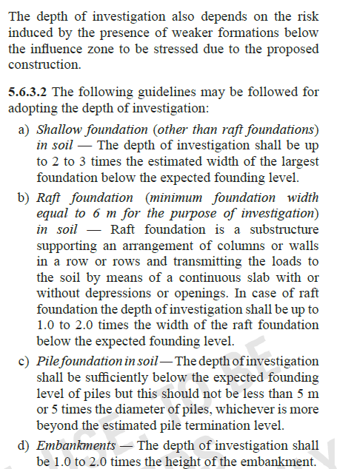
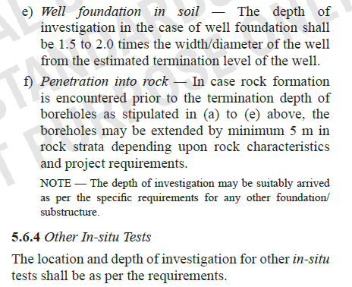
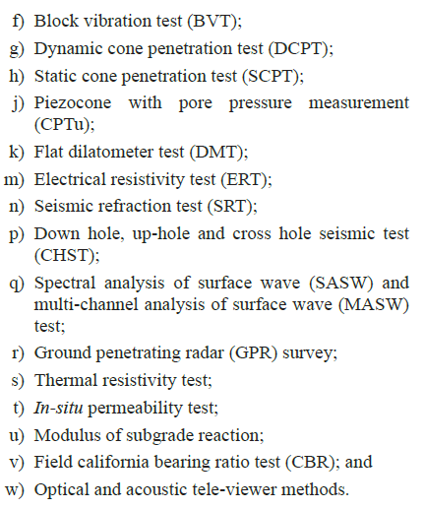
IS 1892: 2021

Slide 36
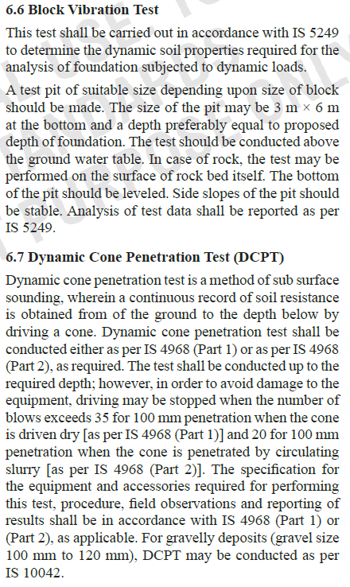
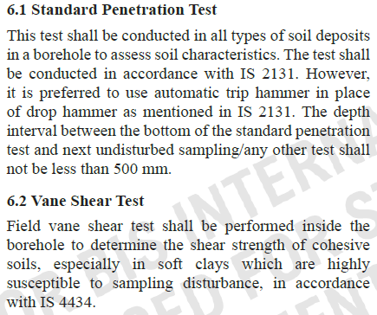
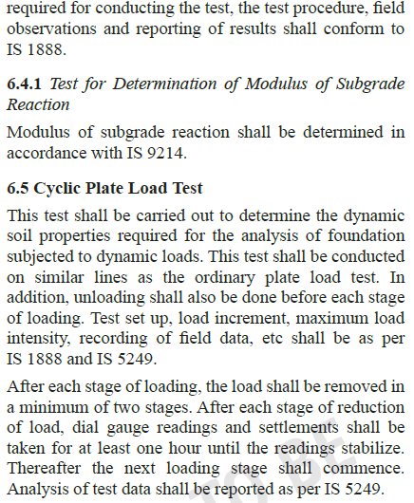
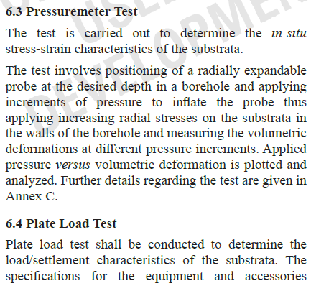
IS 1892: 2021

Slide 37
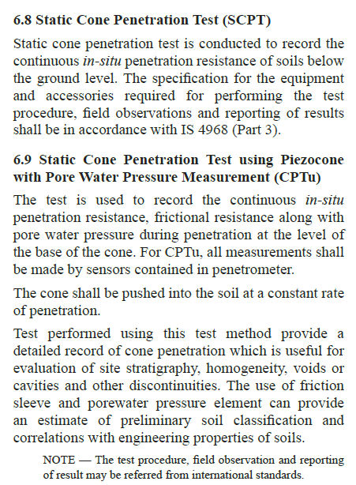
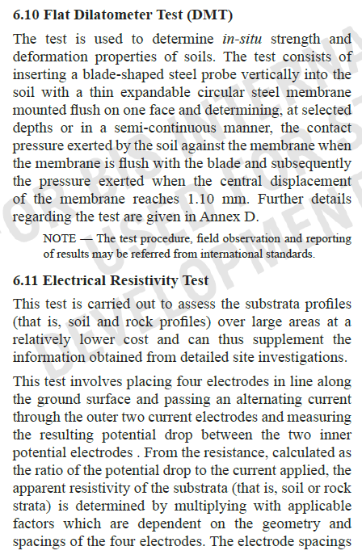
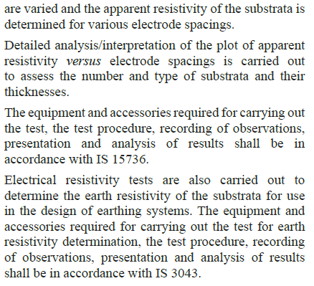
IS 1892: 2021

Slide 38
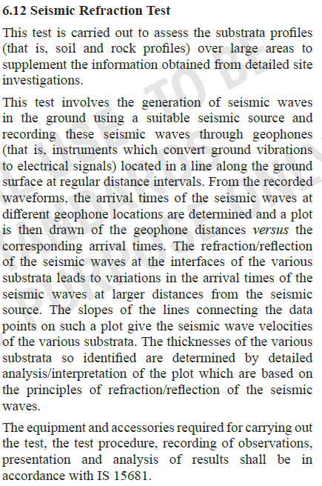
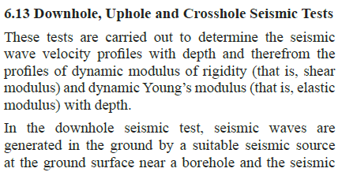
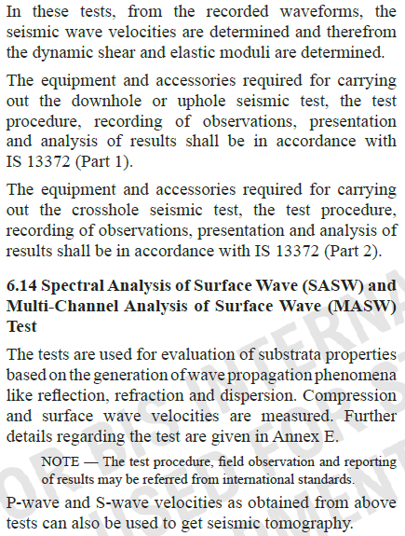
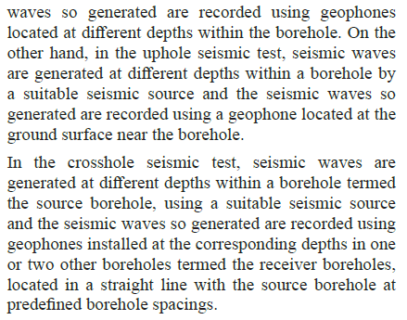
IS 1892: 2021

Slide 39
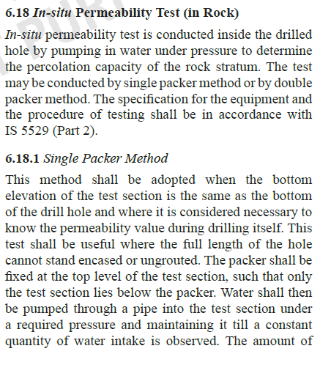
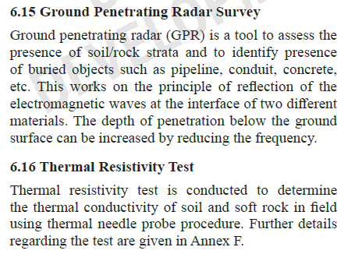
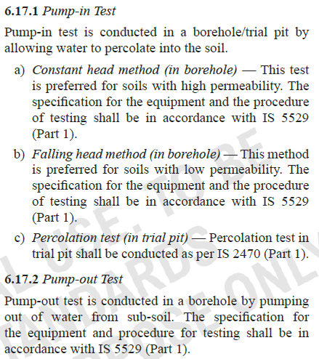
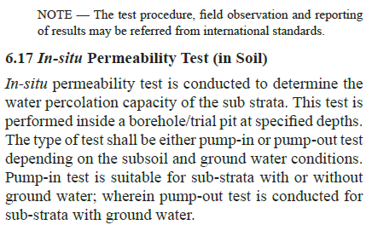
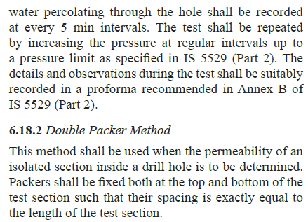
IS 1892: 2021

Slide 40
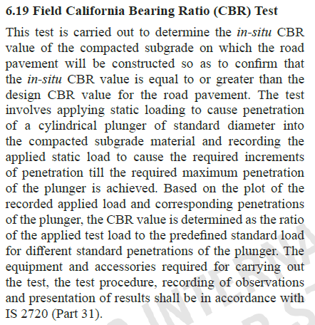
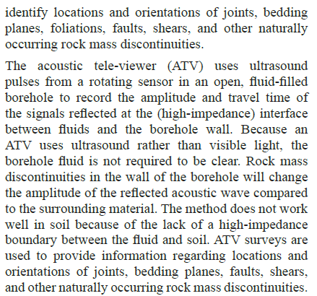
IS 1892: 2021

Slide 41
Salient Features & Analysis of IS 1892:2021
Salient Features
Scope and Application:
IS 1892:2021 covers the subsurface investigation required for planning and design of Foundations for buildings, structures including industrial structures and infrastructure projects excluding river valley projects
It applies to foundations for buildings and other structures, ensuring that they are stable and durable under various loads and conditions.
Foundation Types:
A subsurface investigation for a construction site is essential for a preliminary design and subsequently to finalize the foundation design. The object of the investigation is to provide the designer with all necessary information about the existing site and ground conditions.
It includes guidance on selecting appropriate foundation types based on soil conditions and structural requirements.
Soil Investigation:
Emphasizes the importance of a comprehensive soil investigation to determine soil properties and behaviour.
Provides guidelines on how to conduct soil testing and interpret soil reports.
Key Learnings

Slide 42
Salient Features & Analysis of IS 1892:2021………..
Design Criteria:
In view of large variations in the nature of super structures, extent of plan area and the soil strata conditions, no single method/approach can be suitable for all situations. The choice of type and number of tests and depth of test depends on the nature of substrata variation, type of loading and the type of structure proposed at a given location. This standard is intended to provide guidelines on ways to proceed in a given situation.
New Considerations (latest techniques and equipment developed and being used in the country for subsurface investigation.) :
Provisions on location and depth of investigation have been modified;
Provisions on various boring techniques have been updated and continuous soil samplers have been included;
Provisions on wash boring and mud-rotary boring have been deleted;
Series of in-situ tests have been added, such as static cone penetration test using piezocone with pore pressure measurement (CPTu), field California bearing ratio (CBR) test, cross hole seismic test (CHST), ground penetrating radar survey (GPR), spectral analysis of surface wave (SASW) and multi-channel analysis of surface wave (MASW), dilatometer test (DMT) and in-situ permeability test, etc;
f) Provisions on optical and acoustic tele-viewer methods have been added; and
g) Provisions on pressuremeter test (PMT) have been detailed.
Key Learnings

Slide 43
Salient Features & Analysis of IS 1892:2021………..
Provisions on optical and acoustic tele-viewer methods have been added
Provisions on pressure meter test (PMT) have been detailed.
Analysis
Relevance:
The standard is highly relevant for ensuring that foundations are designed and constructed with safety, durability, and efficiency in mind. It helps in preventing issues like foundation settlement, tilting, or failure which can have serious consequences for structural integrity.
Integration with Other Standards:
IS 1892:2021 is often used in conjunction with other standards, such as those related to concrete, steel, and soil mechanics, to provide a comprehensive framework for foundation design and construction.
Implementation Challenges:
While the standard provides valuable guidelines, implementing its recommendations requires skilled professionals, including structural engineers and geotechnical experts.
There may be challenges in interpreting soil data accurately and applying the correct design parameters, which necessitates ongoing training and professional development.
Impact on Safety:
By following IS 1892:2021, the likelihood of foundation-related failures is significantly reduced, enhancing the overall safety of structures. It contributes to the prevention of accidents and structural failures.
Key Learnings

Slide 44
Salient Features & Analysis of IS 1892:2021………..
Analysis……..
Economic Considerations:
Proper foundation design and construction can lead to cost savings by avoiding costly repairs and ensuring the longevity of the structure. Adhering to the standard helps in optimizing the use of materials and resources.
Adaptation to Local Conditions:
The standard takes into account local soil and climatic conditions, making it adaptable to various geographic regions within India. However, adaptations might be needed for specific regional conditions.
Key Learnings

Slide 45
General Requirements of Foundations
Load Bearing Capacity:
Soil Strength: Foundations must be designed based on the bearing capacity of the soil to support the weight of the structure.
Load Distribution: The foundation should distribute the load from the building evenly to prevent excessive settlement or failure.
2. Type of Foundation:
Shallow Foundations: Includes spread footings, mat foundations, and others suitable for relatively strong and uniform soil.
Deep Foundations: Includes piles and caissons for weaker soils or where deep support is required.
3. Settlement and Stability:
Settlement Control: Foundations must be designed to minimize differential settlement, which can cause structural issues.
Lateral Stability: Foundations must resist lateral loads and forces such as wind and seismic activity.
4. Environmental Considerations:
Water Table: High groundwater levels can affect foundation stability and may require special design considerations like waterproofing or drainage.
Soil Conditions: Soil types, such as clay, sand, or silt, can influence foundation design and construction.
5. Construction Methods:
Quality Control: Proper materials and construction practices are essential to ensure foundation integrity.
Inspection and Testing: Foundations should be inspected and tested to verify compliance with design specifications and safety standards.
6. Codes and Standards:
Compliance: Foundations must adhere to National building code and Indian standards to ensure safety and performance.
Principles & Considerations

Slide 46
Types of Foundations
Shallow Foundations are used for buildings where the soil near the surface has adequate strength to support the load, and the foundation depth is relatively shallow compared to the width. They are cost-effective and simpler to construct but are limited by soil conditions and load requirements.
Deep Foundations are necessary when the surface soil is not strong enough to support the load, requiring foundations to be extended deeper into the ground. They are used for heavier loads, in unstable soils, or where site conditions demand reaching more competent soil or rock layers.
Special foundations refer to types of foundations that are used in situations where traditional foundations (like shallow foundations) are not suitable due to unique or challenging site conditions. They are designed to address specific problems such as weak soil, high loads, or adverse environmental conditions

Slide 47
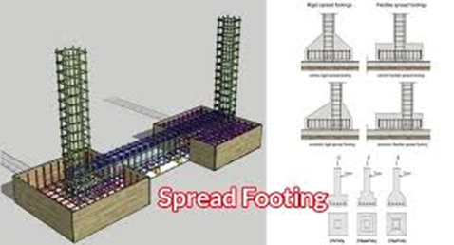
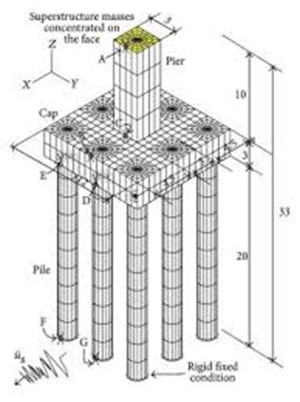
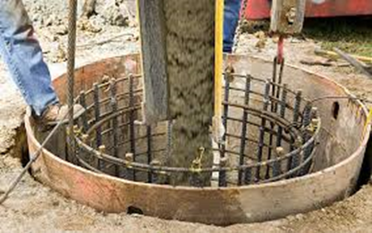
Illustrations
Shallow Foundations
Spread footings
Mat foundations
Deep Foundations
Piles
Caissons

Slide 48
Design Considerations of Shallow Foundations & Impact of application of Indian Standards
IS 456:2000 (Code of Practice for Plain and Reinforced Concrete), IS 3370 (Code of Practice for Concrete Structures for the Storage of Liquids), and IS 6403:1981 (Code of Practice for Determination of Bearing Capacity of Shallow Foundations).
Design Safety and Reliability, Load Bearing Capacity
Impact: Ensures that shallow foundations are designed to safely bear loads based on soil strength and structural requirements. It helps in preventing structural failures due to overloading or inadequate support.
IS 6403:1981 and IS 2911 (Part 1 Sec 2):2010 (Code of Practice for Design and Construction of Pile Foundations - Part 1 – Bored cast in-situ Concrete piles and Part 2 (2021) – Design and construction of piles foundation – Timber Piles)
Settlement Control
Impact :Provides guidelines for calculating expected settlements and controlling differential settlement, which is crucial for maintaining the stability and integrity of structures.
IS 1904:2021(Code of Practice for Design and Construction of Foundations- General Requirements), IS 800:2007 (General Construction in Steel - Code of Practice)
Design Consistency and Quality , Design Methodologies:
Impact: Standardizes the design approach, ensuring that all calculations, methods, and procedures follow a uniform set of practices, leading to consistency and reliability in foundation design.

Slide 49
Design Considerations of Shallow Foundations & Impact of application of Indian Standards……….
IS 456:2000 and IS 10262:2019 (Code of Practice for Concrete Mix Proportioning)
Material Specifications
IS 1498:1970 (Classification and Identification of Soils for General Engineering Purposes), IS 2720 (Part 10): 1991 (Determination of Unconfined Compressive Strength), IS 2720 (Part 13): 1986 (Direct shear test)
Environmental and Soil Considerations , Soil testing and Analysis
Impact: Ensures comprehensive soil testing and accurate classification, which are essential for designing foundations that respond appropriately to local soil conditions and environmental factors.
IS 3370: Part 2 (2021) (Concrete structures for retaining Aqueous Liquids - Part 2: Plain and Reinforced concrete)
Water Table Management:
Impact: Provides guidelines for managing high groundwater levels and incorporating waterproofing measures to prevent water-related issues that can affect foundation stability.
Impact: Defines the quality of materials such as concrete and reinforcement, ensuring that they meet the required standards for durability and strength, thus contributing to the overall quality of the foundation.

Slide 50
Design Considerations of Shallow Foundations & Impact of application of Indian Standards……….
IS 456:2000, IS 3370, IS 1904:2021.
Economic and Practical Efficiency , Cost-Effective Design
Impact: Promotes cost-effective and efficient foundation design by specifying practical methods and materials, reducing unnecessary expenditure while ensuring safety and performance.
IS 456:2000 and IS 3370.
Construction Practices:
Impact: Standardizes construction practices, leading to more efficient construction processes, reducing errors, and ensuring that foundations are built to the specified design parameters.
Regulatory and Compliance Aspects
Indian Standards, including those mentioned, are often required to comply with National building code and regulations
Impact: Ensures that designs are legally compliant, avoiding legal issues and ensuring that constructions meet regulatory requirements

Slide 51
Design Considerations of Shallow Foundations & Impact of application of Indian Standards……….
Materials:
Concrete: IS 456:2000, IS 10262:2019
Steel: IS 1786:2008, IS 432:1982
Design:
Foundations: IS 1904:2021, IS 6403:1981
Concrete Mix Design: IS 10262:2019
Soil Mechanics: IS 1498:1970
Construction Practices:
Concrete Construction: IS 456:2000, IS 3370
Soil Testing: IS 2720
Quality Assurance Various Indian Standards for materials, design, and construction practices
Impact: Provides a framework for quality assurance and control, helping to maintain high standards throughout the design and construction phases.
Standards Applied: IS 456:2000, IS 3370
Sustainability and Future-Proofing, Long term Performance
Impact: Emphasizes durability and long-term performance, ensuring that foundations remain stable and functional throughout their intended lifespan, contributing to sustainable construction practices.
Standards Applied: IS 1904:2021 and other related standards
Adaptability
Impact: Facilitates adaptability to different site conditions and construction needs, allowing for adjustments and modifications as required by changing conditions or new findings.

Slide 52
Application of Indian Standards for Design of Deep Foundations (Impact Factor Analysis)
Standards for Design:
IS 2911 – Code of Practice for Design and Construction of Pile Foundations
Part 1: Concrete piles-Bored cast/Driven cast In-situ concrete piles
Part 2: Timber piles
Ensuring Safety and Reliability
Impact: Ensures that pile foundations are designed to safely support loads, with guidelines for assessing the load-carrying capacity and conducting load tests to validate design assumptions.
IS 1786:2008 – High Strength Deformed Steel Bars and Wires for Concrete Reinforcement
IS 456:2000 – Code of Practice for Plain and Reinforced Concrete
O
Standards for Material Quality
Impact: Ensures that the steel used in deep foundations meets strength and durability requirements, enhancing the structural integrity of the piles.
IS 2911 – Code of Practice for Design and Construction of Pile Foundations
Overview: Provides standardized procedures for the design and construction of piles.
Improving Design Consistency and Efficiency , Standardised Design Procedures
Impact: Guarantees that the concrete used in pile foundations has the required strength and durability, contributing to the overall safety and longevity of the structure.
Impact: Ensures consistency in design practices, reducing variability and improving reliability in pile foundation design.

Slide 53
Application of Indian Standards for Design of Deep Foundations (Impact Factor Analysis)………..
IS 2911 – Code of Practice for Design and Construction of Pile Foundations- Bored cast in situ and driven cast in situ concrete Piles
Part 1 Sec 1 & 2: General Requirements (2010)
Efficient Load Distribution, Enhancing Construction Quality and Practices
Impact: Provides guidelines for distributing loads effectively through pile foundations, which helps in optimizing design and construction costs. Outlines best practices for pile installation, including driving methods, boring techniques, and grouting, ensuring high construction quality and performance
IS 456:2000 – Code of Practice for Plain and Reinforced Concrete
IS 2911 – Part 4: 2013 Design and construction of Piles foundations – Load test on Piles
Quality Control, Inspection & Testing
Impact: Emphasizes quality control in the production and placement of concrete for piles, reducing defects and enhancing durability. Specifies methods for load testing to verify the performance of pile foundations, ensuring that they meet design specifications and perform as expected.
IS 1498:1970 – Classification and Identification of Soils for General Engineering Purposes
Overview: Provides guidelines for classifying and identifying soils, which is crucial for designing deep foundations
IS 2720 – Methods of Test for Soils
Addressing Environmental and Site-Specific Conditions, Soil & Site conditions
Impact: Helps in selecting appropriate foundation types and designing piles that can effectively transfer loads to deeper, more stable soil or rock layers.
Ensures accurate soil testing and analysis, which is essential for determining the appropriate design parameters for deep foundations.

Slide 54
Application of Indian Standards for Design of Deep Foundations (Impact Factor Analysis)………..
Indian Standards provide a framework for compliance with National building code and regulations.
IIS 2911 – Code of Practice for Design and Construction of Pile Foundations
I
Regulatory and Compliance Benefits. Legal and Regulatory Compliance, Documentation and Reporting
Impact: Ensures that deep foundation designs adhere to legal and regulatory requirements, reducing the risk of legal issues and ensuring safety and performance.. Provides standardized documentation and reporting procedures for deep foundation projects, facilitating clear communication and record-keeping
IS 456:2000 – Code of Practice for Plain and Reinforced Concrete
Long-Term Performance and Sustainability. Durability & Maintenance
Impact: Ensures that concrete used in deep foundations is durable and resistant to environmental factors, contributing to the long-term performance and sustainability of the foundation.
IS 2911 – Code of Practice for Design and Construction of Pile Foundations
I
Adaptability
Impact: Allows for adaptability in design and construction methods based on site-specific conditions and load requirements, supporting sustainable practices.

Slide 55
Extract of Indian Standards
Key Learnings, Implications & Analysis

Slide 56
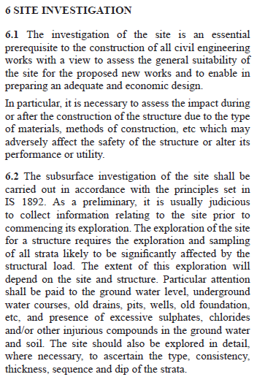
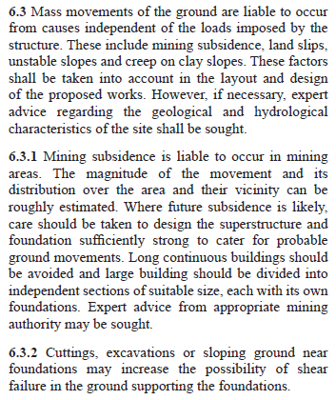
IS 1904: 2021

Slide 57
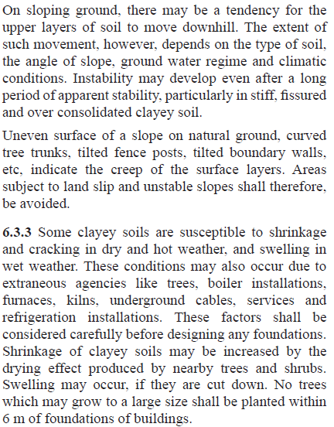
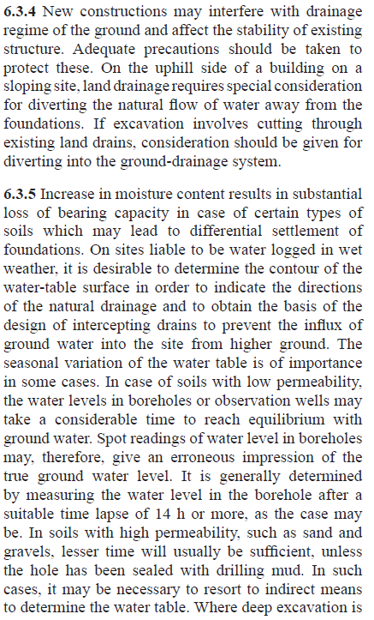
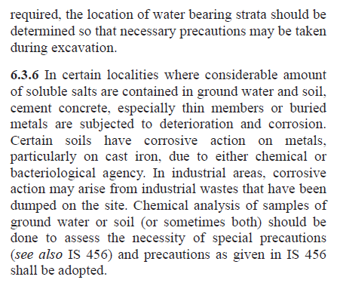
IS 1904: 2021

Slide 58
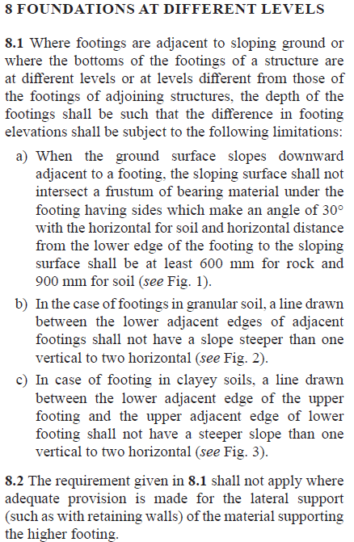
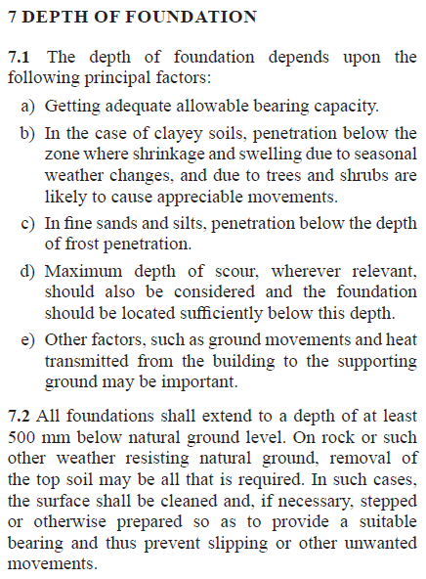
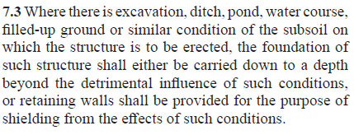
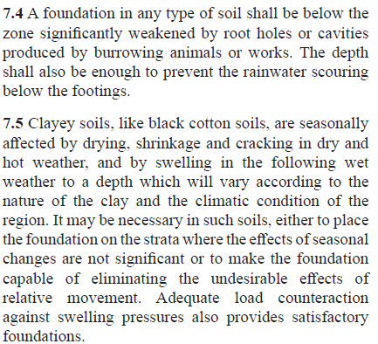
IS 1904: 2021

Slide 59
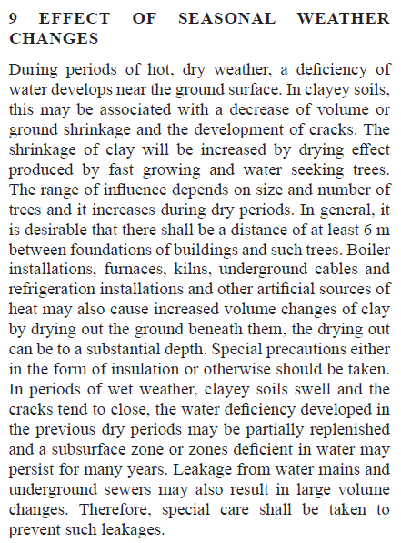
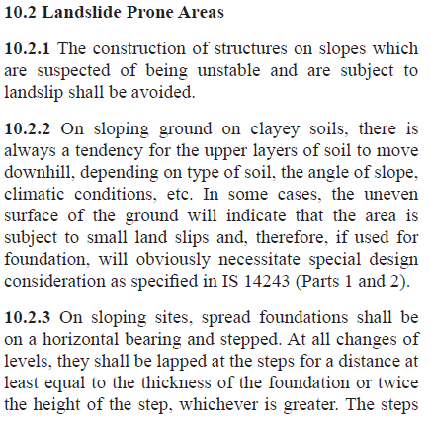
IS 1904: 2021

Slide 60
IS 1904: 2021

Slide 61
IS 1904: 2021

Slide 62
Salient Features & Analysis of IS 1904:2021
Salient Features
Scope and Applicability:
IS 1904:2021 applies to the General Requirements for design and construction of foundations in soils for buildings and other structures, including both shallow and deep foundations.
It addresses various types of foundations, such as isolated footings, combined footings, strap footings, rafts, piles, and caissons.
Soil and Site Investigation:
Emphasizes the necessity of thorough soil investigation and site analysis.
Provides guidelines on soil testing methods and interpretation of soil properties to inform foundation design.
Load Considerations:
Details methodologies for considering different types of loads on foundations, including dead loads, live loads, wind loads, and seismic loads.
Provides a framework for calculating load distribution and designing foundations to safely carry these loads.
Design Criteria:
Specifies design criteria and safety factors for foundation design to ensure structural stability and safety.
Includes recommendations for minimum depths, load-bearing capacities, and settlement limits.
Understanding its implications

Slide 63
Salient Features & Analysis of IS 1904:2021………
Construction Practices:
Outlines best practices for the construction of foundations to ensure adherence to design specifications.
Covers aspects such as material quality, workmanship, and construction methods.
Updates from Previous Versions:
Reflects the latest advancements in engineering practices, materials, and technology, incorporating changes from earlier versions of the standard.
Analysis
Relevance and Importance:
IS 1904:2021 is crucial for ensuring that foundations are designed and constructed to be safe, stable, and durable. It helps prevent foundation-related issues such as excessive settlement or structural instability.
Integration with Other Standards:
The standard complements other related standards in structural design and materials. It is often used alongside standards dealing with concrete, steel structures, and geotechnical engineering.
Implementation Considerations:
The effective implementation of IS 1904:2021 requires skilled professionals, including structural engineers, geotechnical engineers, and construction managers. Proper training and adherence to the guidelines are essential.
Understanding its implications

Slide 64
Salient Features & Analysis of IS 1904:2021……..
Economic and Practical Benefits:
Proper foundation design and construction can lead to cost savings by avoiding expensive repairs and ensuring the longevity of the structure. It also helps in optimizing the use of materials and resources.
Impact on Safety and Reliability:
By adhering to IS 1904:2021, the likelihood of foundation failures is significantly reduced, enhancing the overall safety and reliability of structures. It contributes to preventing accidents and ensuring structural integrity.
Adaptation to Local Conditions:
The standard is designed to be applicable across various geographic regions in India, taking into account local soil and climatic conditions. However, specific regional adjustments may be needed for certain locations.
Challenges and Limitations:
Implementing the standard effectively may present challenges, such as accurately interpreting soil data and applying appropriate design parameters. Continuous professional development and training are necessary to address these challenges.
In summary, IS 1904:2021 is a critical standard for the design and construction of foundations, offering comprehensive guidelines to ensure that foundations are safe, stable, and well-suited to their intended loads and site conditions. Its detailed provisions for soil investigation, load considerations, design criteria, and construction practices make it an essential tool for engineers and construction professionals.
Understanding its implications

Slide 65
Ground Improvement
Ground improvement in civil engineering refers to various techniques used to enhance the physical properties of soil and other ground materials to make them more suitable for construction purposes. These methods are employed to address issues like poor soil stability, inadequate bearing capacity, or excessive settlement. The goal is to improve the performance of the ground to ensure the safety, stability, and longevity of structures built upon it.
Key Techniques
Compaction
Grouting
Soil Stabilization
Vibro compaction and Vibro-replacement
Deep Soil Mixing
Drainage Systems
Geosynthetics
Dynamic Compaction
Preloading and Surcharging
Definition and importance of ground improvement in civil engineering
Challenges addressed by ground improvement techniques

Slide 66
Importance of Ground Stabilization /improvement
Significance of Ground Improvement
Foundation Stability
Safety & Cost Efficiency
Longevity of Structures
Environmental Impact
Construction Feasibility
Mitigating Natural Hazards

Slide 67
Indian Standards for Ground Improvement
IS 15284:Part 1/Part 2 - Guidelines for Ground Improvement Techniques
IS 2911:(Part 1-4) - Code of Practice for construction of pile foundations
IS 15284:2003 - Guidelines for Ground Improvement Techniques Using Stone Columns
Key provisions and guidelines for implementing ground improvement techniques
Relevant IS Specifications

Slide 68
Impact of Application of Indian standards for Ground Improvement
IS 6403:1981 - Code of Practice for Determination of Bearing Capacity of Shallow Foundations
Impact: Provides guidelines for evaluating the bearing capacity of foundations. Ground improvement methods like soil stabilization and reinforcement are often designed to enhance the soil's bearing capacity to meet these standards.
IS 1498:1970 - Classification and Identification of Soils for General Engineering Purposes
Impact: Helps in soil classification, which is crucial for selecting appropriate ground improvement techniques. For example, clayey soils may require different stabilization methods compared to sandy soils.
IS 15284 (Part 1):2003 - Code of Practice for Design and construction for ground improvement- Stone columns
Impact: Provides guidelines for the design and construction of ground improvement by stone columns, a common ground improvement technique used to increase load-bearing capacity and stability of foundations.

Slide 69
Impact of Application of Indian standards for Ground Improvement………..
IS 2911 (Part 1/Sec 1):2010 - Code of Practice for Design and Construction of Pile Foundations: Part 1 – Driven cast in-situ concrete piles
Impact: Specifies procedures for the construction of bored piles, impacting techniques like ground improvement through pile foundation methods, including grouting and pile reinforcement.
IS 456:2000 - Code of Practice for Plain and Reinforced Concrete
Impact: While primarily for concrete, this standard influences ground improvement by ensuring that concrete used in foundation elements and ground improvement techniques (like underpinning) meets strength and durability requirements.
IS 6403:1981 - Code of Practice for Determination of Bearing Capacity of Shallow Foundations
Impact: Ensures that the bearing capacity of soils, after ground improvement, meets required safety and design criteria for shallow foundations.

Slide 70
Impact of Application of Indian standards for Ground Improvement………
IS 6066:1994 – Pressure Grouting on Rock foundations for River valley projects - Code of Practice for Grouting of Foundations
Impact: Provides guidelines for grouting, a common ground improvement technique used to enhance soil properties and fill voids.
IS 3370 (Part 2):2021 - Code of Practice for Concrete Structures for the Storage of Liquids
Impact: Influences ground improvement techniques related to the construction of liquid storage tanks and structures, including soil stabilization and foundation design.
IS 4332 – Method of tests for Stabilized Soils
Impact: Specifically addresses methods of tests for soil stabilization thus, significantly impacting effectiveness of various ground improvement techniques

Slide 71
Impact of Application of Indian standards for Ground Improvement……….
IS 13094:2021– Selection of ground improvement techniques for foundations in weak soils
Impact: Provides guidelines for ground improvement technique used for stabilizing and reinforcing soil. This is critical for slopes, embankments, and excavation support.
IS 3370 (Part 1):2021 - Code of Practice for the Design and Construction of Reinforced Concrete Structures for the Storage of Liquids
I
Impact: Although primarily for liquid storage structures, it impacts ground improvement related to these structures, including the design and reinforcement of foundation elements.
IS 9103:1999 - Specification for Admixtures for Concrete
Impact: Defines the requirements for concrete admixtures, influencing ground improvement techniques that involve concrete, such as grout for soil stabilization or foundation underpinning.

Slide 72
Comparison of ground improvement techniques with and without adherence to IS codes
With Adherence to IS Codes
Without adherence to IS Codes
Soil Stabilization
Standards: IS 2720 (Part 10):1991, IS 1498:1970
Techniques: Lime stabilization, cement stabilization
Benefits:
Quality Assurance: IS codes provide standardized methods for mixing ratios, application procedures, and testing, ensuring consistent quality.
Safety: Ensures that the soil stabilization meets the required strength and durability, reducing the risk of failure.
Performance: Better predictability of soil behaviour under load, leading to more reliable engineering designs.
Documentation: Adherence to IS codes ensures thorough documentation and traceability of procedures and results.
Techniques: Varying methods not standardized
Risks:
Inconsistency: Lack of standardized procedures may lead to inconsistent results and performance.
Quality Issues: Potential for improper mixing ratios or application methods, which can affect the effectiveness of stabilization.
Safety Concerns: Higher risk of structural failure or unexpected soil behaviour due to unverified methods.
Documentation and Verification: Lack of standardized documentation may complicate verification and quality control.

Slide 73
Comparison of ground improvement techniques with and without adherence to IS codes………..
With Adherence to IS Codes
Without adherence to IS Codes
Grouting
Standards: IS 2116:1980 (for fine aggregate for masonry mortar), IS 456:2000 (for reinforced concrete)
Techniques: Cement grouting, chemical grouting
Benefits:
Standardization: Provides guidelines for grout materials, mixing ratios, and application techniques, ensuring uniformity.
Effectiveness: Ensures that the grouting process effectively fills voids and improves soil properties.
Safety: Adheres to safety standards for material handling and application, reducing risks of improper grout application.
Testing: Provides methods for testing the quality and effectiveness of the grout.
Techniques: Non-standardized grouting procedures
Risks:
Effectiveness: Unverified methods may result in incomplete void filling or insufficient improvement in soil properties.
Inconsistency: Variation in grout quality and application can lead to unpredictable performance.
Safety: Increased risk of health hazards or unsafe working conditions due to lack of standardized safety procedures.
Quality Control: Difficulties in assessing and ensuring the quality of the grouting process.

Slide 74
Comparison of ground improvement techniques with and without adherence to IS codes………..
With Adherence to IS Codes
Without adherence to IS Codes
Dynamic Compaction
Standards: IS 2131:1981 (for soil testing)
Techniques: Heavy weight dropped from a height to compact soil
Benefits:
Precision: IS codes provide guidelines on impact energy, drop height, and compaction patterns, ensuring effective compaction.
Quality Assurance: Ensures uniformity and effectiveness in increasing soil density and strength.
Testing: Includes procedures for testing the improved soil, ensuring it meets design specifications.
Techniques: Ad-hoc or inconsistent compaction practices
Risks:
Ineffectiveness: Variability in techniques can lead to uneven compaction and inadequate soil improvement.
Quality Issues: Difficulty in ensuring consistent compaction quality.
Safety: Increased risk of accidents due to non-standardized equipment and methods.

Slide 75
Challenges and Considerations
Technological Advancements
Innovation in Materials and Techniques: New materials and construction technologies emerge regularly. Updated codes integrate these innovations to ensure that they are used safely and effectively.
Improved Testing Methods: Advances in testing methods and equipment can lead to more accurate and efficient assessments of materials and construction practices.
2. Enhanced Safety and Performance
Updated Safety Standards: As understanding of materials and structural behaviour evolves, safety standards must be updated to reflect new knowledge and prevent accidents or failures.
Improved Performance Criteria: Revisions incorporate new performance data and research findings to enhance the durability, reliability, and efficiency of construction practices.
3. Compliance with International Standards
Global Harmonization: Aligning IS codes with international standards (like ISO) helps in maintaining consistency and facilitates global trade and collaboration.
Benchmarking: Comparing with international best practices ensures that Indian standards are competitive and up-to-date.
Need for continuous updates and revisions of IS codes
Implementation challenges and solutions
Training and awareness among stakeholders

Slide 76
Challenges and Considerations……
Addressing Practical Issues
Feedback from Industry: Practical experiences and feedback from professionals and industry practitioners can highlight areas where codes may need improvement or clarification.
Lessons from Failures: Analysis of past failures and issues in construction practices can lead to revisions that address identified weaknesses.
5. Regulatory and Legal Requirements
Compliance: Updated codes ensure compliance with current regulatory and legal requirements, which can change over time due to new laws or regulations.
Insurance and Liability: Adhering to updated standards helps in managing insurance and liability issues, ensuring that practices meet current legal and insurance requirements.
6. Environmental and Sustainability Concerns
Sustainable Practices: Revisions can incorporate guidelines for environmentally friendly and sustainable construction practices, reflecting growing awareness of environmental issues.
Resource Efficiency: Updates can promote the efficient use of resources, reducing waste and improving overall sustainability in construction.
7. Addressing Emerging Challenges
Climate Change: Codes may need updates to address issues related to climate change, such as increased resilience to extreme weather events.
Urbanization: As urban areas grow and become more complex, codes must be revised to address the challenges associated with high-density construction and infrastructure.
Need for continuous updates and revisions of IS codes
Implementation challenges and solutions
Training and awareness among stakeholders

Slide 77
Challenges and Considerations……
Professional and Academic Input
Research and Academia: Contributions from research and academic institutions provide new insights and data that can be used to refine and improve standards.
Professional Expertise: Continuous input from industry experts helps in keeping the standards practical and relevant to current practices.
Examples of Areas Requiring Updates
Building Materials: New types of concrete, steel, and other materials that may offer improved performance or sustainability.
Construction Methods: Advances in construction techniques, such as prefabrication or modular construction.
Testing Standards: Enhanced methods for testing soil, materials, and structural components.
Structural Design: New insights into seismic design, load requirements, and structural safety.
Process for Updates and Revisions
Review and Feedback: Periodic review of existing standards and collection of feedback from stakeholders.
Research and Analysis: Incorporation of new research findings and technological advancements.
Drafting Revisions: Updating the code draft based on research and feedback.
Consultation and Approval: Engaging with industry experts and regulatory bodies for consultation and approval.
Publication and Dissemination: Publishing the revised code and ensuring widespread dissemination to relevant stakeholders.
Need for continuous updates and revisions of IS codes
Implementation challenges and solutions
Training and awareness among stakeholders

Slide 78
Challenges……..
Addressing these challenges involves a combination of training, resource investment, stakeholder engagement, and regulatory support. By tackling these issues systematically, the implementation of IS codes/Standards can be made more effective, ensuring that construction and engineering practices meet high standards of quality, safety, and efficiency.

Slide 79
A typical Case Study
Step-by-Step Application of Indian Standards
1. Site Investigation and Soil Testing
Standards Applied:
IS 1892:2021 - Code of Practice for Subsurface Soil Investigation
IS 6403:1981 - Code of Practice for Determination of Bearing Capacity of Shallow Foundations
Procedure:
Soil Investigation: Conducted a comprehensive soil investigation to assess soil properties, including soil strength, compressibility, and groundwater conditions.
Tests Performed: Standard Penetration Test (SPT), Cone Penetration Test (CPT), Laboratory tests (e.g., Atterberg limits, soil classification, shear strength).
Findings:
Soil layers consisted of loose sandy soil with low to medium strength.
High groundwater table was observed, which could affect foundation stability.
Design Considerations:
Based on the soil investigation, it was determined that the soil’s bearing capacity was insufficient for shallow foundations.
The high groundwater table necessitated special consideration for foundation design to prevent potential uplift and ensure stability.
Project Overview
Project Name: Apex Towers
Location: Mumbai, India
Type: High-rise residential building
Height: 30 stories
Foundation Type: Piled foundation
Soil Type: Loose sandy soil with varying water table levels

Slide 80
Case Study……
. Foundation Design
Standards Applied:
IS 456:2000 - Code of Practice for Plain and Reinforced Concrete
IS 3370: Part 2: 2021 - Code of Practice for Concrete Structures for Storage of Liquids
IS 2911: Part 1/Sec 1: 2010 - Code of Practice for Design and Construction of Pile Foundations (Bored Cast-In-Situ Piles)
Design Process:
Foundation Type: Decided on a piled foundation to transfer loads to deeper, more stable soil strata.
Piles: Bored piles were chosen due to the loose nature of the surface soil and high groundwater table.
Pile Design:
Load Calculation: Used IS 456 and IS 2911 to determine the load-carrying capacity of piles, ensuring they could handle the building’s loads.
Pile Dimensions and Spacing: Designed based on soil bearing capacity, pile load testing results, and structural requirements.
Project Overview
Project Name: Apex Towers
Location: Mumbai, India
Type: High-rise residential building
Height: 30 stories
Foundation Type: Piled foundation
Soil Type: Loose sandy soil with varying water table levels

Slide 81
Case Study……
Foundation Construction
Standards Applied:
IS 1200 - Methods of Measurement of Building and Civil Engineering Works
IS 456:2000 - Code of Practice for Plain and Reinforced Concrete
Construction Practices:
Quality Control: Implemented strict quality control measures during pile installation and concrete pouring.
Materials: Ensured that concrete mix adhered to IS 456 specifications for strength and durability.
Inspection: Regular inspections were carried out to monitor construction practices and compliance with design specifications.
Waterproofing: Applied waterproofing measures to address potential water ingress due to the high groundwater table, following guidelines from IS 3370.
4. Monitoring and Maintenance
Standards Applied:
IS 1200 - Methods of Measurement of Building and Civil Engineering Works
IS 1892:2021 - Code of Practice for Subsurface Soil Investigation
Project Overview
Project Name: Apex Towers
Location: Mumbai, India
Type: High-rise residential building
Height: 30 stories
Foundation Type: Piled foundation
Soil Type: Loose sandy soil with varying water table levels

Slide 82
Case Study……
Monitoring:
Settlement Monitoring: Installed settlement markers to monitor any movement in the foundation.
Inspection Schedule: Established a routine inspection schedule to ensure the foundation’s long-term stability and address any issues promptly.
Maintenance:
Periodic Checks: Conducted regular checks and maintenance as per IS 1892 guidelines to address any settlement issues or structural concerns.
Conclusion
The application of Indian Standards in soil mechanics and foundation engineering ensured that the Apex Towers project was designed and constructed with a high degree of safety and efficiency. The comprehensive soil investigation guided the selection of a piled foundation, while adherence to standards ensured that the design and construction processes were robust and reliable.
Project Overview
Project Name: Apex Towers
Location: Mumbai, India
Type: High-rise residential building
Height: 30 stories
Foundation Type: Piled foundation
Soil Type: Loose sandy soil with varying water table levels

Slide 83
Case Study……..
Enhanced Safety: Proper soil investigation and pile design minimized the risk of foundation failure and structural issues.
Cost Efficiency: Efficient use of materials and construction practices helped control costs while maintaining high safety standards.
Long-term Stability: Regular monitoring and adherence to maintenance guidelines ensured the long-term stability and performance of the foundation.
This case study illustrates the practical application of Indian Standards to address real-world challenges in foundation engineering, ensuring that engineering practices are aligned with safety, quality, and performance requirements.
Benefits Observed

Slide 84
Glimpses of Extracts of Few Indian Standards on Soil Mechanics & Foundation Engineering
For Reference purposes

Slide 85
IS 1498:1970

Slide 86
IS 1498:1970

Slide 88
IS 456 : 2000

Slide 89
IS 6403: 1981

Slide 90
IS : 2720 ( Part II ) - 1973
IS : 2720 ( Part IV ) - 1985

Slide 91
IS : 2720 ( Part VI ) - 1985

Slide 92
IS 13301: 1992

Slide 93
IS 13301: 1992

Slide 94
IS 2911:Part 4: 2013

Slide 95
IS 2911:Part 4: 2013

Slide 96
IS 2911:Part 4: 2013

Slide 97
IS 2911:Part 4: 2013

