Slide 1
MECHANICAL TESTING OF METALS
1
Kunal Kumar Scientist-E
Metallurgical Engineering Department Bureau of Indian Standards www.bis.gov.in

Slide 2
Standard
2
🠶 A standard is a document, established by consensus and approved by a recognized body, that provides, for common and repeated use, rules, guidelines or characteristics for activities or their results, aimed at the achievement of the optimum degree of order in a given context (see ISO Guide 2).
🠶 Standards are refined and purified form of that subject.
🠶 The process of standard development is based on the core principle of Openness, transparency, impartiality and consensus.
🠶 Standard can be a product specification, a code of practice, a terminology standard, a process specification, a service specification, a test method, system specification, dimensions, etc. (see ISO/IEC Guide 2).
NOTE – Standards should be based on the consolidated results of science, technology and experience, and aimed at the promotion of optimum community benefits. A Standard is a document setting out good practices established by consensus subject to public consultation and approved by a national committee.

Slide 3
Stages of Formulation of Indian Standards
3
Identification of Need:
🠶 Stakeholder Input: Industry, government, consumers, and other stakeholders identify the need for a new standard or revision of an existing one.
🠶 Market Demand: Emerging technologies, market requirements, or regulatory changes may drive the need for new standards.
Proposal Stage:
🠶 New Work Item Proposal (NWIP): A proposal for a new standard or revision is submitted to the Bureau of Indian Standards (BIS).
🠶 Approval: The relevant technical committee reviews and approves the proposal for further action.
Preparatory Stage:
🠶 Working Group Formation: A working group of experts is formed to draft the standard.
🠶 Initial Draft: The working group prepares the initial draft of the standard based on research, existing international/national standards, and expert input.

Slide 4
Stages of Formulation of Indian Standards
4
4. Committee Stage:
🠶 Technical Committee Review: The draft standard is reviewed by the relevant technical committee, which includes representatives from industry, government, academia, and other stakeholders.
🠶 Comments and Revisions: Feedback is collected, and the draft is revised accordingly to address comments and suggestions.
Public Comment Stage:
🠶 Public Circulation: The draft standard is circulated for public comments, allowing a wider range of stakeholders to provide input.
🠶 Feedback Collection: Comments from the public are collected, reviewed, and incorporated into the draft as necessary.
Finalization Stage:
🠶 Technical Committee Approval: The revised draft, incorporating public comments, is reviewed
and approved by the technical committee.
🠶 Draft Indian Standard (DIS): The final draft is prepared and submitted for formal approval.

Slide 5
Stages of Formulation of Indian Standards
5
7. Approval Stage:
🠶 Sectional Committee Approval: The sectional committee approves the final draft standard.
🠶 BIS Council Approval: The BIS Council, which oversees the activities of BIS, gives final approval for the standard.
Publication Stage:
🠶 Notification: The approved standard is notified and published by BIS.
🠶 Availability: The new or revised standard is made available to the public and stakeholders through BIS publications and online portals.
Review and Revision:
🠶 Periodic Review: Standards are periodically reviewed to ensure they remain relevant and up- to-date.
🠶 Amendments and Revisions: Based on the review, standards may be amended or revised to reflect technological advancements, regulatory changes, and industry needs.

Slide 6
Need for Standards on Various Mechanical Testing of Metals
6
Consistency and Uniformity:
🠶 Standard Procedures: Standards ensure that mechanical tests are conducted in a consistent and uniform manner across different laboratories and locations.
🠶 Comparable Results: By following standardized methods, results from different sources are comparable, reducing discrepancies caused by varying testing procedures.
Accuracy and Precision:
🠶 Defined Protocols: Standards provide precise protocols for sample preparation, test conditions, and measurement techniques, ensuring high accuracy and precision.
🠶 Minimizing Variability: Adhering to standards helps minimize variability and errors in test results, leading to more reliable data.
Quality Assurance:
🠶 Material Certification: Standards are used to certify the quality and performance of materials, ensuring they meet specified criteria.
🠶 Quality Control: Consistent testing procedures enable effective quality control and assessment of materials used in critical applications.

Slide 7
Need for Standards on Various Mechanical Testing of Metals
Safety and Reliability:
Stru⁷ctural Integrity: Standards ensure that materials used in construction, aerospace, automotive, and other critical industries have the necessary mechanical properties to ensure safety and reliability.
🠶 Failure Prevention: Accurate testing helps identify potential weaknesses and prevent material failures, contributing to overall safety.
Design and Engineering:
🠶 Material Selection: Engineers rely on standardized test data to select appropriate materials based on their mechanical properties.
🠶 Performance Prediction: Standards provide essential data for predicting material performance under different conditions, aiding in design and analysis.
International Trade:
🠶 Global Compatibility: Internationally recognized standards facilitate global trade by ensuring that test results are trusted and accepted worldwide.
🠶 Regulatory Compliance: Standards ensure compliance with international regulations and requirements, allowing materials to be used in global markets.
Research and Development:
🠶 Benchmarking: Standards provide benchmarks for comparing new materials and innovations against established criteria.
🠶 Innovation Support: Consistent testing methods enable researchers to develop and test new materials with predictable and reliable
properties.

Slide 8
MTD 3 – Mechanical Testing of Metals Sectional Committee
8
🠶 Scope : Standardization in the field of “Mechanical Testing of Metals”.
🠶 This committee has formulated 105 standards. List of the standards can be seen and downloaded from www.standardsbis.in.
🠶 Some of the important standards are detailed in next slides.

Slide 9
Principle of Mechanical Testing of Metals
9
🠶 The principle of mechanical testing of metals
involves
evaluating their mechanical properties to determine their suitability for specific applications. These tests assess properties such as strength, hardness, ductility, toughness, and fatigue resistance. .

Slide 10
INDIAN STANDARDS ON MECHANICAL TESTING OF METALS
10
Tensile Testing
IS 1608 / ISO 6892 Metallic materials - Tensile testing
Part 1 Method of test at room temperature (Fourth Revision)
Part 2 Method of Test at Elevated Temperature (Fourth Revision)
Part 3 Method of test at low temperature
Hardness Testing
Brinell’s Hardness Test
IS 1500 / ISO 6506 Metallic materials - Brinell hardness test
Part 1 Test Method (Fifth Revision)
Part 2 Verification and calibration of testing machines
Part 3 calibration of reference blocks (Fifth Revision)
Part 4 table of hardness values (Fifth Revision)

Slide 11
INDIAN STANDARDS ON MECHANICAL TESTING OF METALS
11
Knoop Hardness Test
IS 6885 / ISO 4545 Metallic Materials — Knoop Hardness Test
Part 1 Test Method (Second Revision)
Part 2 Verification and Calibration of Testing Machines (Second Revision)
Part 3 Calibration of Reference Blocks (Second Revision)
Part 4 Tables of Hardness Values (Second Revision)
Hardness Testing
IS 17149 : Part 1 : 2019 /ISO 16859-1 : 2015 Metallic materials - Leeb
hardness test: Part 1 Test Method

Slide 12
INDIAN STANDARDS ON MECHANICAL TESTING OF METALS
12
Impact Tests
Charpy V-notch Test
IS 1757 (Part 1) : 2020/ISO 148-1:2016- Metallic Materials — Charpy
Pendulum Impact Test Part 1 Test Method (Fourth Revision)
Izod Impact
IS 1598 : 1977 - Method for izod impact test of metals (First Revision)

Slide 13
INDIAN STANDARDS ON MECHANICAL TESTING OF METALS
13
Vocabulary
IS 5069 : 2018 / ISO 23718 Metallic Materials - Mechanical Testing - Vocabulary (Second Revision)
Bend Tests
IS 1599 : 2019 / ISO 7438 : 2016 - Metallic materials - Bend test (Fourth Revision)
IS 2329 : 2005 / ISO 8491:1998 Metallic materials - Tube (In Full Section) - Bend test (Second Revision

Slide 14
14
1
IS 1608
Metallic Materials - Tensile Testing

Slide 15
IS 1608 Metallic Materials - Tensile Testing
15
PARTS & SCOPE
This standard has three parts
Part 1 Method of test at room temperature
Part 2 Method of test at elevated temperature
Scope : This document specifies a method of tensile
Part 3 Method of test at low temperature
Scope : This part of IS 1608 / ISO 6892 specifies the
Scope : This part of IS 1608 / ISO 6892 specifies a
method for tensile testing of metallic materials and defines the mechanical properties which can be determined at room temperature.(10°C to 35°C)
testing of metallic materials at temperatures higher than room temperature.(higher than 35°C)
method of tensile testing of metallic materials at temperatures between +10
°C and -196 °C.

Slide 16
IS 1608 Metallic Materials - Tensile Testing
16
Important terms and definitions
Gauge Length(L)
Elongation
Percentage permanent elongation
Percentage elongation after fracture
Extensometer gauge length
Percentage extension
Percentage plastic extension at maximum force(Ag)
Strain rate
Crosshead separation rate
Maximum Force
11. Tensile strength
12. Yield strength
13. Upper yield strength
14. Lower yield strength
15. Proof strength

Slide 17
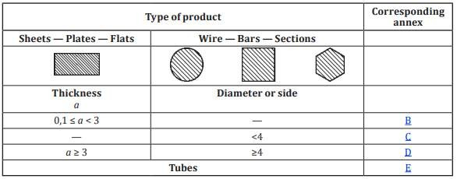
IS 1608 Metallic Materials - Tensile Testing
17
TYPES OF TEST PIECES ACCORDING TO PRODUCT TYPE
c/s of test pieces may be annular or in special cases some other uniform c/s

Slide 18
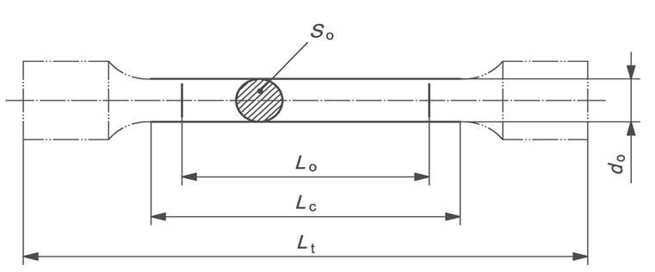
IS 1608 Metallic Materials - Tensile Testing
18
Test Piece Dimensions
Original gauge length shall not be less than 15mm. When c/s area of test piece is too small for this requirement to be met, higher value of k, preferably 11.3 or non proportional test piece may be used.
For non proportional test pieces, L0 is independent of S0
Fig. Standard specimen dimension for circular cross section test pieces (Machined)

Slide 19
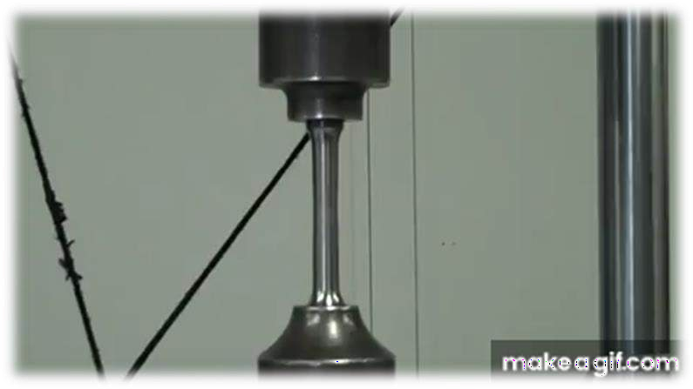
IS 1608 Metallic Materials - Tensile Testing
19
Principle
Straining a test piece by tensile force, generally to fracture, for the determination of proof strength.

Slide 20
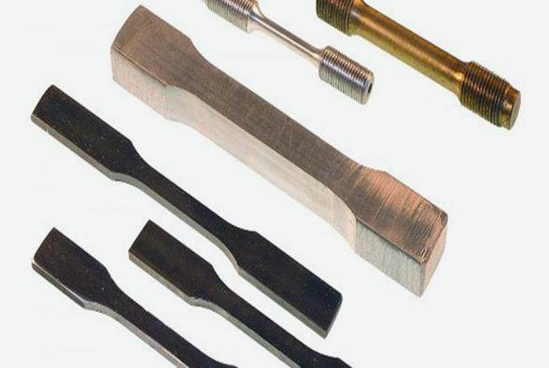
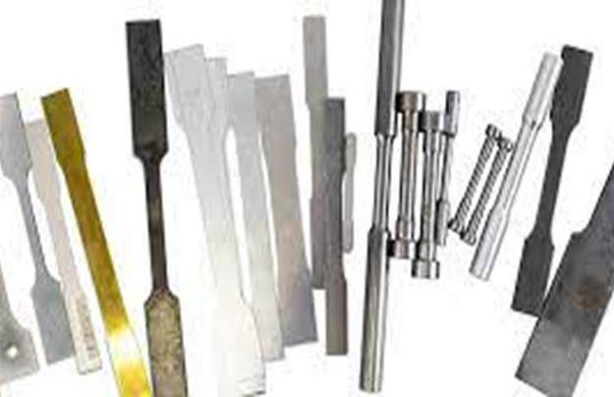
IS 1608 Metallic Materials - Tensile Testing
20
Example of some specimen:

Slide 21
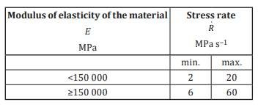
IS 1608 Metallic Materials - Tensile Testing
21
Testing Methods
Testing rate based on strain rate (Method A)
Method A is intended to minimize the variation of the test rates during the moment when strain rate sensitive parameters
are determined and to minimize the measurement uncertainty of the test results.
Two different types of strain rate control
Method A1 closed loop involves the control of the strain rate itself , 𝒆ሶ _{𝑳𝒆} , that is based on the feedback obtained from an extensometer.
Method A2 open loop involves the control of the estimated strain rate over the parallel length , 𝒆ሶ _{𝑳𝒄} , Which is achieved by using the crosshead separation rate calculated by multiplying the required strain rate by the parallel length.
Testing rate based on stress rate (Method B)
The rate of separation of the crossheads of the machine shall be kept as constant as possible and within the limits corresponding to the stress rates in the following table.

Slide 22
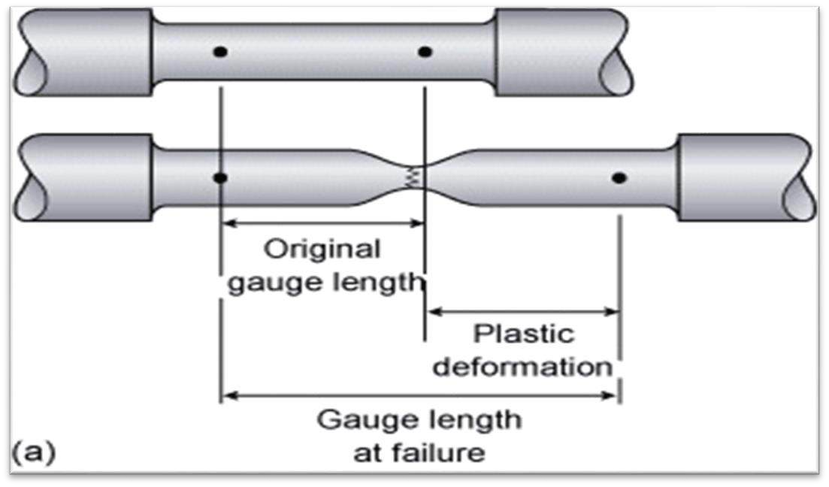
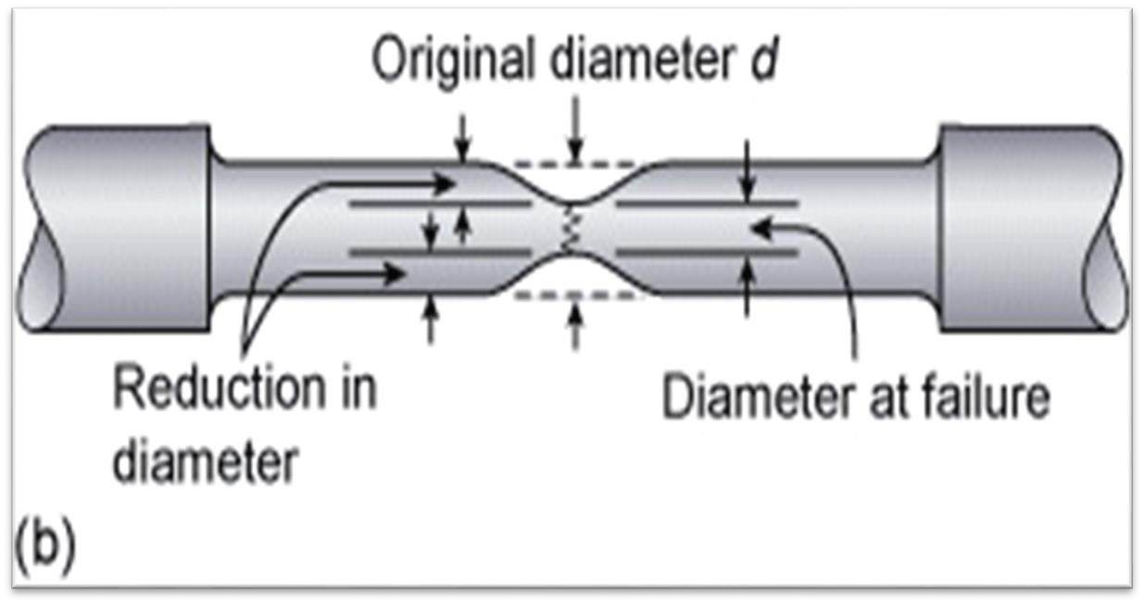
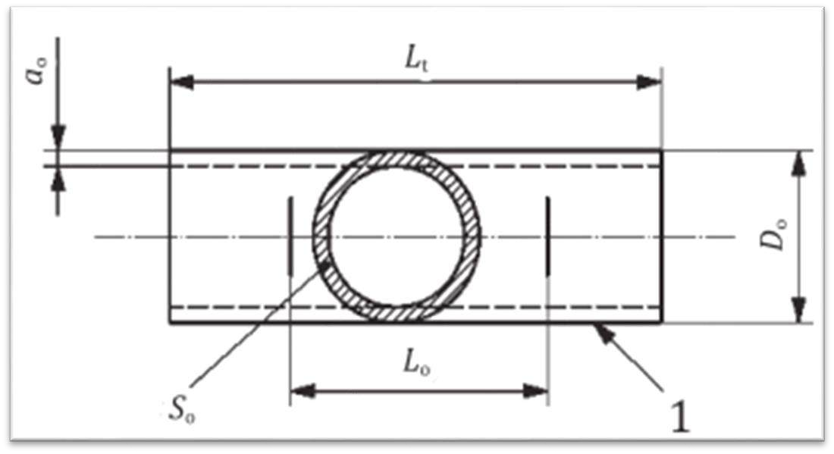
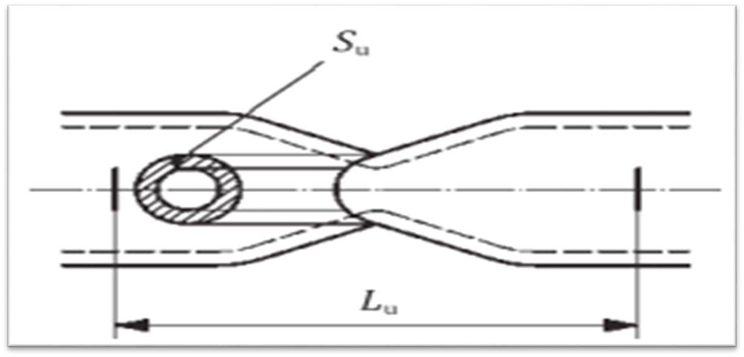
IS 1608 Metallic Materials - Tensile Testing
22
Example of some specimen:

Slide 23
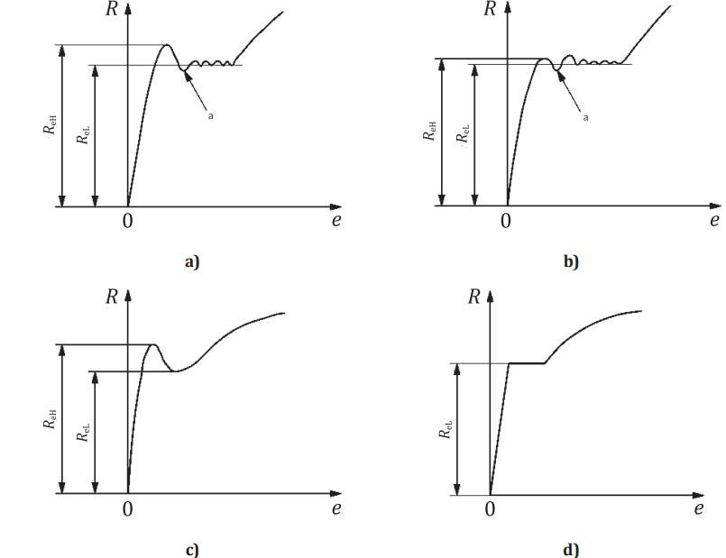
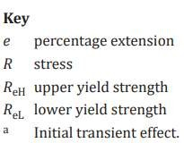
IS 1608 Metallic Materials - Tensile Testing
23

Slide 24
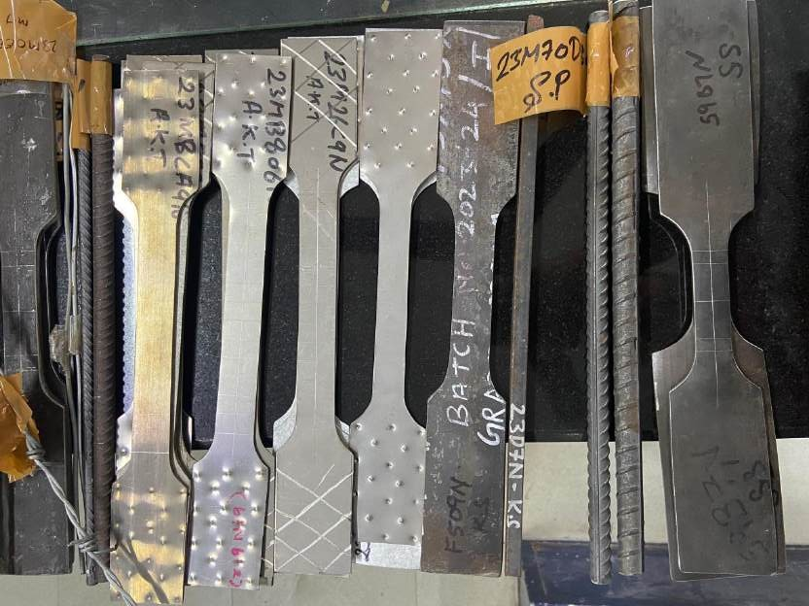
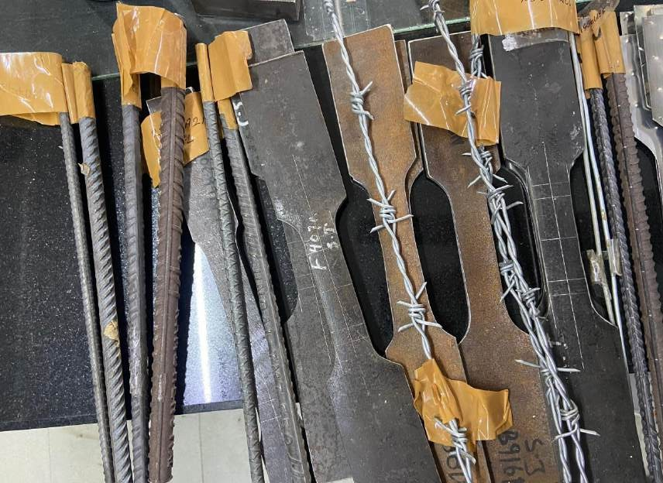
IS 1608 Metallic Materials - Tensile Testing
24

Slide 25
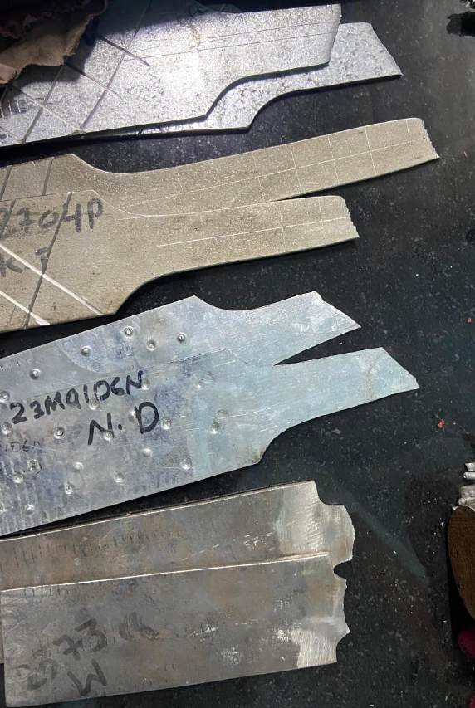
IS 1608 Metallic Materials - Tensile Testing
25

Slide 26
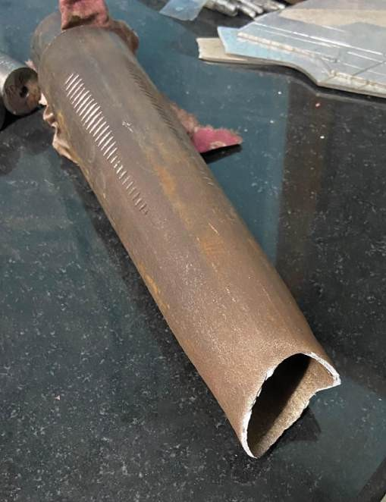
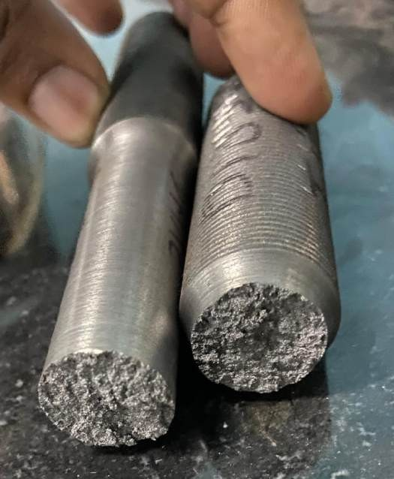
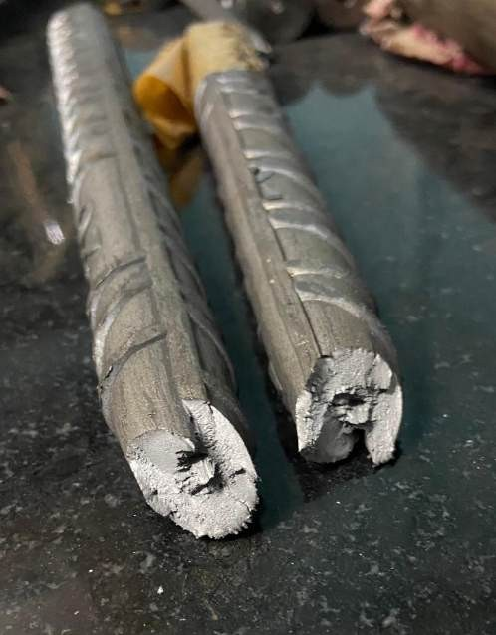
IS 1608 Metallic Materials - Tensile Testing
26

Slide 27
IS 1608 Metallic Materials - Tensile Testing
27
Testing Reports
The test report shall contain at least the following information, unless otherwise agreed by the parties concerned:
reference to this part of IS 1608 / ISO 6892, extended with the test condition information specified in 10.3.4, e.g. IS 1608 Part 1 / ISO 6892-1:2016 A224;
identification of the test piece;
specified material, if known;
type of test piece;
location and direction of sampling of test pieces, if known;
testing control mode(s) and testing rate(s) or testing rate range(s) (see 10.3.1) if different from the recommended methods and values given in 10.3.2 and 10.3.3;
test results:
results should be rounded (according to IS / ISO 80000-1) to the following precisions or better, if not otherwise specified in product standards: strength values, in megapascals, to the nearest whole number;
percentage yield point extension values, Ae, to the nearest 0,1 %;
all other percentage extension and elongation values to the nearest 0,5 %;
percentage reduction of area, Z, to the nearest 1 %.

Slide 28
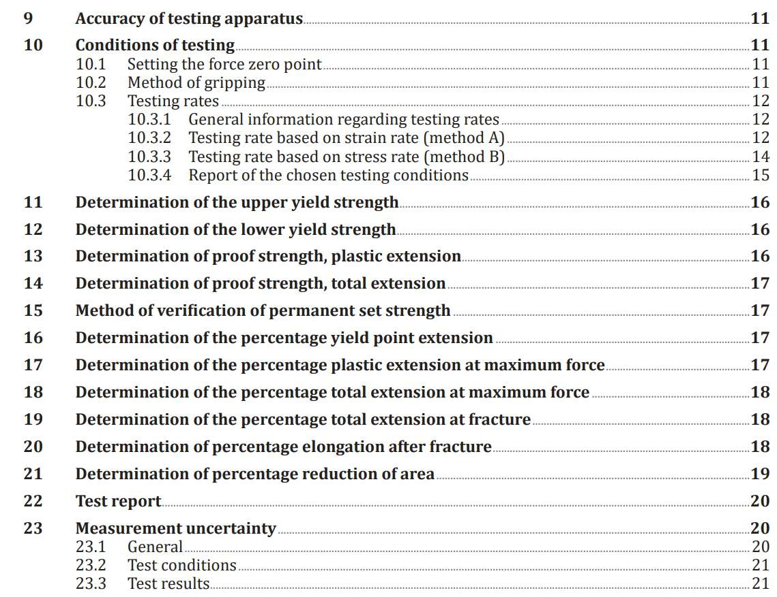
IS 1608 Metallic Materials - Tensile Testing
28
Testing Reports

Slide 29
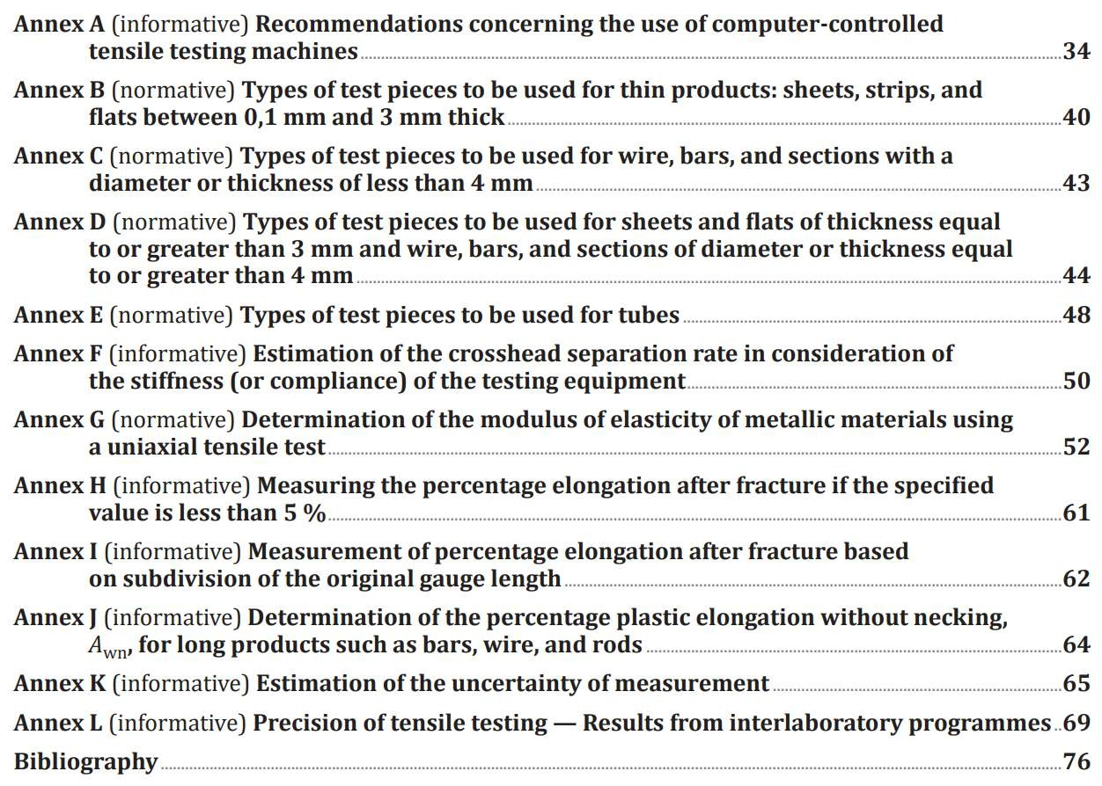
IS 1608 Metallic Materials - Tensile Testing
29
Testing Reports

Slide 30
IS 1608 Metallic Materials - Tensile Testing
30
Specific differences
Parameters under IS Code (IS 1608)
Parameters without IS Code
🠶 Test Specimen: Specifies dimensions, preparation, and
🠶 Specimen Variability: Different specimen preparation methods, and shapes may be used
dimensions,
shape of the test specimen.
🠶 Strain Rate Control: Defines the strain rate at which the test should be conducted.
without
standard guidelines.
🠶 Inconsistent Strain Rate: The strain rate at which the test is
conducted may vary, leading to inconsistent results.
🠶 Temperature Control: Provides guidelines for testing at different temperatures if required.
🠶 Variable Temperature Conditions: use of same
🠶 Machine Calibration: Regular calibration of the testing
temperature may lead to incorrect result.
🠶 Non-standard Calibration: Without calibration, the test result may be inaccurate.
machine to ensure accuracy.
🠶 Measurement and Calculation: Standardized methods for
measuring and calculating mechanical properties such as
ultimate tensile strength, yield strength, and elongation.
🠶 Fracture Analysis: Guidelines for analyzing and reporting fracture characteristics.
🠶 Non-standard Measurement: Methods for measuring and
calculating mechanical properties may vary.
🠶 Lack of Fracture Analysis: Fracture characteristics may not be analyzed or reported consistently.

Slide 31
31
2
IS 1500 / ISO 6506
Metallic Materials –
Brinell Hardness Test

Slide 32
IS 1500/ISO 6506 Metallic Materials – Brinell Hardness Test
32
PARTS & SCOPE
This standard has four parts
Part 1 Test method
Part 2 Verification and
calibration of testing machines
Part 3 Calibration of reference
blocks
Part 4 Table of hardness
values
Scope : This part of IS 1500 / ISO 6506 specifies the method for the Brinell hardness test for
Scope : This document specifies methods of direct and indirect verification of testing machines used for determining Brinell hardness in accordance with IS 1500 Part 1/ ISO 6506-1 and also specifies when these two types of verification have to be performed.
Scope : This part of IS 1500 / ISO 6506 specifies a method
Scope : This part of IS 1500 / ISO 6506 gives a table of the Brinell hardness values for use in tests on flat surfaces.
metallic materials. It is
applicable to both fixed location
for the calibration of
reference blocks to be used in
and portable hardness testing machines.
the indirect verification of Brinell hardness testing machines as described in IS
1500 Part 2/ ISO 6506-2.
The procedures necessary to ensure metrological traceability of the calibration machine are also specified.

Slide 33
IS 1500/ISO 6506 Metallic Materials – Brinell Hardness Test
33
Principle
An indenter (tungsten carbide composite ball with diameter, D) is forced into the surface of a test piece and, after removal of the force, F, the diameter of the indentation, d, left in the surface is measured.
The Brinell hardness is proportional to the quotient obtained by dividing the test force by the curved surface area of the indentation. The indentation is assumed to take the shape of the unloaded ball indenter, and its surface area is calculated from the mean indentation diameter and the ball diameter, using the formula given in Table.

Slide 34
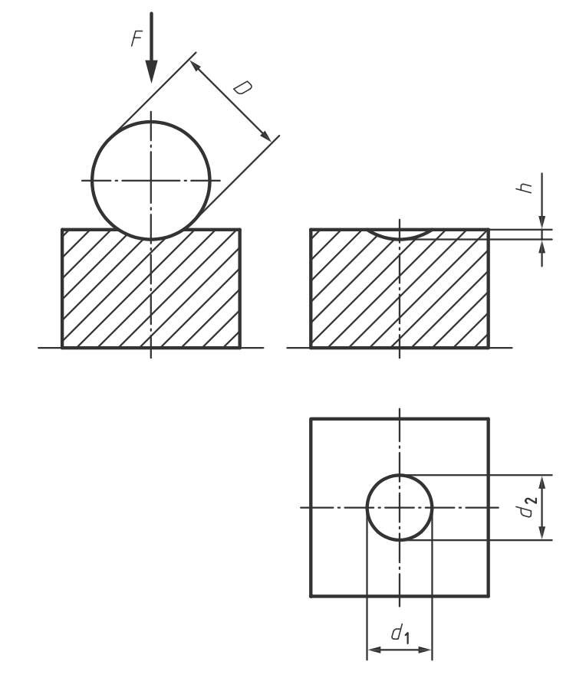
IS 1500/ISO 6506 Metallic Materials – Brinell Hardness Test
34
Symbol | Definition |  |  | Unit
D | Diameter of the ball Test force Mean diameter of the indentation 𝑑 = ^{𝑑1+𝑑2} 2 Indentation diameters measured at approximately 90º 2 Depth of indentation ℎ = ^{𝐷} 1 − 1 − ^{𝑑} 2 𝐷² Brinell Hardenss = 𝑐𝑜𝑛𝑠𝑡𝑎𝑛𝑡 𝑠𝑒𝑒 𝑁𝑂𝑇𝐸 ^{𝑇𝑒𝑠𝑡 𝐹𝑜𝑟𝑐𝑒} 𝐼𝑑𝑒𝑎𝑙𝑖𝑧𝑒𝑑 𝑆𝑢𝑟𝑓𝑎𝑐𝑒 𝑎𝑟𝑒𝑎 𝑜𝑓 𝑖𝑛𝑑𝑒𝑛𝑡𝑎𝑡𝑖𝑜𝑛 2𝐹 HBW = 0.102 * ^{𝜋𝐷2} 1− 1−^{𝑑2} _{𝐷}2 Force – diameter index |  |  | mm
F d |  |  |  | N mm
^{d}1,^{d}2 |  |  |  | mm
h
 |  |  |  | mm
HBW
0.102 F/D²
NOTE - Constant = 0.102 ≈ kgf to N. |  | 1 9.80665 | , where 9.80665 is the conversion factor from

Slide 35
IS 1500/ISO 6506 Metallic Materials – Brinell Hardness Test
35
Procedure
The test force should be chosen so that the diameter of the indentation, d, lies between the values 0.24 D and 0.6 D. if the diameter of the indentation lies outside these limits, the ratio of indentation diameter to indenter diameter (d/D) shall be stated in the test report.
Bring the indenter into contact with the test surface and apply the test force in a direction perpendicular to the surface; without shock, vibration, or overrun, until the applied force attains the specified value. the time from the initial application of force to the time the full test
force is reached shall be 7⁺¹ s. maintain the test force for 14⁺¹ s. for certain materials, where a longer duration of the test force is required,
−5 −4
this time shall be applied with a tolerance of ±2 s.

Slide 36
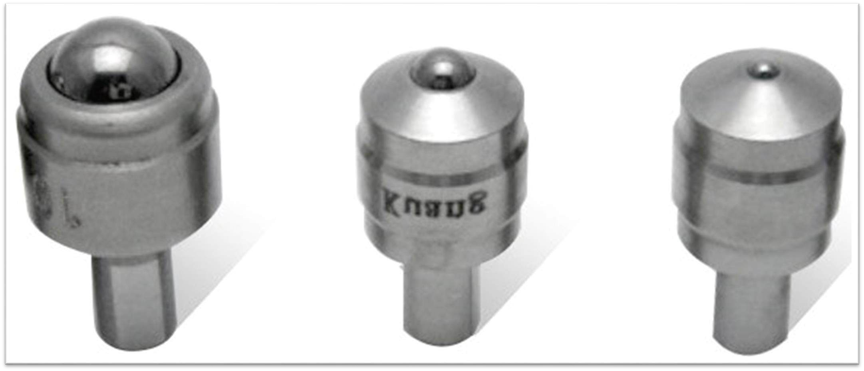
IS 1₃₆500/ISO 6506 Metallic Materials – Brinell Hardness Test
Indenters

Slide 37
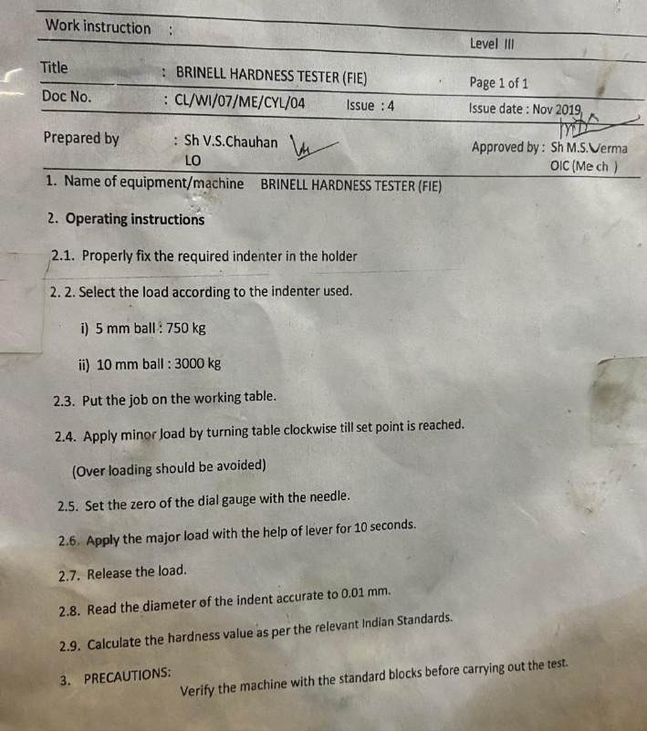
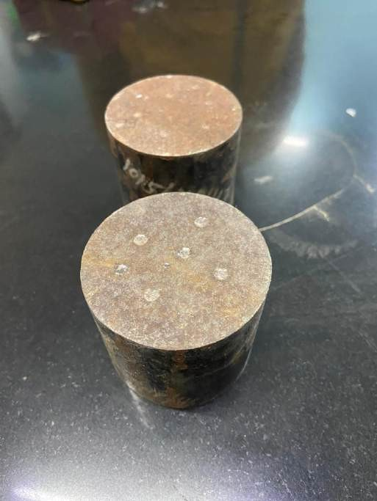
IS 1500/ISO 6506 Metallic Materials – Brinell Hardness Test
37

Slide 38
IS 1500/ISO 6506 Metallic Materials – Brinell Hardness Test
Can anyone tell what does the following designation represents:
600 HBW 1/30/20
600
Brinell Hardness Value
HBW
Hardness Symbol
1
Ball Diameter in mm
30
Approximate kgf equivalent of applied test force where 30kgf= 2942N
20
Duration time of test force (20s) if not within specified range (10s to 15s)
38

Slide 39
IS 1500/ISO 6506 Metallic Materials – Brinell Hardness Test
Specific difference
Parameters under IS Code (IS 1500)
Parameters without IS Code
Indenter Size and Material: Typically a hard steel or carbide ball with a specified diameter (e.g., 10 mm).
Indenter Variability: Different sizes and materials may be used without standard guidelines.
Test Load: Specified loads (e.g., 500, 1500, 3000 kgf) depending
on the material being tested.
Inconsistent Loads: Loads applied may vary and are not standardized.
Dwell Time: The duration for which the load is applied is specified (e.g., 10-15 seconds).
Variable Dwell Time: The duration for which the load is applied may not be consistent.
Calculation of Hardness: The formula for calculating the Brinell
Hardness Number (BHN) is standardized.
Non-standard Calculation: The formula or method for calculating hardness may vary, leading to inconsistent results.
39

Slide 40
40
3
IS 1586 / ISO 6508
Metallic Materials - Rockwell Hardness Test

Slide 41
IS 1586 / ISO 6508 Metallic Materials - Rockwell Hardness Test
41
This standard has three parts:
Part 1 Test method
Part 2 Verification and calibration
Part 3 Calibration of reference blocks
of testing machines and
indenters
Scope : This part of IS
1586 / ISO
6508 specifies the method for
Scope : This part of IS 1586 / ISO 6508 specifies a method for the calibration of reference blocks to be used for the indirect and daily verification of Rockwell hardness testing machines, as specified in IS 1586 Part 2 / ISO 6508-2:2015.
Rockwell regular and Rockwell superficial hardness tests for scales A, B, C, D, E, F, G, H, K, 15N, 30N, 45N, 15T, 30T, and 45T for
Scope : This part of IS 1586 / ISO 6508 specifies two separate methods of verification of testing machines (direct and indirect) for determining Rockwell hardness in accordance with IS 1586 Part 1 / ISO 6508-1:2015, together with a method for verifying Rockwell hardness indenters
metallic materials and is
applicable to stationary and
portable hardness testing machines.

Slide 42
IS 1586 / ISO 6508 Metallic Materials - Rockwell Hardness Test
42
Principle
An indenter of specified size, shape, and material is forced into the surface of a test
specimen under two force levels using the specific conditions.
The specified preliminary force is applied and the initial indentation depth is measured, followed by the application and removal of a specified additional force, returning to the preliminary force.
The final indentation depth is then measured and the Rockwell hardness value is derived from the difference, h, in final and initial indentation depths and the two constants N and S
Rockwell hardness = N - ^{ℎ}
𝑆
N – Full range constant
h – Permanent depth of indentation under preliminary test force after removal of additional test force (permanent indentation depth) (mm)
S – Scaling constant (mm)

Slide 43
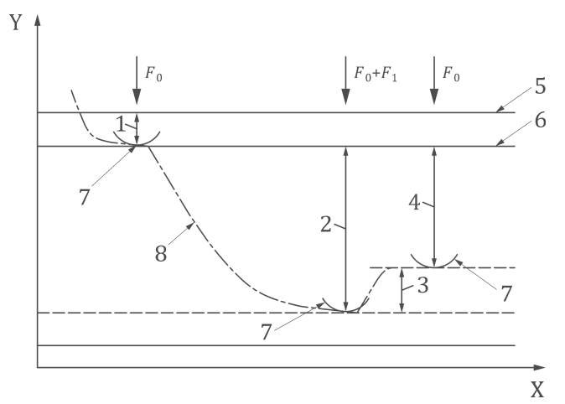
IS 1586 / ISO 6508 Metallic Materials - Rockwell Hardness Test
43
Principle
Total force F = F₀+F₁
F₀ preliminary test force
F₁ additional test force
Key
X time | 4 permanent indentation depth, h
Y indenter position | 5 surface of specimen
1 indentation depth by preliminary force, F0 | 6 reference plane for measurement
2 indentation depth by additional test force, F1 | 7 position of indenter
3 elastic recovery just after removal of additional test force, F1 | 8 indentation depth vs. time curve

Slide 44
IS 1586 / ISO 6508 Metallic Materials - Rockwell Hardness Test
Symbol | Definition | Unit
F₀ F₁ F S N h | Preliminary test force Additional test force (total force minus preliminary force) Total test force Scaling constant, specific to the scale Full range constant, specific to the scale Permanent depth of indentation under preliminary test force after removal additional test force (permanent indentation depth) | N N N mm - mm
HRA HRC HRD | Rockwell Regular hardness = 100 − ^{ℎ} 0.002
HRBW HREW HRFW HRGW HRHW HRKW | Rockwell Regular hardness = 130 − ^{ℎ} 0.002
HRN HRTW | Rockwell Superficial hardness = 100 − ^{ℎ} 0.002
44

Slide 45
IS 1586 / ISO 6508 Metallic Materials - Rockwell Hardness Test
45
Procedure
Bring the indenter into contact with the test surface and exceed 2 s. The duration of the preliminary test force, 𝐹_{B,} shall be 3 ⁺ ¹apply the preliminary test force, 𝐹_{0,} without shock, vibration, oscillation, or overload. The prelimina⁻r²y force application time should not
Measure the initial indentation depth.
Apply the additional force F1 without shock, vibration, oscillation, or overload to increase the force from 𝐹_{B} to the total force, F
The total test force, F, shall be maintained for a duration of 5 ⁺¹S. Remove the additional test force,
−3
+1
F1, and while the preliminary test force, 𝐹₀, is maintained, after 4 ₋₃ s, the final reading shall be
made
Measure the final indentation depth while the preliminary test force is applied
The distance between the centres of two adjacent indentations shall be at least three times the diameter of the indentation. The distance from the centre of any indentation to an edge of the test piece shall be at least two and a half time the diameter of the indentation

Slide 46
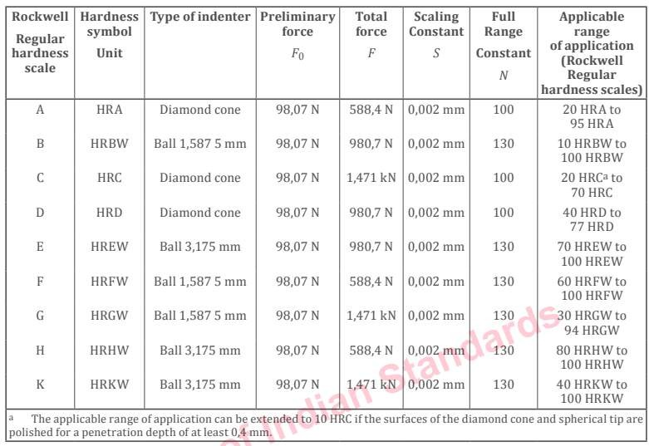
IS 1586 / ISO 6508 Metallic Materials - Rockwell Hardness Test
46
Scale

Slide 47
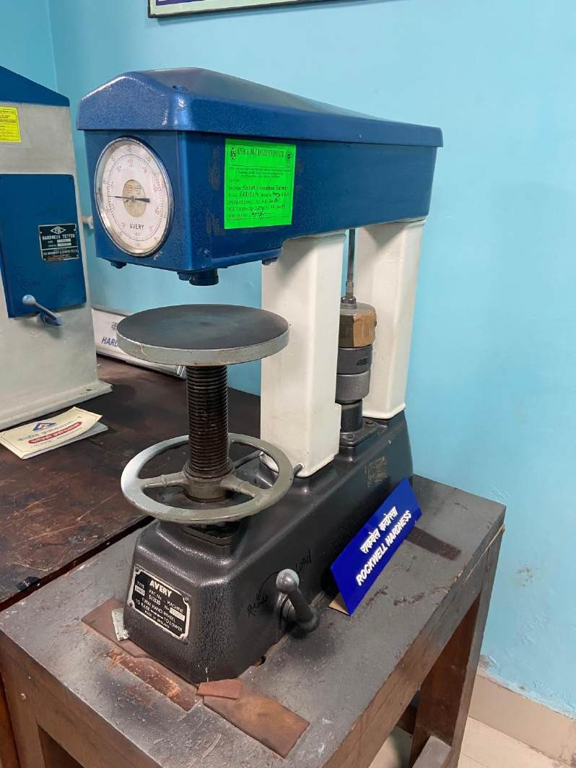
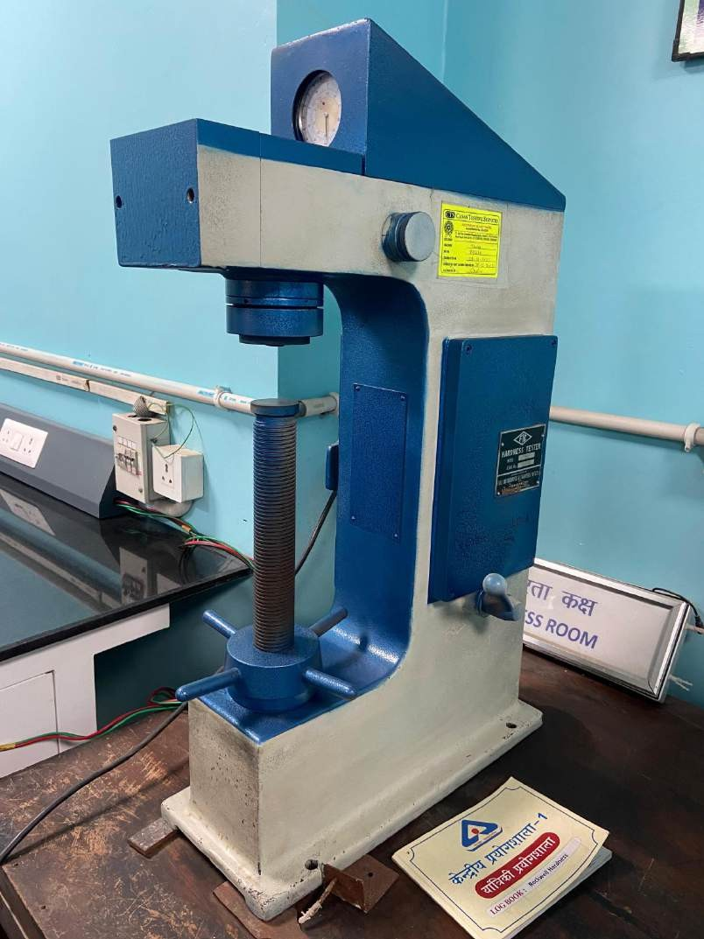
IS 1586 / ISO 6508 Metallic Materials - Rockwell Hardness Test
47
Procedure

Slide 48
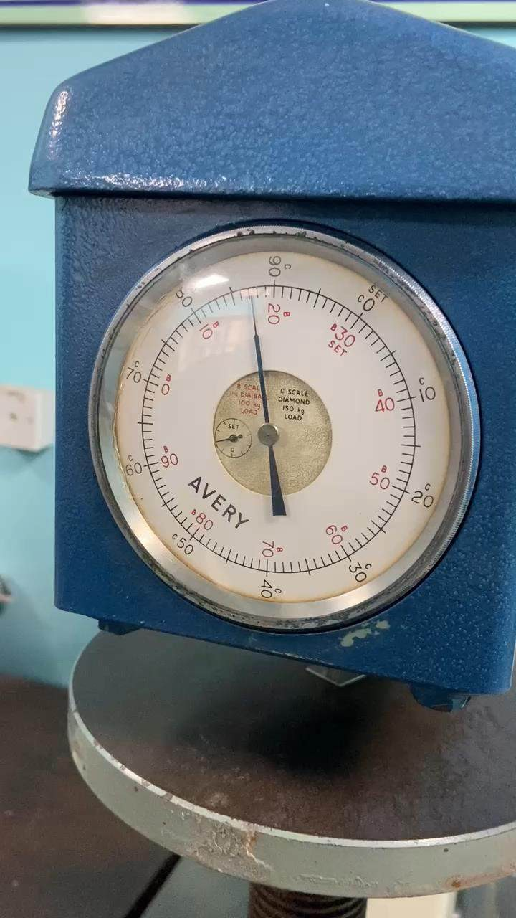
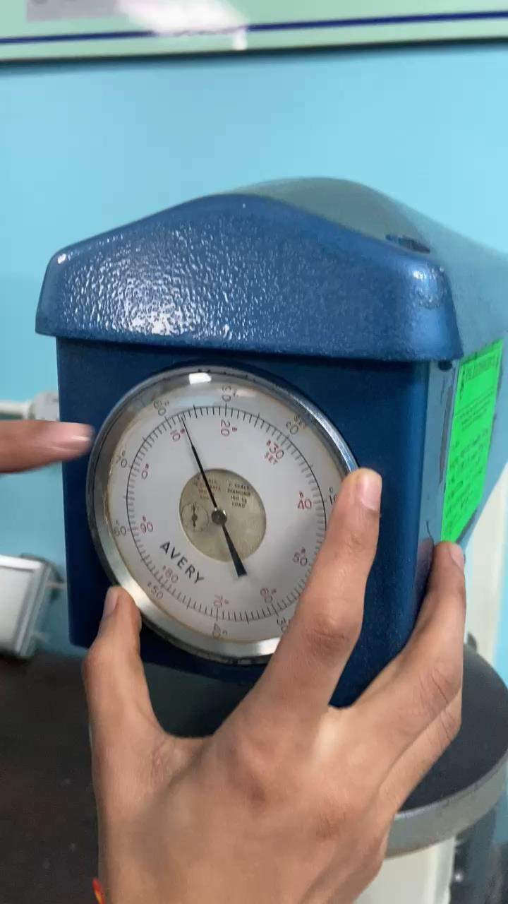
IS 1586 / ISO 6508 Metallic Materials - Rockwell Hardness Test
48
Procedure

Slide 49
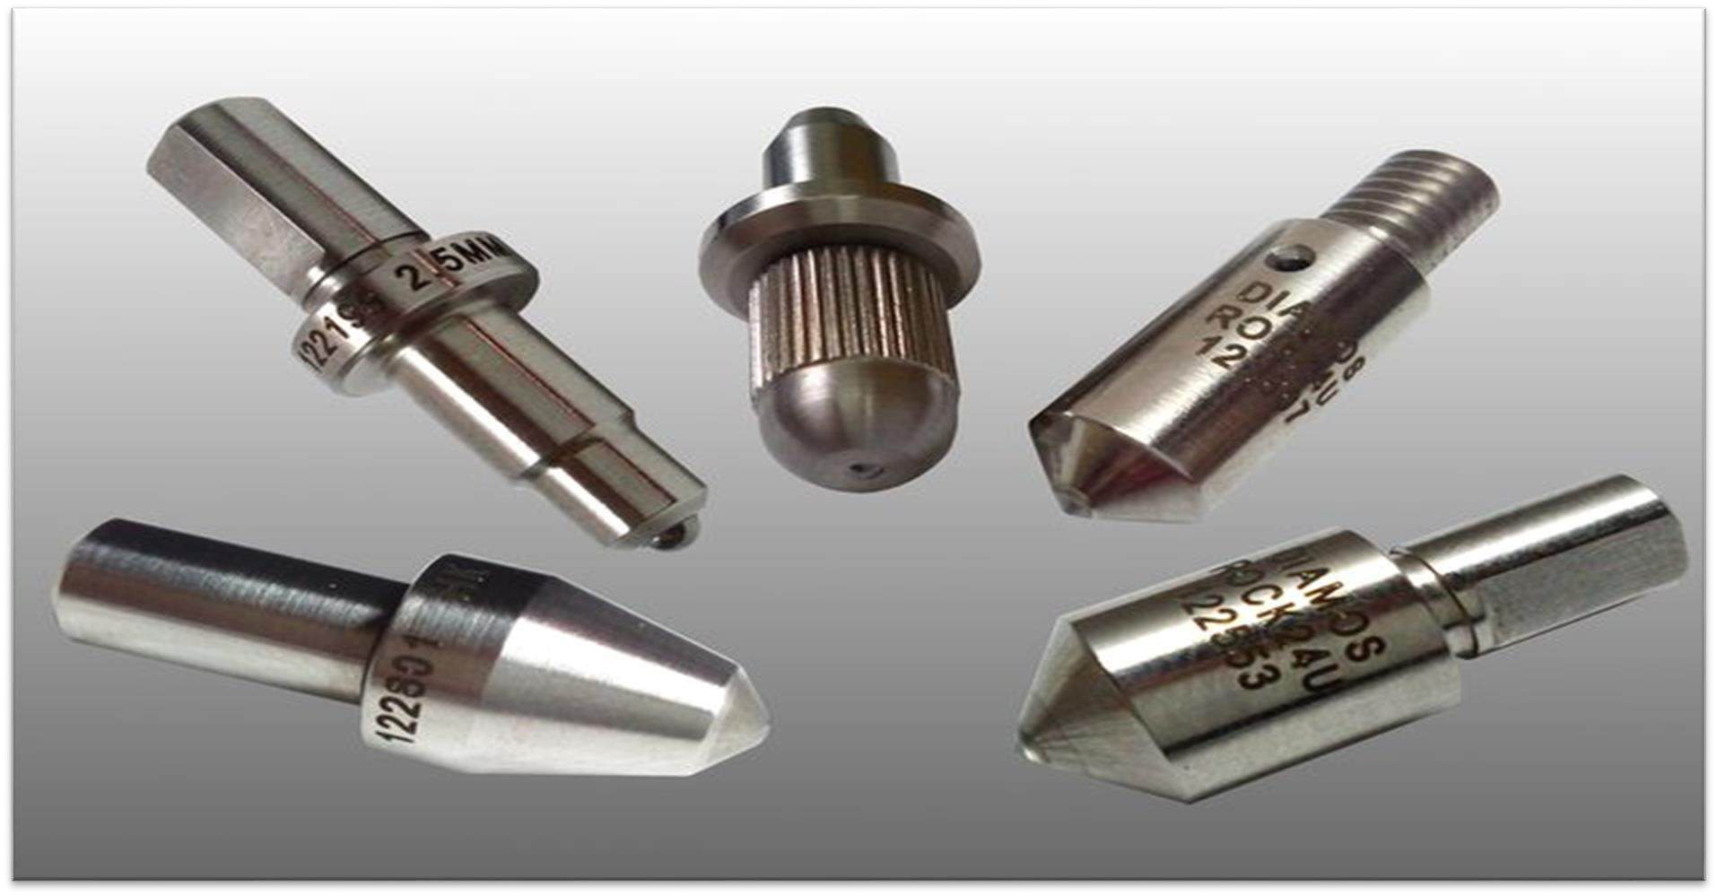
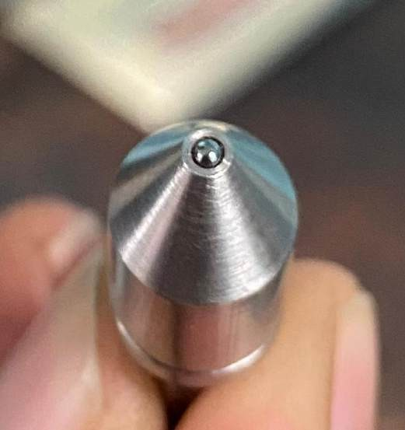
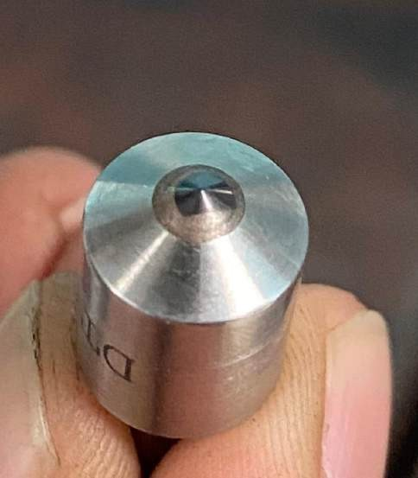
IS 1586 / ISO 6508 Metallic Materials - Rockwell Hardness Test
49
Indenters
Procedure

Slide 50
IS 1586 / ISO 6508 Metallic Materials - Rockwell Hardness Test
Can anyone elaborate the following designations
🠜 70 HRC
🠜 80 HRBW
80
Rockwell hardness value
HR
Rockwell Hardness Symbol
B
Rockwell scale symbol
W
Indication of type of ball used
W= Tungstun Carbide Composite
50

Slide 51
IS 1586 / ISO 6508 Metallic Materials - Rockwell Hardness Test
51
Test Report
Procedure
The laboratory shall record at least the following information and that information shall be included in the test report, unless agreed by the parties concerned:
a reference to this part of IS 1586 / ISO 6508, i.e. IS 1586 Part 1 / ISO 6508-1;
all details necessary for the complete identification of the test piece, including the curvature of the test surface;
the test temperature, if it is not within the limits of 10 °C to 35 °C;
the hardness result in the format defined in 4.2;
all operations not specified in this part of IS 1586 / ISO 6508, or regarded as optional;
details of any occurrence which might have affected the result;
the actual extended total force duration time used, if greater than the 6 s allowed by the tolerances;
the date the test was performed;
if conversion to another hardness scale is also performed, the basis and method of this conversion shall be specified (see IS 4258 / ISO 18265[12]).

Slide 52
IS 1586 / ISO 6508 Metallic Materials - Rockwell Hardness Test
52
Parameters under IS Code (IS 1586)
Parameters without IS Code
🠶 Indenters and Scales: Specifies the use of different indenters (diamond cone or steel balls) and scales (A, B, C, etc.) for different materials.
🠶 Test Load: Standardized major loads (60, 100, and 150 kgf) depending on the scale being used.
🠶 Preload (Minor Load): Consistently applied minor load (typically 10 kgf) to set the baseline.
🠶 Dwell Time: Specified duration for which the major load is applied to ensure consistent results.
🠶 Calculation of Hardness: The formula for calculating the Rockwell Hardness Number (HR) is standardized.
🠶 Indenter Variability: Different sizes and types of indenters may be used without standard guidelines.
🠶 Inconsistent Loads: Loads applied may vary and are not standardized.
🠶 Variable Preload: The minor load applied may not be consistent, affecting the baseline.
🠶 Variable Dwell Time: The duration for which the
load is applied may not be consistent.
🠶 Non-standard Calculation: The formula or method for calculating hardness may vary, leading to inconsistent results.

Slide 53
53
4
IS 6885 / ISO 4545
Metallic Materials —
Knoop Hardness Test

Slide 54
IS 6885/ISO 4545 Metallic Materials — Knoop Hardness Test
54
PARTS & SCOPE
This standard has four parts
Part 1 Test method
Part 2 Verification and
Part 3 Calibration of reference blocks
Calibration Machines
of
Testing
Part 4 Tables of
Hardness Values
Scope : This document gives a table for the calculation of Knoop hardness values for use
Scope : This document
specifies the Knoop hardness
Scope : This document specifies the method of verification and calibration of
test method for metallic materials for test forces from
Scope : This document specifies the method for the calibration of reference blocks to be used for the indirect verification of Knoop hardness testing machines as specified in IS 6885 Part 2 / ISO 4545-2. The method is applicable only for indentations with long diagonals ≥0,020 mm
0.009 807 N to 19.613 N. The
Knoop hardness test is specified
in this document for lengths of indentation diagonals ≥0,020
mm. Using this method to
determine Knoop hardness from smaller indentations is outside the scope of this document as results would suffer from large
testing machines for
in tests carried out in accordance with IS 6885 Part1
/ ISO 4545-1.
determining Knoop hardness for
metallic materials in accordance with IS 6885 Part 1 /
ISO 4545-1. A direct method of verification and calibration is
specified for the testing machine,
indenter, and the
uncertainties
limitations
due to the
of optical
diagonal length measuring
system. An indirect verification method using reference blocks is specified for the overall checking of the machine.
measurement and
imperfections in tip geometry.

Slide 55
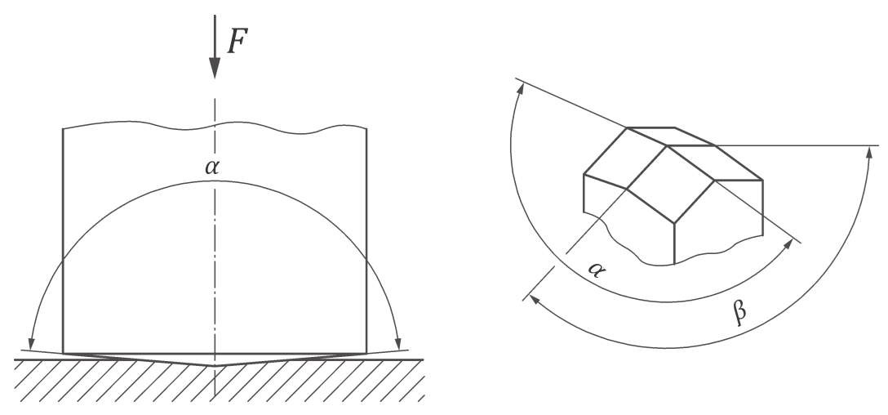
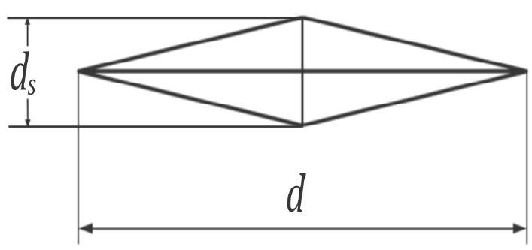
IS 6885/ISO 4545 Metallic Materials — Knoop Hardness Test
55
Principle
A diamond indenter, in the form of a rhombic-based pyramid with angles, α and β, between opposite edges respectively equal to 172.5° and 130° at the vertex, is forced into the surface of a test piece followed by measurement of the long diagonal, d, of the indentation remaining in the surface after removal of the test force, F

Slide 56
IS 6885/ISO 4545 Metallic Materials — Knoop Hardness Test
56
Test Piece
The thickness of the test piece, or of the layer under test, shall be at least 1/3 times the length of the diagonal length of the
indentation. No deformation shall be visible at the back of the test piece after the test.

Slide 57
IS 6885/ISO 4545 Metallic Materials — Knoop Hardness Test
57
Procedure
Procedure
Procedure
The indenter shall be brought into contact with the test surface and the test force shall be applied in a direction
perpendicular to the surface, without shock, vibration, or overload, until the applied force attains the specified value. The
time from the initial application of the force until the full test force is reached shall be 7⁺¹ s.
−5
The indenter shall contact the test piece at a velocity of ≤ 0.070 mm/s
The duration of the test force shall be 14⁺¹ s, except for tests on materials whose time-dependent properties would make
−4
this an unsuitable range.
The length of the long diagonal shall be measured and used for the calculation of the knop hardness. For all tests, the perimeter of the indentation shall be clearly defined in the field of view of the microscope. Magnifications should be selected so that the diagonal can be enlarged to greater than 25 %, but less than 75 % of the maximum possible optical field of view.

Slide 58
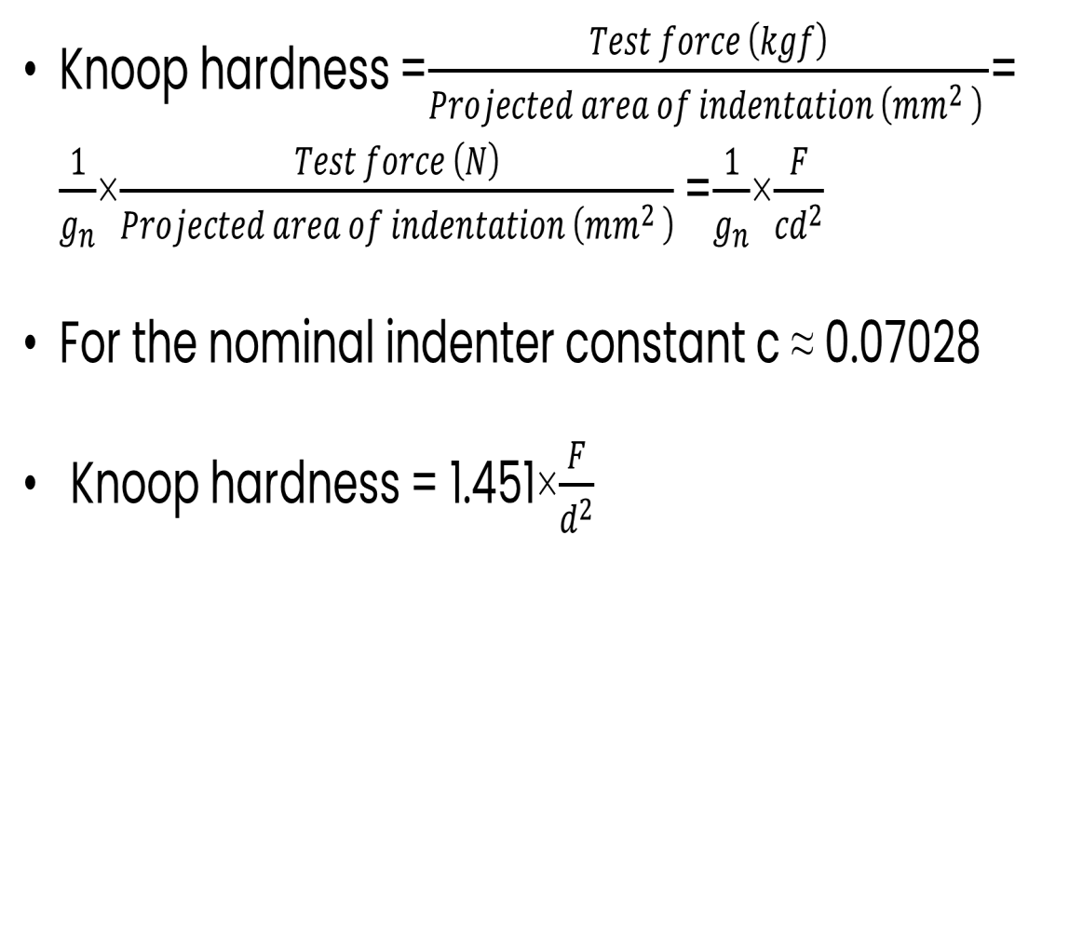
IS 6885/ISO 4545 Metallic Materials — Knoop Hardness Test
Knoop hardness = ^{𝑇𝑒𝑠𝑡 𝑓𝑜𝑟𝑐𝑒 𝑘T𝑓} =
𝑃𝑟𝑜W𝑒𝑐𝑡𝑒𝑑 𝑎𝑟𝑒𝑎 𝑜𝑓 𝑖𝑛𝑑𝑒𝑛𝑡𝑎𝑡𝑖𝑜𝑛 𝑚𝑚²
1 _{× =} 1 × 𝐹
𝑇𝑒𝑠𝑡 𝑓𝑜𝑟𝑐𝑒 𝑁
T_{𝑛} 𝑃𝑟𝑜W𝑒𝑐𝑡𝑒𝑑 𝑎𝑟𝑒𝑎 𝑜𝑓 𝑖𝑛𝑑𝑒𝑛𝑡𝑎𝑡𝑖𝑜𝑛 𝑚𝑚² T_{𝑛} 𝑐𝑑²
For the nominal indenter constant c ≈ 0.07028
Knoop hardness = 1.451× ^{𝐹}
_{𝑑}2
58

Slide 59
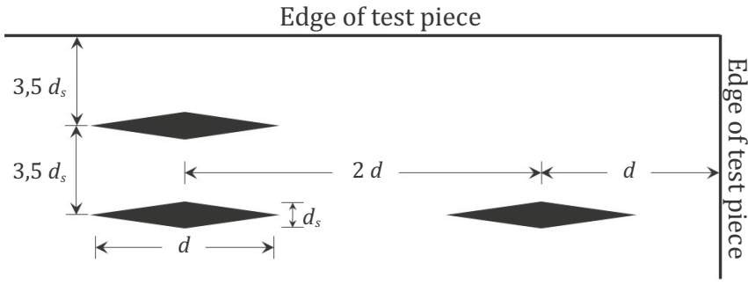
IS 6885/ISO 4545 Metallic Materials — Knoop Hardness Test
59
Procedure
Procedure
Procedure
Minimum distance for knoop indentations

Slide 60
IS 6885/ISO 4545 Metallic Materials — Knoop Hardness Test
Can anyone interpret following designations -
🠜 640 HK 0.1/20
640
Knoop hardness value
HK
Hardness Symbol
0.1
Approximate kgf equivalent value of applied test force where (0.1 kgf = 0.980 7 N)
20
Duration of test force (20 s) if not within the specified range (10 s to 15 s)
60

Slide 61
IS 6885/ISO 4545 Metallic Materials — Knoop Hardness Test
61
Test Report
Procedure
Procedure
The test report shall include the following information, unless otherwise agreed by the parties concerned:
a reference to this document, i.e. IS 6885 Part 1 / ISO 4545-1;
all information necessary for identification of the test piece;
the date of the test;
the hardness result obtained in HK, reported in the format defined in 5.2;
all operations not specified in this document, or regarded as optional;
the details of the temperature of the test, if it is outside the ambient range specified in 8.1;
where conversion to another hardness scale is also performed, the basis and method of this conversion any circumstances that affected the results;

Slide 62
IS 6885/ISO 4545 Metallic Materials — Knoop Hardness Test
Specific difference
62
Parameters under IS Code (IS 6885)
Parameters without IS Code
🠶 Indenter Variability: Different shapes and sizes of indenters
may be used without standard guidelines.
🠶 Inconsistent Loads: Loads applied may vary and are not standardized.
🠶 Variable Dwell Time: The duration for which the load is applied may not be consistent.
🠶 Non-standard Measurement: The method for measuring the indentation may vary, leading to inconsistent results.
🠶 Non-standard Calculation: The formula or method for calculating hardness may vary, leading to inconsistent results.
🠶 Indenter Specifications: The diamond indenter has a
specified elongated pyramidal shape with defined dimensions.
🠶 Test Load: Standardized loads (e.g., 25, 50, 100 grams) depending on the material being tested.
🠶 Dwell Time: Specified duration for which the load is applied (e.g., 10-15 seconds).
🠶 Measurement: The length of the long diagonal of the indentation is measured precisely using a microscope.
🠶 Calculation of Hardness: The Knoop Hardness Number (KHN) is calculated using a standardized formula:
𝐾𝐻𝑁=𝐹/𝐿2𝐶
where F is the applied load in kilograms-force, L is the measured length of the long diagonal of the indentation in millimeters, and C is a constant that depends on the indenter geometry.

Slide 63
63
5
IS 1501 / ISO 6507
Metallic Materials —
Vickers Hardness Test

Slide 64
IS 1501 / ISO 6507 Metallic Materials — Vickers Hardness Test
64
PARTS & SCOPE
This standard has four parts
Part 1 Test method
Scope : This document
Part 2 Verification and Calibration of Testing Machines
Part 3 Calibration of
reference blocks
Part 4 Tables of Hardness Values
specifies the
Scope : This document specifies the method for
Scope : This document gives a table for the calculation of Knoop
Vickers hardness test method
Scope : This document
specifies the method of
for the three different
verification and calibration of
the calibration of
ranges of test force for
testing machines for
reference blocks to be
hardness values for
determining Knoop hardness
used for the indirect verification of Knoop
use in tests carried out
metallic materials
for metallic materials in
in accordance with IS 6885 Part 1 / ISO 4545-1
knoop hardness test
including hard metals
accordance with IS 6885 Part 1
hardness testing
and other cemented
/ ISO 4545-1. A direct method of verification and calibration is specified for the testing machine, indenter, and the diagonal length measuring system. An indirect verification
carbides.
machines as specified in
IS 6885 Part 2 / ISO
4545-2. The method is
applicable only for
method using reference
indentations with long
blocks is specified for the
diagonals ≥0.020 mm
overall checking of the machine.

Slide 65
IS 1501 / ISO 6507 Metallic Materials — Vickers Hardness Test
65
Principle
A diamond indenter, in the form of a right pyramid with a square base and with a specified angle between opposite faces at the vertex, is forced into the surface of a test piece followed by measurement of the diagonal length of the indentation left in the surface after removal of the test force, F
The Vickers hardness is proportional to the quotient obtained by dividing the test force by the area of the slaped surface of indentation, which is assumed to be a right pyramid with a square base and having at the vertex the same angle as the indenter.
Geometry of indenter, The measured angles between the opposite faces at the vertex of the diamond pyramid shall be within the range 136° ± 0.5° (a = 136° ± 0.5°)

Slide 66
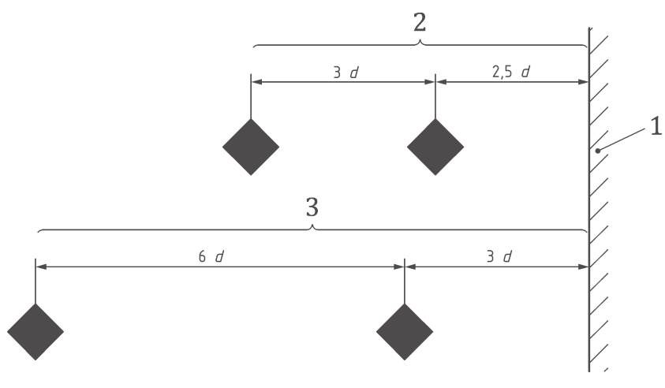
IS 1501 / ISO 6507 Metallic Materials — Vickers Hardness Test
66
Principle
Minimum distance between adjacent indentations
Key
1 edge of test piece
2 steel, copper and copper alloys
3 light metals, lead and tin and their alloys

Slide 67
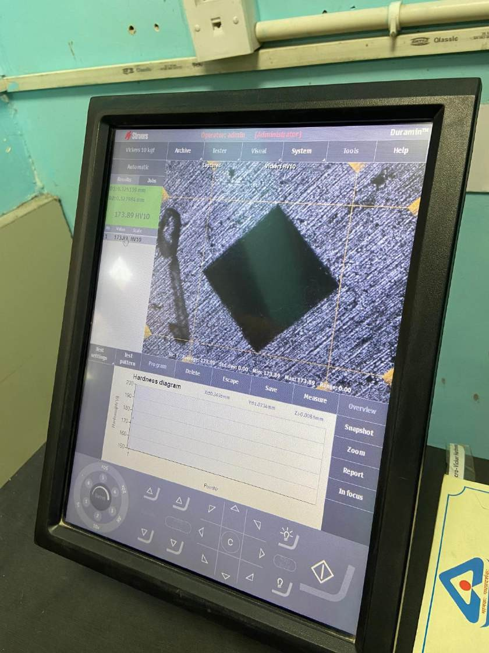
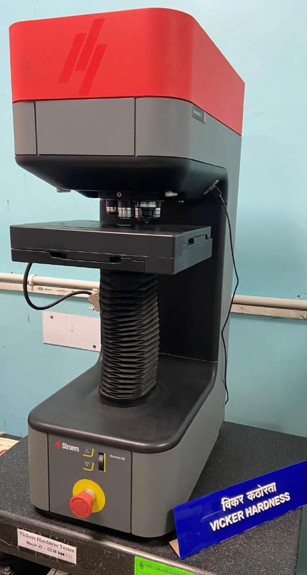
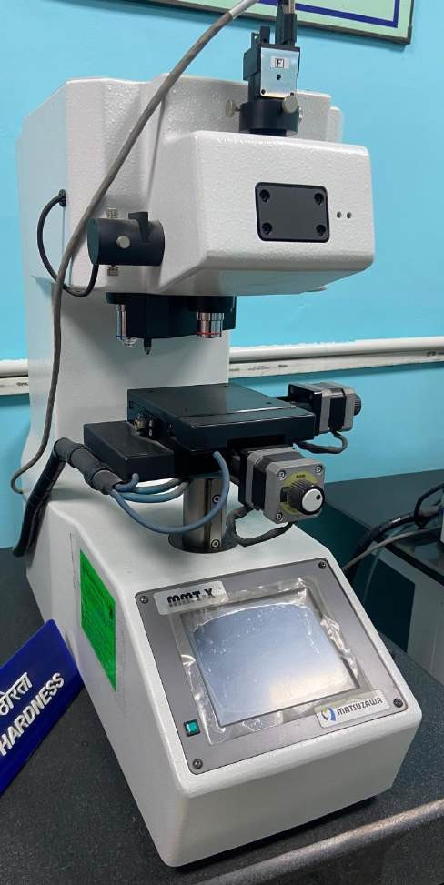
IS 1501 / ISO 6507 Metallic Materials — Vickers Hardness Test
67

Slide 68
IS 1501 / ISO 6507 Metallic Materials — Vickers Hardness Test
68
Procedure
The indenter shall be brought into contact with the test surface and the test force shall be applied in a direction perpendicular to the surface, without shock, vibration or overload until the applied force attains the specified value. The time from the initial application of the force until the full test force is reached
shall be 7⁺¹ s
−5
For the Vickers hardness range and low-force Vickers hardness range and low-force Vickers hardness range tests, the indenter shall contact the test piece at a velocity of ≤ 0.2 mm/s. For micro-hardness tests, the indenter shall contact the test piece at a velocity of ≤ 0.070 mm/s
The duration of the test force shall be 14⁺¹ , except for test on materials whose time-dependent
−4.
properties would make this an unsuitable range.

Slide 69
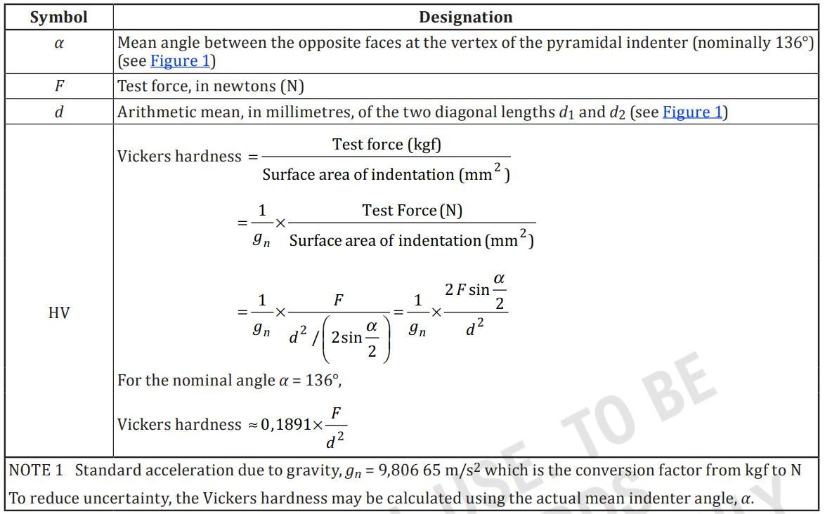
Calculation
69

Slide 70
IS 1501 / ISO 6507 Metallic Materials — Vickers Hardness Test
Can anyone interpret following designations -
🠜 640 HV 30/20
640
Vickers hardness value
HV
Hardness Symbol
30
Approximate kgf equivalent value of applied test force where
20
Duration of test force (20 s) if not within the specified range (10 s to 15 s)
70

Slide 71
IS 1501 / ISO 6507 Metallic Materials — Vickers Hardness Test
71
Test Report
The test report shall include the following information unless otherwise agreed by the parties concerned:
a reference to this document, i.e., IS 1501 Part 1 / ISO 6507-1;
all information necessary for identification of the test piece;
the date of the test;
the hardness result obtained in HV, reported in the format defined in 5.2;
all operations not specified in this document or regarded as optional;
details of any circumstances that affected the results;
the temperature of the test, if it is outside the ambient range specified in 8.1;
where conversion to another hardness scale is also performed, the basis and method of this conversion

Slide 72
IS 1501 / ISO 6507 Metallic Materials — Vickers Hardness Test
72
Specific difference
Parameters under IS Code (IS 1501) Parameters without IS Code
🠶 Indenter Specifications: The diamond indenter is a right pyramid with a square base and an angle of 136° between opposite faces.
🠶 Indenter Variability: Different shapes and sizes of indenters may be used without standard guidelines.
🠶 Inconsistent Loads: Loads applied may vary and are not standardized.
🠶 Variable Dwell Time: The duration for which the load is
applied may not be consistent.
🠶 Non-standard Measurement: The method for measuring the indentation may vary, leading to inconsistent results.
🠶 Test Load: Standardized loads (e.g., 10, 30, 50 kgf) depending on the material being tested.
🠶 Dwell Time: Specified duration for which the load is applied (e.g., 10-15 seconds).
🠶 Measurement: The diagonals of the square indentation are measured precisely using a microscope.
🠶 Calculation of Hardness: The Vickers Hardness Number
(VHN) is calculated using a standardized formula:
𝐻𝑉= 0.1891×𝐹/𝑑2
🠶 Non-standard Calculation: The formula or method for
calculating hardness may vary, leading to inconsistent results.
where F is the applied load in kilograms-force, and d is the average length of the diagonals in millimeters.

Slide 73
73
6
IS 1757 / ISO 148
Metallic Materials — Charpy Pendulum Impact Test

Slide 74
IS 1757 / ISO 148 Metallic Materials — Charpy Pendulum Impact Test
74
This standard has three parts:
Part 1 Test method
Scope : This part of IS 1757
/ ISO 148 specifies the Charpy (V-notch and U- notch) pendulum impact
Part 2 Verification of Testing Machines
Scope : This part of IS 1757 / ISO
148 covers the verification of pendulum-type impact testing machines, in terms of their constructional elements, their overall performance and the accuracy of the results they produce. It is applicable to machines with 2 mm or 8 mm strikers used for pendulum impact tests carried out, for instance, in accordance with IS 1757 Part 1 / ISO 148-1.
Part 3 Preparation
and
characterization of charpy V-
notch test pieces for indirect
verification of pendulum impact machines
test method
Scope : This part of IS 1757 / ISO 148
for determining the energy
specifies the requirements,
preparation and methods for
absorbed in an impact
qualifying test pieces used for the
test of metallic materials.
indirect verification of pendulum
impact testing machines in
accordance with IS 1757 Part 2 / ISO 148-2.It specifies notched test pieces with nominal dimensions identical to those specified in 1757 Part 1 / ISO 148-1; however, the tolerances are more stringent.

Slide 75
IS 1757 / ISO 148 Metallic Materials — Charpy Pendulum Impact Test
75
Principle
This test consists of breaking a notched test piece with a single blow from a swinging pendulum, under the specified conditions.
The notch in the test piece has a specified geometry and is located in the middle between two supports, opposite to the location which is impacted in the test. The energy absorbed in the impact test, the lateral expansion and the shear fracture appearance are normally determined.

Slide 76
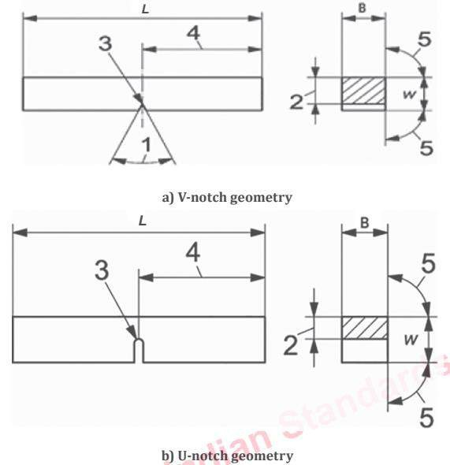
IS 1757 / ISO 148 Metallic Materials — Charpy Pendulum Impact Test
76
Test Piece
Designation | Symbol and no. | V-notch test piece | U-notch test piece
Length | L | 55 mm ±0.60 mm | 55 mm ±0.60 mm
Width | W | 10 mm ± 0.075 mm | 10 mm ±0.11 mm
Thickness^{c} | B | 10 mm ±0.11 mm | 10 mm ±0.11 mm
Angle of notch | 1 | 45° ±2°
Ligament | 2 | 8 mm ±0.075 mm | 5 mm ±0.09mm
Notch radius | 3 | 0.25 mm ±0.025 mm | 1 mm ±0.07 mm
Notch position (centering) | 4 | 27.5 mm ±0.42 mm ^{d} | 27.5 mm ±0.42 mm ^{d}
Angle between adjacent longitudinal faces of test piece | 5 | 90° ±2° | 90° ±2°

Slide 77
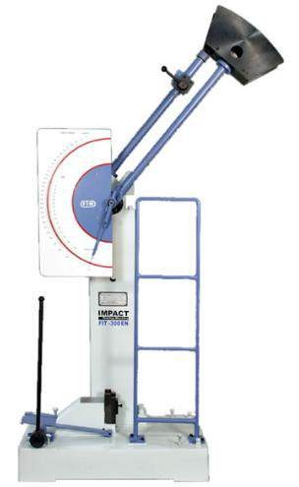
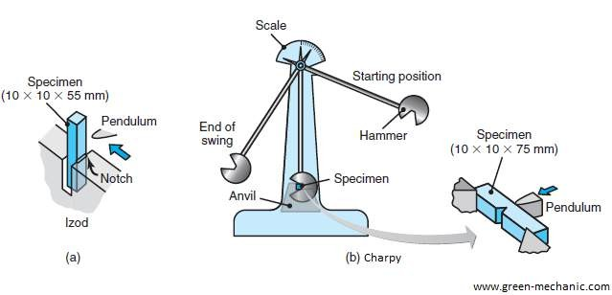
IS 1757 / ISO 148 Metallic Materials — Charpy Pendulum Impact Test
77
Test Piece

Slide 78
IS 1757 / ISO 148 Metallic Materials — Charpy Pendulum Impact Test
78
Test Report
Mandatory information
The test report shall contain the following information or, when agreed by the customer, it shall be possible to retrieve this information based on a traceable coding of the test report by the test laboratory:
Reference to this part of IS 1757 / ISO 148, i.e. IS 1757 Part 1 / ISO 148-1;
Identification of the test piece (e.g. type of steel and cast number);
Size of the test piece, if other than the standard test piece;
Temperature of the test or the conditioning temperature of the test specimens;
Absorbed energy, KV2, KV8, KU2, or KU8, as appropriate;
Whether the specimen, or the majority of specimens in a group of specimens were broken (not required for material acceptance tests);
Any abnormalities that could have affected the test.

Slide 79
IS 1757 / ISO 148 Metallic Materials — Charpy Pendulum Impact Test
79
Specific differences
Parameters under IS Code (IS 1757)
Parameters without IS Code
🠶 Test Specimen: Specifies dimensions, notch type, and notch dimensions for the test specimen.
🠶 Temperature Control: Detailed instructions on conditioning
specimens at specified temperatures.
🠶 Pendulum Specifications: Defines the geometry and weight of the pendulum.
🠶 Calibration: Regular calibration of the testing machine to ensure accuracy.
🠶 Energy Measurement: Accurate measurement of the energy
absorbed during fracture.
🠶 Specimen Variability: Different specimen dimensions and notch types may be used without standard guidelines.
🠶 Inconsistent Temperature: Without conditioning of Specimens at standardized temperatures, the result may not be accurate.
🠶 Pendulum Variability: Variations in the geometry and weight of the pendulum can affect results.
🠶 Non-standard Calibration: without calibration, the test result may not be accurate.
🠶 Variable Energy Measurement: Methods for measuring the
energy absorbed during fracture may vary.

Slide 80
80
7
IS 1598
Method For Izod Impact Test Of Metals

Slide 81
IS 1598 Method For Izod Impact Test Of Metals
81
Scope
This standard prescribes the method of conducting Izod impact test on metals
Principle
The test consists of breaking by one blow from a swinging hammer, under specified conditions, a notched test piece, gripped vertically with the bottom of the notch in the same plane as the upper face of the grips. the blow is struck at a fixed position on the face having the notch. The energy absorbed is determined.

Slide 82
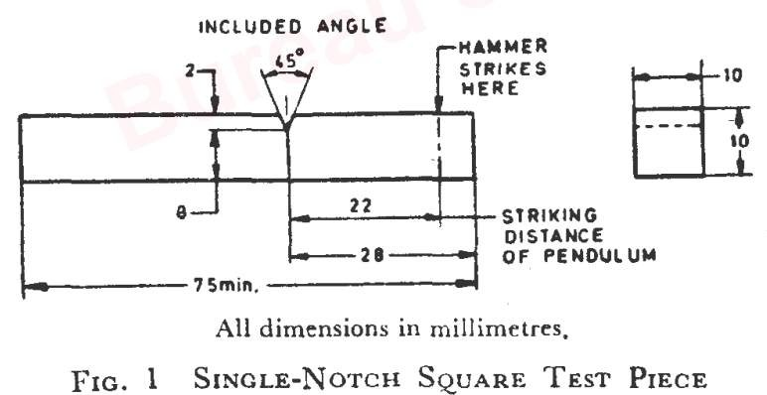
IS 1598 Method For Izod Impact Test Of Metals
Test Piece
82

Slide 83
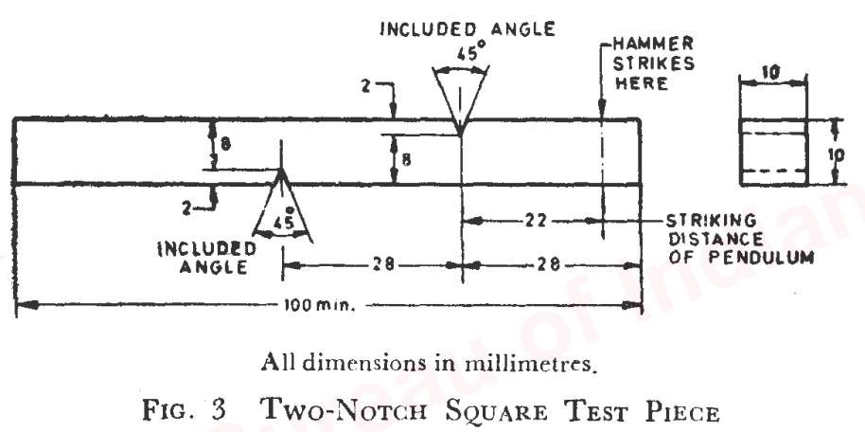
IS 1598 Method For Izod Impact Test Of Metals
Test Piece
83

Slide 84
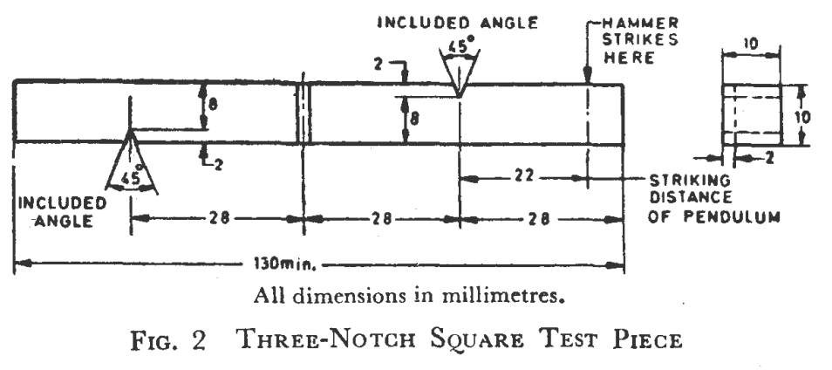
IS 1598 Method For Izod Impact Test Of Metals
Test Piece
84

Slide 85
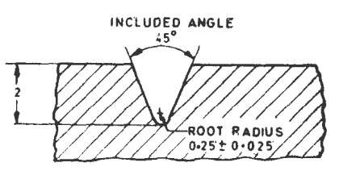
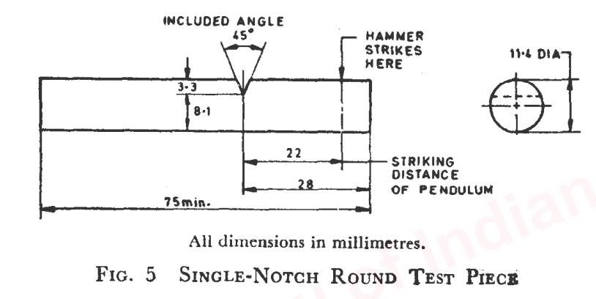
IS 1598 Method For Izod Impact Test Of Metals
Test Piece
Fig. 4 Enlarged view of notch for square test piece
85

Slide 86
IS 1598 Method For Izod Impact Test Of Metals
Test Piece
86

Slide 87
IS 1598 Method For Izod Impact Test Of Metals
87
Specific differences
Parameters under IS Code (IS 1598)
Parameters without IS Code
🠶 Test Specimen: Specifies dimensions, notch type, and notch
dimensions for the test specimen.
🠶 Temperature Control: Detailed instructions on conditioning specimens at specified temperatures.
🠶 Pendulum Specifications: Defines the geometry and weight of the pendulum.
🠶 Calibration: Regular calibration of the testing machine to
ensure accuracy.
🠶 Energy Measurement: Accurate measurement of the energy absorbed during fracture.
🠶 Specimen Variability:
Different specimen dimensions and
notch types may be used without standard guidelines.
🠶 Inconsistent Temperature: without conditioning of specimen
at standardized temperatures, test result may be inaccurate.
🠶 Pendulum Variability: Variations in the geometry and weight of the pendulum can affect results.
🠶 Non-standard Calibration: Without calibration, the test result may be inaccurate.
🠶 Variable Energy Measurement: Methods for measuring the energy absorbed during fracture may vary.

Slide 88
88
8
IS 1599 / ISO 7438
Metallic Materials - Bend Test

Slide 89
IS 1599 / ISO 7438 METALLIC MATERIALS - BEND TEST
Scope
This Indian Standard specifies a method for determining the ability of metallic materials to undergo plastic deformation in bending.
This International Standard applies to test pieces taken from metallic products, as specified in the relevant product standard. It is not applicable to certain materials or products, for example tubes in full section or welded joints, for which other standards exist.
89

Slide 90
IS 1599 / ISO 7438 METALLIC MATERIALS - BEND TEST
Principle
The bend test consists of submitting a test piece of round, square, rectangular or polygonal cross-section to plastic deformation by bending, without changing the direction of loading, until a specified angle of bend is reached.
Test Equipment:
Bending device with two supports and a former( Figure 1);
Bending device with a V-block and a former ( Figure 2);
Bending device with a clamp ( Figure 3);
90

Slide 91
IS 1599 / ISO 7438 METALLIC MATERIALS - BEND TEST
Scope
1.
General : Round, square, rectangular, or polygonal cross-section test pieces shall be used in the test. Any areas of the material affected by shearing or flame cutting and similar operations during sampling of test pieces shall be removed.
Edges of rectangular test pieces Width of the test piece:
2.
3.
the same as the product width, if the latter is equal to or less than 20 mm;
when the width of a product is more than 20 mm:
i.
ii.
20 ± 5 mm for products of thickness less than 3 mm,
between 20 mm and 50 mm for products of thickness equal to or greater than 3 mm
4.
5.
Thickness of the test piece
Length of the test piece
91

Slide 92
IS 1599 / ISO 7438 METALLIC MATERIALS - BEND TEST
Procedure
— KNOOP HARDNESS TEST
Fig. Bending the legs of the test piece
Fig. legs of the test piece parallel to each other
Fig. Legs of the test piece in direct contact
92

Slide 93
IS 1599 / ISO 7438 METALLIC MATERIALS - BEND TEST
93

Slide 94
IS 1599 / ISO 7438 METALLIC MATERIALS - BEND TEST
94

Slide 95
IS 1599 / ISO 7438 METALLIC MATERIALS - BEND TEST
95

Slide 96
IS 1599 / ISO 7438 METALLIC MATERIALS - BEND TEST
When the requirements are not specified in product standard, absence of cracks visible without the use of magnifying aids is considered as evidence that the test piece withstood the bend test
96

Slide 97
IS 1599 / ISO 7438 METALLIC MATERIALS - BEND TEST
Test Report
The test report shall include the following information:
a reference to this International Standard, i.e. IS 1599 / ISO 7438;
identification of the test piece (type of material, cast number, direction of the test piece axis relative
to a product, etc.);
shape and dimensions of the test piece;
test method;
any deviation from this International Standard;
test result.
97

Slide 98
IS 1599 / ISO 7438 METALLIC MATERIALS - BEND TEST
98
Specific differences
Parameters under IS Code (IS 1599)
Parameters without IS Code
🠶 Test Specimen: Specifies dimensions and preparation of the test specimen, ensuring uniformity.
🠶 Bend Angle: Defines the angle to which the specimen must be bent, typically 180 degrees or until fracture.
🠶 Bending Rate: Specifies the rate at which the bending should occur, ensuring consistent application of force.
🠶 Specimen Variability: Different specimen dimensions and
preparation methods may be used without standard guidelines.
🠶 Inconsistent Bend Angle: The angle to which the specimen is bent may vary, leading to inconsistent results.
🠶 Variable Bending Rate: The rate at which the bending occurs may not be controlled, leading to variations in the application of force.
🠶 Non-standard Fixture Design: The design and dimensions of the bending fixtures may vary, affecting the results.
🠶 Unclear Criteria: Pass/fail criteria may not be well-defined,
leading to subjective interpretations of the results.
🠶 Fixture Design: Provides details on the design and
dimensions of the bending fixtures.
🠶 Pass/Fail Criteria: Defines clear criteria for determining
whether the specimen has passed or failed the test based on
the presence of cracks or fractures.

Slide 99
99
Mechanical Testing of Metals
Testing with IS Code
Testing without IS Code
Ensures standardization, reliability, and accuracy.
Results in inconsistent and variable procedures.
Facilitates compliance with regulatory requirements.
May lead to unreliable and less precise measurements.
Provides detailed and consistent reporting.
Can face regulatory and compliance issues.
Enhances the credibility and quality assurance of test results.
Results in inadequate documentation and traceability.
Facilitate acceptance of test report world wide
Test report not accepted world wide.

Slide 100
Why this session is being conducted ?
100
🠶 Fundamental Knowledge: Understanding the standards helps students grasp the fundamental principles of mechanical testing, which is crucial for their academic and professional development.
🠶 Industry Relevance: Familiarity with Indian Standards (IS) prepares students for industry practices, as these standards are widely
used in the engineering and manufacturing sectors in India.
🠶 Quality and Safety: Knowledge of these standards ensures that future engineers can conduct tests that meet quality and safety requirements, which is essential for producing reliable and safe products.
🠶 Global Competence: While Indian Standards are specific to India, they are often aligned with international standards. This prepares students for working in a global environment and understanding different standardization systems.
🠶 Compliance and Regulations: Engineers need to be aware of regulatory requirements and standards to ensure that their work complies with national and international regulations, avoiding legal and safety issues.
🠶 Professional Development: Familiarity with standards is a key component of professional development, enhancing students' resumes and making them more attractive to potential employers.
🠶 Research and Innovation: Understanding the standards allows students to conduct research and innovate within the framework of
established guidelines, leading to credible and standardized results.
🠶 Interdisciplinary Learning: Mechanical testing involves knowledge from various fields such as materials science, physics, and engineering. Learning about standards integrates these disciplines, providing a comprehensive education.

Slide 101
Thank You
101

