Slide 1
presentation on Standards on inorganic chemicals

Slide 2
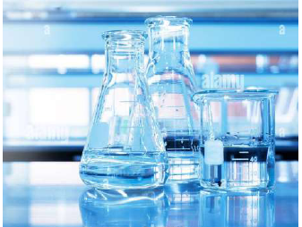
INTRODUCTION
Inorganic chemistry, a fundamental branch of chemistry, deals with synthesis, properties and behaviour of inorganic and organometallic compounds. This field covers chemical compounds that are not carbon-based, which are the subjects of organic chemistry. The distinction between the two disciplines is, however not absolute, as there is remarkable overlap in the subdiscipline of organometallic chemistry. Nevertheless, inorganic chemistry has applications in every aspect of the chemical industry, including catalysis, materials science, pigments, surfactants, coatings, medications, fuels, and agriculture.

Slide 3
SCOPE OF INORGANIC CHEMISTRY
The diverse field of Inorganic Chemistry encompasses a wide range of substances, including metals, minerals, salts, and organometallic compounds, which do not fall under the category of organic compounds primarily made of carbon and hydrogen. Inorganic chemistry is crucial for understanding the materials and processes that form the backbone of industries, environmental systems, and biological functions.
Inorganic chemistry is characterized by its vast scope, covering all elements in the periodic table and their compounds, except for the numerous organic compounds.

Slide 4
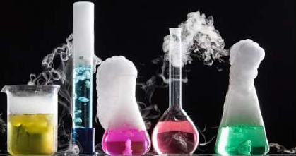
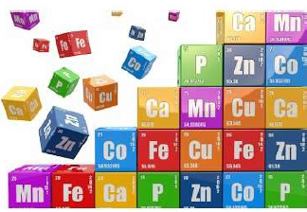
Inorganic Chemistry involves the study of:
Elements and Compounds: From simple salts to complex coordination compounds.
Materials Science: Development and characterization of metals, ceramics, and semiconductors.
Bioinorganic Chemistry: Role of metal ions in biological systems.
Environmental Chemistry: Understanding and mitigating the effects of inorganic pollutants.
Industrial Applications: Catalysts, pigments, coatings, and more.

Slide 5
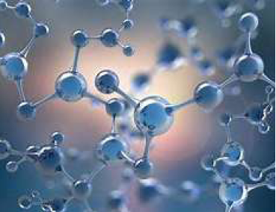
Importance of Analytical Techniques in Inorganic Chemistry
Analytical techniques in inorganic chemistry are essential for characterizing materials, understanding their properties, and ensuring quality control in various applications.
These techniques allow chemists to identify and quantify the elements and compounds present in a sample, understand their structure, and study their behavior under different conditions.
The accuracy and reliability of these analyses are critical for research, industrial applications, and environmental monitoring.

Slide 6
Four Methods to Identify and Quantify Inorganic Elements
(A) SPECTROSCOPY
Principle: Measures the concentration of gas-phase atoms by absorbing optical radiation.
Applications: Used extensively for analysing metal concentrations in water, soil, and biological samples.
Atomic Emission Spectroscopy:
Inductively Coupled Plasma Atomic Emission Spectroscopy (ICP-AES)
Atomic Absorption Spectroscopy: UV Visible
Spectroscopy
Principle: Measures the absorption of ultraviolet or visible light by a compound, which provides information about its electronic structure.
Applications: Used to study transition metal complexes, concentration of solutions, and reaction kinetics.
Principle: Ionizes the sample with inductively coupled plasma and then uses mass spectrometry to detect the ions.
Applications: Highly sensitive technique for detecting trace elements and isotopes.

Slide 7
Standards in which Inductively Coupled Plasma Atomic Emission Spectroscopy (ICP-AES) method is used:
IS 3025 (Part 2) : 2019/ISO 11885 : 2007 - Methods of Sampling and Test (Physical and Chemical) for Water and Wastewater: Part 2 Determination of Selected Elements by Inductively Coupled Plasma Optical Emission Spectrometry (ICP - OES)
IS 3025 (Part 65) : 2022/17294-2 : 2016 - Methods of Sampling and Test Physical and Chemical for Water and Wastewater Part 65 Application of Inductively Coupled Plasma Mass Spectrometry ( ICP-MS ) — Determination of selected elements including Uranium Isotopes
IS 3025 (Part 64) : 2015/ISO 17294-1 : 2004 - Methods of Sampling and Test (Physical and Chemical) for Water and Wastewater: Part 64 Application of Inductively Coupled Plasma Mass Spectrometry (ICP - MS) - General Guidelines
Standards in which UV Visible Spectroscopy is used:
IS 1448 (Part 143) : 2022 - Methods of test for petroleum and its products Part 143 Evaluation of white mineral oils by ultraviolet absorption spectroscopy

Slide 8
(B) CHROMATOGRAPHY
Principle: Separation of molecules in mixture applied onto the surface or into the solid (stationary phase) while moving with mobile phase.
Applications: Used in the detection and quantification of biomolecules including proteins, nucleic acids, enzymes, vitamins, etc.
(C) TITRATION
(D) GRAVIMETRIC ANALYSIS
Principle: Determination of volume or concentration of an unknown solution (analyte) with the help of a solution with known volume and/or concentration (titrant).
Applications: Used for the detection and quantification of metals and other impurities in various samples including wastewater, food products, alcohols, jewellery etc.
Principle: Measures the mass of an analyte or its derivative to determine its concentration.
Applications: Simple and precise method for quantifying compounds in a sample, particularly useful for substances that can be easily precipitated and weighed.

Slide 9
Standards in which different Chromatography method is used:
IS 18108 : 2023/ISO 14674: 2005 - Milk and milk powder - Determination of aflatoxin M1 content - Clean-up by immunoaffinity chromatography and determination by thin-layer chromatography
IS 16641 : 2018/ISO 20638 : 2015 - Infant formula - Determination of nucleotides by liquid chromatography
IS 5182 (Part 21) : 2001 - Methods for measurement of air pollution: Part 21 non methane hydrocarbons in air by gas chromatography
IS 5182 (Part 17) : 1979 - Methods for measurement of air pollution: Part 17 C1 to C2 hydrocarbons in air by gas chromatography
IS 15669 : 2006/ISO 10695 - Water quality - Determination of selected organic nitrogen and phosphorus compounds - Gas chromatographic method
IS 15210 : 2002/ISO 8762 - Workplace air - Determination of vinyl chloride - Charcoal tube/gas chromatographic method

Slide 10
Standards in which Titrimetric method is used:
IS 13433 (Part 1) : 1992/ISO 6490-1 - Animal feeds and feeding stuffs - Determination of calcium Part 1 Titrimetric Method
IS 2600 (Part 7) : 2022 - Methods Of Chemical Analysis of Zinc and Zinc Base Alloys For Die Castings Part 7 : Determination of Aluminium by Titrimetric Method
IS 4027 (Part 11) : 2000 - Hemical analysis of bronzes - Methods: Part 11 determination of lead - Ethylenediamine tetraacetic acid (EDTA) - Titrimetric – method
IS 6092 (Part 2/Sec 6) : 2004/ISO 7408 - Methods of sampling and test for fertilizers: Part 2 determination of nitrogen: Sec 6 ammoniacal nitrogen content in the presence of other substances which release ammonia when treated with sodium hydroxide - Titrimetric method
IS 582 (Part 12) : 2022/ISO 5397:1984 - Methods of Chemical Testing of Leather Part 12 Determination of nitrogen content and hide substance Titrimetric method

Slide 11
Standards in which Gravimetric method is used:
IS 2317 : 1975 - Method for gravimetric determination of sulphates
IS 17321 : 2020/ISO 8343 : 1985 – Ferronickel - Determination of Silicon Content - Gravimetric Method
IS 12548 : 2022/ISO 3908 : 2009 - Hardmetals Determination of insoluble free carbon Gravimetric method
IS 17319 : 2020/ISO 6352 : 1995 - Ferronickel - Determination of Nickel Content Dimethylglyoxime - Gravimetric Method
IS 13938 (Part 1) : 1994 - Chemical analysis of ferromanganese: Part 1 determination of silicon by gravimetric method
IS 1448 (Part 162) : 2018 - Methods of Test For Petroleum and Its Products [P:162] Determination of insoluble Contamination of Hydraulic Fluids by Gravimetric Analysis
IS 15106 : 2002/ISO 11465 - Determination of dry matter and water content on a mass basis - Gravimetric method

Slide 12
Standardization on Chemicals
BIS is engaged in standardization in the field of Inorganic Chemicals through following Sectional Committee:
Inorganic Chemicals Sectional Committee, CHD 1
Scope: To formulate Indian Standards on terminology, methods of sampling and tests (including general methods) code of practices and specification for all inorganic chemicals (except electroplating and photographic chemicals).
To participate in the work of ISO/TC 47 Chemistry and ISO/TC 298 Rare Earth.
CHD 1 has published around 200 standards out of which around 155 are product standards.
Member Secretary – Mr. Sagar Singh

Slide 13
Important Product Standards on Inorganic Chemicals

Slide 14
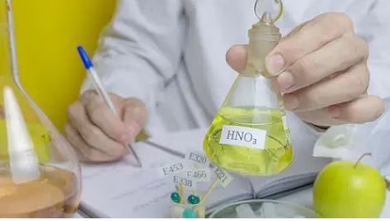
IS 264:2005
NITRIC ACID – SPECIFICATION (Third Revision)
SCOPE
This standard prescribes the requirements and the methods of sampling and test for nitric acid.
GRADES
Nitric acid shall be of the following five grades:
a) Technical (Tech),
b) Nitration,
c) Explosive,
d) Chemically pure (CP), and
e) Analytical reagent (AR).

Slide 15
Technical, Nitration and Explosive Grades
The material shall be not darker than pale brown in colour and shall be free from sediment and other visible impurities.
Chemically Pure and Analytical Reagent Grades
The material shall be clear and almost colourless, free from sediment and other visible impurities.
The main industrial use of nitric acid is for the production of fertilizers. Nitric acid is neutralized with ammonia to give ammonium nitrate. This application consumes 75–80% of the 26 million tonnes produced annually (1987). The other main applications are for the production of explosives, nylon precursors, and specialty organic compounds.
In elemental analysis by ICP-MS, ICP-AES, GFAA, and Flame AA, dilute nitric acid (0.5–5.0 %) is used as a matrix compound for determining metal traces in solutions
DESCRIPTION
USES OF NITRIC ACID

Slide 16
Nitric acid is supplied in screw-stoppered stone bottles or glass carboys, the containers shall be fitted with leak-tight stoppers.
The stoppers shall be further sealed by putty made from china clay or a mixture of sodium silicate and asbestos flour or a mixture of sulphur and sand.
Nitric acid of chemically pure and analysis reagent grades shall be supplied in glass bottles or glass carboys fitted with tight fitting TEFLON WASHERS (of thickness 0.2 mm) and stoppered with HDPE or other suitable stopper. The use of HDPE or other suitable caps over the stopper is recommended.
They shall prominently display the cautionary notice:
BIS Certification Marking - The use of the Standard Mark is governed by the provisions of the Bureau of Indian Standards Act, 1986 and the Rules and Regulations made thereunder.
PACKING AND MARKING OF NITRIC ACID
‘CORROSIVE, HANDLE WITH CARE’

Slide 17
SAFETY
Nitric acid is a corrosive acid and a powerful oxidizing agent. The major hazard posed by it is chemical burns, as it carries out acid hydrolysis with proteins (amide) and fats (ester), which consequently decomposes living tissue (e.g. skin and flesh). Concentrated nitric acid stains human skin yellow due to its reaction with the keratin. These yellow stains turn orange when neutralized. Systemic effects are unlikely, and the substance is not considered a carcinogen or mutagen.
The standard first-aid treatment for acid spills on the skin is, as for other corrosive agents, irrigation with large quantities of water. Washing is continued for at least 10 –15 minutes to cool the tissue surrounding the acid burn and to prevent secondary damage. Contaminated clothing is removed immediately and the underlying skin washed thoroughly.
Being a strong oxidizing agent, nitric acid can react violently with many compounds.

Slide 18
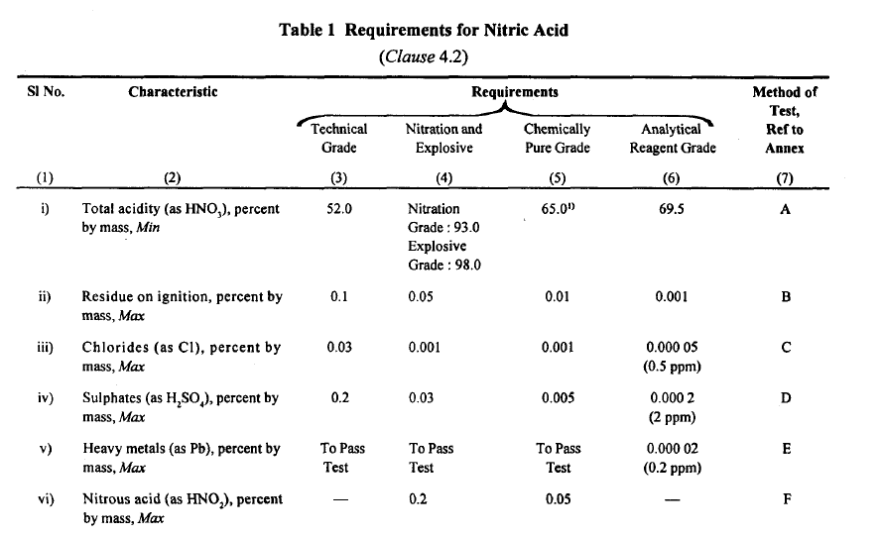

Slide 19
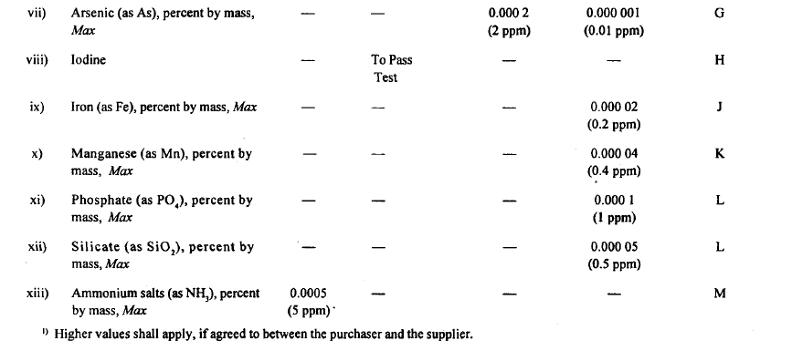

Slide 20
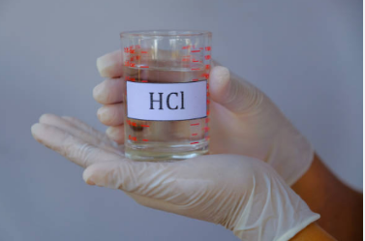
IS 265:2021
HYDROCHLORIC ACID — SPECIFICATION (Fifth Revision)
SCOPE
This standard prescribes requirements and methods of sampling and test for hydrochloric acid.
GRADES
There shall be following five grades of hydrochloric
acid:
a) Technical grade (Tech),
b) Chemical pure grade (CP),
c) Food Grade (FG),
d) Analytical reagent grade (AR); and
e) Boiler water grade (BW).

Slide 21
Technical Grade and Boiler Water Grade
The material shall be a clear, colourless or light yellow liquid free from dirt and other visible impurities.
Food Grade
The material shall be clear, colourless or light yellow liquid free from dirt and other visible impurities and organic materials.
The material produced only by synthesis of pure chlorine and hydrogen shall be suitable for food grade.
Hydrochloric acid obtained as a by-product from other chlor-organic processes, will not be suitable material for food grade unless it meets the requirement of total organic carbon.
Chemically Pure and Analytical Reagent Grade
The material shall be a colourless fuming liquid free from dirt and other visible impurities.
DESCRIPTION

Slide 22
Hydrochloric acid of analytical reagent grade shall be supplied in glass bottles or polyethylene containers or glass carboys fitted with tight-fitting HDPE or other suitable stoppers. The use of HDPE or other suitable caps over the stopper is recommended.
When hydrochloric acid is supplied in glass carboys, polyethylene carboys or hard-rubber drums, the containers shall be fitted with leak-proof stoppers.
The bottles and jars shall be packed in suitable pent-top packing cases. They shall be placed in an upright position on saw dust, straw, chalk or dry earth, and the empty surrounding space shall also be filled with the same material to prevent movement.
They shall prominently display the words:
BIS Certification Marking - The use of the Standard Mark is governed by the provisions of the Bureau of Indian Standards Act, 1986 and the Rules and Regulations made thereunder.
PACKING AN MARKING OF HYDROCHLORIC ACID
‘CORROSIVE, HANDLE WITH CARE’

Slide 23
USES OF HYDROCHLORIC ACID
Hydrochloric acid is a strong inorganic acid that is used in many industrial processes such as refining metal. The application often determines the required product quality. Hydrogen chloride, not hydrochloric acid, is used more widely in industrial organic chemistry, e.g. for vinyl chloride and dichloroethane.
In industry demanding purity (food, pharmaceutical, drinking water), high-quality hydrochloric acid is used to control the pH of process water streams.
One of the most important applications of hydrochloric acid is in the pickling of steel, to remove rust or iron oxide scale from iron or steel before subsequent processing, such as extrusion, rolling, galvanizing, and other techniques.
Akin to its use for pickling, hydrochloric acid is used to dissolve many metals, metal oxides and metal carbonates.

Slide 24
SAFETY
Being a strong acid, hydrochloric acid is corrosive to living tissue and to many materials, but not to rubber. Typically, rubber protective gloves and related protective gear are used when handling concentrated solutions.
Vapours or mists are a respiratory hazard, which can be partially mitigated by use of a respirator equipped with cartridges specifically designed to capture hydrochloric acid. Airborne acid is an irritant to the eyes, and may require the use of protective goggles or a facemask.

Slide 25
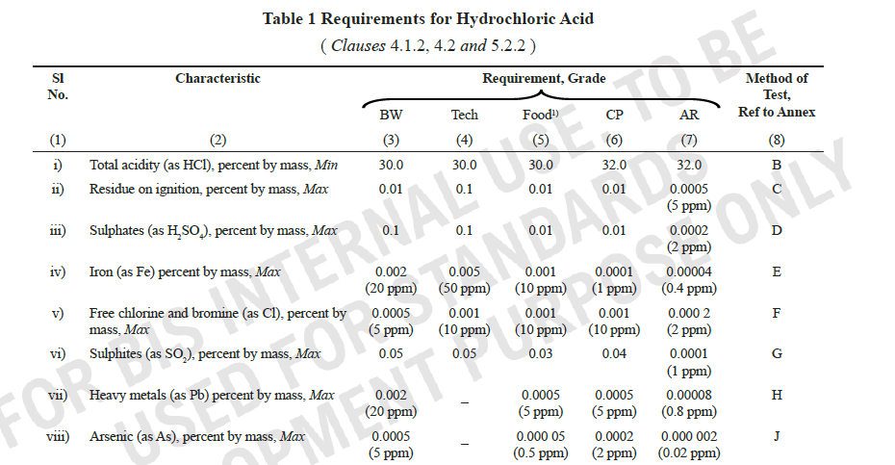

Slide 26
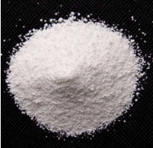
IS 296:2023
SODIUM CARBONATE ANHYDROUS - SPECIFICATION (Fourth Revision)
SCOPE
This standard prescribes the requirements and the methods of sampling and test for sodium carbonate, anhydrous.
GRADES
The material shall be of two grades, namely,
Pure, and
Analytical Reagent.

Slide 27
DESCRIPTION
The material shall be in the form of granular or fine white powder, free from foreign matter and visible impurities, and shall be readily soluble in water, forming a clear, colourless solution.
Sodium carbonate is obtained as three hydrates and as the anhydrous salt:
Sodium carbonate decahydrate (natron), Na₂CO₃·10H₂O, which readily effloresces to form the monohydrate.
Sodium carbonate heptahydrate (not known in mineral form), Na₂CO₃·7H₂O.
Sodium carbonate monohydrate (thermonatrite), Na₂CO₃·H₂O. Also known as crystal carbonate.
The material of the pure grade shall be packed in air-tight containers with polyethylene lining.
The material of the analytical reagent grade shall be packed in glass or other suitable containers on which the material has no action.
BIS Certification Marking - The use of the Standard Mark is governed by the provisions of the Bureau of Indian Standards Act, 1986 and the Rules and Regulations made thereunder.
PACKING AN MARKING OF SODIUM CARBONATE

Slide 28
USES OF SODIUM CARBONATE ANHYDROUS
Sodium carbonate, anhydrous, is used in the manufacture of sodium salts and for other special purposes. It is also used as a reagent in analytical chemistry.
As a cleansing agent for domestic purposes like washing clothes. Sodium carbonate is a component of many dry soap powders. It has detergent properties through the process of saponification, which converts fats and grease to water-soluble salts (specifically, soaps).
It is used for lowering the hardness of water.
It is used in the manufacture of glass.
It is used in the manufacture of sodium compounds like borax.
Sodium carbonate is also used as a relatively strong base in various fields. As a common alkali, it is preferred in many chemical processes because it is cheaper than sodium hydroxide and far safer to handle. Its mildness especially recommends its use in domestic applications.

Slide 29
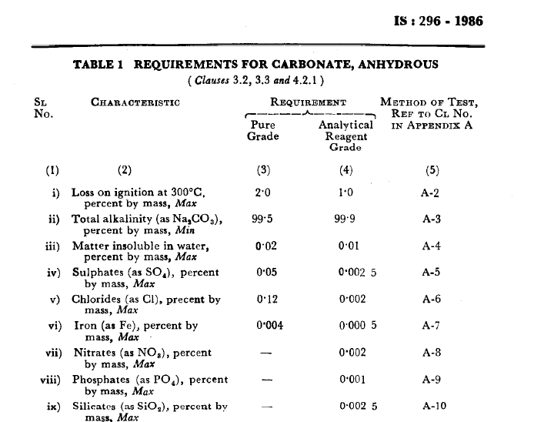

Slide 30
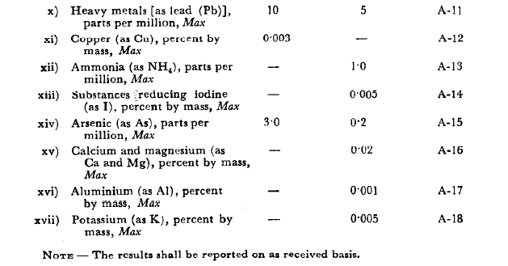

Slide 31
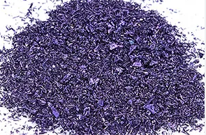
IS 333:2023
POTASSIUM PERMANGANATE – SPECIFICATION
(Third Revision)
SCOPE
This standard prescribes the requirements and the methods of sampling and test for potassium permanganate.
GRADES
The material shall be of the following three grades:
a) Technical,
b) Pure, and
c) Analytical reagent ( AR ).

Slide 32
DESCRIPTION
Potassium permanganate of technical grade shall be in the form of dark purple powder or irregular crystals or conglomerates.
Potassium permanganate of pure and analytical reagent grades shall be in the form of dark purple crystals having a metallic lustre.
The purplish-black colour of solid potassium permanganate, and the intensely pink to purple colour of its solutions, is caused by its permanganate anion, which gets its colour from a strong charge-transfer absorption band caused by excitation of electrons from oxo ligand orbitals to empty orbitals of the manganese(VII) center.
The material shall be packed in closed containers as agreed to between the purchaser and the supplier.
BIS Certification Marking - The use of the Standard Mark is governed by the provisions of the Bureau of Indian Standards Act, 1986 and the Rules and Regulations made thereunder.
PACKING AN MARKING OF POTASSIUM PERMANGANATE

Slide 33
USES OF POTASSIUM PERMANGANATE
Potassium permanganate is used as an oxidizing agent mainly in the production of saccharin and benzoic acid; bleaching and decolourising ethereal oils, waxes and fatty materials; leather tanning; staining and preservation of wood; and as a deodorant and disinfectant.
Almost all applications of potassium permanganate exploit its oxidizing properties. As a strong oxidant that does not generate toxic byproducts, KMnO4 has many niche uses potassium permanganate is used for a number of skin conditions.
Potassium permanganate is used extensively in the water treatment industry.
A major application of KMnO₄ is as a reagent for the synthesis of organic compounds.

Slide 34
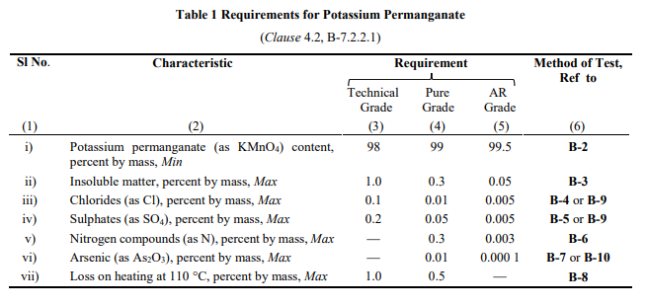

Slide 35
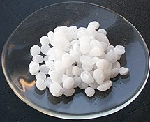
IS 376:2023
SODIUM HYDROXIDE ANALYTICAL - REAGENT SPECIFICATION (Fourth Revision)
SCOPE
This standard prescribes, the requirements and the methods of sampling and test for sodium hydroxide, analytical reagent.
DESCRIPTION
The material shall be in the form of white sticks or pellets.

Slide 36
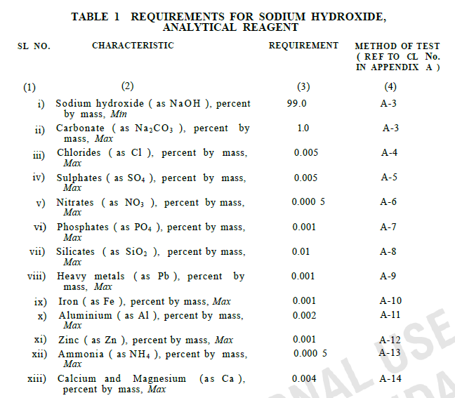

Slide 37
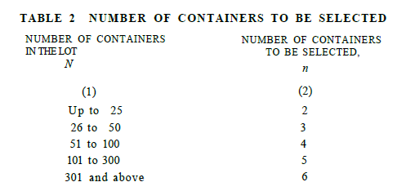

Slide 38
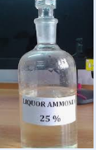
IS 799 : 2023
AMMONIA LIQUOR - SPECIFICATION (Third Revision)
SCOPE
This standard prescribes the requirements and methods of sampling and test for ammonia, liquor. The material is also known as aqua ammonia, and ammonium hydroxide.

Slide 39
GRADES
There shall be two grades, namely:
Technical grade intended for uses, such as cleansing agent, refrigerant, accelerator in vulcanization, and in the ammonia process of ferro printing of drawings; and
Analytical reagent grade.
USES
Liquid ammonia finds application as a water treatment chemical in boiler system.
About 80% of the ammonia produced by industry is used in agriculture as fertilizer. Ammonia is also used as a refrigerant gas, for purification of water supplies, and in the manufacture of plastics, explosives, textiles, pesticides, dyes and other chemicals.

Slide 40
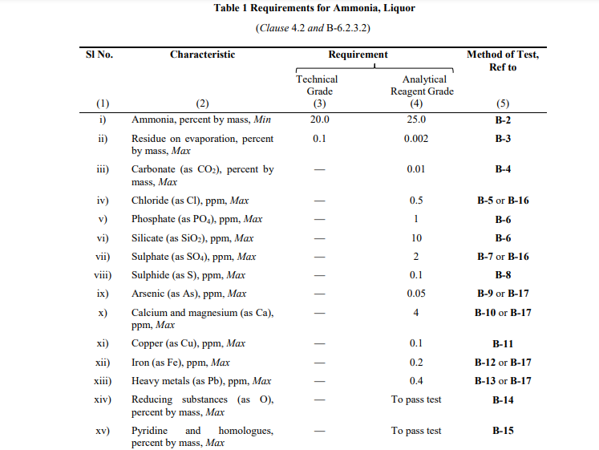

Slide 41
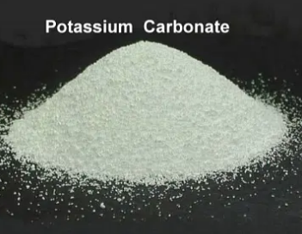
IS 7129 : 2021
POTASSIUM CARBONATE ANHYDROUS - SPECIFICATION (Second Revision)
SCOPE
This standard prescribes the requirements and methods of sampling and test for potassium carbonate, anhydrous.
GRADES
The material shall be of two grades, namely:
a) Pure grade, and
b) Technical grade.

Slide 42
USES OF POTASSIUM CARBONATE
Potassium carbonate is used as a dehydrating agent and for making other potassium salts, such as chlorates and chromates. It also finds its use in ceramics, explosives, fertilizers, mineral water, tanning, electroplating, shampoo preparations, process engraving and lithography, soft soaps, textile dyeing, bleaching and finishing oil, and photography.

Slide 43
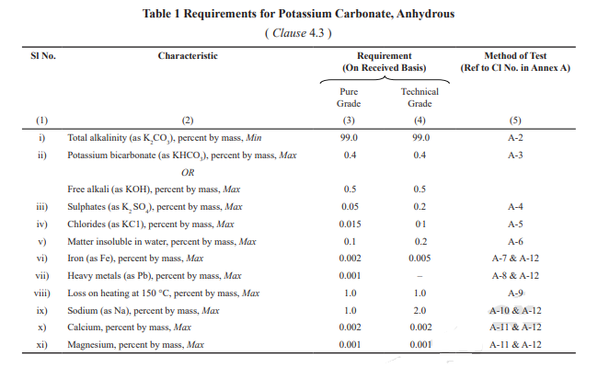

Slide 44
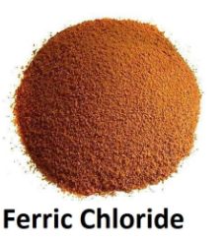
IS 711 : 2023
FERRIC CHLORIDE TECHNICAL – SPECIFICATION
(Second Revision)
SCOPE
This standard prescribes the requirements and the methods of sampling and test for ferric chloride, technical, chiefly used as coagulant in water
purification, in the manufacture of glycerine, in etching glass plates and in photo-engravings.

Slide 45
FORM
The material shall be in one of the following forms:
a) Anhydrous powder;
b) Hydrated; and
c) Liquid.
USES OF FERRIC CHLORIDE
Ferric chloride is used as a coagulant for sewage and industrial wastes, also in glycerine manufacture, in etching copper, in photo-engraving as a mordant, and to produce decorative surface effects on ceramics. It is also an oxidizing, chlorinating and condensing agent, a disinfectant, a pigment and a medicine.

Slide 46
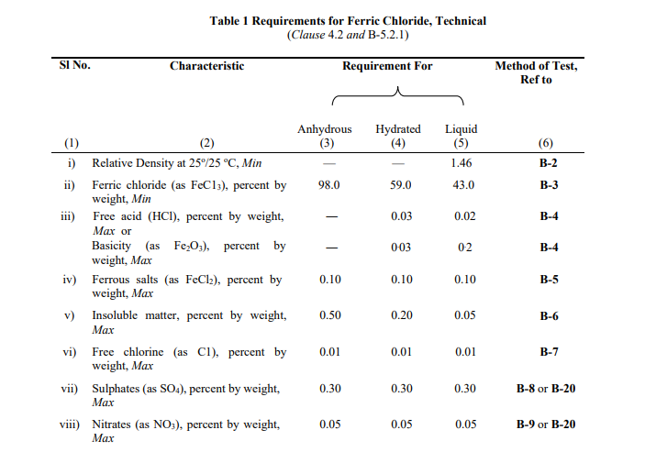

Slide 47
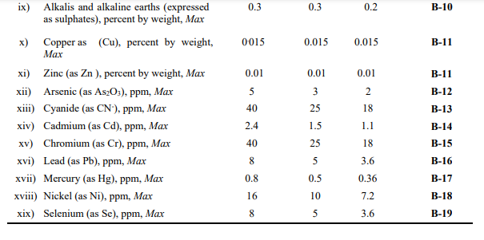

Slide 48
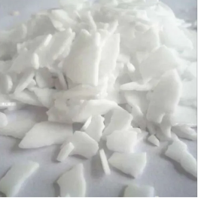
IS 6831 : 2023
CAUSTIC POTASH - SPECIFICATION (Third Revision)
SCOPE
This standard prescribes the requirements and methods of sampling and test for caustic potash. It covers the material in solid and lye forms.
Uses:
Caustic potash is a typical strong alkaline substance made by electrolyzing aqueous solution of potassium chloride. It is widely used in many areas such as alkaline batteries, pharmaceuticals, cosmetics, various potash salts, detergents, and food additives.

Slide 49
GRADES
There shall be three grades of the material as
follows:
Pure — suitable for use in the manufacture of soaps, oxalic acid and other potassium compounds. It may also be used for process engraving and lithography and for manufacture of products like dyestuff and potassium permanganate;
Analytical Reagent (AR) — suitable for use as reagent in analytical work; and
Electronic Grade (ER) — suitable for use in electronic industries.

Slide 50
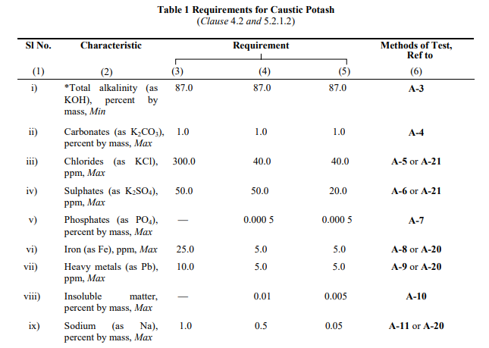

Slide 52
IS 6614 : 2021
ALUMINIUM CHLORIDE, ANHYDROUS,TECHNICAL — SPECIFICATION (First Revision)
This Indian Standard prescribes the requirements, method of sampling and test for aluminium chloride, anhydrous, technical.
USES:
Aluminium chloride, anhydrous, technical finds extensive use in Friedel-Crafts reaction specially in the manufacture of various pharmaceuticals and dyestuffs, in cracking of petroleum; in the manufacture of rubber, and lubricants; in preserving wood, in refining of crude oil, dyeing of fabrics, in manufacture of parchment paper, detergents and ethylbenzene, polymerization and isomerization reaction of hydrocarbons etc.

Slide 53
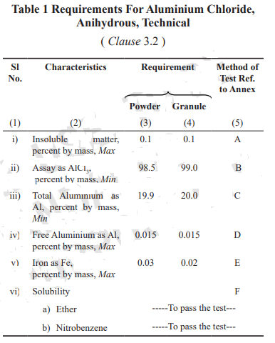

Slide 54
IS 6605 : 2023
POTASSIUM CHROMATE — SPECIFICATION
( First Revision )
This standard prescribes the requirements and the methods of sampling and test for potassium chromate.
Grades:
The material shall be of the following three grades:
a) Technical (Tech);
b) Pure; and
c) Analytical reagent (AR).
Uses:
Potassium chromate is chiefly used in the manufacture of pigments. It is also used in leather finishing, as a mordant in textile industry, in corrosion inhibition and as analytical reagent. It has a limited application in the manufacture of enamels.

Slide 55
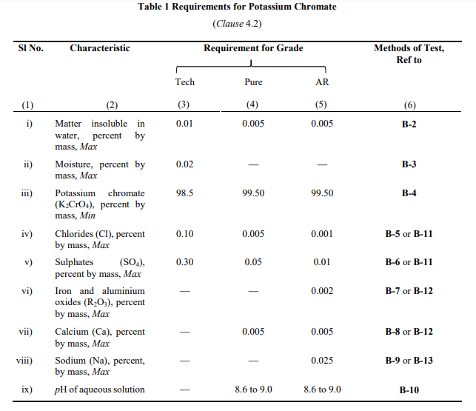

Slide 56
IS 6100 : 2021
SODIUM TRIPOLYPHOSPHATE, ANHYDROUS, TECHNICAL —SPECIFICATION (Second Revision)
This standard prescribes the requirements and the methods of sampling and test for sodium tripolyphosphate, anhydrous, technical, for use as a detergent builder, and as a deflocculant.
Uses:
At present, the largest use of sodium tripolyphosphate is as a builder of synthetic detergents. Most of the built detergents sold today contain sodium tripoly and/or pyrophosphate. Among other important uses of sodium tripolyphosphate are ingredients of the formulation of boiler feed water treatment, purification of china clay, conditioning, of oil drilling mud, antipith agent in paper making, textile processing, dispersant in cements, etc.

Slide 57
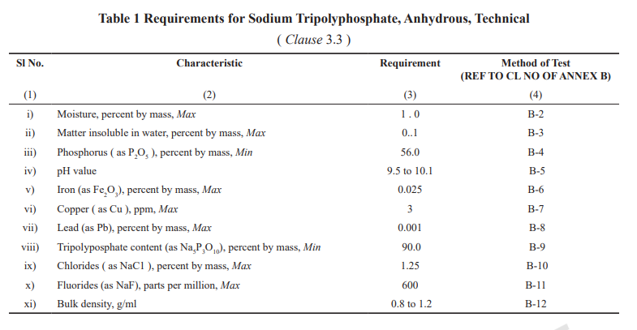

Slide 58
Standards on Inorganic Chemicals under Mandatory Certification
Sl. No. | IS No. | Title
1. | IS 252 | Caustic soda
2. | IS 10116 | Boric acid
3. | IS 798 | Ortho-phosphoric Acid
4. | IS 297 | Sodium Sulphide, Technical
5. | IS 7129 | Potassium Carbonate Anhydrous
6. | IS 4581 | Phosphorus Trichloride Pure And Analytical Reagent
7. | IS 11744 | Phosphorous Pentachloride, Technical

Slide 59
Sl. No. | IS No. | Title
8. | IS 11657 | Phosphorus Oxychloride, Technical
9. | IS 2080 | Specification for stabilized hydrogen peroxide
10. | IS 3205 | Precipitated Barium Carbonate
11. | IS 6100 | Sodium Tripolyphosphate Anhydrous, Technical

Slide 60
BIS Standardization Module
Standardization module has been established to help the members/non members to comment on the documents from all the sectional committees.

Slide 61
Provision of Commenting on document by any stakeholder
Go to https://bis.gov.in/
Select Published Standards (under standards link)
Select Department (Chemical Department)
Click on the standards (Numbers of standards given)
Click on the comment link in front of the corresponding standard number and submit the comment
Link:https://www.services.bis.gov.in:8071/php/BIS_2.0/dgdashboard/published/pub_stn_list/62/CHD/

Slide 62
Provision for making a request to become a new member in Sectional Committees
Go to https://bis.gov.in/
Go to standards
Select Technical Departments
Go to - Become a new member
Register and login
Link:https://www.services.bis.gov.in:8071/php/BIS_2.0/dgdashboard/committee_sso

Slide 63
Proposal of New Work Items
Go to https://bis.gov.in/
Select Proposals for New Standards (under standards link)
Select Department (Chemical Department)
Click on Submit a New Proposal
Link:https://www.services.bis.gov.in:8071/php/BIS_2.0/bisconnect/new_proposal/New_proposal_1/proposals_commtt?depid=NjI%3D&depname=Q0hE
Similarly, Comment on wide circulation documents can also be made.

