Slide 1
Standardization in Technical Drawing

Slide 2
Why we Need a “Standard”?
Quality Assurance: Standards ensure that products meet a minimum quality level, which boosts consumer confidence and satisfaction.
Safety: Standards often include safety requirements that help protect consumers from potential hazards associated with products.
Interoperability: Standards ensure compatibility between different products and systems, which is essential in industries where components need to work together seamlessly.
Trade Facilitation: Standardized products are more easily accepted in international markets, promoting trade and economic growth. Compliance with ISO standards can help Indian products compete globally.
Innovation and Improvement: Standards provide a baseline, encouraging manufacturers to innovate and improve upon existing products to gain a competitive edge.

Slide 3
Regulation and Compliance: Standards help in regulatory compliance, simplifying the enforcement of laws and regulations by providing clear guidelines.
Cost Efficiency: By adhering to standards, manufacturers can reduce costs associated with rework, recalls, and customer complaints due to non-conformance to quality or safety requirements.
Consumer Protection: Standards protect consumers by ensuring that the products they use are safe, reliable, and of good quality.
Environmental Protection: BIS standards often include environmental guidelines to ensure that products are produced and disposed of in an environmentally friendly manner.
Resource Efficiency: Standards promote efficient use of resources, which can reduce costs for manufacturers and consumers and contribute to sustainability.
Benchmarking: Standards serve as benchmarks for measuring product quality, performance, and safety, allowing for consistent evaluation and improvement.
BIS standards, therefore, play a critical role in maintaining the quality and safety of products and services, promoting economic growth, and protecting the interests of consumers and businesses alike.

Slide 4
Role of Technical Drawings in Standardization
Technical drawing plays a crucial role in the development and implementation of standards for several important reasons:
Clear Communication: Technical drawings provide a precise and unambiguous way to convey the specifications, dimensions, and construction details of a product. This clarity helps ensure that everyone involved in the production process has a shared understanding of the requirements.
Consistency and Accuracy: Technical drawings ensure that products are manufactured consistently and accurately according to the specified standards. This consistency is essential for maintaining quality and ensuring that products meet the required performance criteria.
Compliance with Standards: Technical drawings help manufacturers adhere to industry standards and regulations. By providing detailed visual representations of product specifications, these drawings ensure that all aspects of the design comply with relevant standards.

Slide 5
Facilitating Communication Across Disciplines: Technical drawings bridge the gap between different disciplines involved in product development, such as engineering, manufacturing, and quality assurance. They provide a common language that all parties can understand and work from.
Reducing Errors and Rework: Detailed technical drawings reduce the likelihood of errors and rework by providing precise instructions for manufacturing. This precision helps prevent misunderstandings and mistakes that can lead to costly delays and defects.
Innovation and Improvement: Technical drawings support innovation by providing a clear foundation for modifying and improving existing designs. Engineers can build on established standards and drawings to develop new and enhanced products.
In summary, technical drawing is vital in standard development and implementation because it ensures clear communication, accuracy, consistency, and compliance with standards, all of which are essential for producing high-quality, reliable products.

Slide 6
CHAPTER 1: Types of projection, representation of lines, view, section, and cuts.

Slide 7
Why we need IS 15021 (Part 1) Technical drawings - Projection methods: Part 1 Synopsis
Clarity and Precision: Technical drawings are essential for accurately communicating the specifications of a part or assembly. IS 15021 (Part 1) provides standardized methods to ensure that drawings are clear and precise, reducing the risk of misunderstandings and errors.
Consistency: Standardized projection methods ensure that all technical drawings follow the same rules and conventions. This consistency is crucial when multiple teams or organizations are involved in the design and manufacturing process, as it allows everyone to interpret the drawings in the same way.
Efficiency: Using standardized projection methods makes the creation and interpretation of technical drawings more efficient. Engineers, designers, and manufacturers can work more quickly and accurately, knowing that they all adhere to the same guidelines.
Training and Education: Standardized methods make it easier to train new engineers and designers. Students and professionals can learn the same rules and apply them in various contexts, ensuring that they are well-prepared to work in different environments.
Quality Control: Standardized drawings facilitate quality control by providing clear guidelines for inspection and verification. Manufacturers can check parts against the drawings to ensure they meet the required specifications.

Slide 8
IS 15021 (Part 1) TECHNICAL DRAWINGS — PROJECTION METHODS
Projection methods are defined by:
— the type of projectors, which may be either parallel or convergent;
— the position of the projection plane in relation to the projectors, either orthogonal or oblique;
— the position of the object (its main features), which may be either parallel/orthogonal or oblique to the projection plane. A survey of the various possibilities and their relationships is given in table:

Slide 9
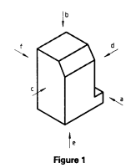
s
IS 15021 (Part 2) TECHNICAL DRAWINGS — PROJECTION METHODS (Orthographic Representation)
This part of IS 15021, specifies basic rules for the application of orthographic representation to all types of technical drawings in all technical fields.
Orthographic representation is obtained by means of parallel orthogonal projections and results in flat, two dimensional views systematically positioned relative to each other. To show an object completely, the six views in directions a, b, c, d, e and f may be necessary, in order of priority (see figure 1 ).

Slide 10
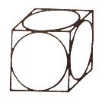
IS 15021 (Part 3) TECHNICAL DRAWINGS — PROJECTION METHODS (Axonometric Representations)
This part of IS 15021, specifies basic rules for the application of the recommended axonometric representations for all types of technical drawings.
When drawing objects, you must represent the 3-dimensional shape in a plane. This changes the dimensions and proportions of the object. In order for our drawing to be read by others, we have to follow certain rules. To represent the three-dimensional shapes in a plane, we will use projections. For engineers, technologists and skilled workers, knowledge of plane representation is essential. Until a part is made, it is only seen in its planar projections on a drawing board or screen(see figure).

Slide 11
IS 15021 (Part 4) TECHNICAL DRAWINGS — PROJECTION METHODS (CENTRAL PROJECTION)
This part of 1S 15021, specifies basic rules for the development and application of central projection in technical drawings.
Central Projection Methods :
The mode of the central projection depends on the position of the object to be represented with respect to the projection plane.

Slide 12
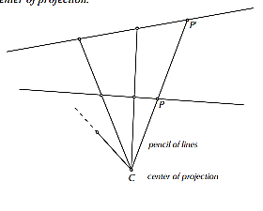
Central projections are similar to parallel projections in that they also associate points in one set with points in another set by projection lines that pass through the associated points, with the difference that the projection lines all pass through a given point.
The set of all lines that pass through any point C is a pencil of lines through C. For any two lines coplanar with a pencil of lines through a point C on neither line, for any point on one line there is a line in the pencil maps it to a point on the other. This is called a central projection and C is the center of projection(see figure).

Slide 13
Methods of representation
First angle projection
The first angle projection method is an orthographic representation in which the object to be represented appears between the observer and the coordinate planes on which the object is orthogonally projected.
In the first angle projection schema, the views
come in the following sequence- top left, then
clockwise, the Right view, Front view, and the Top view.
IS 15021 (Part 2) : 2001 TECHNICAL DRAWINGS — PROJECTION METHODS

Slide 14
Methods of representation
Third Angle projection
The third angle projection method is an orthographic representation in which the object to be represented as seen by the observer, appears behind the coordinate planes on which the object is orthogonally projected.
In the third angle projection schema, the top view
sits at the top of the front view, and the right view sits
on the right side of the front view.
IS 15021 (Part 2) : 2001 TECHNICAL DRAWINGS — PROJECTION METHODS

Slide 15
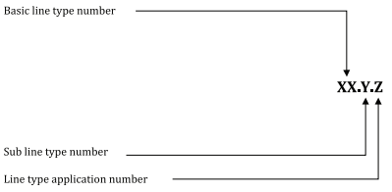
Principles of Dimensioning and Lines
The alphabet of lines is a set of standard line types established by the American National Standards Institute (ANSI) for technical drawing. The alphabet of lines and the approximate dimensions used to create different line types, are referred to as line styles when used with CAD.
The line type designation consists of
a combination of a basic line type
and a subtype, depending on the
line width.
IS 10714 (Part 2) : 2023/ISO 128-2:2022 Technical
product documentation (TPD) -- General principles of
representation: Part 2 Basic conventions for lines

Slide 17
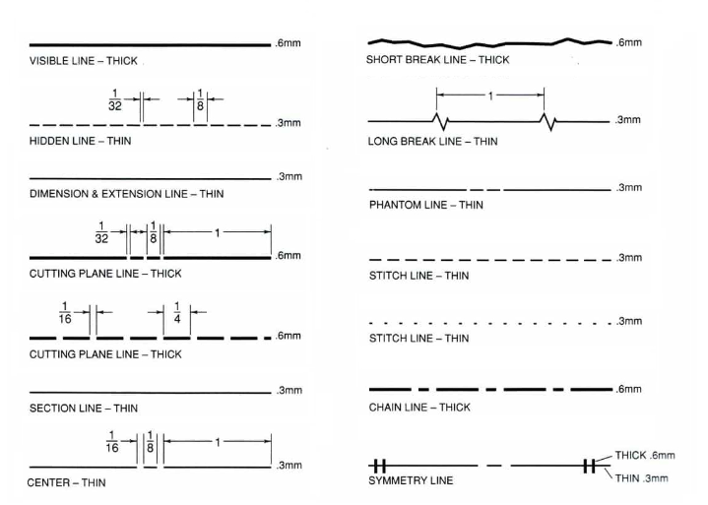
The standard line types used in technical drawings are:

Slide 18
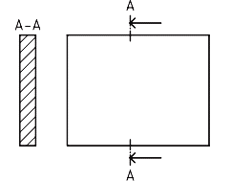
General information on cuts and sections
The general rules for the arrangement of views apply equally when drawing cuts and sections.
The position of the cutting plane(s) shall be indicated by means of a cutting line represented with a dashed dotted wide line.
If the cutting plane changes its direction, the cutting line should only be drawn at the ends of the cutting plane, where the cutting plane changes direction.
IS 10714 (Part 3) : 2023/ISO 128-3:2022 Technical product documentation (TPD) -- General principles of representation: Part 3 Views, sections and cuts

Slide 19
CHAPTER 2: Standardized representation of threads, fasteners, welds, bearings, springs and related components.

Slide 20
Why we need IS 15023 (Technical drawings - Simplified representation of the assembly of parts with fasteners)?
Uniformity: By adhering to standardized drawing practices, organizations ensure uniformity across technical drawings. This uniformity is essential for maintaining consistency in documentation and communication, especially in projects involving multiple teams or organizations.
Efficiency: Simplified representations can save time and effort during the creation and interpretation of technical drawings. This efficiency is beneficial in speeding up the design, review, and manufacturing processes.
Error Reduction: Standardized drawing practices help reduce errors and misunderstandings. Clear and consistent drawings minimize the risk of misinterpretation, which can lead to costly mistakes in the manufacturing or assembly process.
Communication: The standard facilitates better communication among engineers, designers, and manufacturers. It ensures that everyone involved in the project has a common understanding of how parts are assembled with fasteners.
International Compatibility: By aligning with ISO 5845-1, IS 15023 (Part 1) ensures that technical drawings are compatible with international standards. This is particularly important for organizations involved in global projects, as it helps in seamless collaboration and compliance with international practices.

Slide 21
Screw and Screw Threads
Use:
To fasten parts together
For the relative adjustment of the adjacent parts

Slide 22
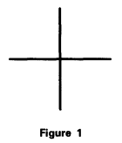
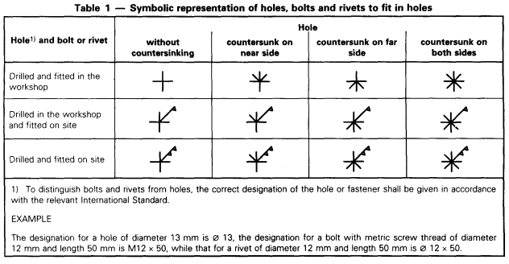
Simplified representation of Fasteners
In order to represent holes, bolts and rivets on projection planes normal to their axes, the symbolic representation shall be drawn in continuous thick lines, type A, in accordance with ISO 128. The position of the fastener is indicated by a cross (see fig.1).
Symbolic representation of holes, bolts and rivets to fit in holes(Table 1).

Slide 23
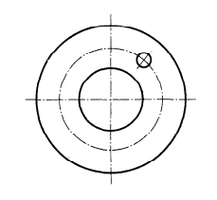
IS 13637 ( Part 1 ) : 1993 TECHNICAL DRAWINGS — ROLLING BEARINGS
Method of representation
In representations perpendicular to the bearing axis, the rolling element may be shown as a circle, regardless of its actual shape (ball, roller, needle, etc.) and size (see figure)
The space on a drawing where a rolling bearing is located shall be circumscribed by means of a square or rectangle (even if there is no inner or outer ring respectively).

Slide 24
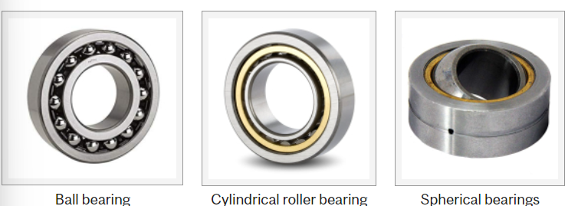
Bearing
IS 13637 (Part 1) : 1993/ISO 8826-1 Technical drawings - Rolling bearings: Part 1 General simplified representation
A machine element is used to constrain relative motion between parts to only one degree of freedom (free linear motion or free rotation/angular motion around a fixed axis), and to reduce friction between these moving parts. Normally, most bearings (ball, roller, or spherical bearings) are stronger in radial direction than in axial.

Slide 25
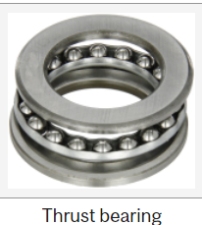
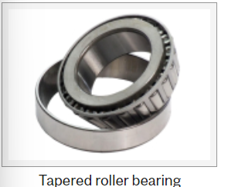
However, thrust bearings, like other bearings permitting rotation between parts, are designed to support a predominantly axial load. The thrust bearings often require special design of the housing since they consist of several separate components.
Tapered roller bearings are designed to accommodate combined loads: they can take both radial and axial loads and used for gear boxes for heavy trucks, bevel-gear transmission, lathe spindles, etc. Tapered roller bearing forms a cup and cone assembly, where the cup is comprised of the outer ring and the cone assembly consists of inner ring, rollers, and cage.

Slide 26
Springs
Springs are mechanical devices that store and release energy. They are used in various applications across different industries due to their ability to absorb, store, and release mechanical energy. Here are some key uses of springs:
Energy Storage: Springs can store energy when compressed, stretched, or twisted, and release it when the force is removed. This principle is used in clocks, watches, and other devices requiring controlled energy release.
Shock Absorption: Springs absorb shock and vibrations, protecting delicate components in machines and vehicles. For example, they are crucial in automotive suspension systems to provide a smooth ride by absorbing bumps and shocks from the road.
Load Bearing: Springs support loads and return to their original shape when the load is removed. This characteristic is used in mattresses, chairs, and cushions to provide comfort and support.

Slide 27
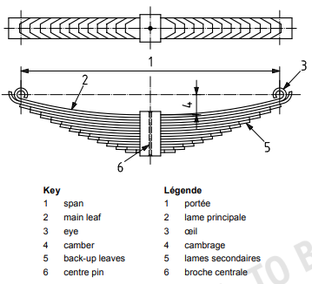
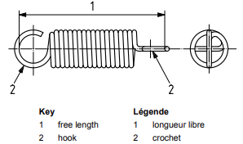
Mechanical Springs
Produce a pull, a push, or a twist (torque) force when displaced.
Store or absorb energy.
May be made of round or rectangular wire bent into a suitable form such as a coil (see figure) , or made of flat stock loaded as a beam.
IS 10716 (Part 3) : 2015 Technical Product Documentation - Springs: Part 3

Slide 28
CHAPTER 3: Limits, Fits and Tolerances and Surface finish symbols

Slide 29
Why we need IS 919 (Part 1) Geometrical product specifications (GPS) — ISO code system for tolerances on linear sizes part 1 basis of tolerance, deviation and fits
Uniformity and Standardization:
Ensures a consistent and uniform system for specifying and interpreting tolerances on linear dimensions.
Facilitates clear communication and understanding between designers, manufacturers, and quality control personnel.
Interchangeability:
Enhances the interchangeability of parts by providing a standardized approach to defining acceptable limits of variation in linear dimensions.
Reduces the risk of parts not fitting together due to dimensional inaccuracies.
Quality Control:
Assists in maintaining quality by specifying tolerances that ensure parts meet design requirements and function properly.
Helps in setting up precise and accurate quality control measures during manufacturing processes.
Efficiency in Manufacturing:
Aids in optimizing manufacturing processes by providing clear guidelines for allowable deviations.
Reduces waste and rework caused by parts being out of tolerance.

Slide 30
Cost Reduction
Minimizes costs associated with non-conformance and rejects by providing a clear understanding of acceptable deviations. Helps in achieving efficient production and assembly processes, leading to cost savings.
International Compatibility:
Aligns with international standards, facilitating trade and collaboration with global partners. Ensures products manufactured to IS 919 standards are compatible with those made to equivalent ISO standards.
In summary, IS 919 (Part 1) : 2014 is crucial for ensuring precision, quality, and compatibility in manufacturing processes, thereby supporting efficient production and reducing costs.

Slide 31
Tolerance
It is impossible to produce a part to an exact size or basic size, some variations, known as tolerances, need to be allowed.
The permissible level of tolerance depends on the functional requirements, which cannot be compromised. The algebraic difference between the upper and lower acceptable dimensions.
It is an absolute value.
The basic purpose of providing tolerances is to permit dimensional variations in the manufacture of components, adhering to the performance criterion.

Slide 32
Tolerances
Classification of Tolerance
Unilateral tolerance
Bilateral tolerance
Compound tolerance
Geometric tolerance

Slide 33
Classification of Tolerance
Unilateral tolerance
When the tolerance distribution is only on one side of the basic size. Either positive or negative, but not both.
Tolerances (a) Unilateral (b) Bilateral

Slide 34
2. Bilateral tolerance
When the tolerance distribution lies on either side of the basic size.

Slide 35
3. Compound tolerance
Tolerance for the dimension R is determined by the combined effects of tolerance on 40 mm dimension, on 60º, and on 20 mm dimension

Slide 36
4. Geometric tolerance
Geometric dimensioning and tolerancing (GD&T)
is a method of defining parts based on how they function, using standard symbols.

Slide 37
FITS
The degree of tightness and or looseness between the two mating parts.
Three basic types of fits can be identified, depending on the actual limits of the hole or shaft.
Clearance fit
Interference fit
Transition fit

Slide 38
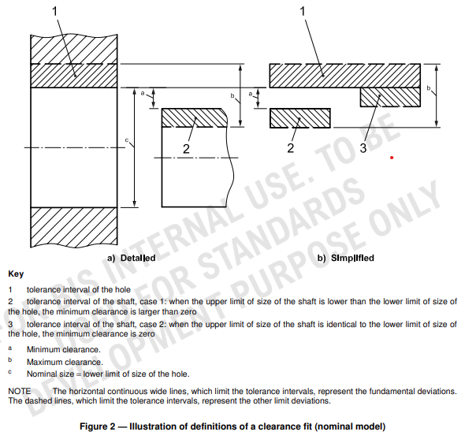
1. Clearance fit
Fit that always provides a clearance between the hole and shaft when assembled, i.e. the lower limit of size of the hole is either larger than or, in the extreme case, equal to the upper limit of size of the shaft(see fig.2).

Slide 39
2. Interference fit
Upper limit of the hole is less than the lower limit of shaft.
No gap between the faces and intersecting of material will occur.
Shaft need additional force to fit into the hole.

Slide 40
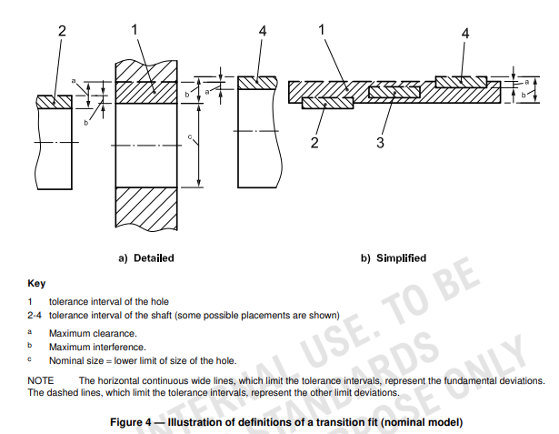
3. Transition fit Dia. of the largest permissible hole is greater than the dia. of the smallest shaft.
Neither loose nor tight like clearance fit and interference fit.
Tolerance zones of the shaft and the hole will be overlapped between the interference and clearance fits.

Slide 41
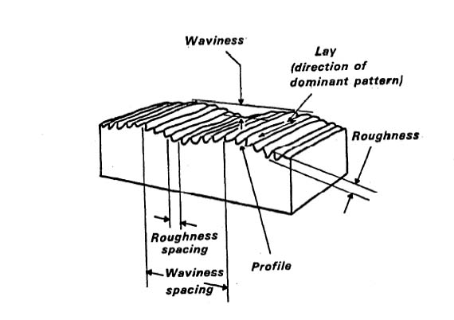
Surface texture (Definitions)
Surface texture describes the variation of the surface from a perfect surface.
Surface texture is made up of
Roughness
Waviness.
Lay
Flaws
It is the topography of the surface.
The term surface texture is preferable to surface finish as surface finish implies coatings and finishing techniques.
(Painting, chrome plating etc)

Slide 42
Roughness
The closely spaced peaks and valleys produced by the machining process
Waviness
Repeated widely spaced irregularities generally resulting from machine vibrations of chatter in the machine

Slide 43
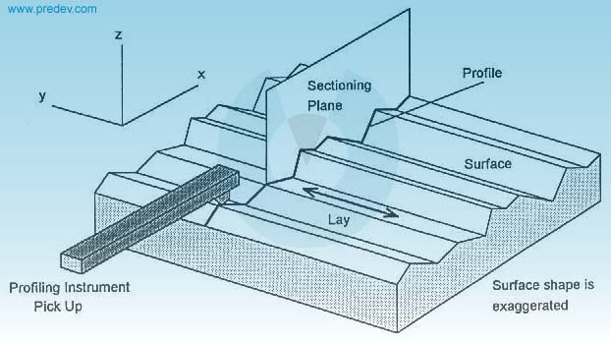
Profile
Profile is the shape of the surface.
It is made up of roughness and weariness.
Profile is influenced by the tool type and shape.

Slide 44
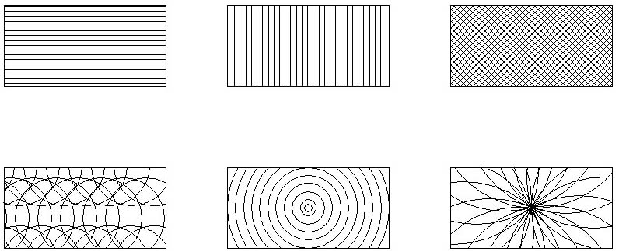
Lay
Lay is the dominate pattern of marks left on the surface arising from machining processes (tool type, feed rate, and machine type) Indicated by symbol
Plane of Projection
Parallel
Perpendicular
Diagonal
Multi
Circular
Radial

Slide 45
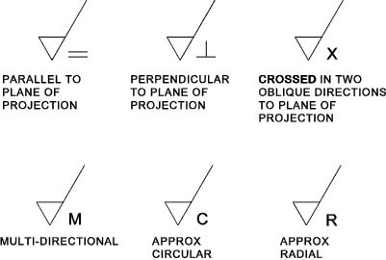
Lay Symbols

Slide 46
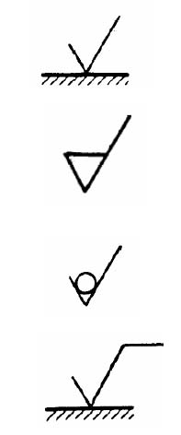
Drawing Symbols
Machining optional
Symbol has an angle of 60 degrees and an open top with two uneven sides. Basic shaped symbol.
Machine finish required
This symbol has a bar added to the top of the standard shaped symbol.
Removal of material not permitted
This symbol is a basic shaped symbol with a circle added in the groove.
Basic symbol with a bar added to the top of the right hand line.
Special surface feature required

Slide 47
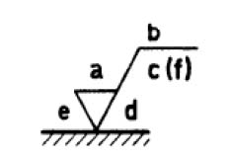
Drawing Symbol Notation
= Production Method
Roughness Grade Number
or Roughness Average =
C= Sampling Length
(f)= Other Roughness Values
Machining Allowance =
= Direction of Lay using
Lay Symbols

