Slide 1
Associating Government Laboratories with Bureau of Indian Standards
Laboratory RECOGNITION AND MANAGEMENT DEPARTMENT

Slide 2
Legal Framework - Laboratory Activity
BIS Act, 2016: Section 13 (4)
The Bureau may establish, maintain or recognize testing laboratories for the purposes of conformity assessment and quality assurance and for such other purposes as may be required for carrying out its functions.

Slide 3
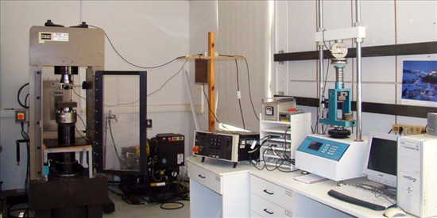
Laboratory Services Ecosystem of BIS
10 BIS Captive laboratories.
CENTRAL LAB: 01 (Sahibabad - It was first to be set up in 1962)
REGIONAL LABS : 04 (Chennai, Kolkata, Mohali & Mumbai)
BRANCH LABS: 03 (Bangalore, Guwahati & Patna)
Satellite Labs: 02 (Hyderabad, Jammu)
08 Referral laboratories of BIS for Gold/Silver Assaying
330 outside recognized laboratories.
266 specialized Government laboratories empaneled by BIS of which 57 are active in BIS LIMS .Data is dynamic.

Slide 4
Laboratory Services Ecosystem of BIS
Laboratories empanelled under LRS 2020: Open for Government Laboratories only.
Laboratories of National repute, Research Institutions, Educational Institutions and other Government labs having expertise in specialised tests.
Empaneled by BIS for utilization of testing facilities.
CSIR Labs, ICAR labs, IITs, BARC, NDDB, Textile Committee, Research Association etc.NFSU, Gandhinagar, CIMFR Dhanbad for specialized tests.

Slide 5
BIS LIMS
Online Application has to be submitted through BIS LIMS
LIMS can be accessed at https://lims.bis.gov.in/ or through https://www.manakonline.in/MANAK/login and selecting laboratories tab.
Please use email ID of Department/Organization in First Step since the same can not be changed later. Other details can be modified later.
BIS does not charges any amount for empanelment .

Slide 7
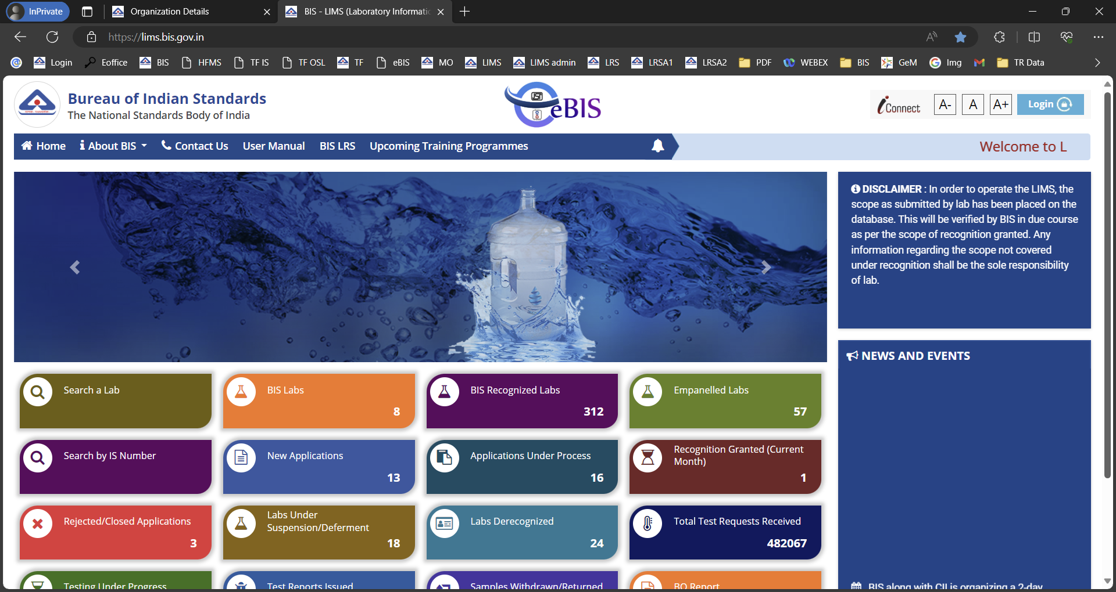

Slide 10
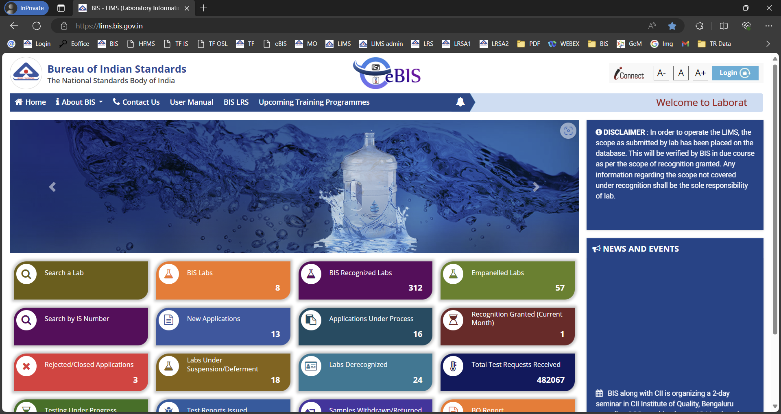

Slide 11
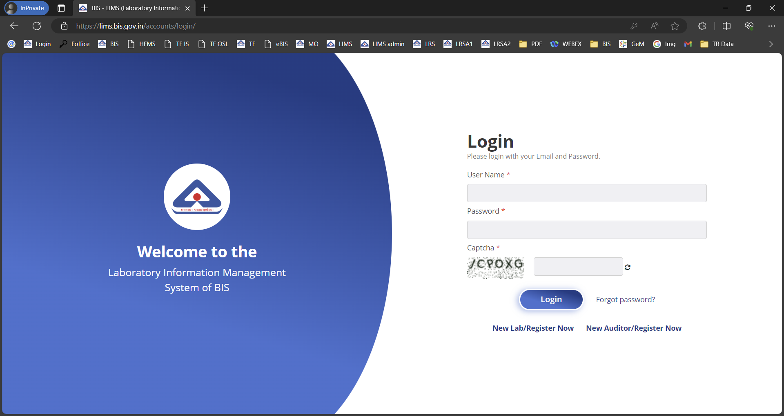

Slide 12
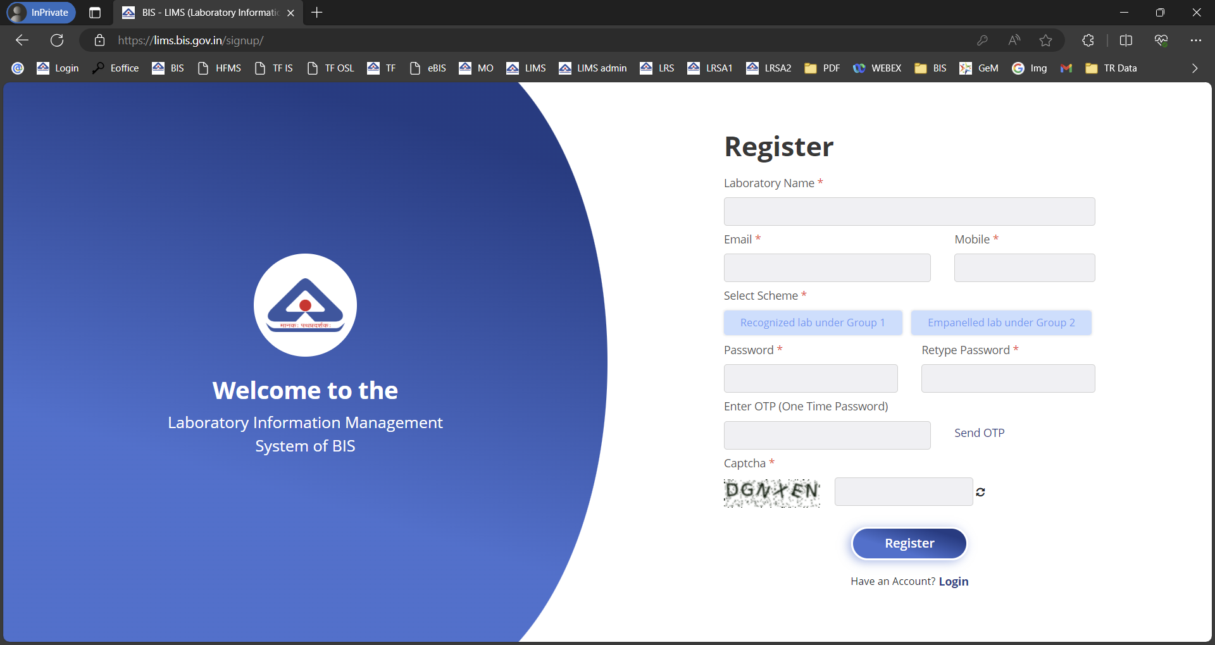

Slide 14
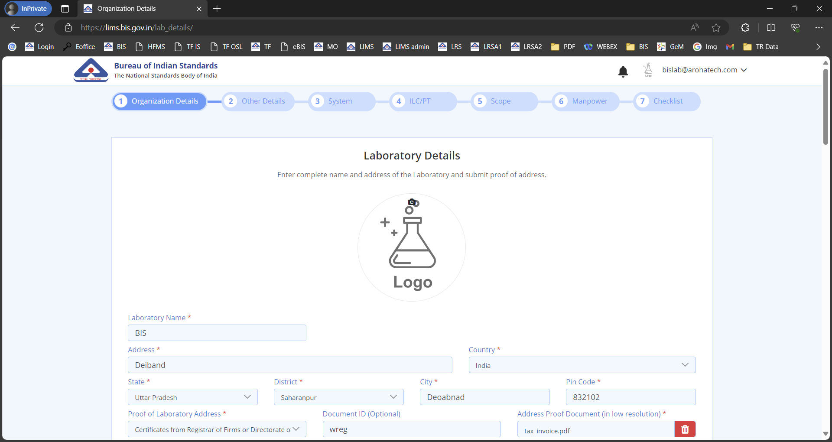

Slide 15
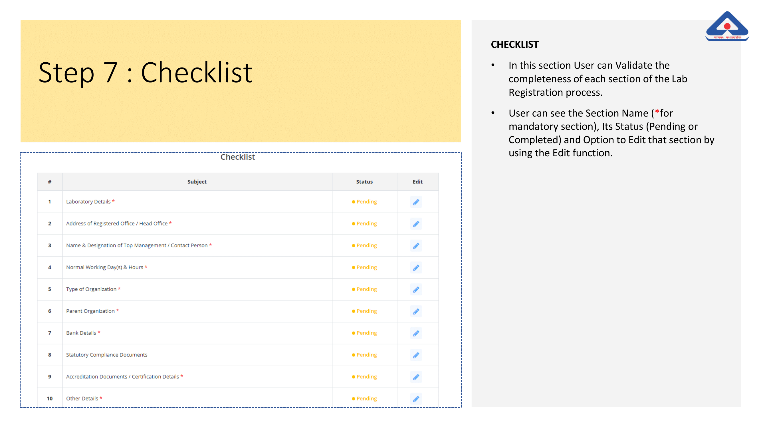

Slide 16
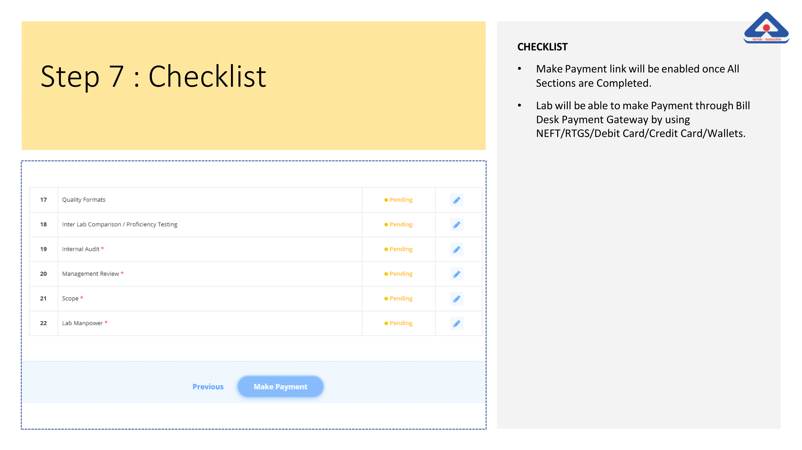

Slide 17
For any queries or issues write us at:
lrmd-bis@bis.gov.in

